Slide 1
ANOVA Q3

Slide 2
Summary of Count, Mean and Sd:
By looking at the output, we can see
that the means of each class are different.
This determines that it rejects Null
Hypothesis.
Mean1 != Mean2 != Mean3

Slide 3
ANOVA Summary:
This determines that there is no much
Significant differences between the groups
ClassA, ClassB and ClassC as we can see that
p-value is 0.2, which is greater than the typical
significance level of 0.05.

Slide 4
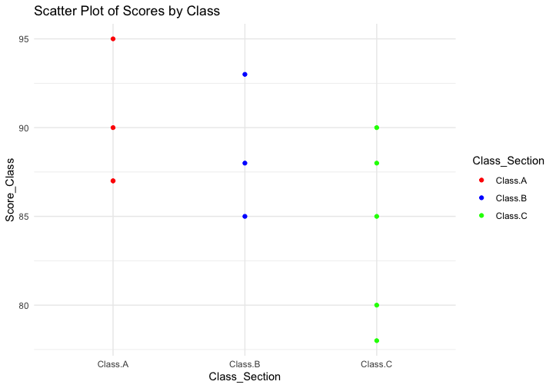
Scatter Plot of Classes and the Scores:

