Slide 1
Addressing Missing Values in R
HAP 719: Advanced Statistics I
Yili Lin

Slide 2
Introduction to Missing Values
1. Definition

Slide 3
Introduction to Missing Values
1. Definition
2. Types
Missing Completely at Random (MCAR)

Slide 4
Introduction to Missing Values
1. Definition
2. Types
Missing Completely at Random (MCAR)
Missing at Random (MAR)

Slide 5
Introduction to Missing Values
1. Definition
2. Types
Missing Completely at Random (MCAR)
Missing at Random (MAR)
Missing Not at Random (MNAR)

Slide 6
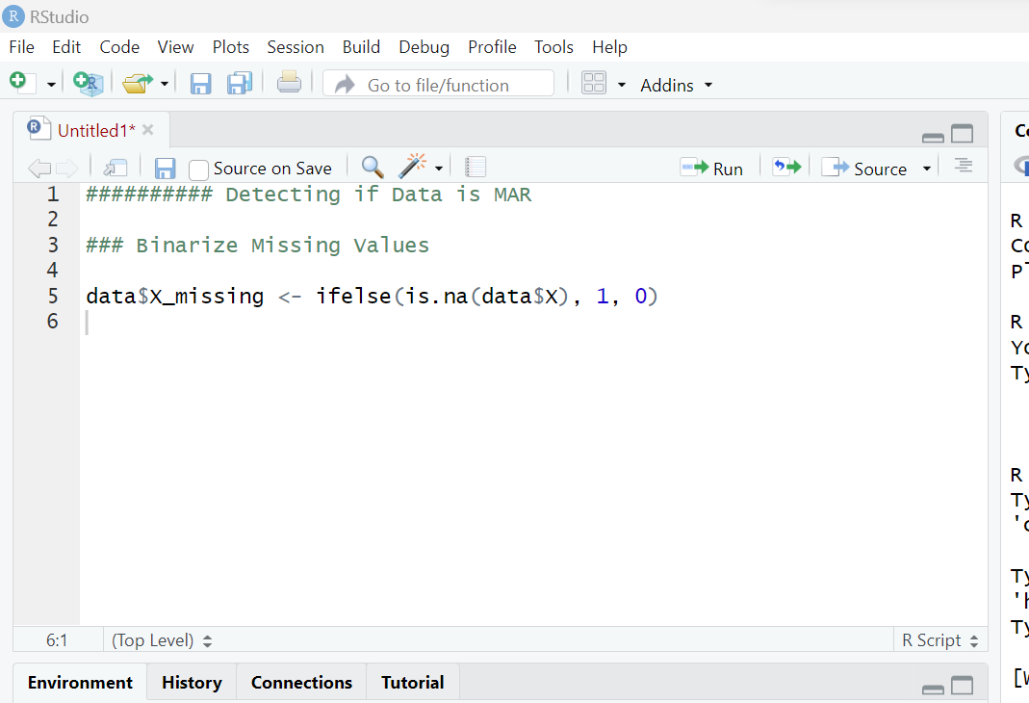
Detecting if Data is Missing at Random
Step 1: Binarize Missing Values

Slide 7
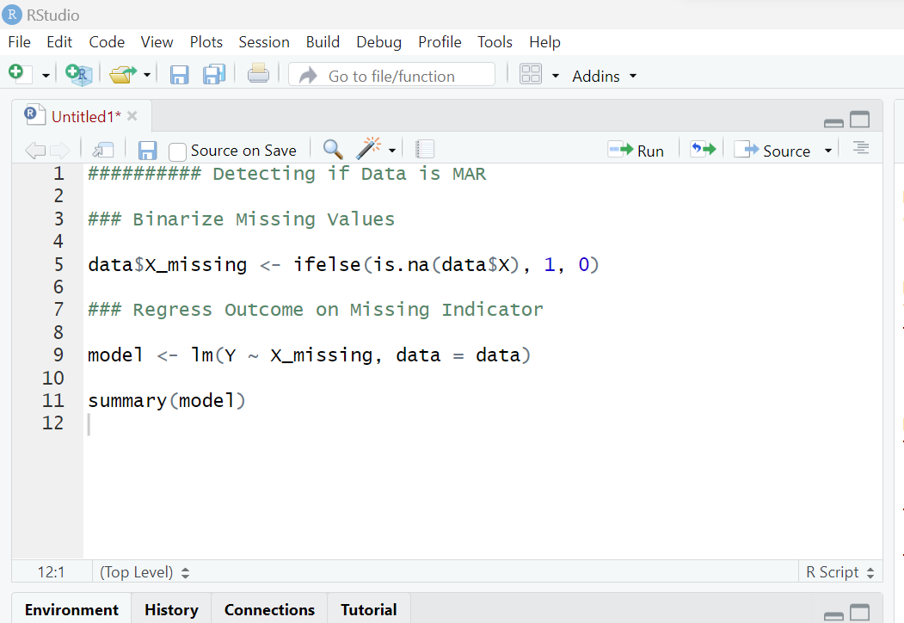
Detecting if Data is Missing at Random
Step 1: Binarize Missing Values
Step 2: Regress Outcome on Missing Indicator

Slide 8
Detecting if Data is Missing at Random
Step 1: Binarize Missing Values
Step 2: Regress Outcome on Missing Indicator
Step 3: Testing the Coefficient of the Missing Indicator

Slide 9
Identifying Missing Values
is.na(data)

Slide 10
Identifying Missing Values
is.na(data)
sum(is.na(data))

Slide 11
Identifying Missing Values
is.na(data)
sum(is.na(data))
anyNA(data)

Slide 12
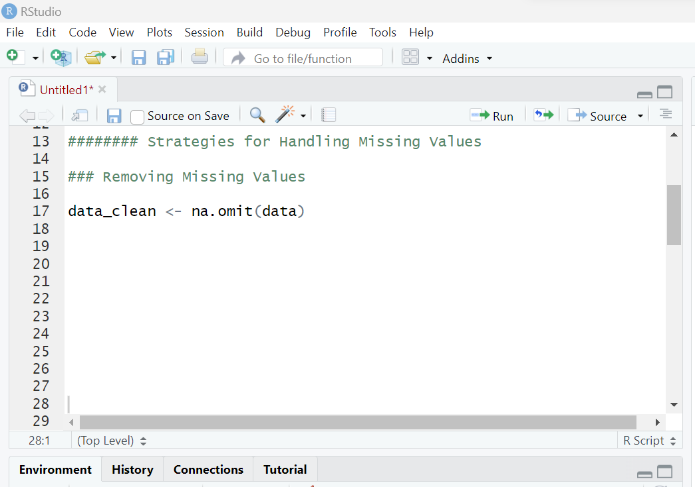
Strategies for Handling Missing Values
Removing Missing Values

Slide 13
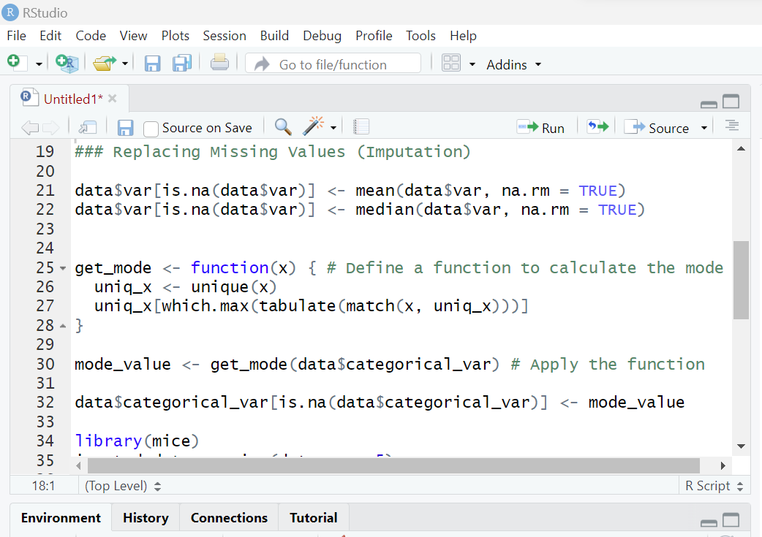
Strategies for Handling Missing Values
Removing Missing Values
Replacing Missing Values
Multiple Imputation

Slide 14
Strategies for Handling Missing Values
Removing Missing Values
Replacing Missing Values
Multiple Imputation

Slide 15
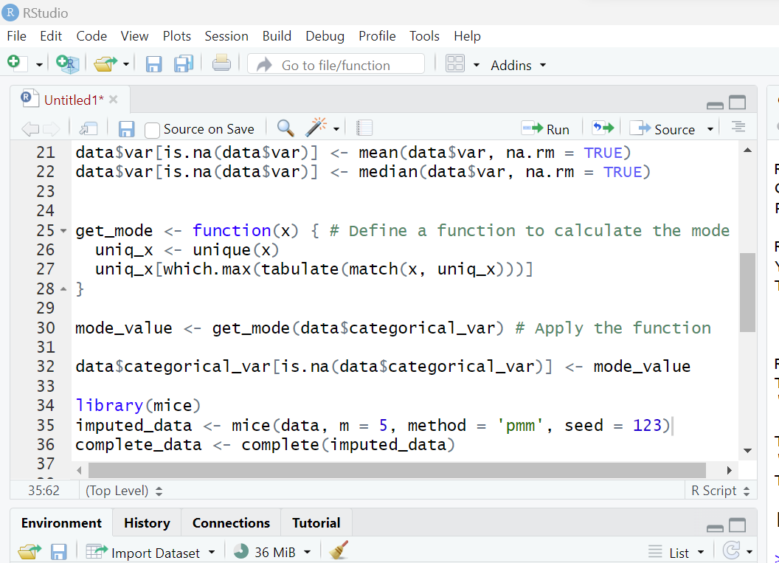
Strategies for Handling Missing Values
Removing Missing Values
Replacing Missing Values
Multiple Imputation

Slide 16
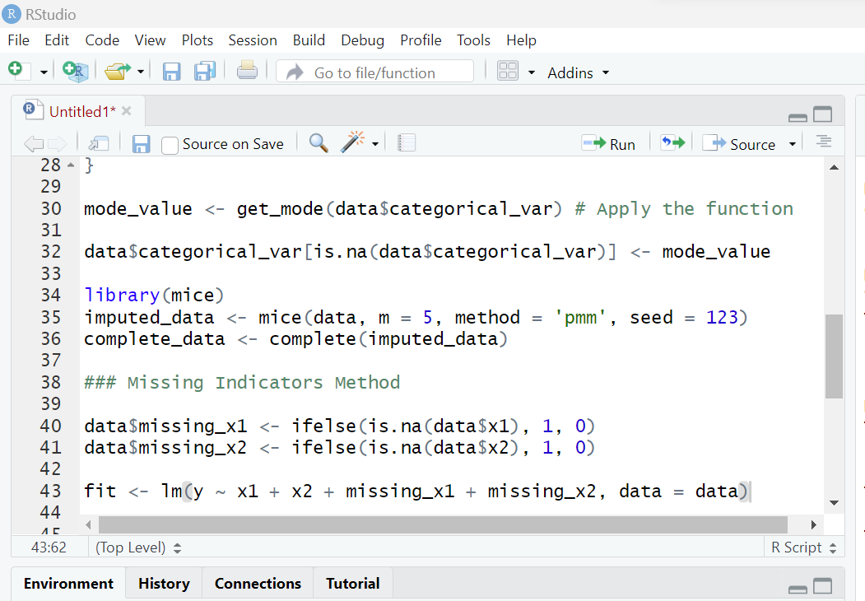
Strategies for Handling Missing Values
Removing Missing Values
Replacing Missing Values
Missing Indicators Method

Slide 17
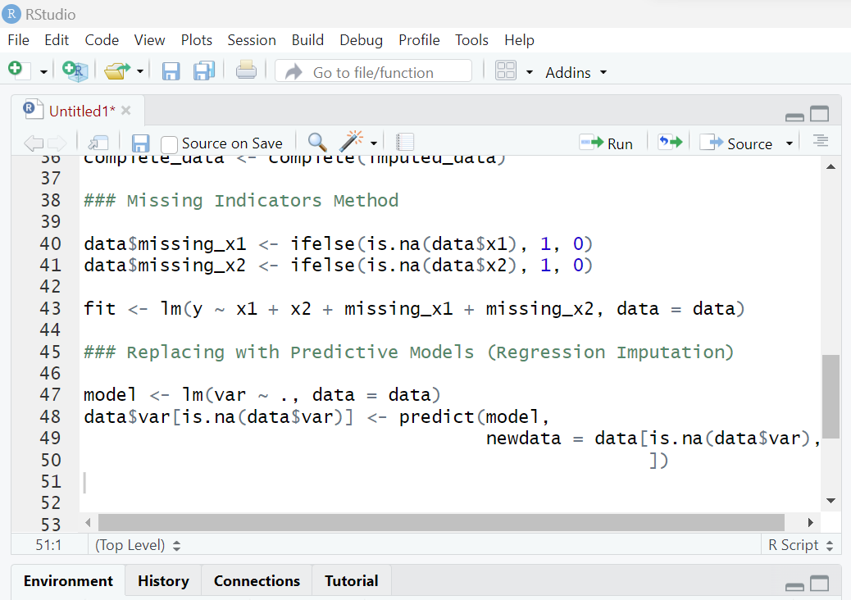
Strategies for Handling Missing Values
Removing Missing Values
Replacing Missing Values
Missing Indicators Method
Replacing with Predictive Models
Regression Imputation

Slide 18
Thank You!

