Slide 1
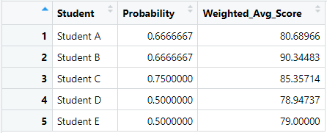
Calculate the inverse propensity weighted average for all students

