Slide 1
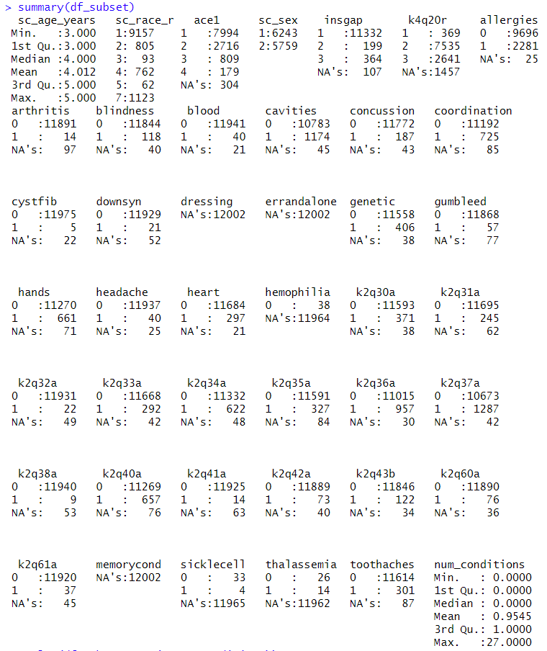
Summary Statistics

Slide 2
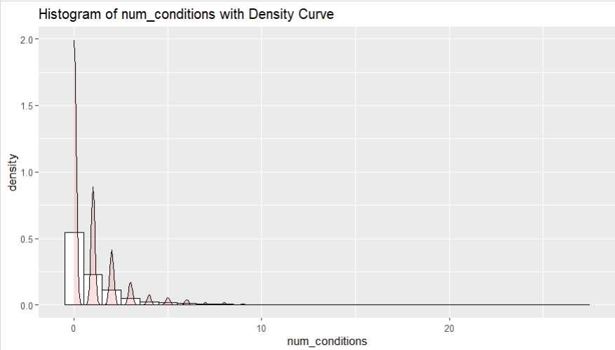
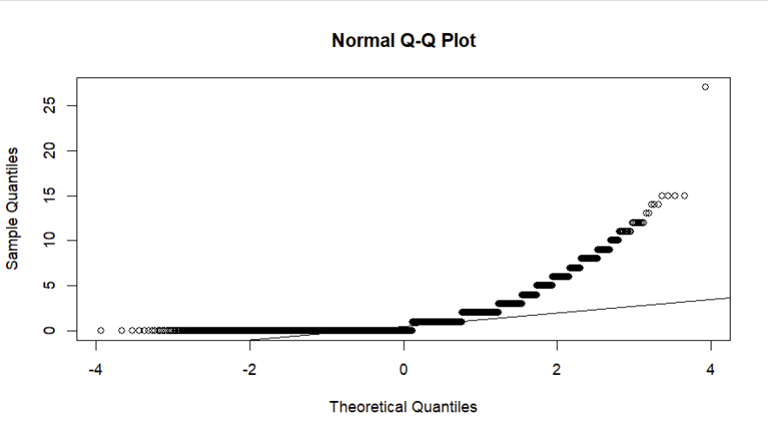
Is the dependent variable normally distributed? (No. It is not normally distributed)

Slide 3
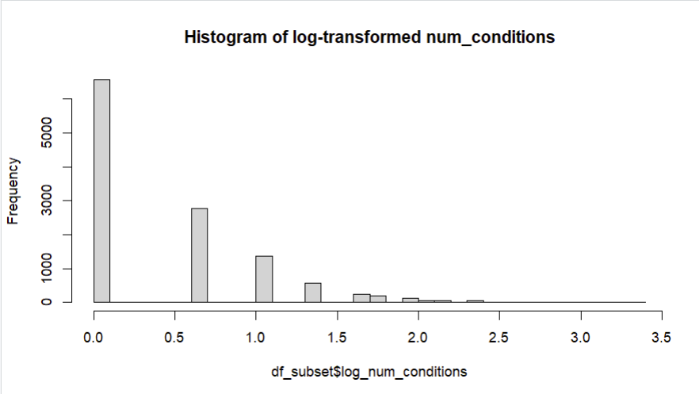
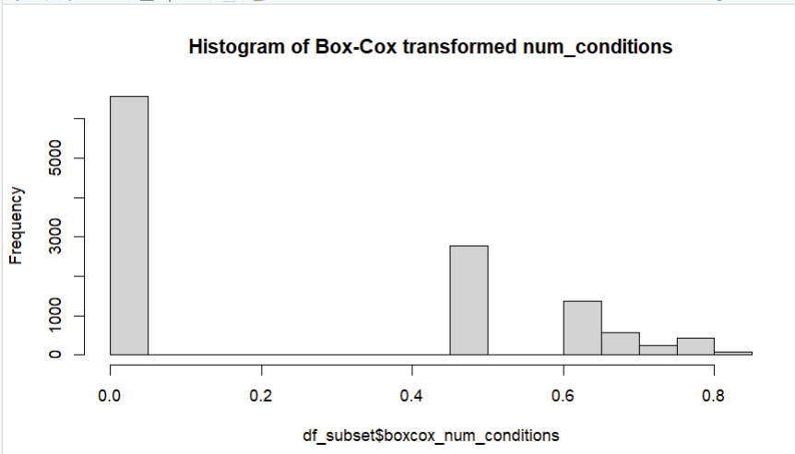
After transformation, is the dependent variable normally distributed? (No. It is still not normally distributed after transformation)

Slide 4
Results of t-tests and ANOVA Tests. (Note: Assumptions were validated. For practice only)

