Slide 1
Test that the sample comes from the population
T-statistic: 1.825742
Critical t-value: 2.04523
P-value: 0.07820332
Given a significance level of 0.05 and a p-value of 0.078, there is no statistically significant evidence to suggest that the sample mean and the population mean are different. The observed difference could be due to random sampling variability.

Slide 2
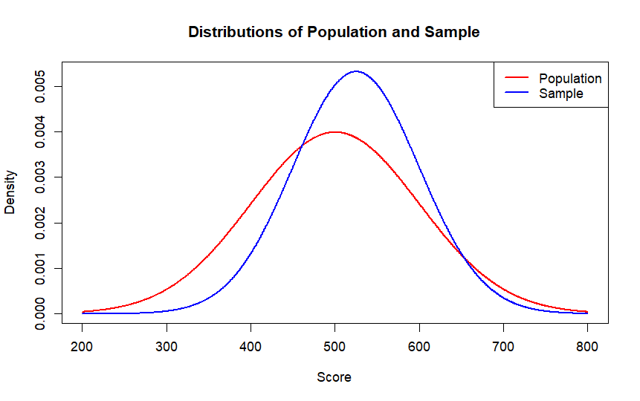
Draw the two distributions

Slide 3
Provide a confidence interval for the mean of the sample
95% Confidence Interval:
496.99 to 553.01

