Slide 1
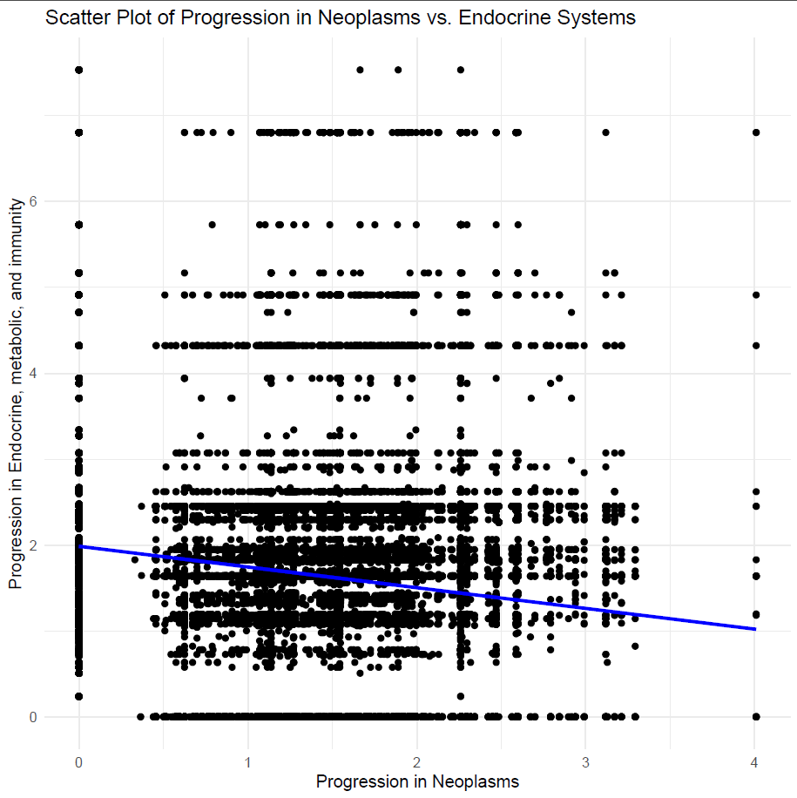
Plot progression of illness in the neoplasm body system against progression of illness in endocrine body system.

