Slide 1
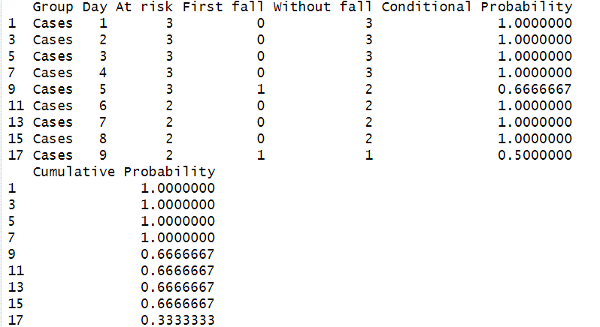
Probability (No Fall | No Fall Yet) - Cases

Slide 2
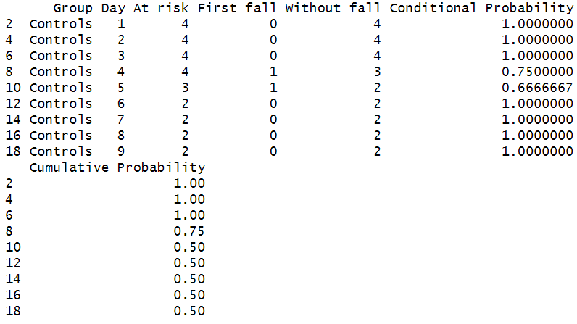
Probability (No Fall | No Fall Yet) - Controls

Slide 3
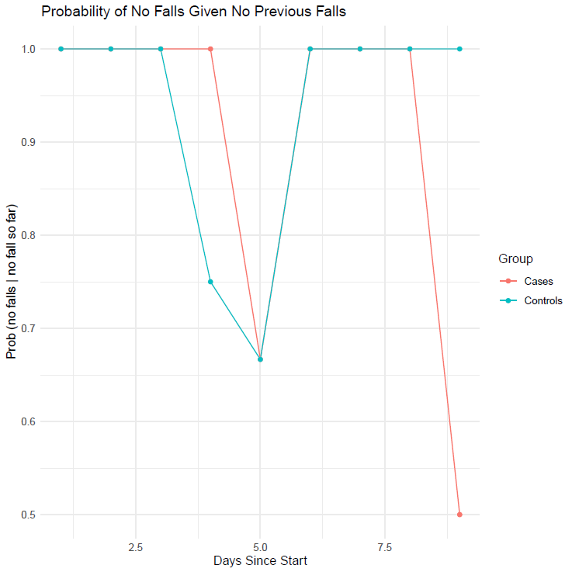
Plot - Probability (No Fall | No Fall Yet)

Slide 4
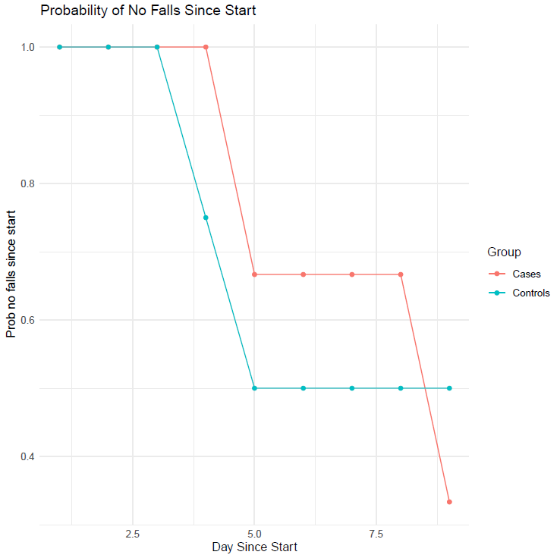
Plot - Probability (No Falls Yet)

