Slide 1


Do a chi-square test to see if caloric intake affects systolic blood pressure

Slide 2
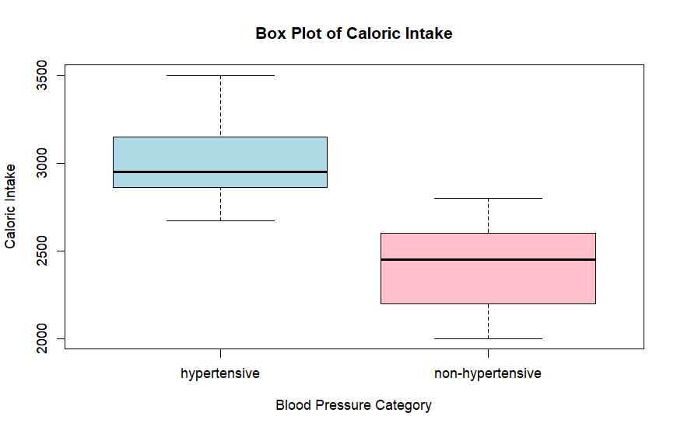
Create a box plot for caloric intake of hypertensive and another box plot for caloric intake of non-hypertensive

