Slide 1
Report the odds of adverse outcomes and the standard deviation of the odds:

Slide 2
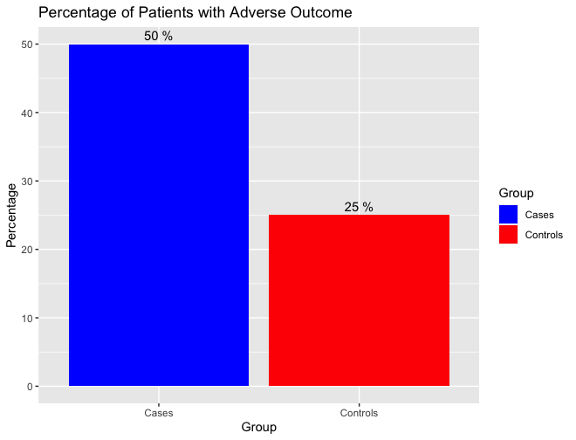
Plot percent of patients with adverse outcome for controls (before intervention) and cases
(after intervention).

