Slide 1

Logistic Regression
Question 4

Slide 2
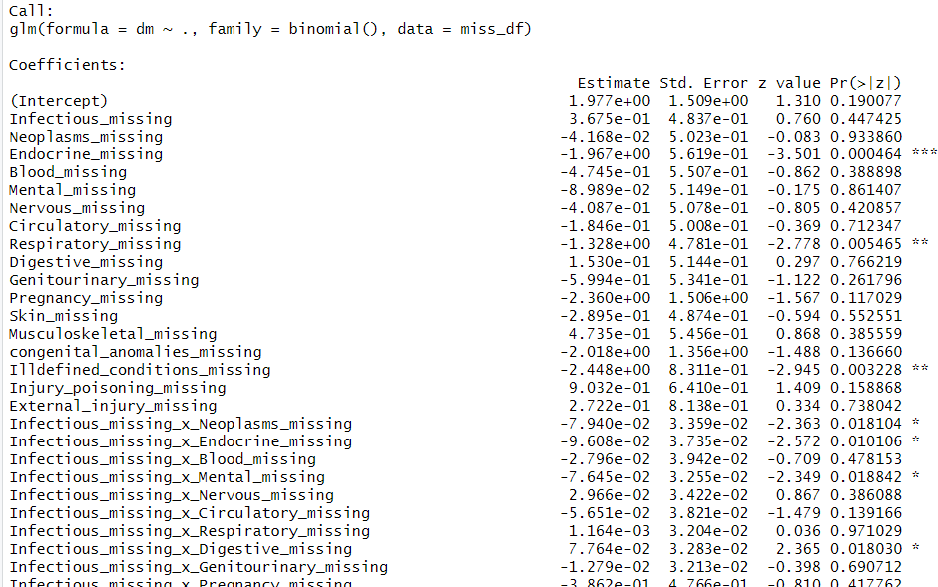
Create a binary variable that is 1 every time a variable is missing and 0 otherwise. Predict diabetes from patterns of missing binary variables and interaction among missing indicators.
Percent of variation explained by the model: 8.479 %
8.479

Slide 3
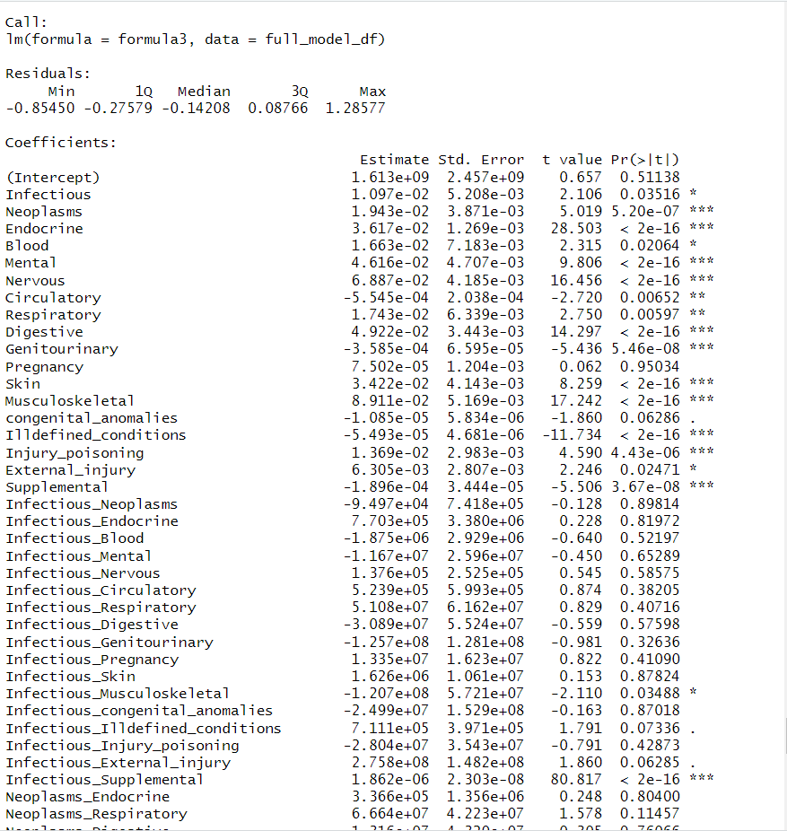
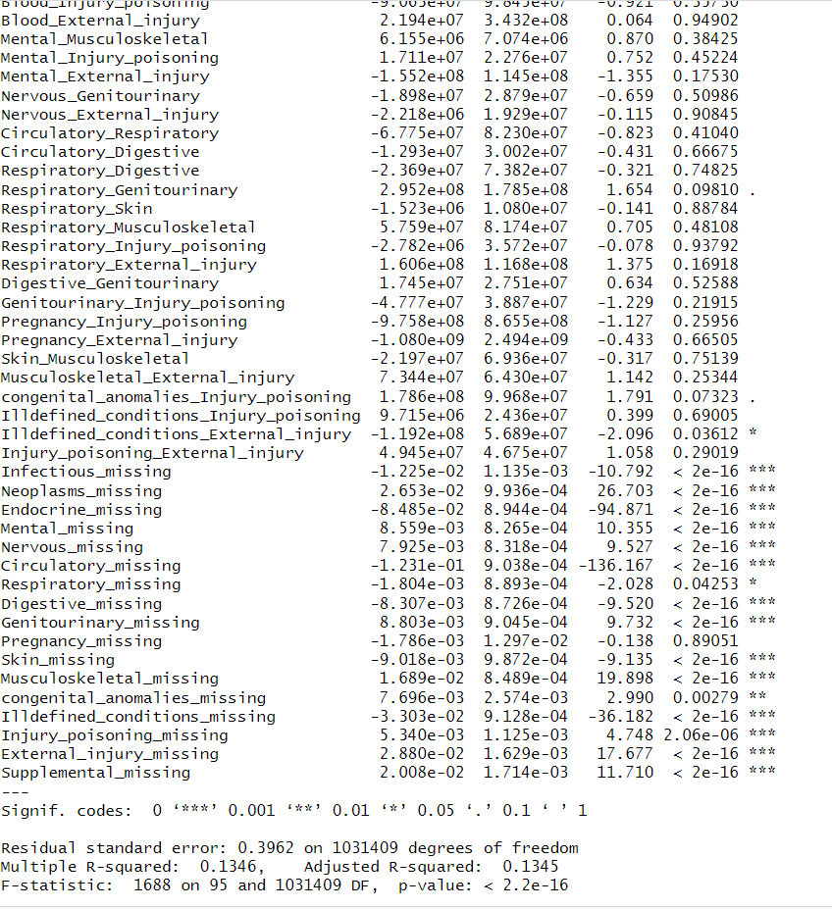
Regress diabetes on body systems, pairs of body systems, and statistically significant patterns of missing values. Report the coefficients and the percent of variation explained
Percent of variation explained by the model: 8.993%

