Slide 1
Comparing two Rates
Farrokh Alemi Ph.D.
Notes:
This is a lecture prepared by Farrokh Alemi based on OpenIntro statistics book.

Slide 2
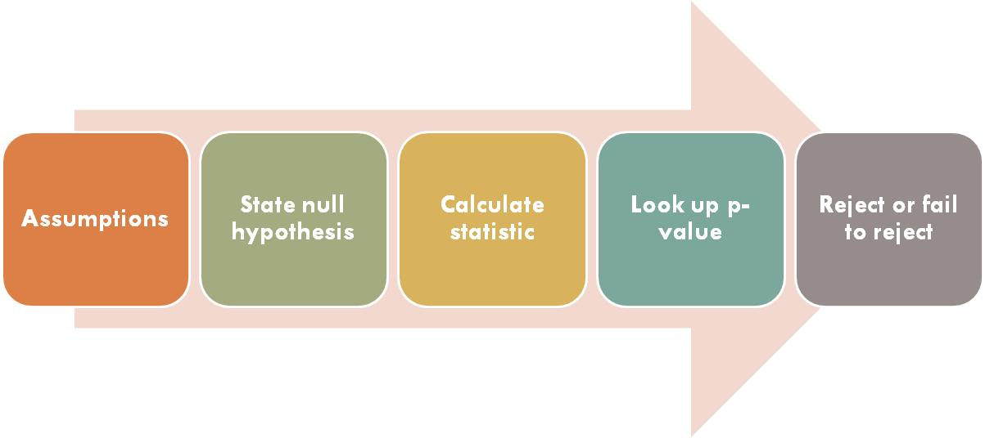
Framework for Hypothesis Testing
Notes:
Recall the framework for hypothesis testing. First we examine the assumptions, then state the hypothesis, calculate the statistic, look up the p value and then decide to reject or fail to reject the null hypothesis.

Slide 3
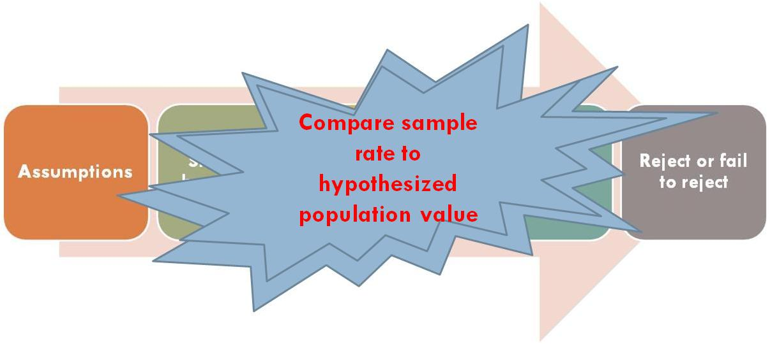
Framework for Hypothesis Testing
Notes:
In this set of slides we apply this framework to comparing the rate calculated from a sample to a hypothesized value.

Slide 4
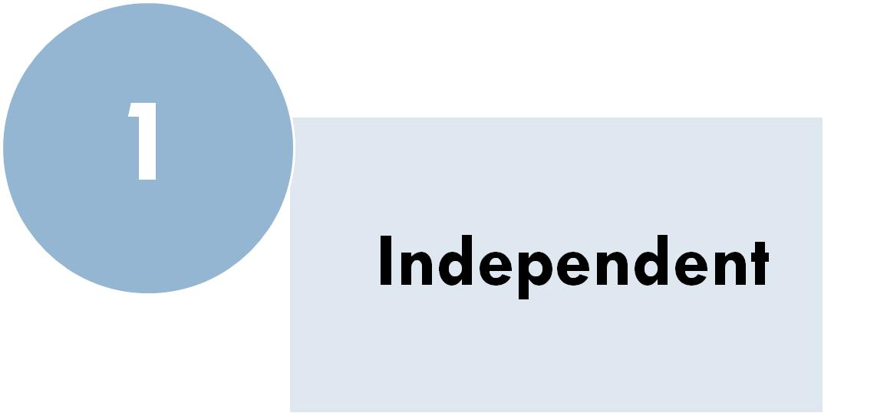
Assumptions
Notes:
First assumption is that sample observations are independent. If data come from a simple random sample and consist of less than 10% of the population, then the independence assumption is reasonable. Alternatively, if the data come from a random process, we must evaluate the independence condition more carefully. For example, arrival of patients to a hospital may be argued to be random. Patients diseases are independent unless the patients has an infectious disease or there is mass casuality, in which case observing the occurrence of one diseases will raise suspicion that others may be infected.

Slide 5
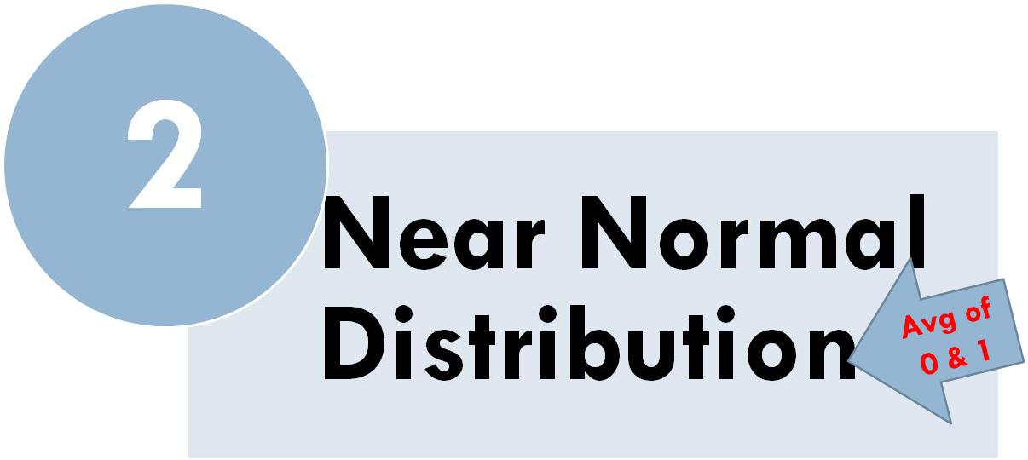
Assumptions
Notes:
The second assumption is that the distribution of the rate is near normal

Slide 6
Assumptions
Notes:
A rate can be considered the average of observations, if observations are scored as 1 when it succeeds, and 0 otherwise. This average is assumed to have a Normal distribution. The assumption of Normal distribution is reasonable when

Slide 7
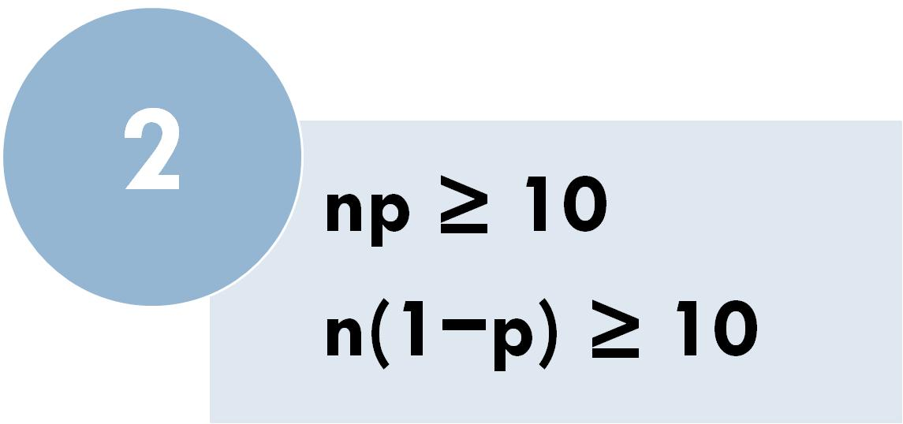
Assumptions
Notes:
There are at least 10 successes and 10 failures in our sample. This is called the success-failure condition.

Slide 8
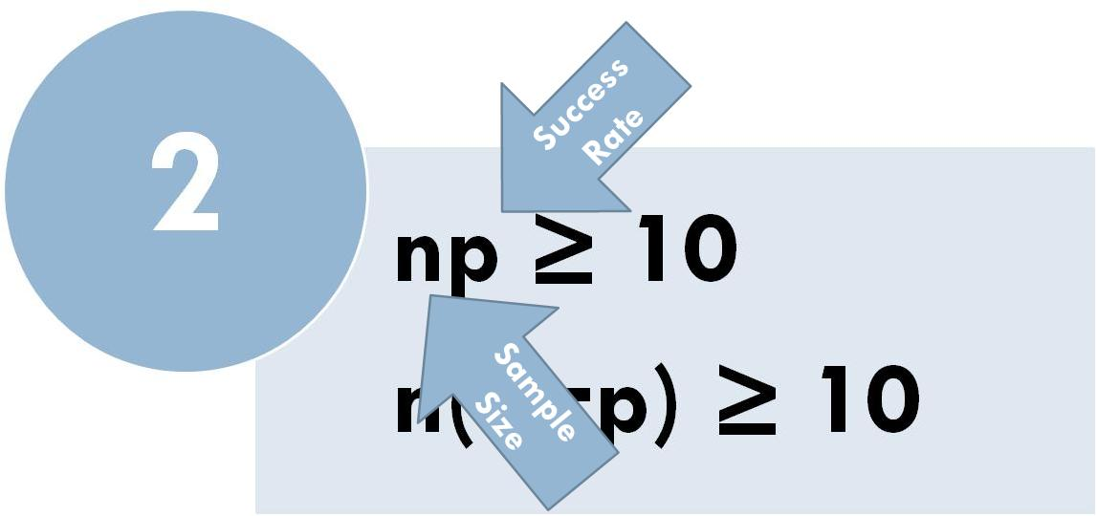
Assumptions
Notes:
The first formula says that the sample size, n, times the probability of success, shown as p, is greater than 10. Here p is the population rate of success. This population rate can be estimated as the sample rate.

Slide 9
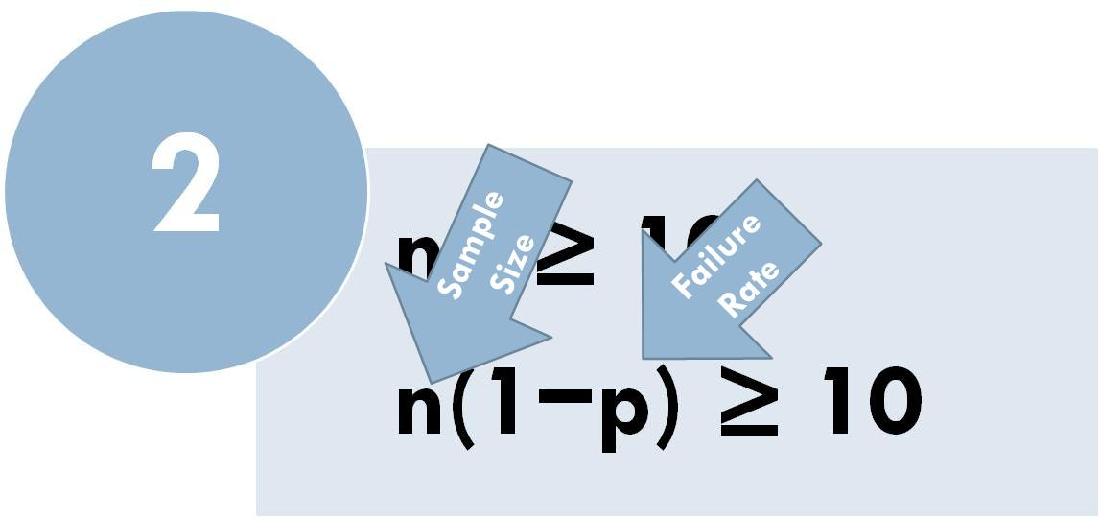
Assumptions
Notes:
The second formula says that the sample size, n, times the probability of failure, shown as one minus p, is greater than 10. Here again p is estimated from either the sample rate or from hypothesized population rate.

Slide 10
Hypotheses
Notes:
In our framework for hypothesis testing the next step is to state the hypotheses. The null hypothesis is the probability of success or the rate of observing the event, is a specific value.

Slide 11
Hypotheses
Notes:
The alternative hypothesis, if we are doing a two sided test, is that rate is not the hypothesized null value

Slide 12
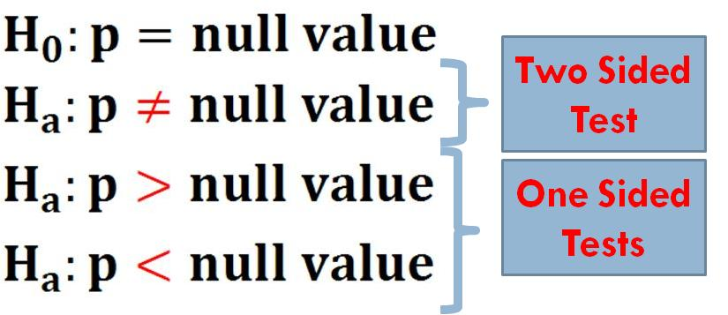
Hypotheses
Notes:
The alternative hypothesis, if we are doing a one sided test, is that the rate is more or less than the null value.

Slide 13
Calculate Statistic
Notes:
The third step in our framework for hypothesis testing is to calculate the test statistic. The statistic Z is calculated from the point estimate minus the null value divided by standard error.

Slide 14
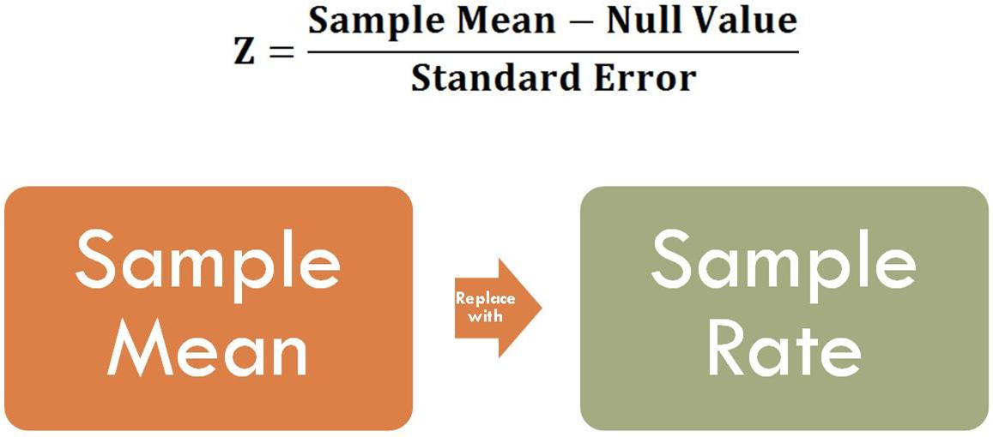
Calculate Statistic
Notes:
For sample mean we use

Slide 15
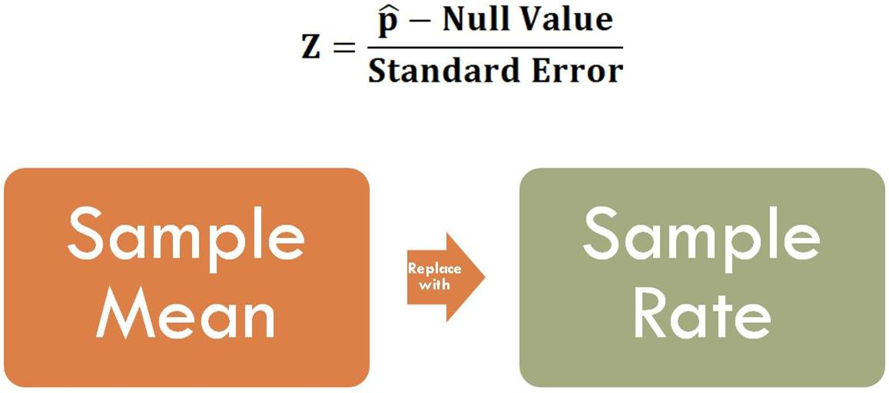
Calculate Statistic
Notes:
the rate of success within the sample.

Slide 16
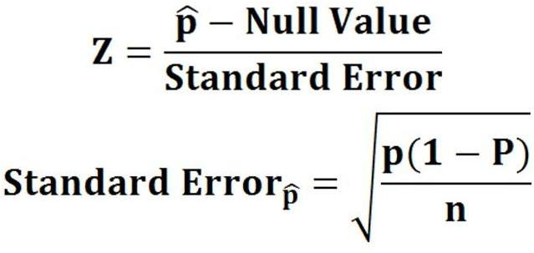
Calculate Statistic
Notes:
Standard error of the sample rate is calculated as square root of

Slide 17
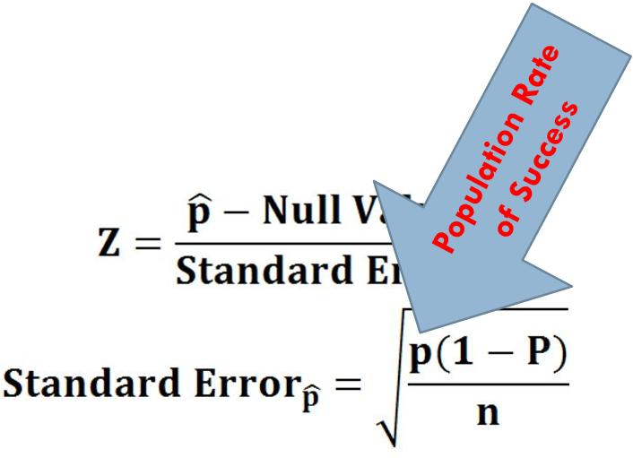
Calculate Statistic
Notes:
rate of success

Slide 18
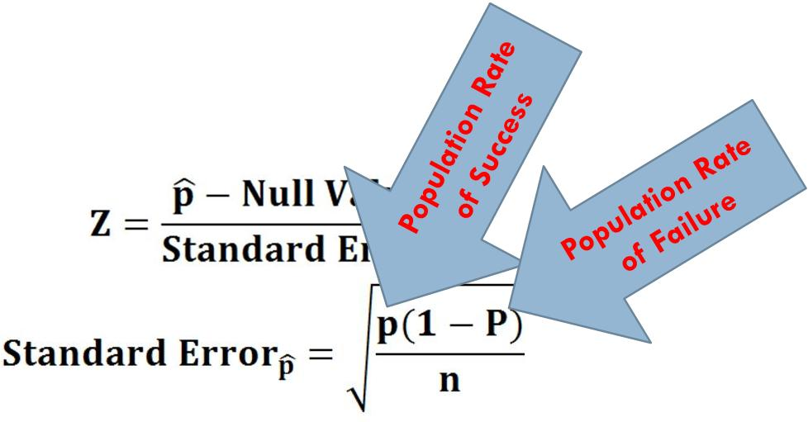
Calculate Statistic
Notes:
Times rate of failure

Slide 19
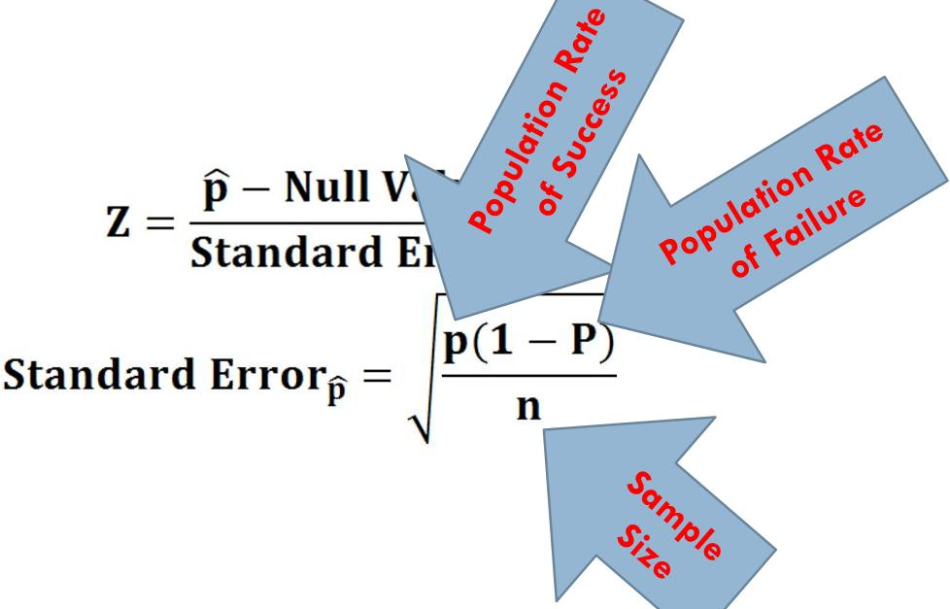
Calculate Statistic
Notes:
Divided by the sample size.

Slide 20
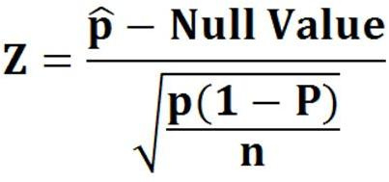
Calculate Statistic
Notes:
Then the statistic Z is calculated using this formula.

Slide 21
Look-up P Value
Notes:
Next step in our inference framework is to look up the p value associated with the calculated Z statistic. As before this is done using Z tables. The Z tables give the area associated with observing a value less than Z. In one sided tests, the p-value is the white area. In two sided tests, the p-value is double the white area.

Slide 22
Make Inference
Notes:
Last step in our framework is to infer from the sample if the population has the hypothesized null value. If the p-value is less than 0.05 or a pre-set level of type 1 error, the null hypothesis is rejected.

Slide 23
Example
A random sample of patients eligible to use our hospital indices that 52% use our services. Does this provide convincing evidence (significance level of 95%) for the claim that 50% of eligible patients use our hospital?
Notes:
Let us look at an example. A random sample of patients eligible to use our hospital indices that 52% use our services. Does this provide convincing evidence (at significance level of 95%) for the claim that more than 50% of eligible patients use our hospital?

Slide 24
Assumptions
Notes:
First, we check assumptions. Our first assumption was that the observations in the sample are independent. Since we took a random sample then this is likely, especially if we sampled less than 10% of the population.

Slide 25
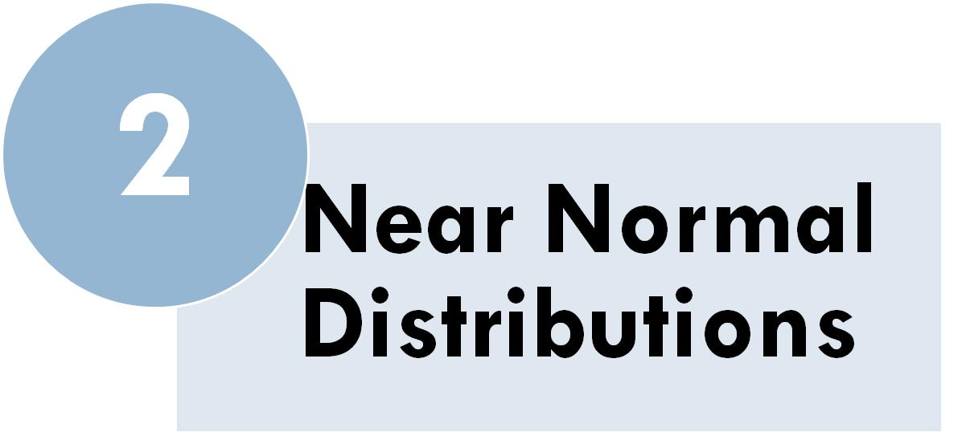
Assumptions
Notes:
The second assumption is that the rate of use of our hospital services can be considered an average and this sample average has a near normal distribution.

Slide 26
Assumptions
Notes:
In a one-proportion hypothesis test, the success-failure condition is checked using the null proportion. The hypothesized null value for the proportion is 50% or 0.5.

Slide 27
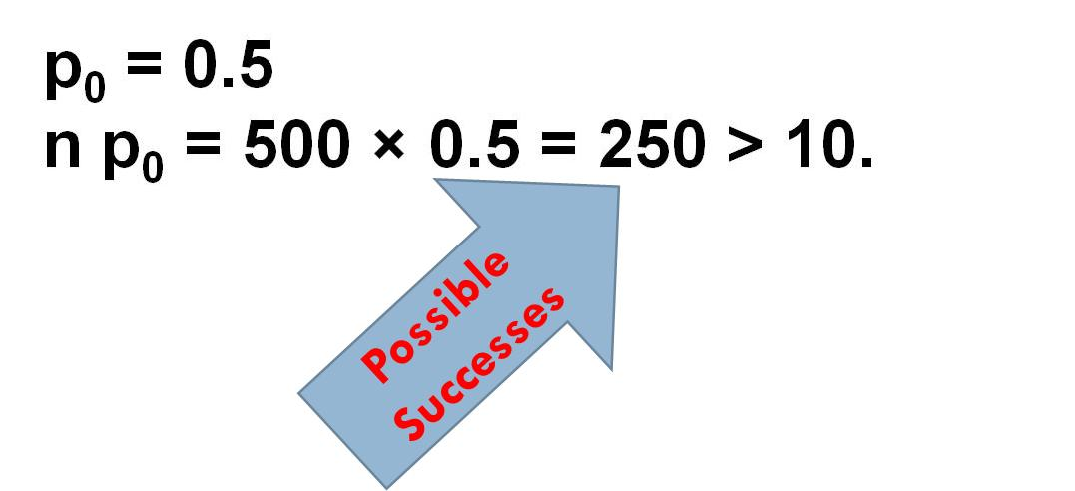
Assumptions
Notes:
The number of patients who use our services is expected to be 500 times 0.5 or 250, which is higher than 10 required.

Slide 28
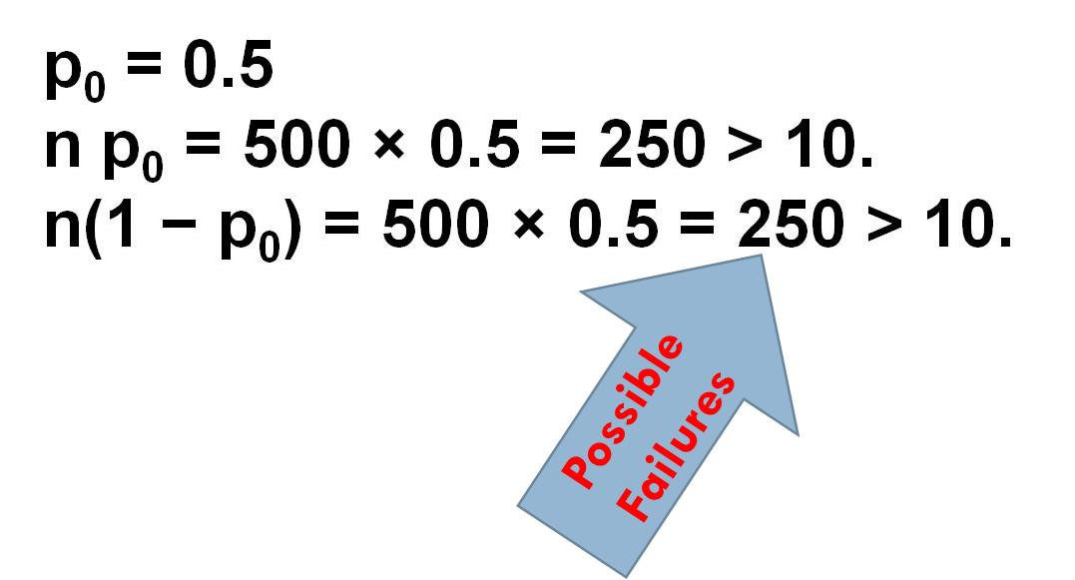
Assumptions
Notes:
The same holds for the number of failures. Therefore the success-failure condition is verified. We can approximate the distribution of the rate as near normal distribution.

Slide 29
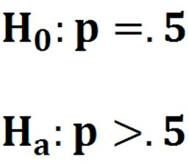
Hypotheses
Notes:
Next we state the hypotheses. The null hypothesis is that the rate of use of our service is 50%. The alternative hypothesis is that the rate is higher. Notice that these hypotheses require a one sided test.

Slide 30
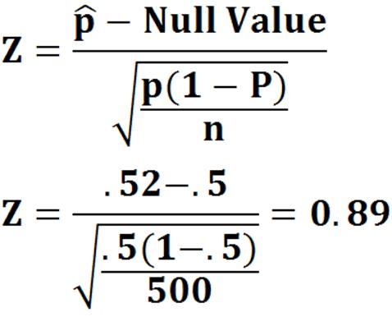
Calculate Statistic
Notes:
The sample mean was 0.52. The hypothesized value was 0.5 and the sample size was 500. The Z is calculated as 0.89.

Slide 31
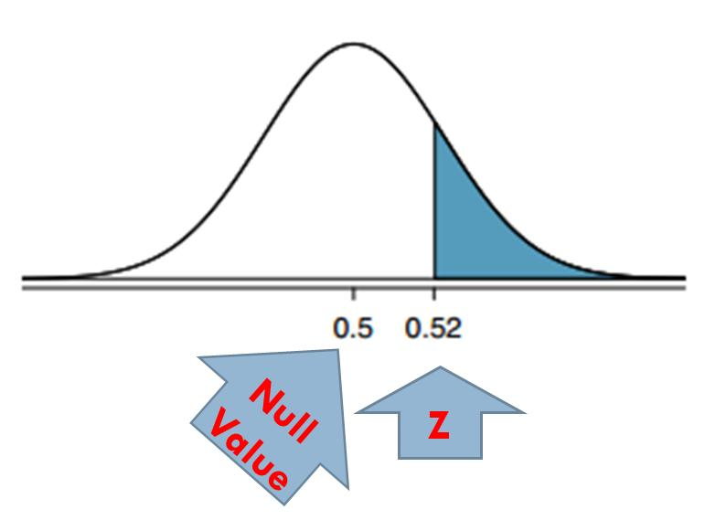
Calculate p Value
Notes:
We now look up the p-value associated with a Z of 0.89. This Z score is .8133, which gives us the p-value for the right tail as 0.1867. This is the area marked in blue.

Slide 32
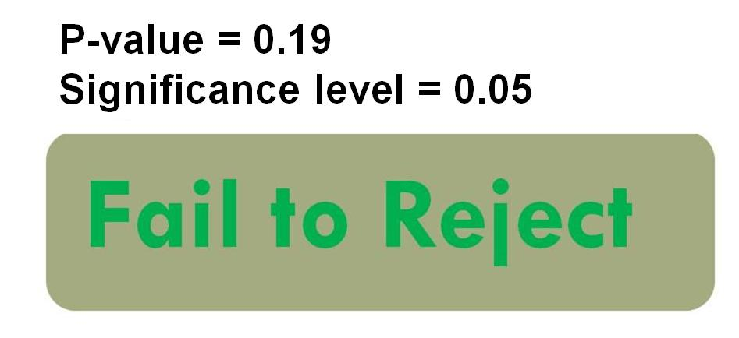
Make Inference
Notes:
Because the p-value of 0.19 is larger than 0.05, we do not reject the null hypothesis.

Slide 33
Take Home Lesson
Test population rate
Notes:
In this lecture, we have used our inference framework to see how to test if the population rate is different from a hypothesized value.

