Slide 1
Comparing two Independent Means
Farrokh Alemi Ph.D.
Notes:
This is a lecture prepared by Farrokh Alemi based on OpenIntro statistics book.

Slide 2
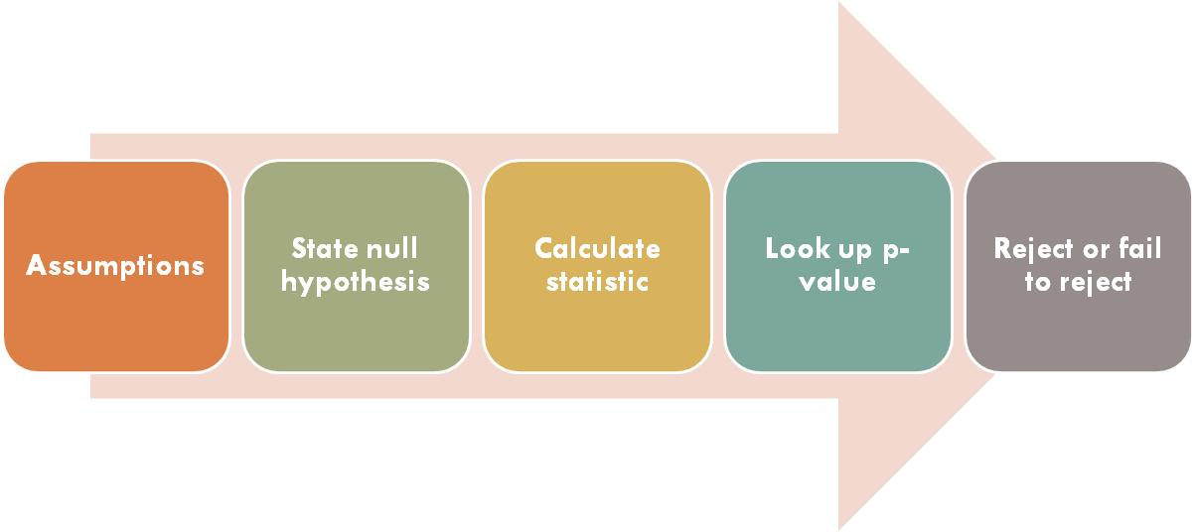
Framework for Hypothesis Testing
Notes:
Recall the framework for hypothesis testing. First we examine the assumptions, then state the hypothesis, calculate the statistic, look up the p value and then decide to reject or fail to reject the null hypothesis.

Slide 3
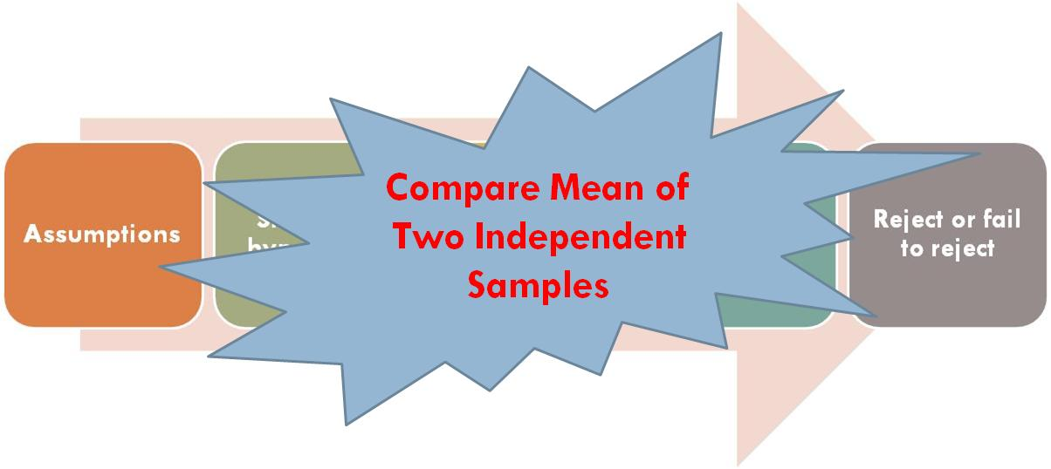
Framework for Hypothesis Testing
Notes:
In this set of slides we apply this framework to comparing the means of two independent samples. We consider the difference in two population means under the condition
that the data are not paired.

Slide 4
Assumptions
Notes:
First assumption is that data the two samples are independent, usually means that less than 10% of the population is sampled and the cases sampled do not share relevant characteristics.

Slide 5
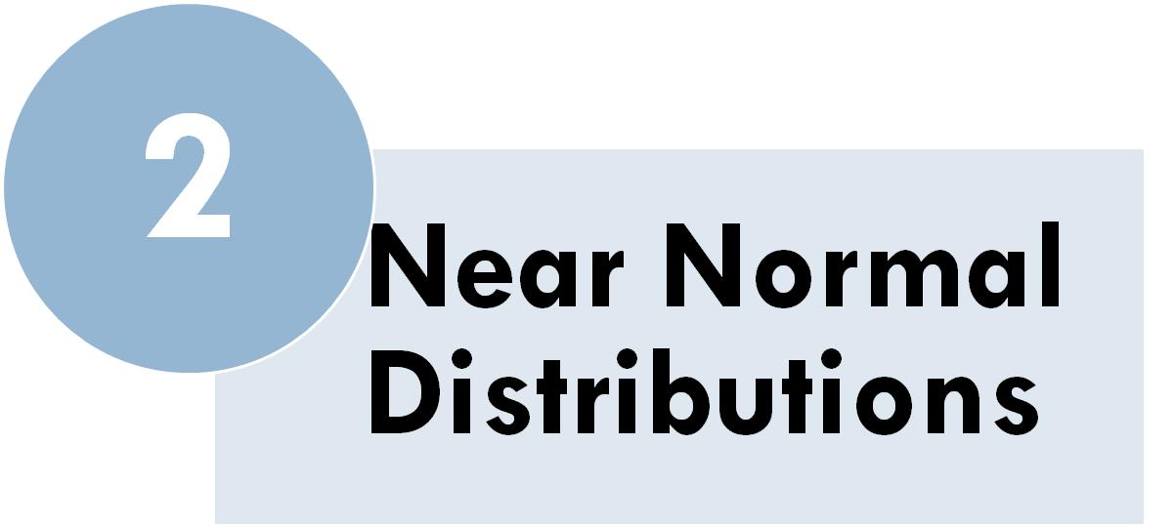
Assumptions
Notes:
The second assumption is that either sample has near normal distribution.

Slide 6
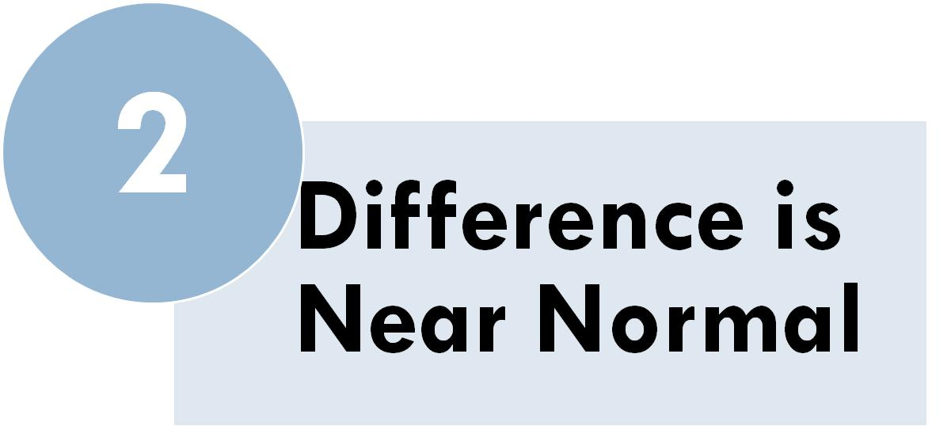
Assumptions
Notes:
Which implies that difference of the mean of the two samples also has a near normal distribution.

Slide 7
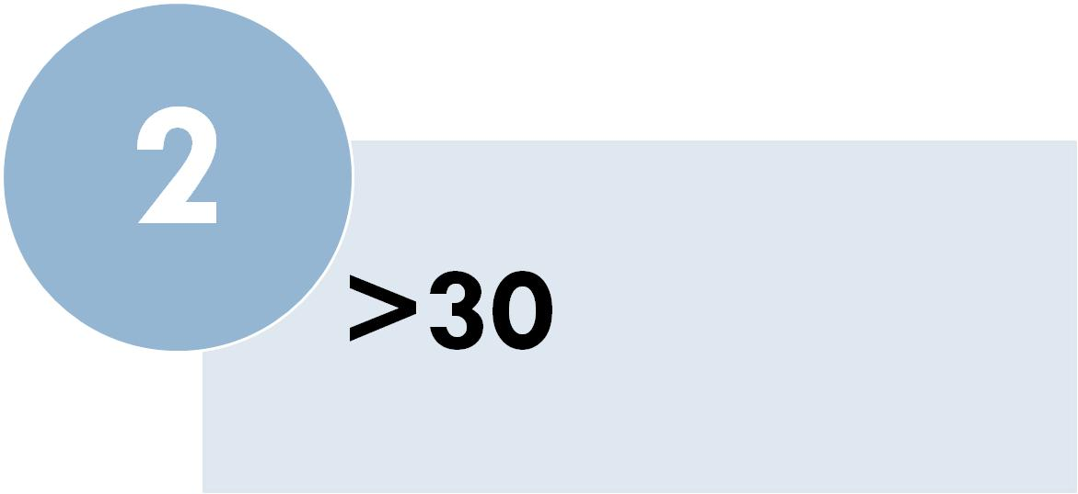
Assumptions
Notes:
This assumption of near normal usually translates to having samples larger than 30 cases and

Slide 8
Assumptions
Notes:
Not very skewed to either left or right.

Slide 9
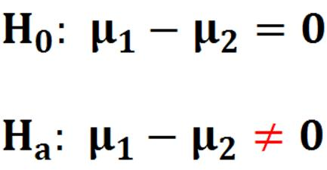
Hypotheses
Notes:
In our framework for hypothesis testing the next step is to state the hypotheses. The null hypothesis is the difference of the two independent means is zero. The alternative hypothesis, if we are doing a two sided test, is that the difference of the two independent means are not the same.

Slide 10
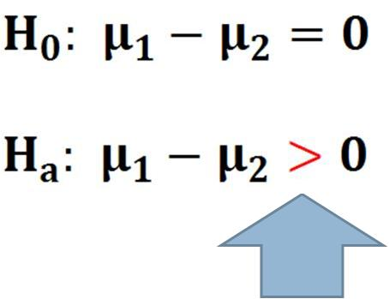
Hypotheses
Notes:
If doing a one sided test, the alternative hypothesis is that the difference of two independent means is higher than zero.

Slide 11
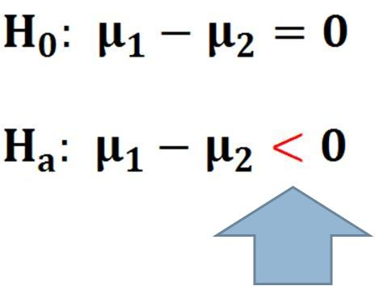
Hypotheses
Notes:
Or that the mean of the difference is less than zero.

Slide 12
Calculate Statistic
Notes:
The third step in our framework for hypothesis testing is to calculate the statistic. The statistic Z is calculated from the point estimate minus the null value divided by standard error.

Slide 13
Calculate Statistic
Notes:
When we test for no differences between the two sample means then the null value is zero.

Slide 14
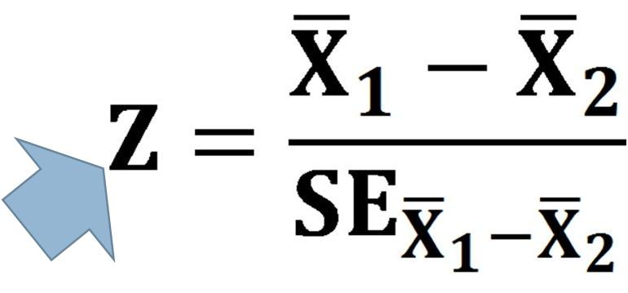
Calculate Statistic
Notes:
Then the statistic Z is calculated from

Slide 15
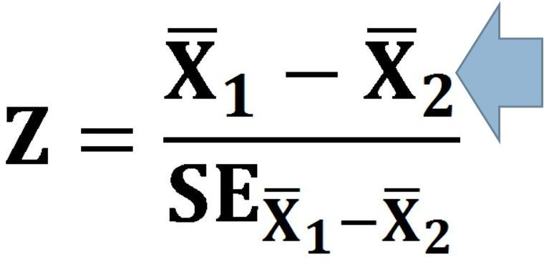
Calculate Statistic
Notes:
Difference of the average of the two samples

Slide 16
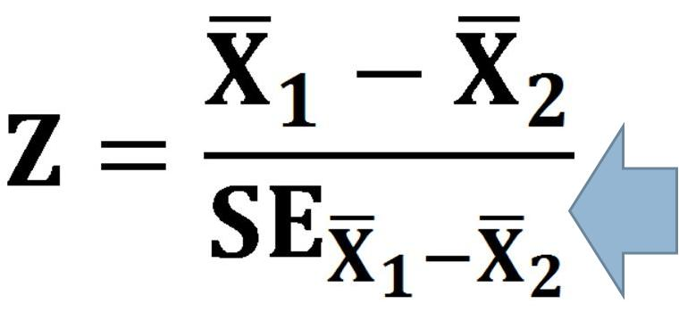
Calculate Statistic
Notes:
Divided by the standard error of the difference of the two means.

Slide 17
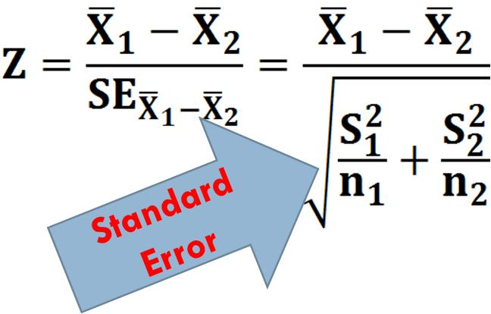
Calculate Statistic
Notes:
The standard error can be calculated using the standard deviation of each of the normally distributed samples.

Slide 18
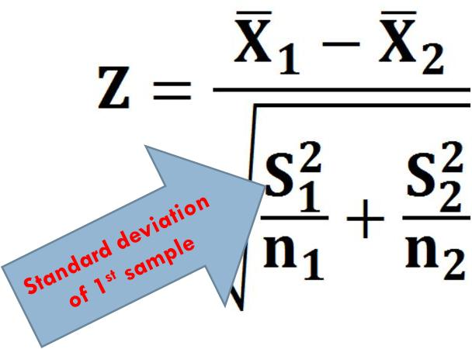
Calculate Statistic
Notes:
In calculating the standard error, S1 is the standard deviation of the first sample.

Slide 19
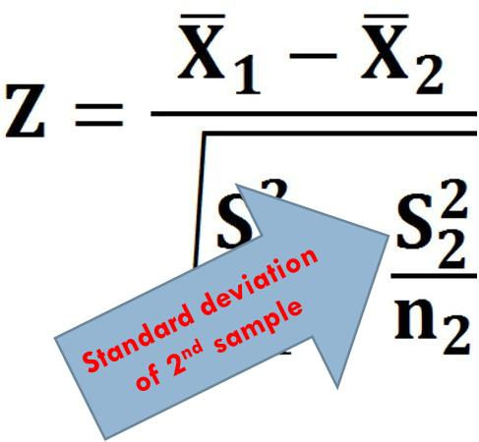
Calculate Statistic
Notes:
S2 is the standard deviation of the second sample.

Slide 20
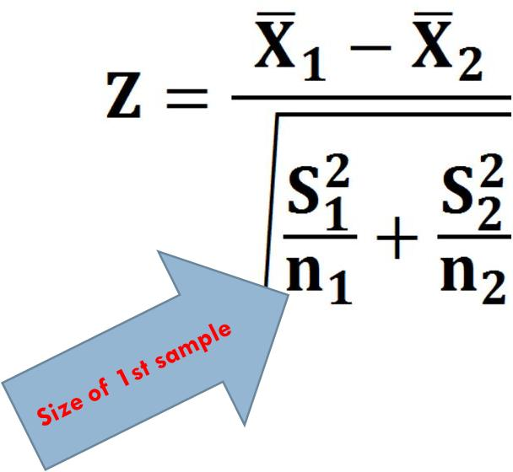
Calculate Statistic
Notes:
N1 is the size of the first sample.

Slide 21
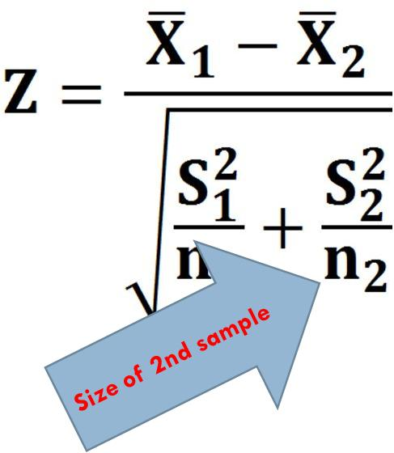
Calculate Statistic
Notes:
N2 is the size of the second sample.

Slide 22
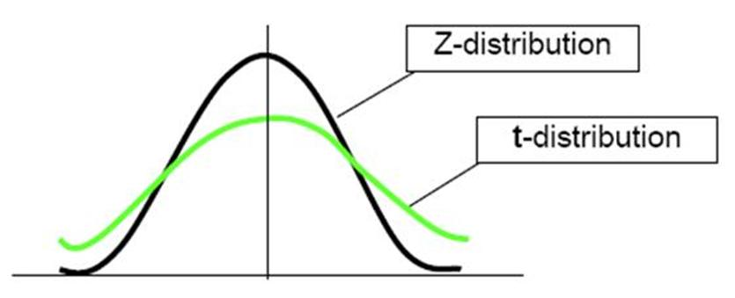
Calculate Statistic
Notes:
The standard error estimate will not generally be accurate for smaller sample sizes, and this motivates the introduction of the t Distribution. When the sample size is smaller than 30, but it is still normally distributed and independent, then standard error can be calculated using the t distribution. Like normal it is symmetric, bell shaped, and uni-modal but it has a lower peak and a higher percent of observations fall in the tails.

Slide 23
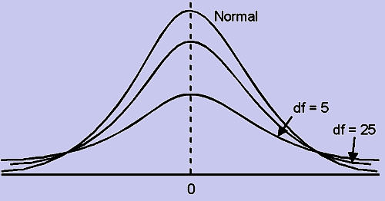
Calculate Statistic
Notes:
The t distribution is always centered at zero and has a single parameter: degrees of freedom. The degrees of freedom for a single sample is the sample size minus one. The degrees of freedom describes the precise form of t distribution. The larger the degrees of freedom, the more closely the t distribution resembles the standard normal model. When the degrees of freedom is about 30 or more, the t distribution is nearly indistinguishable from the normal distribution.

Slide 24
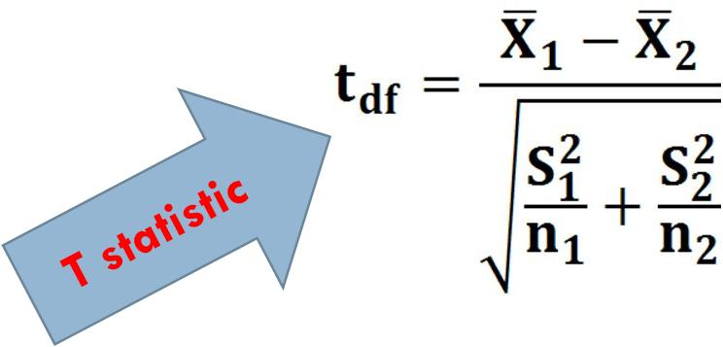
Calculate Statistic
Notes:
For situations where we are dealing with normal independent observations, if sample size is less than 30, then we calculate the t statistic using this formula

Slide 25
Calculate Statistic
Notes:
The degrees of freedom for comparing mean of two samples is the size of the smaller sample minus one.

Slide 26
Look-up P Value
Notes:
Next step in our inference framework is to look up the p value. This depends on whether we have calculated the z or t statistic. Here, we are showing the standard distribution of Z. If we have calculated Z then we can look up one sided or two sided p-values by consulting the Z tables.

Slide 27
Look-up P Value
Notes:
If we have calculated the t-statistic, then we look up the p value in the standard t distribution tables.

Slide 28
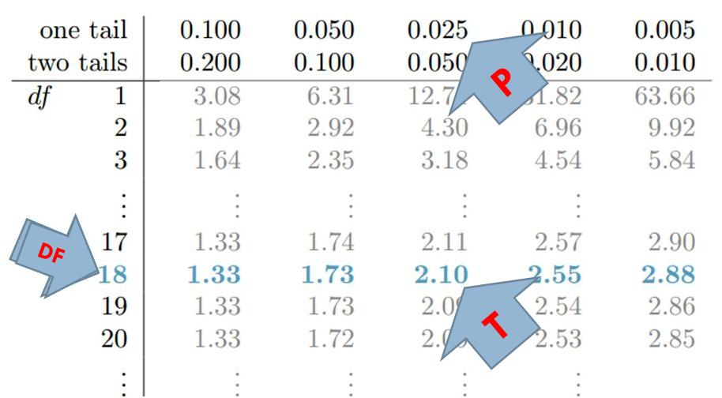
Look-up P Value
Notes:
We start by selecting the row corresponding to degrees of freedom. We find the value for our calculated T statistic and then read the p-value on top of the column corresponding to the matched T value inside the table. For example, if the smallest sample size had 19 cases, then the degrees of freedom is 18. The selected row in blue indicates t-statistics. If we have observed a t value of 2.10, then the one tail probability of observing this t-statistic is given at the top of the column associated with it, in this case 0.025.

Slide 29
Make Inference
Notes:
Last step in our framework is to infer from the sample if the population has the hypothesized null value.

Slide 30
Example
Notes:
Let us look at an example. The left histogram shows weight of infants for mothers who smoked. The right shows it for mothers who did not smoke. The question is whether there is a difference between the mean of the two populations. Both distributions exhibit strong skew.

Slide 31
Example
Notes:
Summary statistics are shown here for mothers who smoked and those who did not. Let us go through the steps in our inference framework.

Slide 32
Assumptions
Notes:
First, we check assumptions. Our first assumption was that the samples are independent. There is some evidence that smokers affect non-smokers, especially if they live together. For mothers who do not live together or know each other, the assumption of independence of samples may be reasonable.

Slide 33
Assumptions
Notes:
The second set of assumption is that both smokers and non-smokers have a near normal distribution. This is verified if the sample size is larger than 30 and it is not strongly skewed. We saw that the sample size is 50 and 100, therefore both are above 30. The sample is skewed but there the skew is not strong. Therefore, we conclude that the assumption of near normal distribution has been met.

Slide 34
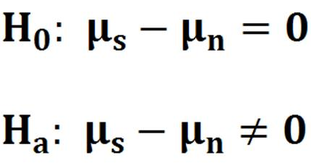
Hypotheses
Notes:
Next we state the hypotheses. The null hypothesis is that there are no difference in the mean of the infant weights in the smoker and non-smoker populations. The alternative hypothesis is that there is a difference. Notice that these hypotheses require a two sided test.

Slide 35
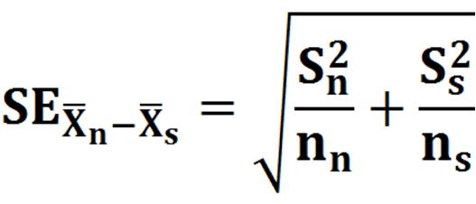
Calculate Statistic
Notes:
We can calculate the t or the Z statistic. Since we have more than 30 cases, we calculate the Z statistic. First we calculate the Standard error of the difference of the two means.

Slide 36
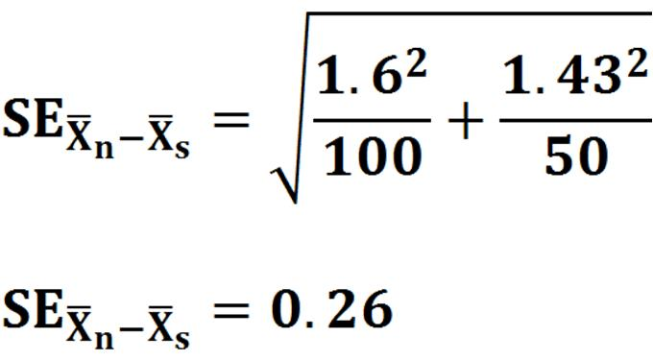
Calculate Statistic
Notes:
The summary statistics provided us with both standard deviations and sample size to calculate the standard error of the difference. From these values we calculate the standard error to be .26.

Slide 37
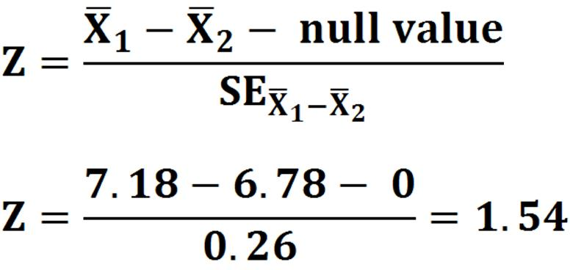
Calculate Statistic
Notes:
Next we calculate the Z statistic. The difference of non-smokers and smokers is put into the equation. The null value is zero as we are testing that there is no difference. The standard error was previously estimated at 0.26. Therefore the Z value is 1.54.

Slide 38
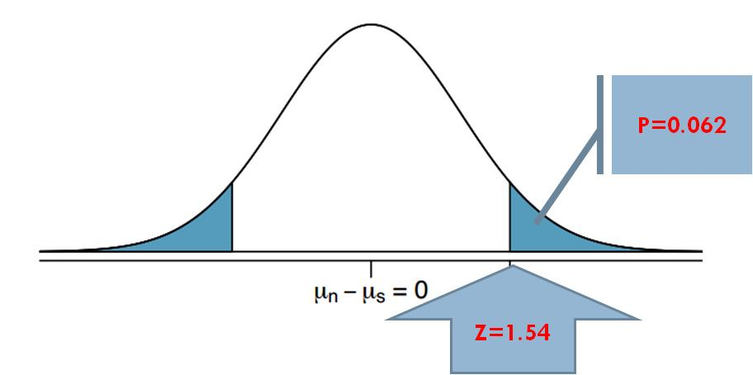
Calculate p Value
Notes:
We now look up the p-value associated with a Z of 1.54. This Z score is .938, which gives us the p-value for the right tail as 0.062.

Slide 39
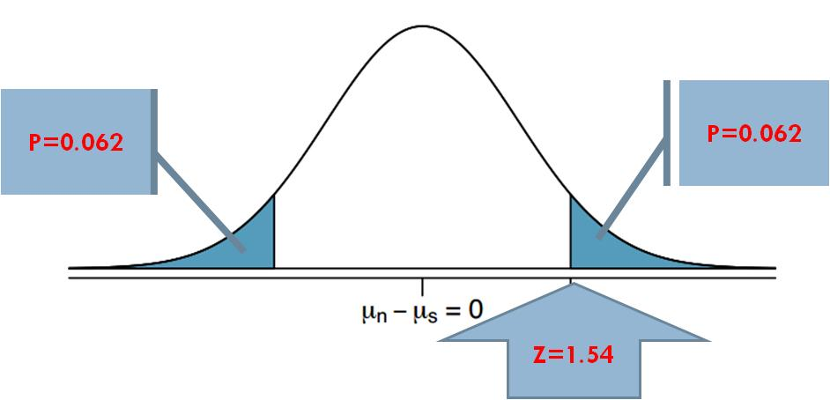
Calculate p Value
Notes:
Because this is a two-sided test and we want the area of both tails, we double this single tail to get the p-value: 0.124.

Slide 40
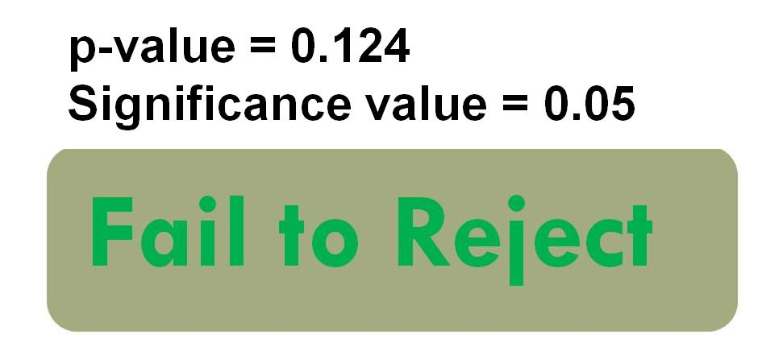
Make Inference
Notes:
This p-value 0.124 is larger than the signiﬁcance value, 0.05, so we fail to reject the null hypothesis.

Slide 41
Example
Notes:
Let us look at an another example. The histogram shows improvement in patient scores on a standardized test after the test was revised to be more culturally sensitive. The question is whether the revision has changed patient scores on the test. Note that the histogram is uni-model and approximately symmetric.

Slide 42
Example
Notes:
Summary statistics are shown here. Version A shows the test before it was revised and version B after. Let us go through the steps in our inference framework.

Slide 43
Assumptions
Notes:
First, we check assumptions. Our first assumption was that the samples are independent. This may be a reasonable assumption if the subjects recruited for the second sample had no relations to subjects recruited for the first sample.

Slide 44
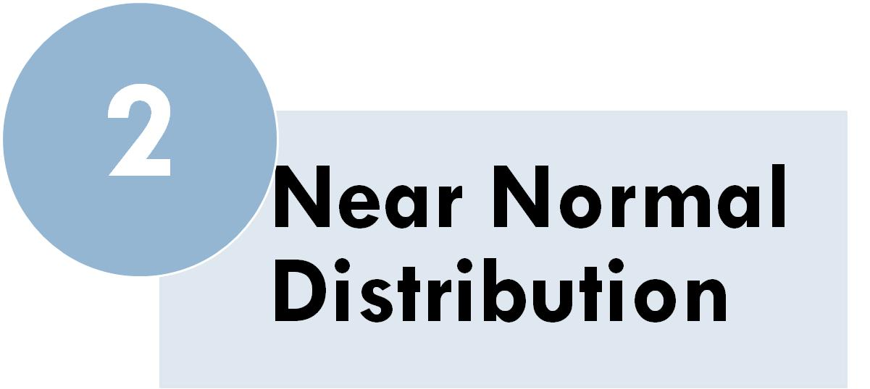
Assumptions
Notes:
The second set of assumption is that the difference has a normal distribution. The histogram is not skewed and seems symmetric enough but the sample size is smaller than 30. Therefore, we cannot make the near normal assumption and need to use the t-distribution.

Slide 45
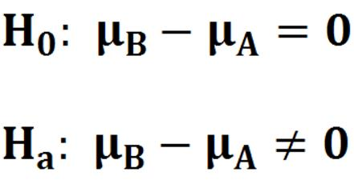
Hypotheses
Notes:
Next we state the hypotheses. The null hypothesis is that there are no difference in the mean of the version B and version A of the test. The alternative hypothesis is that there is a difference. Notice that these hypotheses require a two sided test.

Slide 46
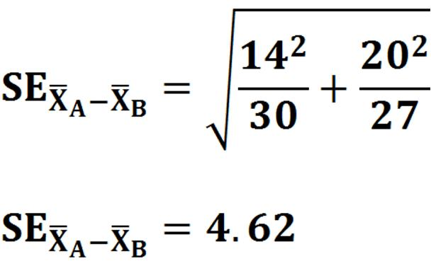
Calculate Statistic
Notes:
We first calculate the standard error. The summary statistics provided us with both standard deviations and sample sizes. From these values we calculate the standard error to be 4.62.

Slide 47
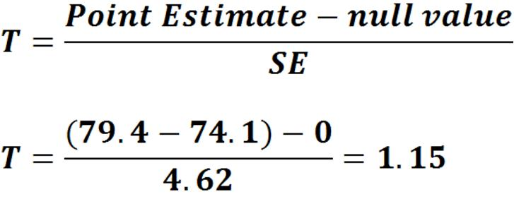
Calculate Statistic
Notes:
Next we calculate the t statistic. The point estimate of the difference is put in. The null value is zero as we are testing that there is no difference. The standard error was previously estimated at 4.62. Therefore the T value is 1.15.

Slide 48
Calculate p Value
Notes:
To look up the t-value in tables of t-distribution, we need an estimate for degrees of freedom. Here the minimum sample size is 27 therefore the degrees of freedom is 26.

Slide 49
Calculate p Value
Notes:
We now look up the p-value associated with a t distribution with 26 degrees of freedom.

Slide 50
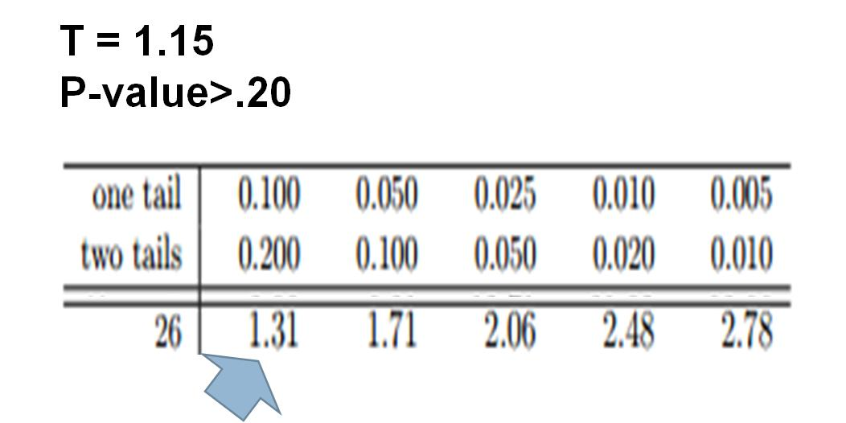
Calculate p Value
Notes:
In the table, we examine row for 26 degrees of freedom. Because the t-statistic of 1.15 is smaller than 1.31, the value in the left column of the row, the two tailed p-value is larger than 0.200.

Slide 51
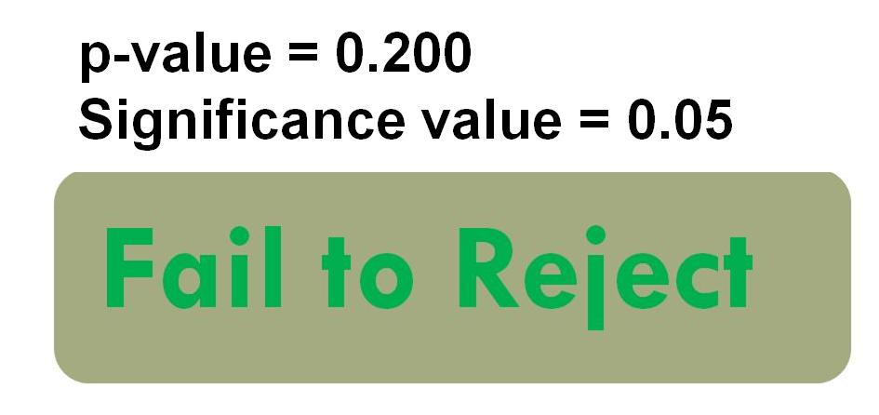
Make Inference
Notes:
Because the p-value is so large, we do not reject the null hypothesis.

Slide 52
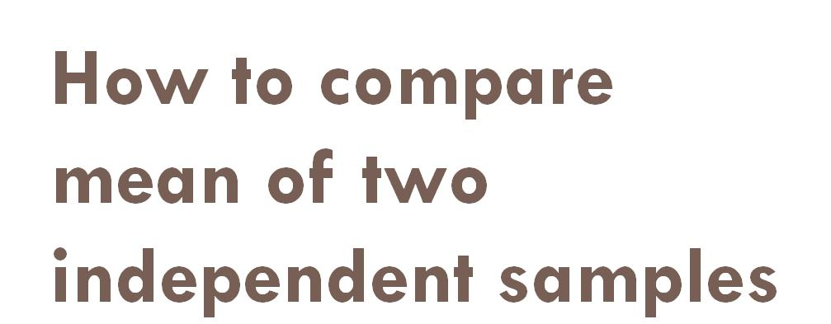
Take Home Lesson
Notes:
In this lecture, we have used our inference framework to see how to compare mean of two independent samples.

