Slide 1
Rethinking Logistic Regression through Corner Cases
Farrokh Alemi+ Ph.D.
Notes:
This brief presentation was organized by Dr. Alemi.

Slide 2
Building Accurate Models
Requires Including
Interactions & Corner
Cases Can Guide Us

Slide 3
Overlooked
Too Many

Slide 4
Interactions
in Two Binary Variables
$$X_{1}=1, X_{2}=1+ then X_{1}X_{2}=1$$
$$X_{1}=1, X_{2}=0+ then X_{1}X_{2}=0$$
$$X_{1}=0, X_{2}=1+ then X_{1}X_{2}=0$$
$$X_{1}=0, X_{2}=0+ then X_{1}X_{2}=0$$
Notes:
For example+ consider two binary variables+ where when the variable is present it is coded as 1 and 0 otherwise. The product of two binary variables is another binary variable which is 1 when both variables are present and 0 otherwise. With two binary variables four situations are possible and the only time the product is 1 is when both variables are present. If one variable is binary and another continuous+ the product of the variable will be 0 when the binary variable or the continuous variable is 0 and otherwise same as the continuous variable. If both variables are continuous then the product of both variables will be continuous and a larger number than the sum of the two variables. Including interaction terms in regression expands our ability to model events.

Slide 5
Regress Y on one or more
independent variables X₁+ …+ X_{n}
plus:
X₁X₂+ X₁X₃+ …+ X₁X_{n}+
X₁X₂X₃+ X₂X₃X₄+ …+ X_{n-2}+X_{n-1}+X_{n}
X₁X₂X₃X₄+ …
Interactions

Slide 6
Regress Y on one or more
independent variables X₁+ …+ X_{n}
plus:
X₁X₂+ X₁X₃+ …+ X₁X_{n}+
X₁X₂X₃+ X₂X₃X₄+ …+ X_{n-2}+X_{n-1}+X_{n}
X₁X₂X₃X₄+ …
????
Highest Level

Slide 7
Regress Y on one or more
independent variables X₁+ …+ X_{n}
plus:
X₁X₂+ X₁X₃+ …+ X₁X_{n}+
X₁X₂X₃+ X₂X₃X₄+ …+ X_{n-2}+X_{n-1}+X_{n}
X₁X₂X₃X₄+ …
X₁X₂X₃…X_{n}
Highest Level
Describes a case

Slide 8
Interactions Can be Observed in the Case Data
Regress Y on one or more
independent variables X₁+ …+ X_{n}
plus:
X₁X₂+ X₁X₃+ …+ X₁X_{n}+
X₁X₂X₃+ X₂X₃X₄+ …+ X_{n-2}+X_{n-1}+X_{n}
X₁X₂X₃X₄+ …
X₁X₂X₃…X_{n}
Highest Level
Describes a case

Slide 9
$${Logit Y =β}_{0}+β_{1}X_{1}+β_{2}X_{2}+β_{3}X_{3}$$
$$+β_{4}X_{1}X_{2}+β_{5}X_{1}X_{3}+β_{6}X_{2}X_{3}$$
$$+β_{7}X_{1}X_{2}X_{3}$$
Assumptions
$$Y_{0,0,0}=β_{0}=0$$
$$Y_{1,1,1}=1$$
Increase in X $≠$ Decrease in Y
Notes:
We assume that Y value when all Xs are not present is 0. When all Xs are present the value is 1. In other words, Y is standardized to go between 0 and 1. We assume that Y is monotonely, and positively related to Xs.

Slide 10
$${LogitY=β}_{0}+β_{1}X_{1}+β_{2}X_{2}+β_{3}X_{3}$$
$$+β_{4}X_{1}X_{2}+β_{5}X_{1}X_{3}+β_{6}X_{2}X_{3}$$
$$+β_{7}X_{1}X_{2}X_{3}$$
What is approx. value for coefficient of X1?
$Search data for β_{1}$?

Slide 11
Observed Value for Case: X1=1 X2=X3=0
$${Y_{1,0,0}=β}_{0}+β_{1}X_{1}$$
$$Y_{1,0,0}={0+ β}_{1}$$
$$Y_{1,0,0}={ β}_{1}$$

Slide 12
Observed Value for Case: X2=1 X1=X3=0
$$Y_{0,1,0}={ β}_{2}$$

Slide 13
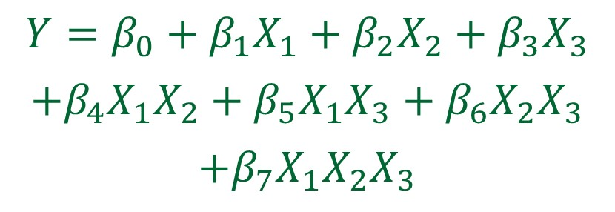
Observed Value for Case X3=0
X2 =X1=1
$$What is β_{4}?$$

Slide 14
Estimation of Interaction Coefficient
$$Y_{1,1,0}−{ β}_{1}−β_{2}=β_{4}$$

Slide 15
Specifying Models by Search
Standardize data to range 0 to 1
Check monotone and positive relation
Stratify data
Ignore stratum less than 30 repetitions
Select strata where X_{i} changes from 0 to 1
Plot existence of interactions
Estimate the coefficient from corner cases

Slide 16
Visualizing Interactions

Slide 17
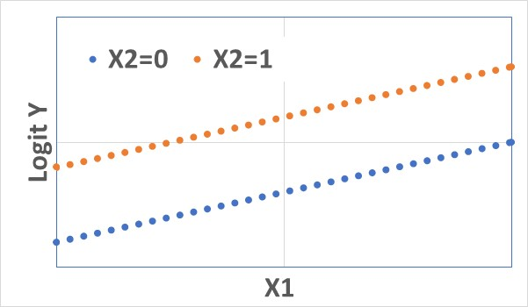
Parallel Lines indicate no Interactions

Slide 18
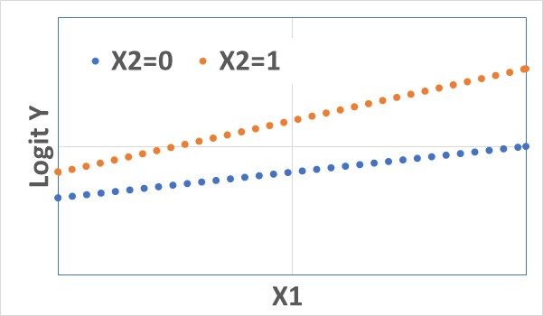
Funnel indicates Interactions

Slide 19
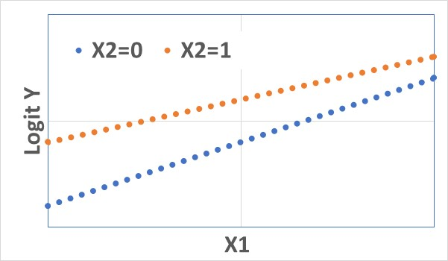
Funnel indicates Interactions

Slide 20
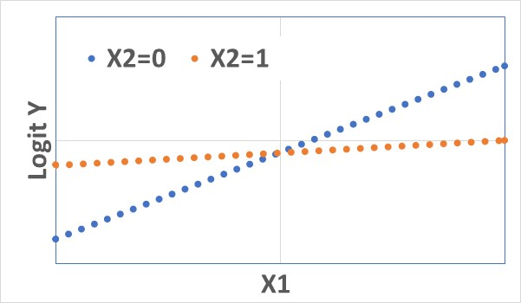
Crossing indicates Non-Mathematical Interaction

Slide 21
Possible Contour Plots
Low+ High years of Education
Low+ Med+ High Levels of Infection
6-Month Survival
6-Month Mortality
Levels of Cardiovascular Illness
Levels of Cardiovascular Illness

Slide 22
Estimating Regression
Coefficients from Contour
Plots

Slide 23
Strata Based Contour Plots
Probability of Death in 6 Months
Comorbidity Strata Arranged in Order of Death in 6 Months

Slide 24
Strata Based Contour Plots
Probability of Death in 6 Months
Does cancer interact with strata?
Comorbidity Strata Arranged in Order of Death in 6 Months

Slide 25
Search for Corner Cases can Estimate Coefficients of Regression Equations and Detect Need for Interaction Terms

