Slide 1
Interaction Plots
Farrokh Alemi Ph.D.
Notes:
This brief presentation was organized by Dr. Alemi.

Slide 2
Case Based Reasoning
Assumptions
Notes:
Interaction plots are case based reasoning and not based on features.

Slide 3
Y predicted from X1, X2, and X3
Assumptions
Notes:
For simplicity, let us start with interaction plot for predicting Y from three independent variables.

Slide 4
Max-Min Standardized
Assumptions
Notes:
Data must be standardized prior to plotting

Slide 5
Assumptions
Notes:
Data must be revised so that increases in X must not lead to decreases in Y.

Slide 6
Monotone & Positive
Assumptions
Notes:
There should be a monotone positive relation between Xs and Y

Slide 7
Interaction Plots
Notes:
If data are transformed so that the assumptions are met, on the Y axis we plot the probability of the case.

Slide 8
List combination of variables in X-axis in order of Probability of Y
Notes:
On the X axis we list the combinations of the variables in the order of their corresponding Y value.

Slide 9
Interaction Plots
Notes:
The first value on the X axis is when neither X2 or X3 are present.

Slide 10
Interaction Plots
Notes:
Next is when only X2 is one and X3 is zero. We are assuming only X2 has a lower value than only X3.

Slide 11
Interaction Plots
Notes:
Next is when only X3 is one and X2 is zero.

Slide 12
Interaction Plots
Notes:
Last is when both are set to one.

Slide 13
Notes:
Two lines are drawn. The first line shows the probability of cases in which X1 is set to zero.

Slide 14
Notes:
The second line shows the probability of cases in which X1 is set to one.

Slide 15
Notes:
If the two lines are parallel, X1 adds the same amount to each combination of X2 and X3, so there are no interactions.

Slide 16
Notes:
The deviation from parallel line indicate possible interactions. Here X1 and X2 are potentially interacting.

Slide 17
Notes:
Sometimes, the data does not support that variables are monotonely increase the Y variable. Here we see that the combination X1 and X2 have higher Y value than the combination X1 and X3, despite the fact that X2 and X3 without X1 have a different order. This is called a preferential order violation. In these situations we use interaction terms to get it as close as possible to the order requirements.

Slide 18
Interaction Plots
Low+ High years of Education
Low+ Med+ High Levels of Infection
6-Month Survival
6-Month Mortality
Levels of Cardiovascular Illness
Levels of Cardiovascular Illness
Notes:
Here are some examples of interaction plots. In this example we see a funnel opening to the right where cardiovascular illness are present. This suggests an interaction between education and cardiovascular illness.

Slide 19
Interaction Plots
Low+ High years of Education
Low+ Med+ High Levels of Infection
6-Month Survival
6-Month Mortality
Levels of Cardiovascular Illness
Levels of Cardiovascular Illness
Notes:
To the right, you see linear relationship between levels of infection and cardiovascular illness.

Slide 20
Look at Real Data
Notes:
Let us look at real data

Slide 21
Interaction Plot
Probability of Death in 6 Months
Comorbidity Strata Arranged in Order of Death in 6 Months
Notes:
This interaction plot shows different combination of comorbidities in the X axis. The numbers are nominal and show different sets of comorbidities.

Slide 22
Interaction Plot
Probability of Death in 6 Months
Comorbidity Strata Arranged in Order of Death in 6 Months
Notes:
For example, the x-axis labeled 1 indicates presence of no comorbidities.

Slide 23
Interaction Plot
Probability of Death in 6 Months
Comorbidity Strata Arranged in Order of Death in 6 Months
Notes:
For example, the x-axis labeled 9 indicates presence of a specific set of comorbidities, for example diabetes, hypertension, and depression. The plot does not tell us which comorbidities are in the set but we can also have this information outside of the plot.

Slide 24
Interaction Plot
Probability of Death in 6 Months
Comorbidity Strata Arranged in Order of Death in 6 Months
Notes:
The Y axis shows the probability of death in 6 months.

Slide 25
Interaction Plot
Probability of Death in 6 Months
Comorbidity Strata Arranged in Order of Death in 6 Months
Notes:
Two lines are plotted. First line is probability of death when stomach cancer is not present.

Slide 26
Interaction Plot
Probability of Death in 6 Months
Comorbidity Strata Arranged in Order of Death in 6 Months
Notes:
The second line gives the probability of mortality when stomach cancer is present. The difference between the two lines is only stomach cancer. Comorbidities are shared between the two lines.

Slide 27
Interaction Plot
Probability of Death in 6 Months
Comorbidity Strata Arranged in Order of Death in 6 Months
Notes:
The difference between the two lines, is larger when no comorbidities are present.

Slide 28
Interaction Plot
Probability of Death in 6 Months
Comorbidity Strata Arranged in Order of Death in 6 Months
Notes:
The impact is very small to the right in strata 29, 30 and 31, where the patient may die from many other serious comorbidities, for example, presence of other cancers. On the right we may have a ceiling effect as we have reached near maximum possible probabilities.

Slide 29
Interaction Plot
Probability of Death in 6 Months
Cancer interacts with strata
Comorbidity Strata Arranged in Order of Death in 6 Months
Notes:
It is clear that the impact of stomach cancer depends on patient’s comorbidities. Sometimes larger other times smaller.

Slide 30
Interaction Plot
Probability of Death in 6 Months
Comorbidity Strata Arranged in Order of Death in 6 Months
Notes:
In the set of comorbidities in cells 19 and 20, the drop in the probability also suggests an interaction effect.

Slide 31
Adjust Model until you Get two Parallel Lines
Notes:
Interactions are added to the model so that we get two parallel lines.

Slide 32
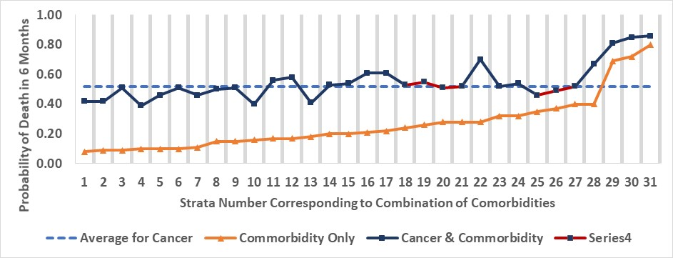
Interaction Plot
Notes:
For example, a 20% interaction adjustment to cells 19 and 20,

Slide 33
Interaction Plot
Notes:
and a 10% adjustment for cell 26, makes the two lines more parallel, thus appropriate for estimation of main effects.

Slide 34
Interaction Plots Tell You Where and How Large Interactions May be.
Notes:
Interaction Plots Tell You Where Interactions Exist & How Large They May be.

Slide 35
Notes:
I hope this presentation has helped you understand how to detect and adjust for interactions.

