Slide 1
Data Types and Structures in R
HAP 719: Advanced Statistics I
Yili Lin

Slide 2
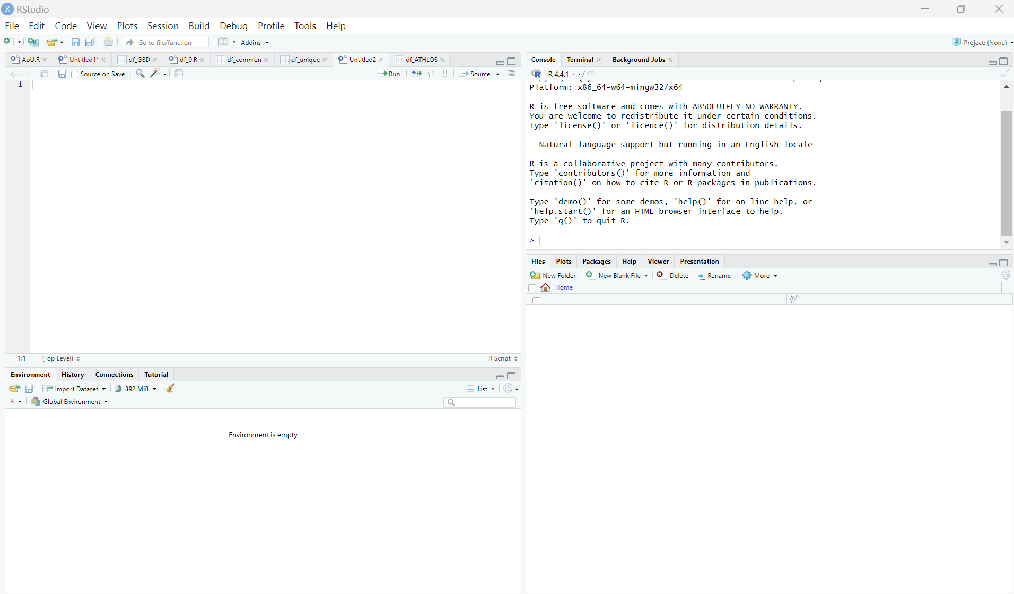
RStudio Overview
Script Editor
Console
Files/Plots/Packages/Help/Viewer
Environment Pane

Slide 3
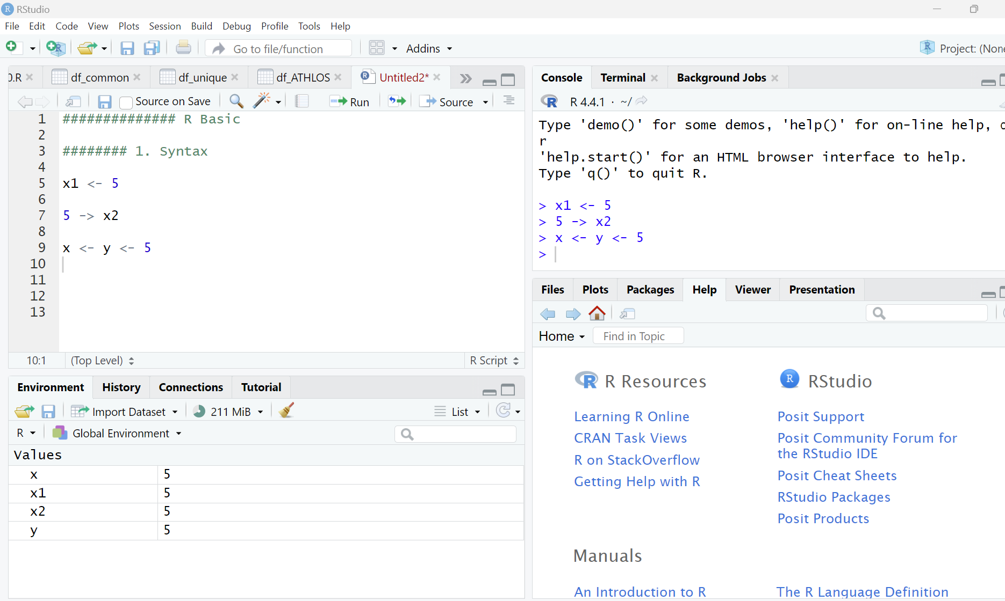
Syntax
Assignment: <-

Slide 4
Syntax
Assignment: <-

Slide 5
Syntax
Assignment: <-

Slide 6
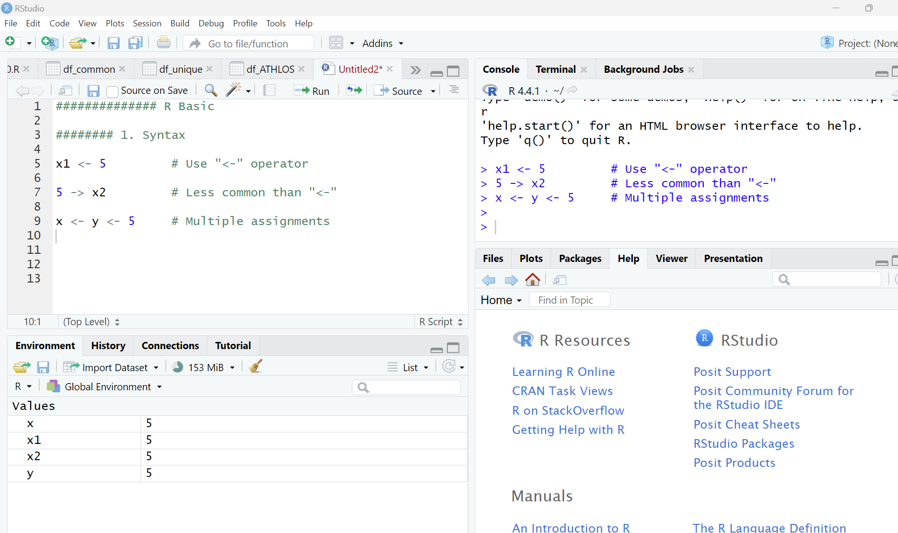
Syntax
Assignment: <-
Comments: #

Slide 7
Syntax
Assignment: <-
Comments: #

Slide 8
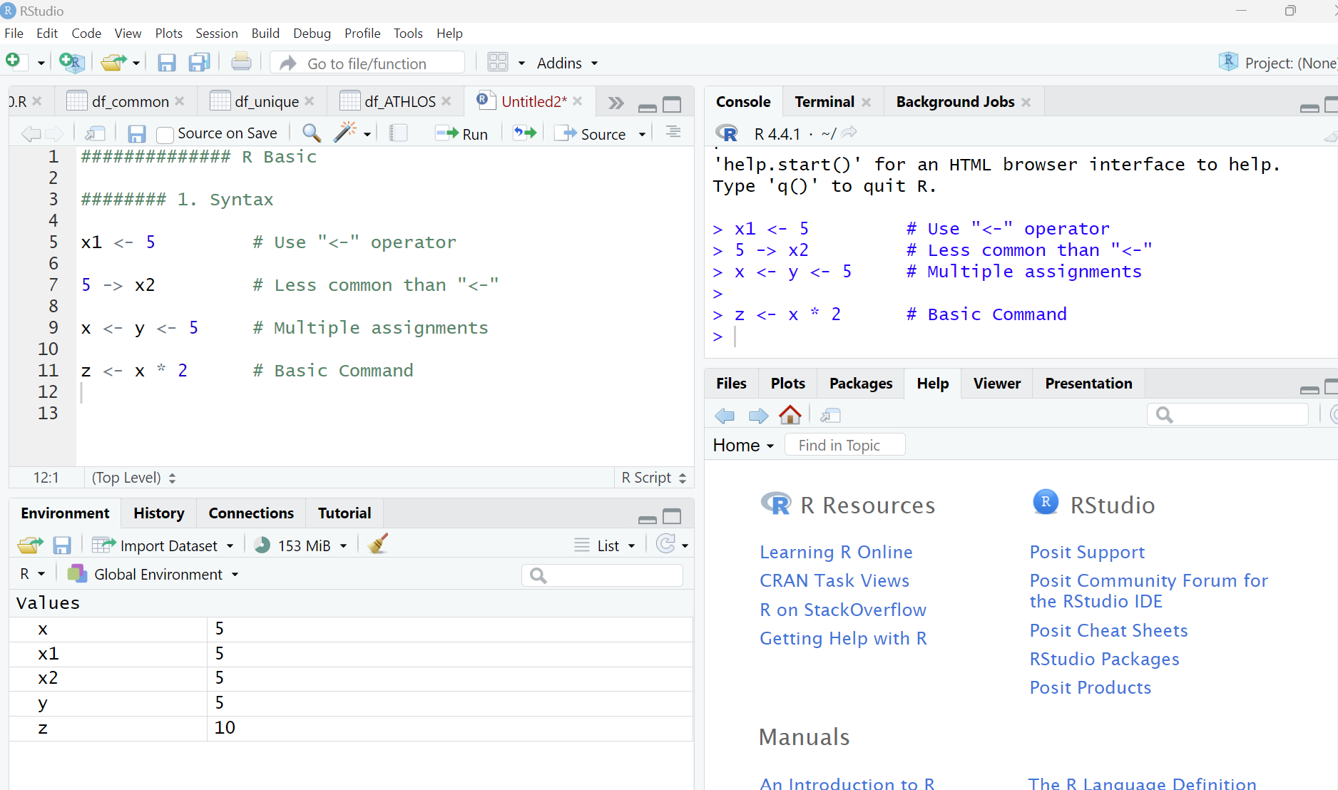
Syntax
Assignment: <-
Comments: #
Basic Command:

Slide 9
Syntax
Assignment: <-
Comments: #
Basic Command:

Slide 10
Syntax
Assignment: <-
Comments: #
Basic Command:

Slide 11
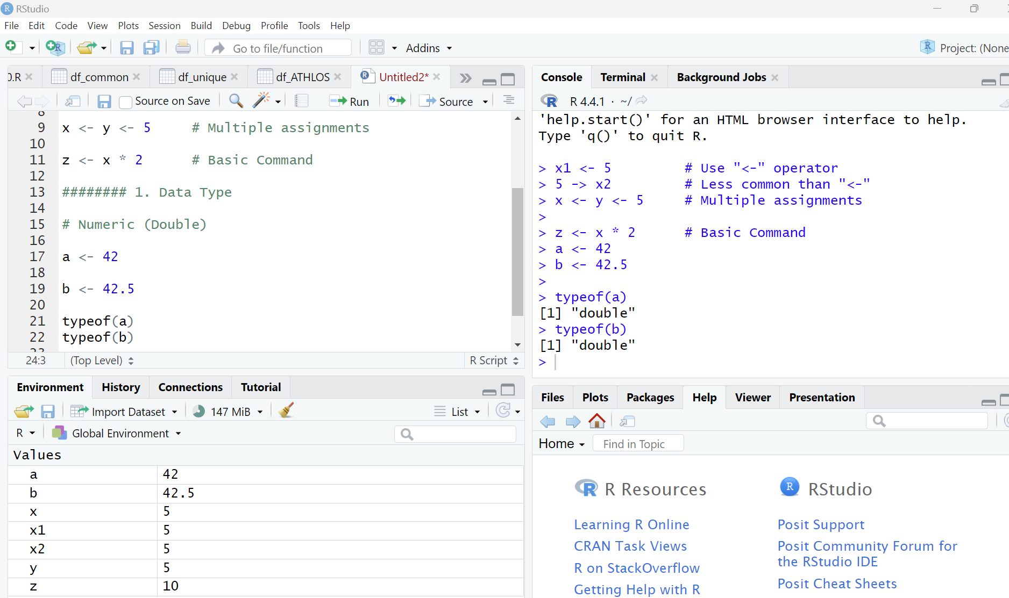
Data Types
Numeric (Double)

Slide 12
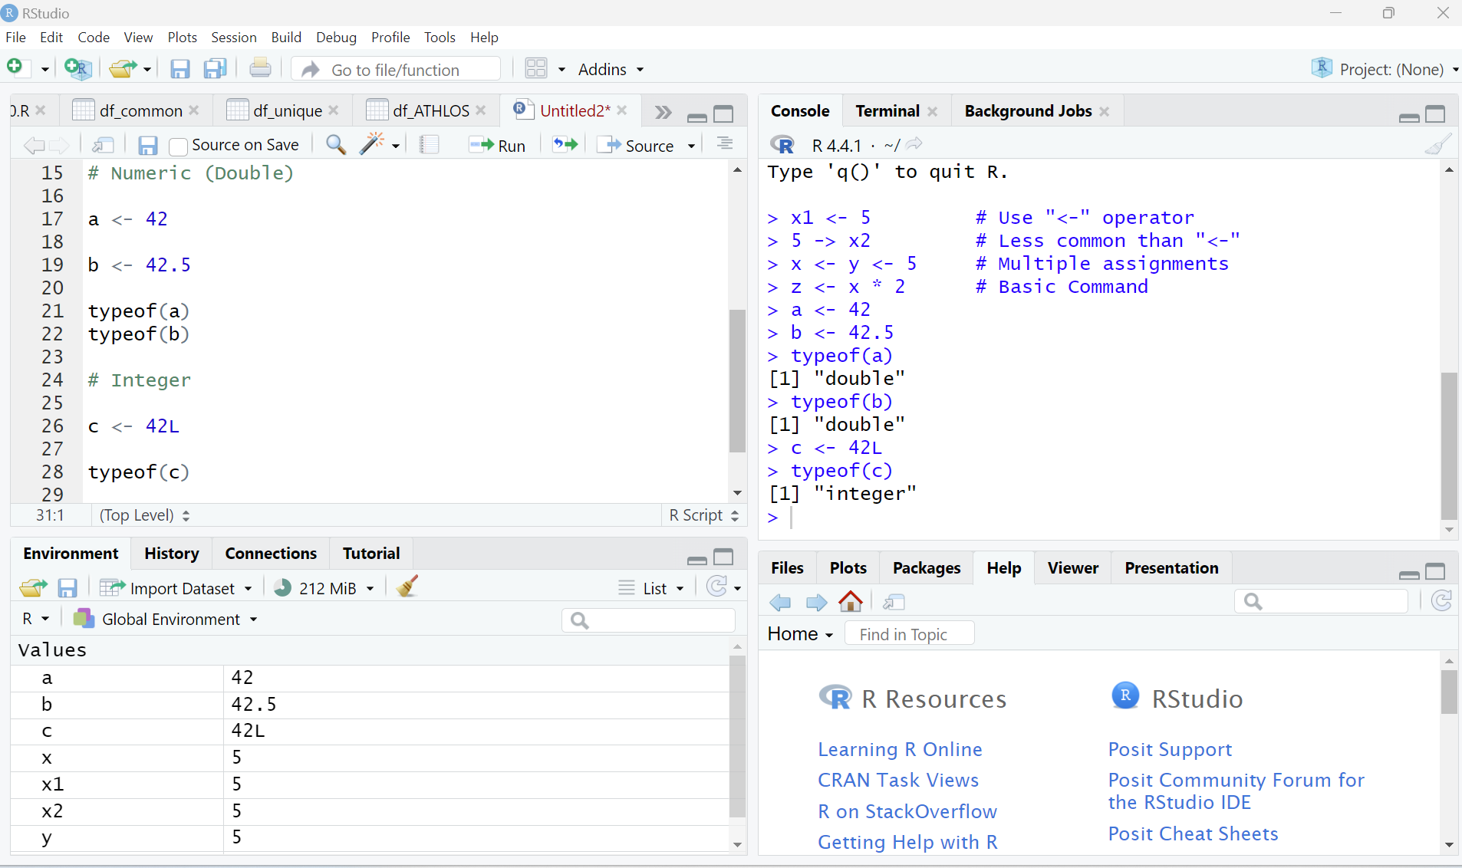
Data Types
Numeric (Double)
Integer

Slide 13
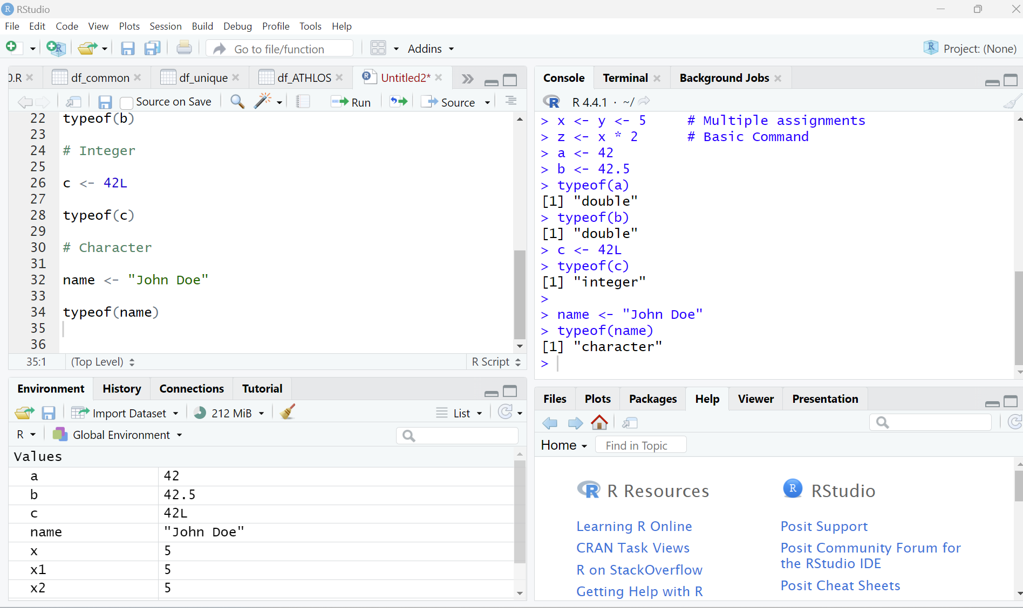
Data Types
Numeric (Double)
Integer
Character

Slide 14
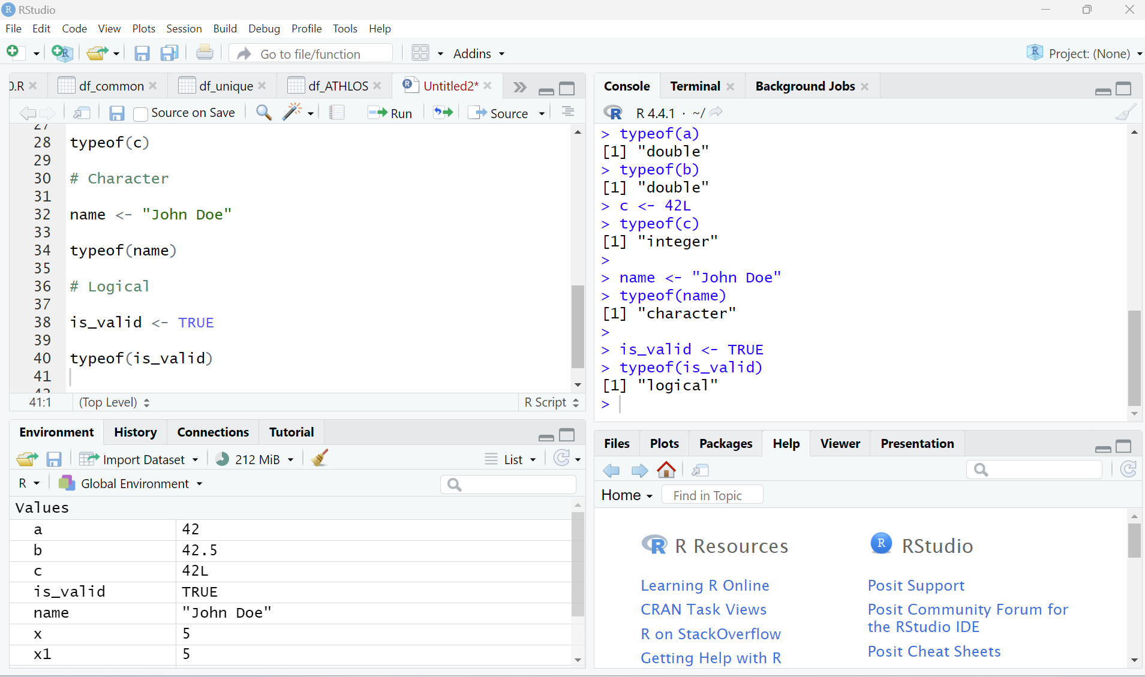
Data Types
Numeric (Double)
Integer
Character
Logical

Slide 15
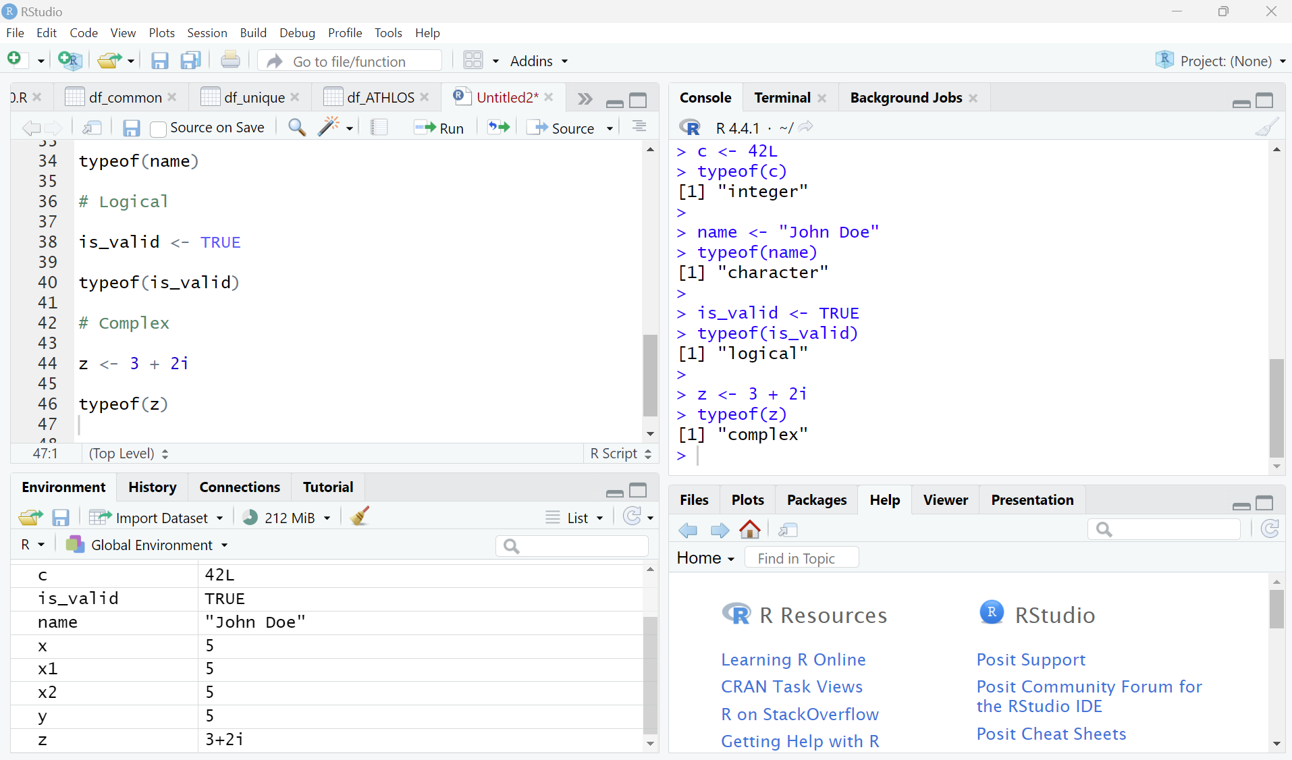
Data Types
Numeric (Double)
Integer
Character
Logical
Complex

Slide 16
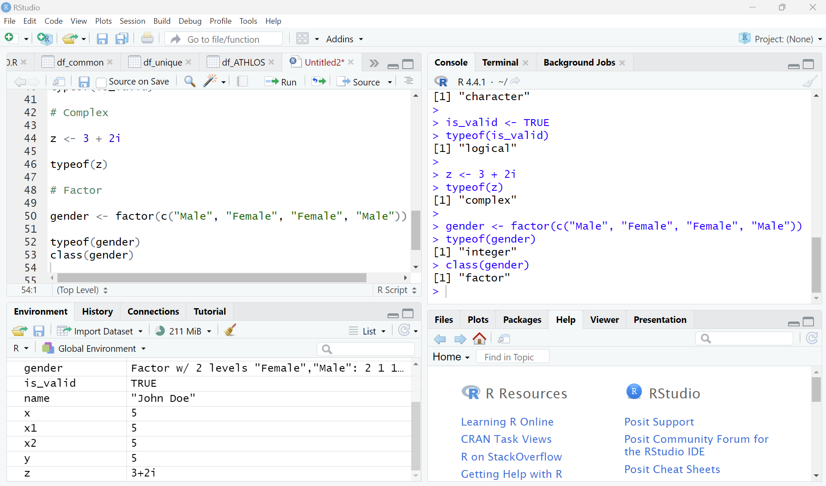
Data Types
Numeric (Double)
Integer
Character
Logical
Complex
Factor

Slide 17
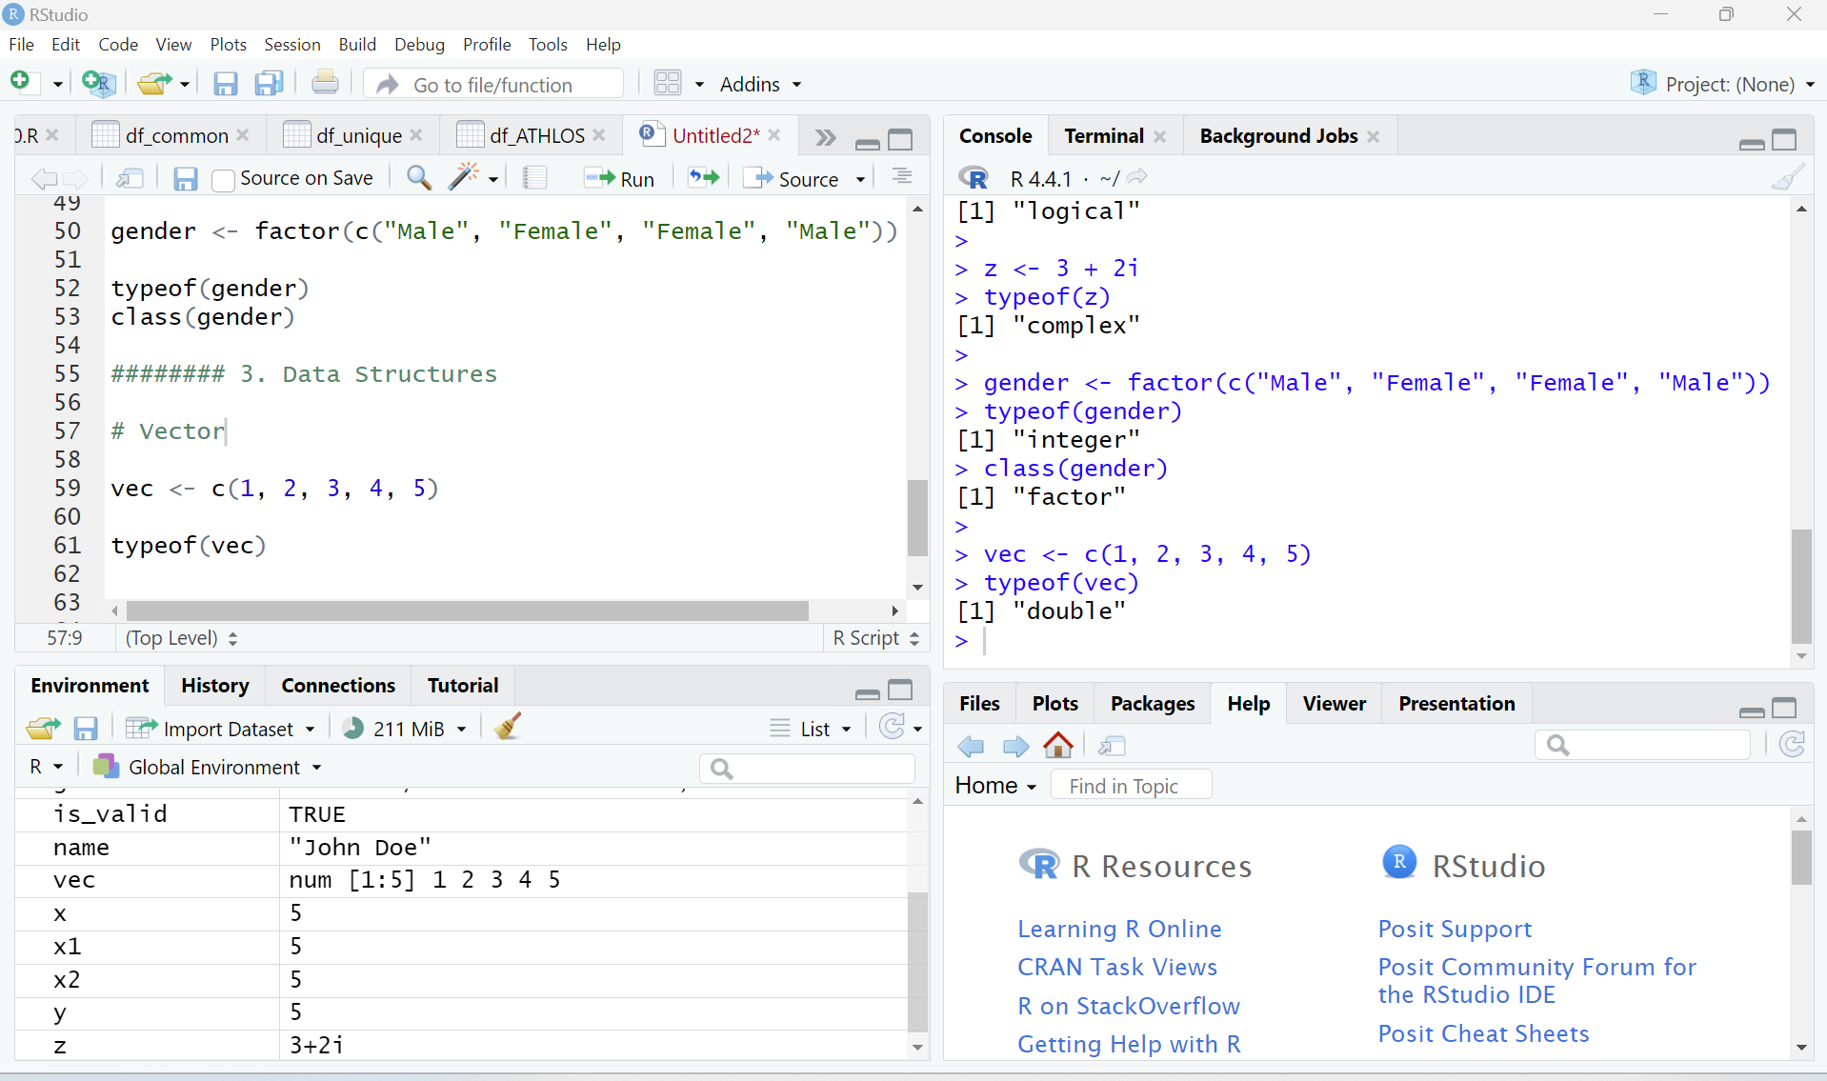
Data Structures
Vector

Slide 18
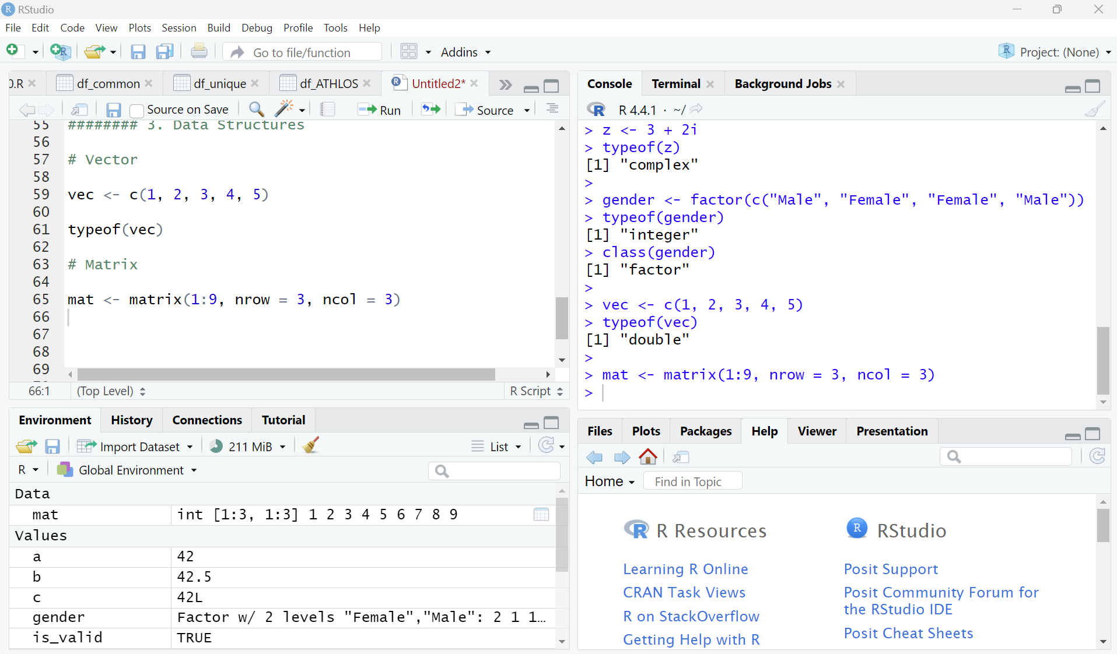
Data Structures
Vector
Matrix

Slide 19
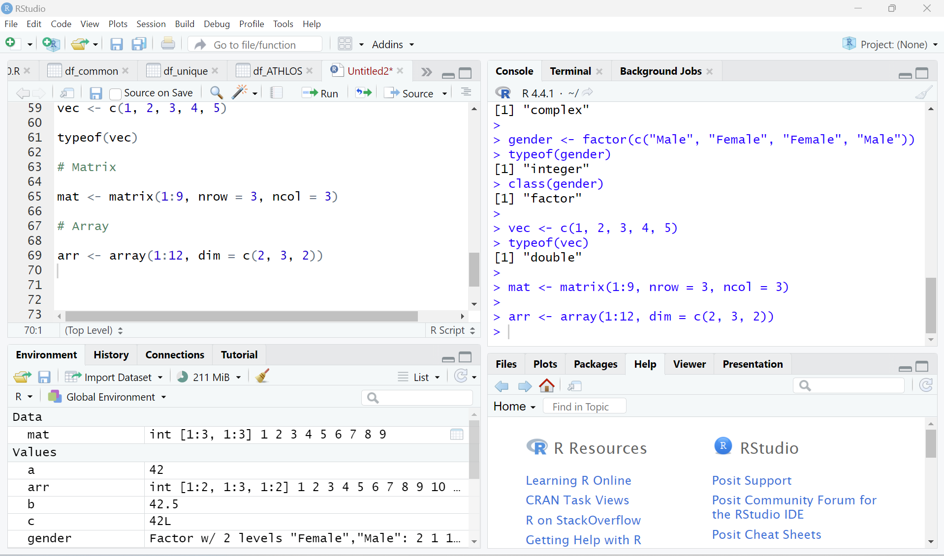
Data Structures
Vector
Matrix
Array

Slide 20
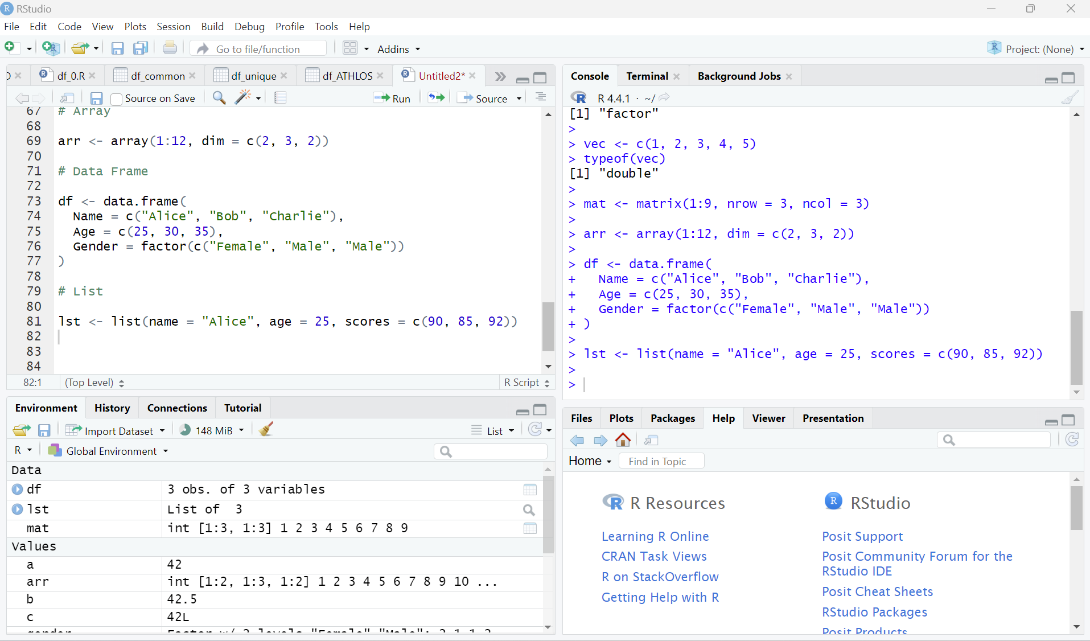
Data Structures
Vector
Matrix
Array
List

Slide 21
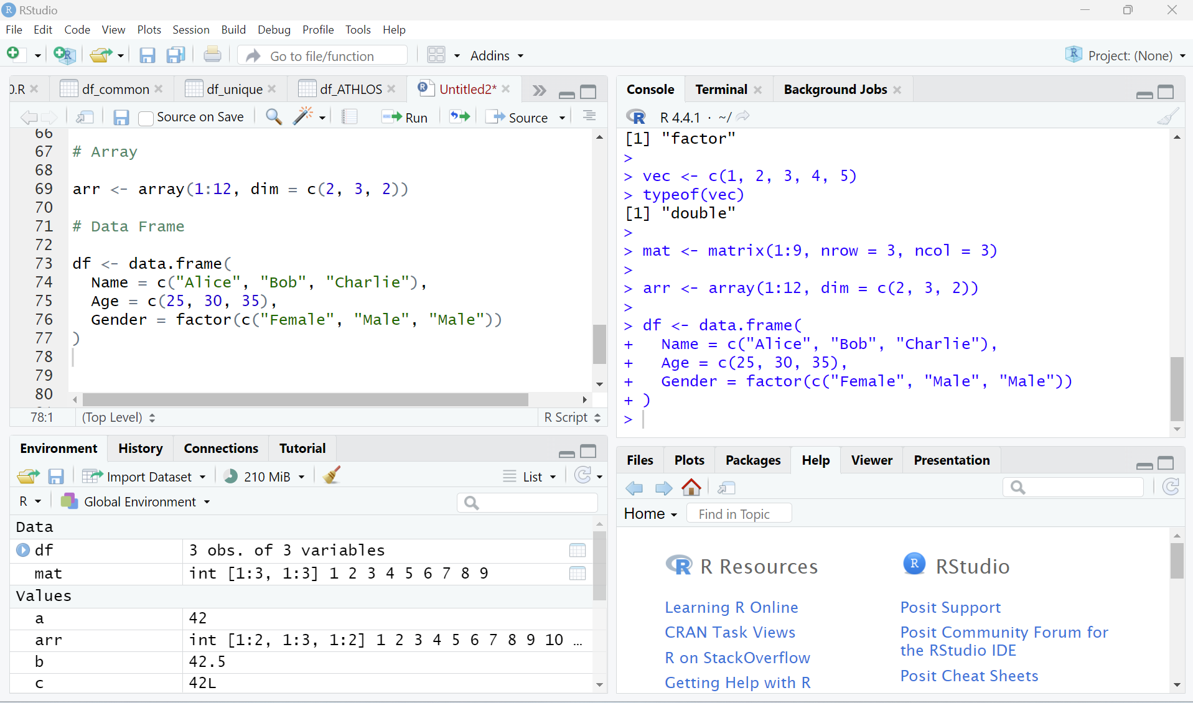
Data Structures
Vector
Matrix
Array
List
Data Frame

Slide 22
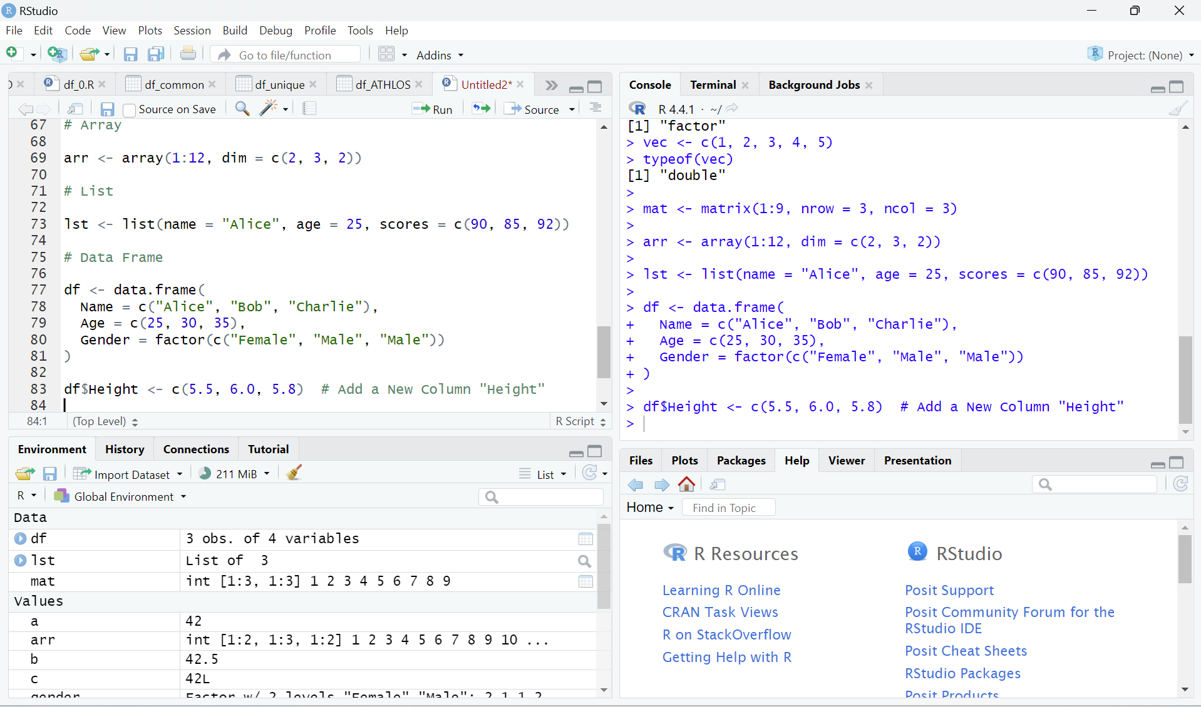
Data Structures
Vector
Matrix
Array
List
Data Frame

Slide 23
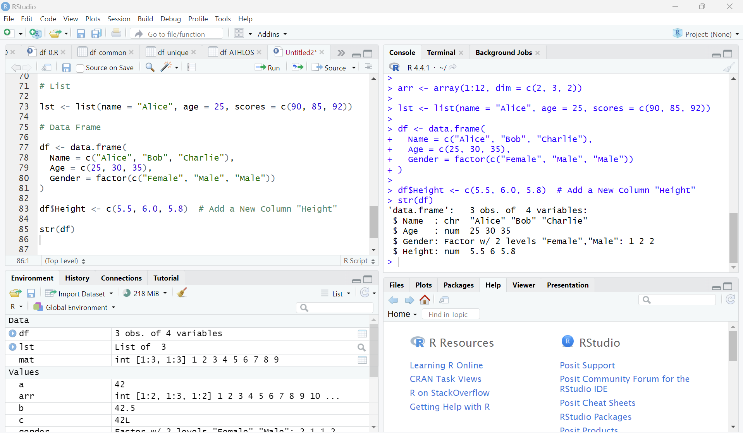
Data Structures
Vector
Matrix
Array
List
Data Frame

Slide 24
Data Structures
Vector
Matrix
Array
List
Data Frame
Factor

Slide 25
Thank You!

