Slide 1
Expectation And Variance of Random Variables
Farrokh Alemi Ph.D.
Notes:
This lecture was organized by Farrokh Alemi and is based on the book OpenIntro Statistics.

Slide 2
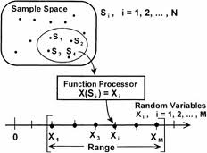
Random Variable
Notes:
A random variable assigns numerical values to events within the sample space.

Slide 3
Probability of Random Variable
Notes:
The random variable X is shown as capital X. The probability that the random variable X has the value X sub I is shown here.

Slide 4
Expected Value
Notes:
The expected value of a random variable is shown as the function E evaluated for the random variable X.

Slide 5
Expected Value
Notes:
The expected value of a discrete random variable is calculated summing product of the probability of the event times the value of the event.

Slide 6
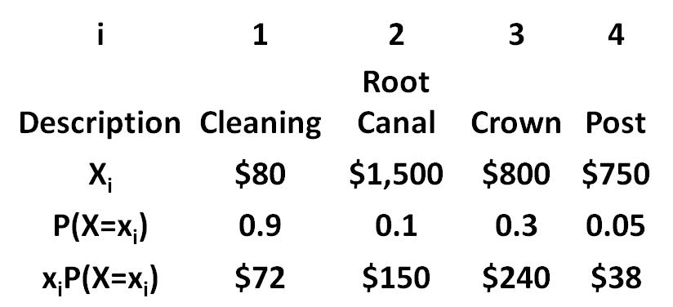
Dental Service
Notes:
In this example, the charges for cleaning, root canal, crown and post are shown for a dental clinic. The probability of a patient needing any one of these services is also shown. What is the average revenue per patient to this dental service. Note that the probabilities of these events do not add up to 1 as some of these events may occur together, so one might have cleaning and a crown.

Slide 7
Dental Service
Notes:
The expected value can be calculated by summing the product of the value of the event times its probability.

Slide 8
Dental Service
Notes:
Expected contribution of cleaning is 72 dollars.

Slide 9
Dental Service
Notes:
Root canal contributes $150 to the cost of an average patient.

Slide 10
Dental Service
Notes:
The contribution of crown is $240.

Slide 11
Dental Service
Notes:
The expected cost is the sum of each of the contributions.

Slide 12
Dental Service
Notes:
The expected cost for an average patient is $500.

Slide 13
Bookstore Revenues
Notes:
A bookstore is expecting to sell the required textbook to 80% of the students and an additional guide to 25% of the buyers. Note that the events have been arranged so that the probabilities sum to one. 55% buy just the required book and 25% buy both the book and the guide. The expected cost for an average student can now be calculated by multiplying the dollar amount of sales with the probability of that sale.

Slide 14
Bookstore Revenues
Notes:
Think of the expected value as a point that would balance the probability distribution of the events. For the bookstore example this occurs at $117.85

Slide 15
Variance
Notes:
The variance of random variable X is shown as sigma squared

Slide 16
Variance
Mean
Notes:
And is equal to difference of the value of the event and meu, the mean or the expected value of the random variable

Slide 17
Variance
Probability of the event
Notes:
Times the probability of the event.

Slide 18
Variance
Notes:
In the bookstore example, we start with calculating the expected sales. We multiply the sales by the probability of the sale and add them up to get 117.85

Slide 19
Variance
Notes:
Next we subtract from each value its expected value.

Slide 20
Variance
Notes:
Next we square these differences.

Slide 21
Variance
Notes:
Finally we multiply the squared differences by the probability of sales and add them up to get 3659.3

Slide 22
Variance
Notes:
The squared root of variance is the standard deviation.

Slide 23
Expected Value of Combinations
Notes:
In independent events, expected value of combination of variables is the proportional sum of expected value of each component.

Slide 24
Variance of Linear Combination
Notes:
In independent events, variance of the combination of random variables is the square of the proportion of the variables times the variance of each variable.

Slide 25
Take Home Lesson
Expected Value of a random variable is the sum of the events weighted by probability of the events

Slide 26
Do One
10% of employees have no health costs, 90% have $300 outpatient costs and 1% have $20,000 hospitalization costs. What is the average health care cost of our employees?
Notes:
See if you can answer this question

