Slide 1
Estimating Remaining Days of Life

Slide 2
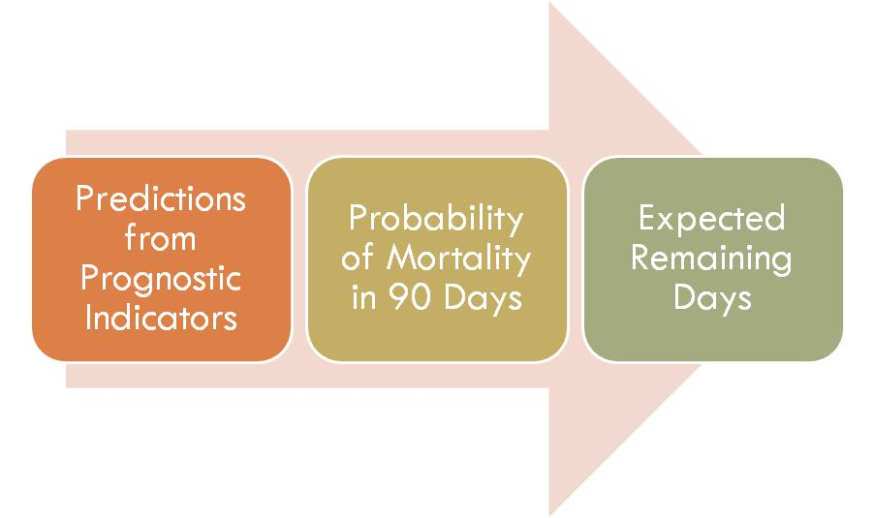
“Doc, how long I have to live?”

Slide 3
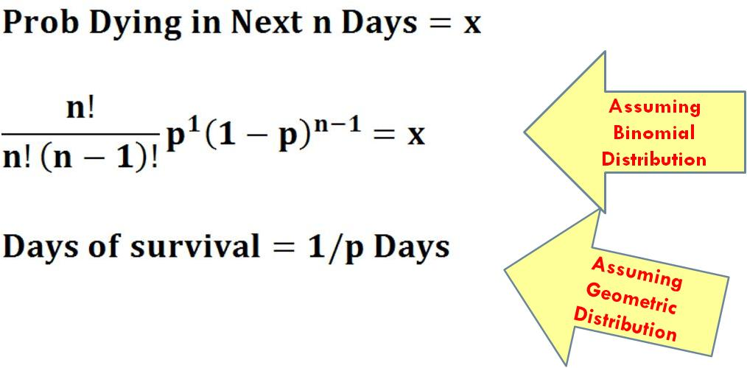
From Probability to Days

Slide 4
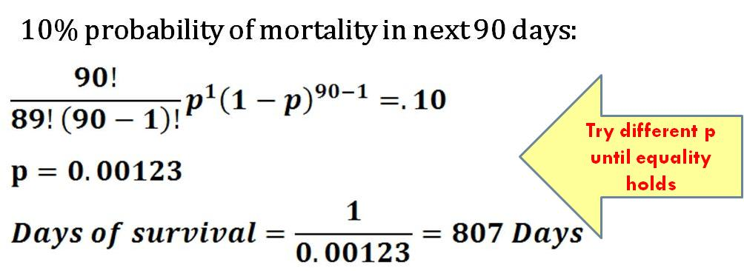
Example

