Slide 1

Nursing Home Falls Control Chart
Problem Statement: Assume that following data were obtained about number of falls in a Nursing Home facility. Produce a control chart and interpret the findings. Except for the data, all cell values should be calculated as a formula. If you change the data, then all calculations, including the plot, should change automatically.
For this problem we want to use a p-chart. This is appropriate because the statistic of interest is the rate of falls among nursing home patients.
(Note that if we wanted a control chart of the number of falls we would use an Xbar chart.)
Step 1: Calculate Grand p and n
- Calculate the rate of falls per time period, p
- Calculate the ‘grand average’ of p
- Calculate the number of cases on which p is based.
Notes:
Stone (2009).
Austin
Our analysis is based on a study done of the Mayo Clinic in 2009.
Physicians generally write orders during morning and afternoon rounds in which they see many patients sequentially. (click)
In the pre-CPOE world the first task is to find the chart. (click) For this study done at the Mayo Clinic, finding the chart took anywhere from 1 minute up to 30 minutes.
Why would it take so long to find a chart? [someone else might have it… or it could have been misplaced].
(Click) Medication orders are generally marked on an order sheet in the chart. Often the orders sheet is put in a bin with the unit clerk for order entry. (Click) At Mayo this took from 3 to 16 minutes.
What could happen to an order sheet?
(Click) The next step is for the unit clerk to enter the order. If there are questions they have to call the physician for clarification. (Click) At Mayo the time from when the order was dropped off to getting it entered was 51 minutes.
Why do you think it took 51 minutes to enter an order?

Slide 2
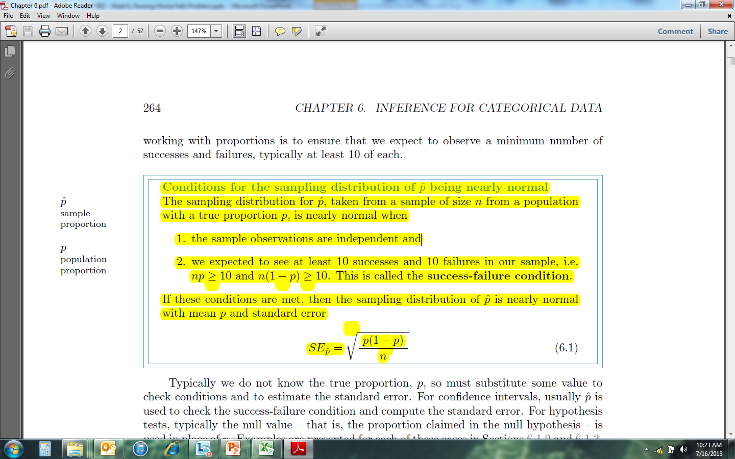
Nursing Home Falls Control Chart
Problem Statement: Assume that following data were obtained about number of falls in a Nursing Home facility. Produce a control chart and interpret the findings. Except for the data, all cell values should be calculated as a formula. If you change the data, then all calculations, including the plot, should change automatically.
Step 2: Check Assumptions
Sample observations are independent – Knowing that one person fell does not give any intuition as to whether someone else will fall.
Success / Failure Condition met?
  np = 176 * 0.3 = 53
  n(1-p) = 176 * (1-0.3) = 123
  Yes, the Success / Failure Condition is Met.
Since these conditions are met we can assume that the sampling distribution is nearly normal.
Notes:
Stone (2009).
Austin
Our analysis is based on a study done of the Mayo Clinic in 2009.
Physicians generally write orders during morning and afternoon rounds in which they see many patients sequentially. (click)
In the pre-CPOE world the first task is to find the chart. (click) For this study done at the Mayo Clinic, finding the chart took anywhere from 1 minute up to 30 minutes.
Why would it take so long to find a chart? [someone else might have it… or it could have been misplaced].
(Click) Medication orders are generally marked on an order sheet in the chart. Often the orders sheet is put in a bin with the unit clerk for order entry. (Click) At Mayo this took from 3 to 16 minutes.
What could happen to an order sheet?
(Click) The next step is for the unit clerk to enter the order. If there are questions they have to call the physician for clarification. (Click) At Mayo the time from when the order was dropped off to getting it entered was 51 minutes.
Why do you think it took 51 minutes to enter an order?

Slide 3
Nursing Home Falls Control Chart
Problem Statement: Assume that following data were obtained about number of falls in a Nursing Home facility. Produce a control chart and interpret the findings. Except for the data, all cell values should be calculated as a formula. If you change the data, then all calculations, including the plot, should change automatically.
Step 3: Calculate Standard Error by Time Period – Recall that for each time period...
Notes:
Stone (2009).
Austin
Our analysis is based on a study done of the Mayo Clinic in 2009.
Physicians generally write orders during morning and afternoon rounds in which they see many patients sequentially. (click)
In the pre-CPOE world the first task is to find the chart. (click) For this study done at the Mayo Clinic, finding the chart took anywhere from 1 minute up to 30 minutes.
Why would it take so long to find a chart? [someone else might have it… or it could have been misplaced].
(Click) Medication orders are generally marked on an order sheet in the chart. Often the orders sheet is put in a bin with the unit clerk for order entry. (Click) At Mayo this took from 3 to 16 minutes.
What could happen to an order sheet?
(Click) The next step is for the unit clerk to enter the order. If there are questions they have to call the physician for clarification. (Click) At Mayo the time from when the order was dropped off to getting it entered was 51 minutes.
Why do you think it took 51 minutes to enter an order?

Slide 4
Nursing Home Falls Control Chart
Problem Statement: Assume that following data were obtained about number of falls in a Nursing Home facility. Produce a control chart and interpret the findings. Except for the data, all cell values should be calculated as a formula. If you change the data, then all calculations, including the plot, should change automatically.
… Next, Calculate the control limits. Recall that we want to use the test statistic for a 95% confidence interval for each time period. This is Z=1.96.
Notes:
Stone (2009).
Austin
Our analysis is based on a study done of the Mayo Clinic in 2009.
Physicians generally write orders during morning and afternoon rounds in which they see many patients sequentially. (click)
In the pre-CPOE world the first task is to find the chart. (click) For this study done at the Mayo Clinic, finding the chart took anywhere from 1 minute up to 30 minutes.
Why would it take so long to find a chart? [someone else might have it… or it could have been misplaced].
(Click) Medication orders are generally marked on an order sheet in the chart. Often the orders sheet is put in a bin with the unit clerk for order entry. (Click) At Mayo this took from 3 to 16 minutes.
What could happen to an order sheet?
(Click) The next step is for the unit clerk to enter the order. If there are questions they have to call the physician for clarification. (Click) At Mayo the time from when the order was dropped off to getting it entered was 51 minutes.
Why do you think it took 51 minutes to enter an order?

Slide 5
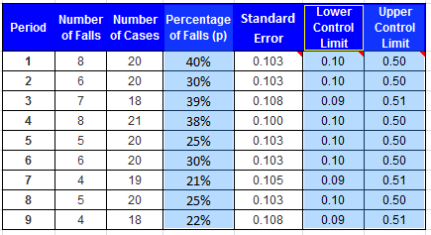
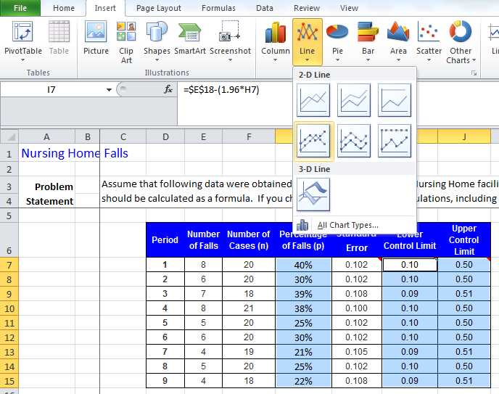
Nursing Home Falls Control Chart
Problem Statement: Assume that following data were obtained about number of falls in a Nursing Home facility. Produce a control chart and interpret the findings. Except for the data, all cell values should be calculated as a formula. If you change the data, then all calculations, including the plot, should change automatically.
Step 4: Draw the Control Chart
a) Highlight the Number of Falls, then the control limits.
b) Choose ‘Insert’ → ‘Line’ Chart …
… it produces this. Need to make it look like a control chart.
Notes:
Stone (2009).
Austin
Our analysis is based on a study done of the Mayo Clinic in 2009.
Physicians generally write orders during morning and afternoon rounds in which they see many patients sequentially. (click)
In the pre-CPOE world the first task is to find the chart. (click) For this study done at the Mayo Clinic, finding the chart took anywhere from 1 minute up to 30 minutes.
Why would it take so long to find a chart? [someone else might have it… or it could have been misplaced].
(Click) Medication orders are generally marked on an order sheet in the chart. Often the orders sheet is put in a bin with the unit clerk for order entry. (Click) At Mayo this took from 3 to 16 minutes.
What could happen to an order sheet?
(Click) The next step is for the unit clerk to enter the order. If there are questions they have to call the physician for clarification. (Click) At Mayo the time from when the order was dropped off to getting it entered was 51 minutes.
Why do you think it took 51 minutes to enter an order?

Slide 6
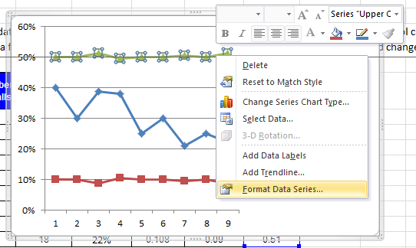
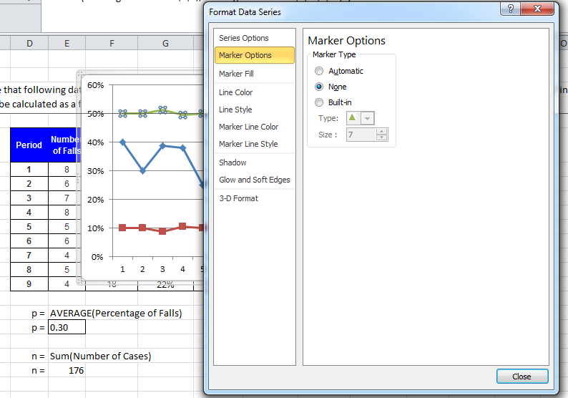
Nursing Home Falls Control Chart
Problem Statement: Assume that following data were obtained about number of falls in a Nursing Home facility. Produce a control chart and interpret the findings. Except for the data, all cell values should be calculated as a formula. If you change the data, then all calculations, including the plot, should change automatically.
Step 6: Draw the Control Chart
d) Clean up the lines – eliminate the line among the fall data and eliminate the markers along the control limits.
Highlight a line. I’ve done the UCL here.
Right Click on the line and choose ‘format data series’. Choose ‘marker options’ and highlight ‘none’. Repeat for the other control limit.
Notes:
Stone (2009).
Austin
Our analysis is based on a study done of the Mayo Clinic in 2009.
Physicians generally write orders during morning and afternoon rounds in which they see many patients sequentially. (click)
In the pre-CPOE world the first task is to find the chart. (click) For this study done at the Mayo Clinic, finding the chart took anywhere from 1 minute up to 30 minutes.
Why would it take so long to find a chart? [someone else might have it… or it could have been misplaced].
(Click) Medication orders are generally marked on an order sheet in the chart. Often the orders sheet is put in a bin with the unit clerk for order entry. (Click) At Mayo this took from 3 to 16 minutes.
What could happen to an order sheet?
(Click) The next step is for the unit clerk to enter the order. If there are questions they have to call the physician for clarification. (Click) At Mayo the time from when the order was dropped off to getting it entered was 51 minutes.
Why do you think it took 51 minutes to enter an order?

Slide 7
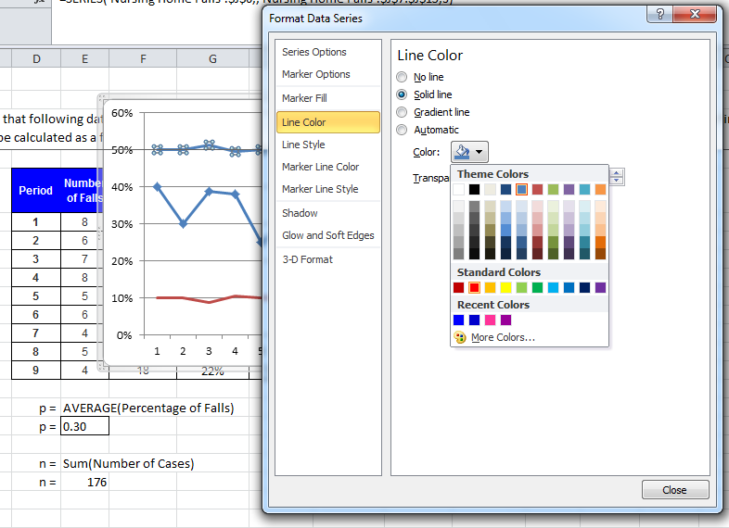
Nursing Home Falls Control Chart
Problem Statement: Assume that following data were obtained about number of falls in a Nursing Home facility. Produce a control chart and interpret the findings. Except for the data, all cell values should be calculated as a formula. If you change the data, then all calculations, including the plot, should change automatically.
Step 6: Draw the Control Chart
d) Continued…
Make both control limits red. Let’s do the UCL. Highlight the line. Choose ‘format data series’. Choose ‘Line color’, choose ‘solid line’, and choose red. Repeat for the other control limit.
This produces the following.
Notes:
Stone (2009).
Austin
Our analysis is based on a study done of the Mayo Clinic in 2009.
Physicians generally write orders during morning and afternoon rounds in which they see many patients sequentially. (click)
In the pre-CPOE world the first task is to find the chart. (click) For this study done at the Mayo Clinic, finding the chart took anywhere from 1 minute up to 30 minutes.
Why would it take so long to find a chart? [someone else might have it… or it could have been misplaced].
(Click) Medication orders are generally marked on an order sheet in the chart. Often the orders sheet is put in a bin with the unit clerk for order entry. (Click) At Mayo this took from 3 to 16 minutes.
What could happen to an order sheet?
(Click) The next step is for the unit clerk to enter the order. If there are questions they have to call the physician for clarification. (Click) At Mayo the time from when the order was dropped off to getting it entered was 51 minutes.
Why do you think it took 51 minutes to enter an order?

Slide 8
Nursing Home Falls Control Chart
Problem Statement: Assume that following data were obtained about number of falls in a Nursing Home facility. Produce a control chart and interpret the findings. Except for the data, all cell values should be calculated as a formula. If you change the data, then all calculations, including the plot, should change automatically.
Step 6: Draw the Control Chart
d) Continued…
Recall we just want one legend entry as ‘control limit’. Right now we have LCL and UCL. Double click on one and delete it. I’ve eliminated the UCL. Go to the data table and change ‘Lower Control Limit’ to ‘Control Limit’. It will change the picture.
Notes:
Stone (2009).
Austin
Our analysis is based on a study done of the Mayo Clinic in 2009.
Physicians generally write orders during morning and afternoon rounds in which they see many patients sequentially. (click)
In the pre-CPOE world the first task is to find the chart. (click) For this study done at the Mayo Clinic, finding the chart took anywhere from 1 minute up to 30 minutes.
Why would it take so long to find a chart? [someone else might have it… or it could have been misplaced].
(Click) Medication orders are generally marked on an order sheet in the chart. Often the orders sheet is put in a bin with the unit clerk for order entry. (Click) At Mayo this took from 3 to 16 minutes.
What could happen to an order sheet?
(Click) The next step is for the unit clerk to enter the order. If there are questions they have to call the physician for clarification. (Click) At Mayo the time from when the order was dropped off to getting it entered was 51 minutes.
Why do you think it took 51 minutes to enter an order?

Slide 9
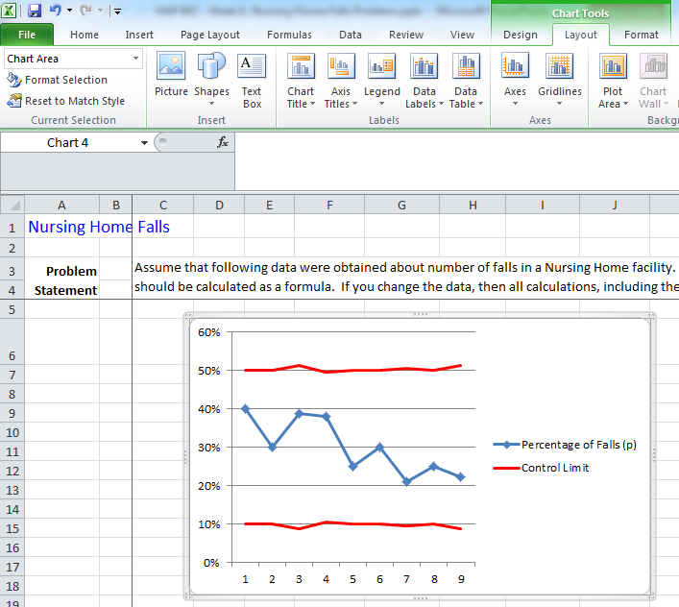
Nursing Home Falls Control Chart
Problem Statement: Assume that following data were obtained about number of falls in a Nursing Home facility. Produce a control chart and interpret the findings. Except for the data, all cell values should be calculated as a formula. If you change the data, then all calculations, including the plot, should change automatically.
Step 6: Draw the Control Chart
d) Continued…
Add a title and axis descriptions by clicking on the graph which will bring up the ‘chart tools’ menu options. Choose ‘Chart Title’ and ‘Axis Titles’ to add these.
Notes:
Stone (2009).
Austin
Our analysis is based on a study done of the Mayo Clinic in 2009.
Physicians generally write orders during morning and afternoon rounds in which they see many patients sequentially. (click)
In the pre-CPOE world the first task is to find the chart. (click) For this study done at the Mayo Clinic, finding the chart took anywhere from 1 minute up to 30 minutes.
Why would it take so long to find a chart? [someone else might have it… or it could have been misplaced].
(Click) Medication orders are generally marked on an order sheet in the chart. Often the orders sheet is put in a bin with the unit clerk for order entry. (Click) At Mayo this took from 3 to 16 minutes.
What could happen to an order sheet?
(Click) The next step is for the unit clerk to enter the order. If there are questions they have to call the physician for clarification. (Click) At Mayo the time from when the order was dropped off to getting it entered was 51 minutes.
Why do you think it took 51 minutes to enter an order?

Slide 10
Nursing Home Falls Control Chart
Problem Statement: Assume that following data were obtained about number of falls in a Nursing Home facility. Produce a control chart and interpret the findings. Except for the data, all cell values should be calculated as a formula. If you change the data, then all calculations, including the plot, should change automatically.
Notes:
Stone (2009).
Austin
Our analysis is based on a study done of the Mayo Clinic in 2009.
Physicians generally write orders during morning and afternoon rounds in which they see many patients sequentially. (click)
In the pre-CPOE world the first task is to find the chart. (click) For this study done at the Mayo Clinic, finding the chart took anywhere from 1 minute up to 30 minutes.
Why would it take so long to find a chart? [someone else might have it… or it could have been misplaced].
(Click) Medication orders are generally marked on an order sheet in the chart. Often the orders sheet is put in a bin with the unit clerk for order entry. (Click) At Mayo this took from 3 to 16 minutes.
What could happen to an order sheet?
(Click) The next step is for the unit clerk to enter the order. If there are questions they have to call the physician for clarification. (Click) At Mayo the time from when the order was dropped off to getting it entered was 51 minutes.
Why do you think it took 51 minutes to enter an order?

