Slide 1
Hierarchical Regression Model Building in R
HAP 719: Advanced Statistics I
Yili Lin

Slide 2
Introduction to Hierarchical Models
Definition (Mixed-Effects Models)
Purpose
Fixed Effects
Random Effects

Slide 3
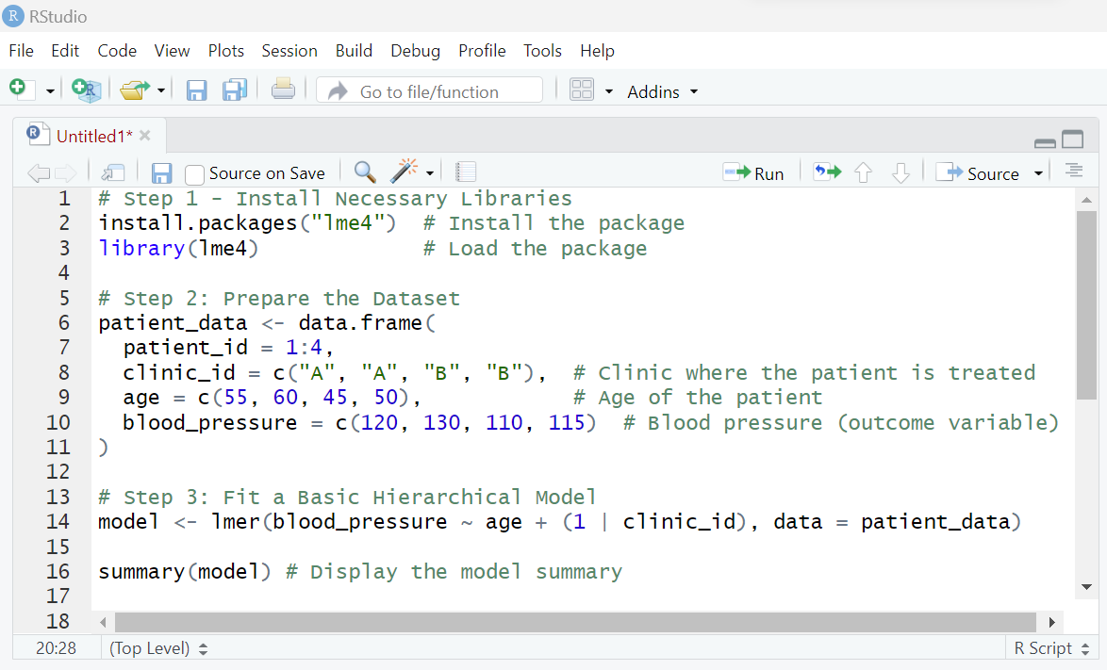
STEP1 : Install Necessary Libraries

Slide 4
STEP2: Prepare the Dataset

Slide 5
STEP2: Prepare the Dataset
patient_id | clinic_id | age | blood_pressure
1 | A | 55 | 120
2 | A | 60 | 130
3 | B | 45 | 110
4 | B | 50 | 115
patient_id: Unique identifier for each patient.
clinic_id: Clinic where the patient is treated (grouping variable).
age: Age of the patient (predictor).
blood_pressure: Blood pressure (outcome variable).

Slide 6
STEP3: Fit a Basic Hierarchical Model

Slide 7
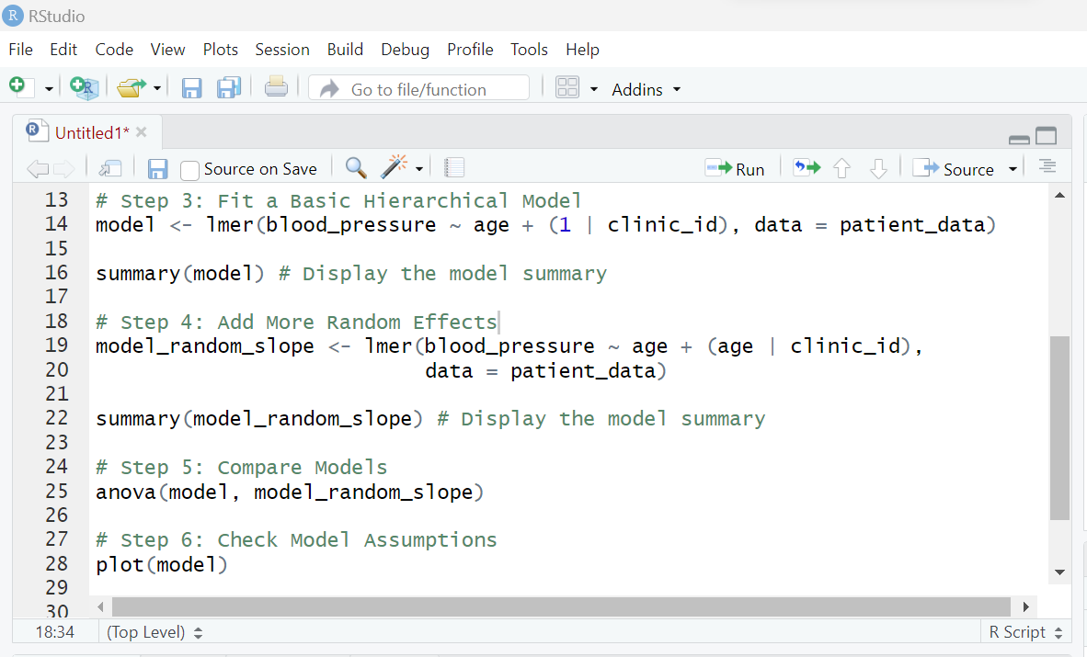
STEP4: Add More Random Effects

Slide 8
STEP5: Compare Models

Slide 9
STEP6: Check Model Assumptions
Linearity
Homoscedasticity
Normality of residuals

Slide 10
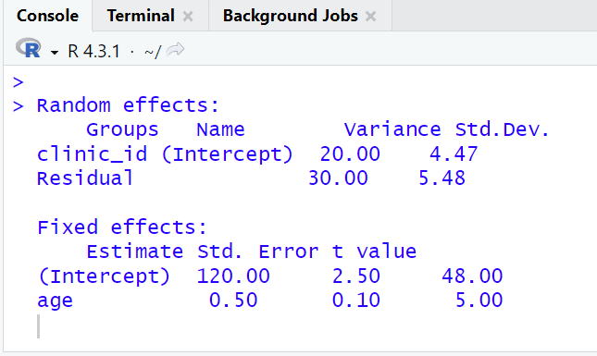
STEP7: Interpreting the Output

Slide 11
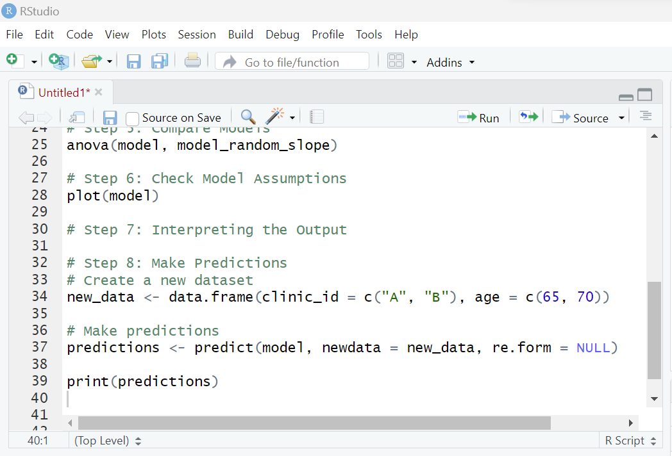
STEP8: Make Predictions

Slide 12
Summary of Key Concepts
Fixed effects
Random effects
Random intercepts
Random slopes
Likelihood ratio test

Slide 13
Thank You!

