Slide 1
How to Download R & RStudio
HAP 719: Advanced Statistics I
Yili Lin

Slide 2
What is R?
Definition
Key Features

Slide 3
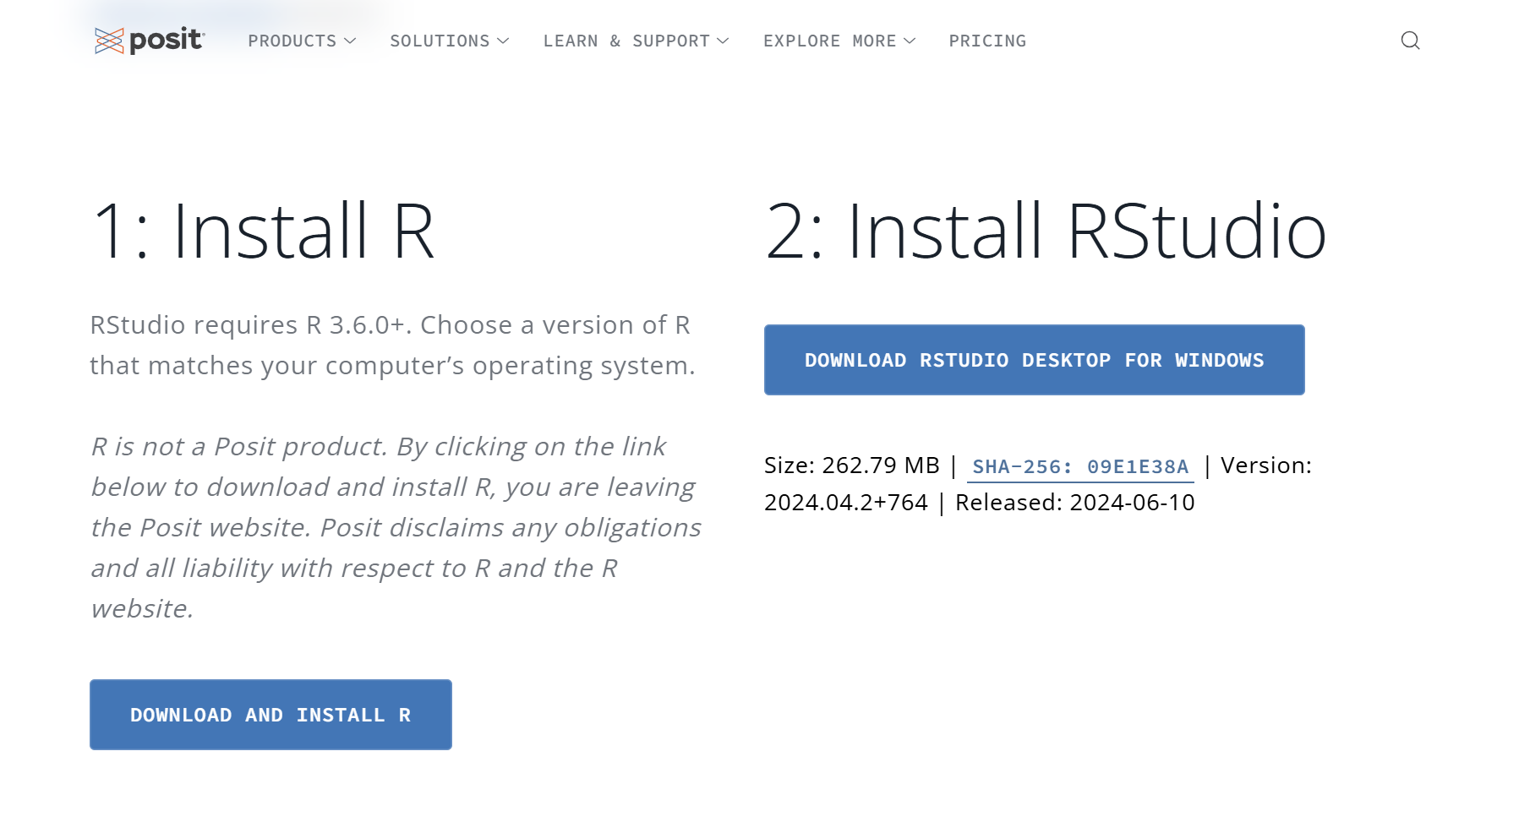
Installing R and RStudio
Go to: RStudio Desktop - Posit

Slide 4
Troubleshooting
Download Issues
Installation Errors
Missing Dependencies or Libraries
R Version Not Found
Permission Issues
RStudio Not Detecting R
Incompatible R Packages
CRAN Mirror Issues

Slide 5
Thank You!

