Slide 1
How to Read Data in R
HAP 719: Advanced Statistics I
Yili Lin

Slide 2
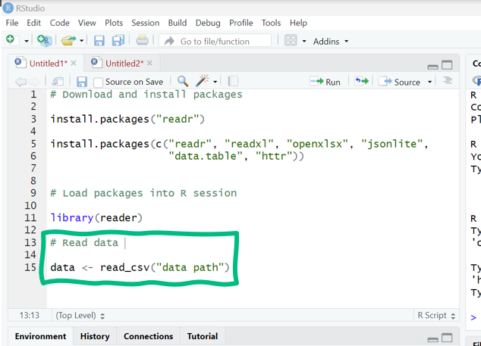
R Packages & Libraries
1. Packages Installing
2. Libraries Loading
3. Essential R Packages for Reading Data

Slide 3
Common Problems in Reading Data
Incorrect File Path: `file.choose()`
Unsupported File Format: `read.csv()`, `readxl`
Header Issues: header=TRUE
Missing or NA Values: na.strings
Data Type Mismatch: colClasses
Large File Sizes: `fread()`
Inconsistent Data
Special Characters and Quotes

Slide 4
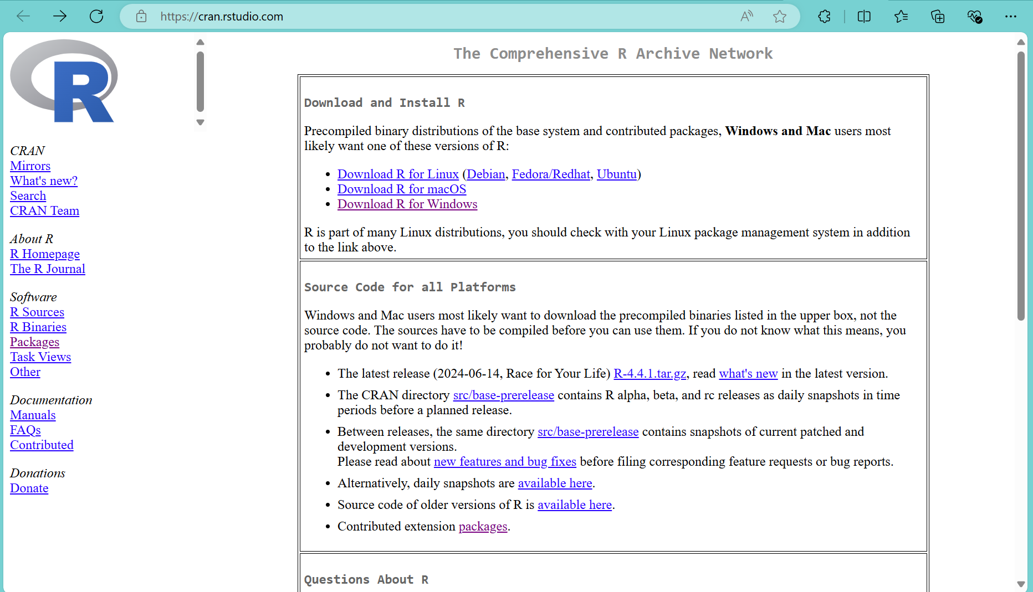
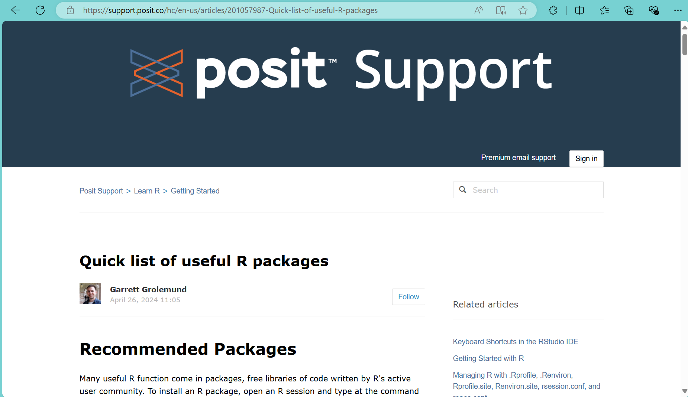
Resources for Free Packages
The Comprehensive R Archive Network (rstudio.com)
Quick list of useful R packages – Posit Support

Slide 5
Thank You!

