Slide 1
Adjusting for Interactions
Farrokh Alemi Ph.D.
4/18/2024
Notes:
This brief presentation was organized by Dr. Alemi.

Slide 2
Key Assumptions & Concepts
Transform the independent variables
Binary or rescaled to range between 0 and 1
Monotone,
Positively related to outcome Y
No order violations
Notes:
The search method works only if the independent variables are transformed to meet these conditions. All independent variables should be either binary or range between 0 and 1. If not, one can use Max/Min transformations so that all variables range between 0 and 1. All independent variables should be monotone and positively related to outcome Y. When they do not, variables should be redefined so that they do. For example of age is not monotonely related to outcome Y, then age is split into two variables so that it is. If a variable is not positively related to outcome, then the variable is redefined so it does. For example, if males are inversely related to the outcome, then the variable is redefined as female so that it is positively related to the outcome. The point is that independent variables may not meet these requirements. When they do not, simple transformations, or redefining the variables, can guarantee that the independent variables meet these requirements.

Slide 3
Key Assumptions & Concepts
Transform the independent variables
Binary or rescaled to range between 0 and 1
Monotone,
Positively related to outcome Y
No order violations for shared features
A<B
BC<AC
Y
Notes:
Order violations refer to a switch in order of outcome Y for two cases where the switch is due to a shared feature. Here we have three independent variables A, B, and C. The outcome Y for case in which A is present but nothing else is present is shown as the position of letter A. We see here that the case where only A is present has a lower outcome than a case where only B is present. This order is reversed when we add a shared feature C to both cases. In the cases with shared feature C, the case with feature A has now a higher Y value than the case with feature B. This is referred to as order violation for shared features. When there is an order violation for shared features, no regression or mathematical model can capture the underlying data. These situations must be modelled as exceptions to the general model. We use this feature repeatedly in the search approach to avoid these exceptions in our analysis.

Slide 4
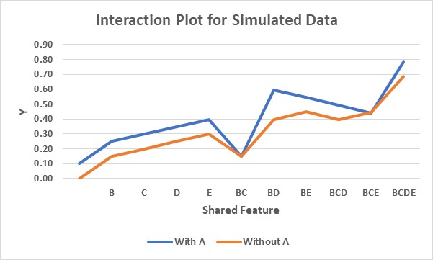
Approach to Interactions
Notes:
How do we make sense of interaction plots with lots of seeming random movement. Here we have simulated data. Note that with shared feature BC the impact of A could be non additive. Also note that the impact of shared feature BD is synergistic and increases impact of A more than observed at most shared features. What can we conclude from all of these observations?

Slide 5
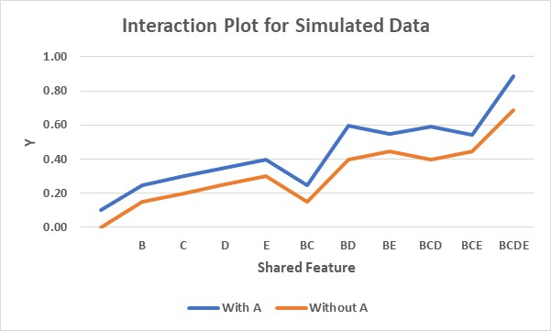
Approach to Interactions
Notes:
The adjustment for BC corrects a series of problems in the data. Using the common denominator of several points of non-linearity we identified shared BC as potential cause of non-linearity and therefore ABC interaction is one interaction term that should be in the regression equation.

Slide 6
Approach to Interactions
Notes:
Now we can identify additional interactions. There are unusual things going on with BD, BCD, and potentially BCDE. These shared features all have excess probabilities and therefore adjustment for their common denominator can correct the problem. At BD we are 0.10 points above the additive effect of A, adjusting for this we now get a different plot.

Slide 7
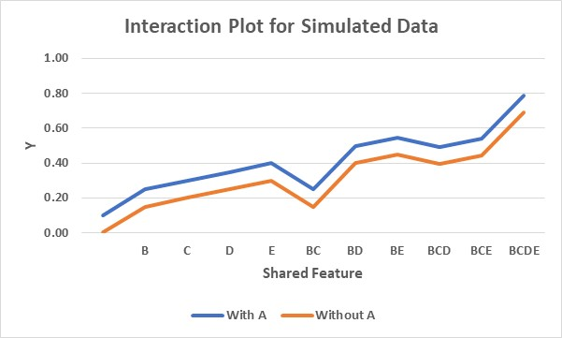
Approach to Interactions
Notes:
We now have the second interaction to include in the regression. The simulated data is fully additive and no other adjustments are needed.

Slide 8
Approach to Interactions
$$Y=β_{0}+β_{1}A+β_{2}B+β_{3}C+β_{4}D+β_{5}E$$ $+β_{16}ABC+β_{17}ABD$
Notes:
The regression equation with interaction terms is now a lot simpler and can be stated as shown here. Only two interactions of all 17 interactions are needed in the regression equation.

Slide 9
Adjustments Create Parallel Lines in the Interaction Plot
Notes:
The goal of adjustments is to create parallel lines in the interaction plot.

