Slide 1
Interpreting Logistic Regression Output in R
HAP 719: Advanced Statistics I
Yili Lin

Slide 2
Overview of Logistic Regression Output
Coefficients
2. Model Fit Metrics
Estimate (Coefficient)
Standard Error
Z value
p-value
Null Deviance
Residual Deviance
Akaike Information Criterion (AIC)

Slide 3
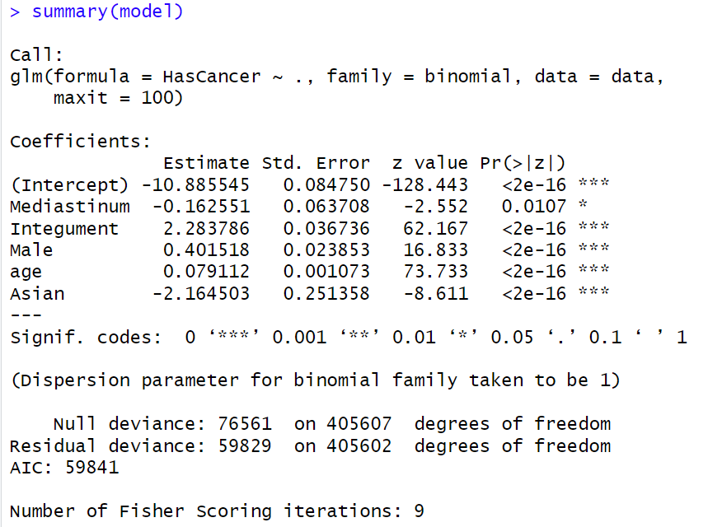
Call

Slide 4
Coefficients

Slide 5
Coefficients
Odds Ratios (OR):
OR > 1: The event is more likely as the predictor increases.
OR < 1: The event is less likely as the predictor increases.
OR = 1: No change in odds with respect to the predictor.

Slide 6
Coefficients

Slide 7
Coefficients

Slide 8
Coefficients

Slide 9
Significance Codes
*** p < 0.001 (highly significant)
** p < 0.01 (moderately significant)
* p < 0.05 (significant)
. p < 0.1 (marginally significant)
blank p ≥ 0.1 (not significant)

Slide 10
Model Fit Metrics

Slide 11
Model Fit Metrics

Slide 12
Model Fit Metrics

Slide 13
Model Fit Metrics
Pseudo R-squared (McFadden’s R²):

Slide 14
Model Fit Metrics

Slide 15
Model Fit Metrics

Slide 16
Model Fit Metrics

Slide 17
Thank You!

