Slide 1
Interpreting Ordinary Regression Output in R
HAP 719: Advanced Statistics I
Yili Lin

Slide 2
Overview of Ordinary Regression Output
Residuals
Coefficients
Significance Codes
Residual Standard Error (RSE)
R-squared and Adjusted R-squared
F-statistic
Estimate (Coefficient)
Standard Error
t-value
p-value

Slide 3
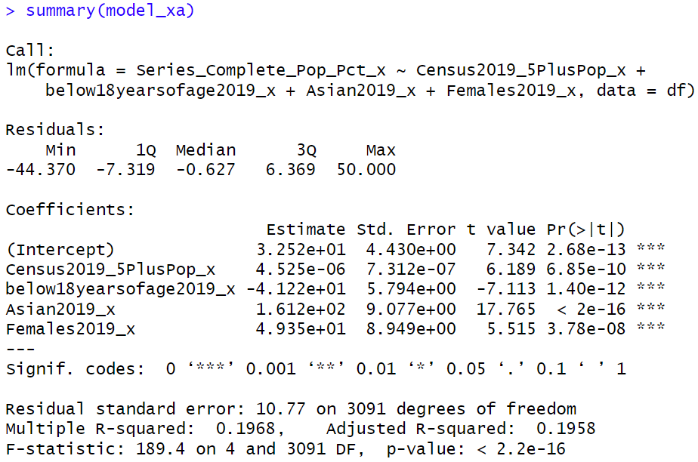
Call

Slide 4
Residuals

Slide 5
Coefficients

Slide 6
Coefficients

Slide 7
Coefficients
Formula:
$$t−value=\frac{Estimate}{Standard Error}$$

Slide 8
Coefficients

Slide 9
Significance Codes
*** p < 0.001 (highly significant)
** p < 0.01 (moderately significant)
* p < 0.05 (significant)
. p < 0.1 (marginally significant)
blank p ≥ 0.1 (not significant)

Slide 10
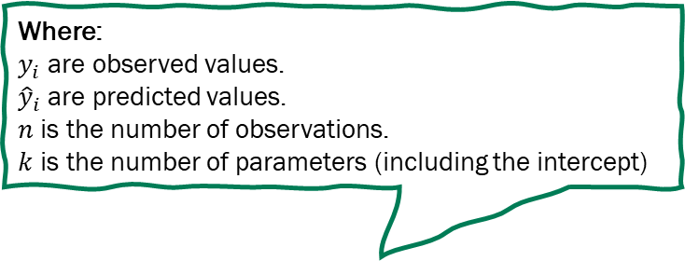
Residual Standard Error (RSE)
Where:
$y_{i}$ are observed values.
${\hat{y}}_{i}$ are predicted values.
$n$ is the number of observations.
$k$ is the number of parameters (including the intercept)

Slide 11
Multiple R-squared (R²)
Where:
${SS}_{residual}$ is the sum of squared residuals.
${SS}_{total}$ is the total sum of squares.

Slide 12
Adjusted R-squared
Where:
$n$ is the number of observations.
$k$ is the number of predictors.

Slide 13
F-statistic
Where:
${SS}_{residual}$ is the sum of squared residuals.
${SS}_{total}$ is the total sum of squares.
$n$ is the number of observations.
$k$ is the number of predictors.

Slide 14
Thank You!

