Slide 1
Introduction to Descriptive Statistics
HAP 719: Advanced Statistics I
Yili Lin

Slide 2
Why Describing Data is Important?
Data Exploration

Slide 3
Why Describing Data is Important?
Data Exploration
Identify Issues

Slide 4
Why Describing Data is Important?
Data Exploration
Identify Issues
Data-Driven Decisions

Slide 5
Why Describing Data is Important
Data Exploration
Identify Issues
Data-Driven Decisions
Communicating Results

Slide 6
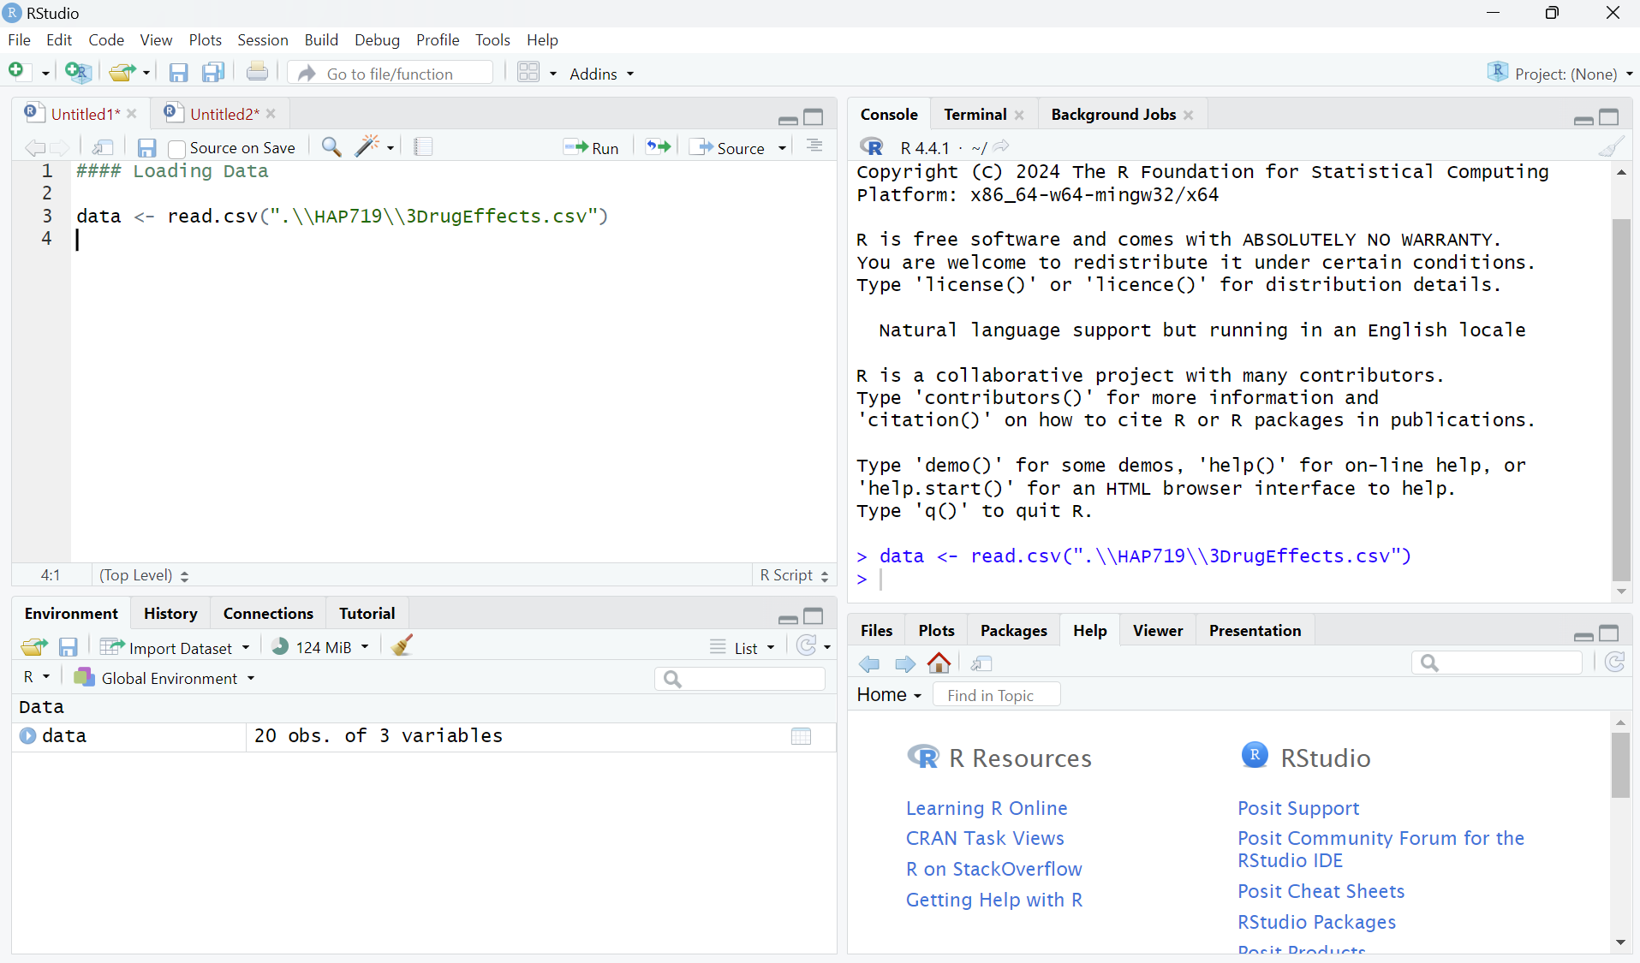
Loading and Inspecting Data
Loading Data

Slide 7
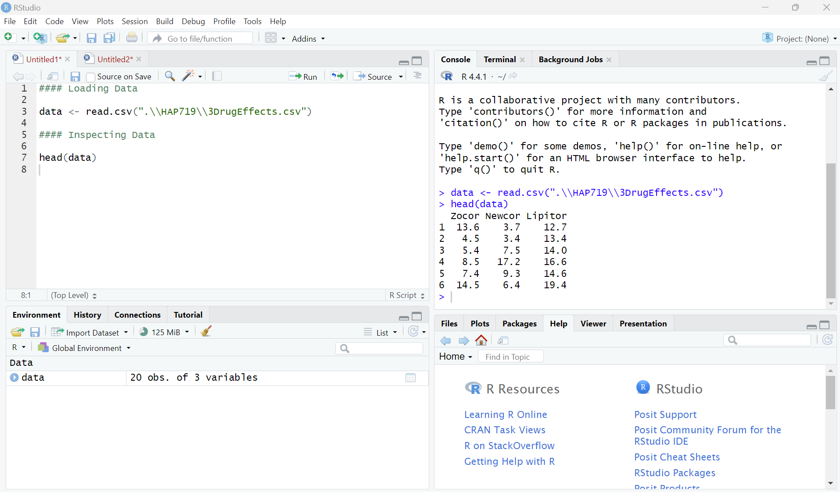
Loading and Inspecting Data
Loading Data
Inspecting Data

Slide 8
Basic Descriptive Statistics
Purpose

Slide 9
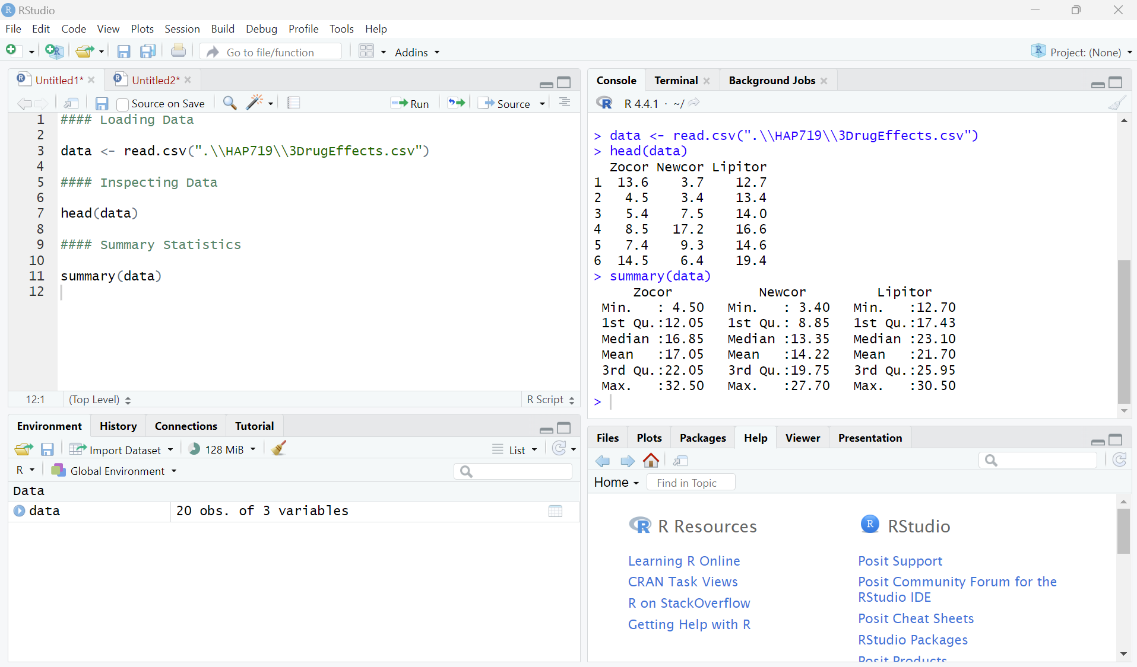
Basic Descriptive Statistics
Purpose
2. Key Functions
Summary Statistics

Slide 10
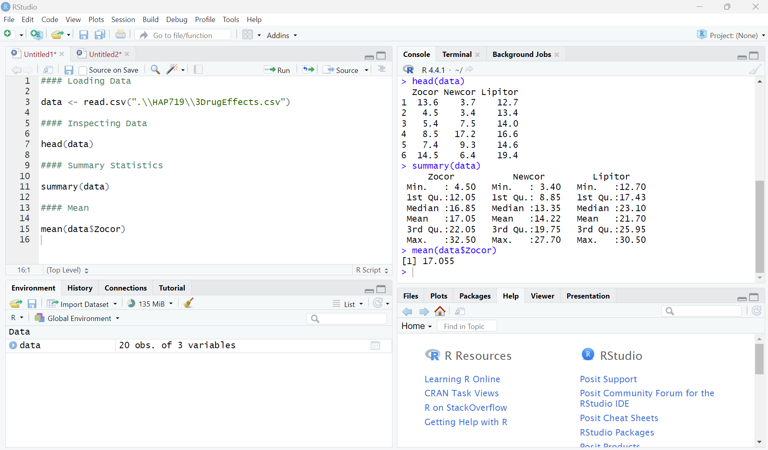
Basic Descriptive Statistics
Purpose
2. Key Functions
Summary Statistics
Mean

Slide 11
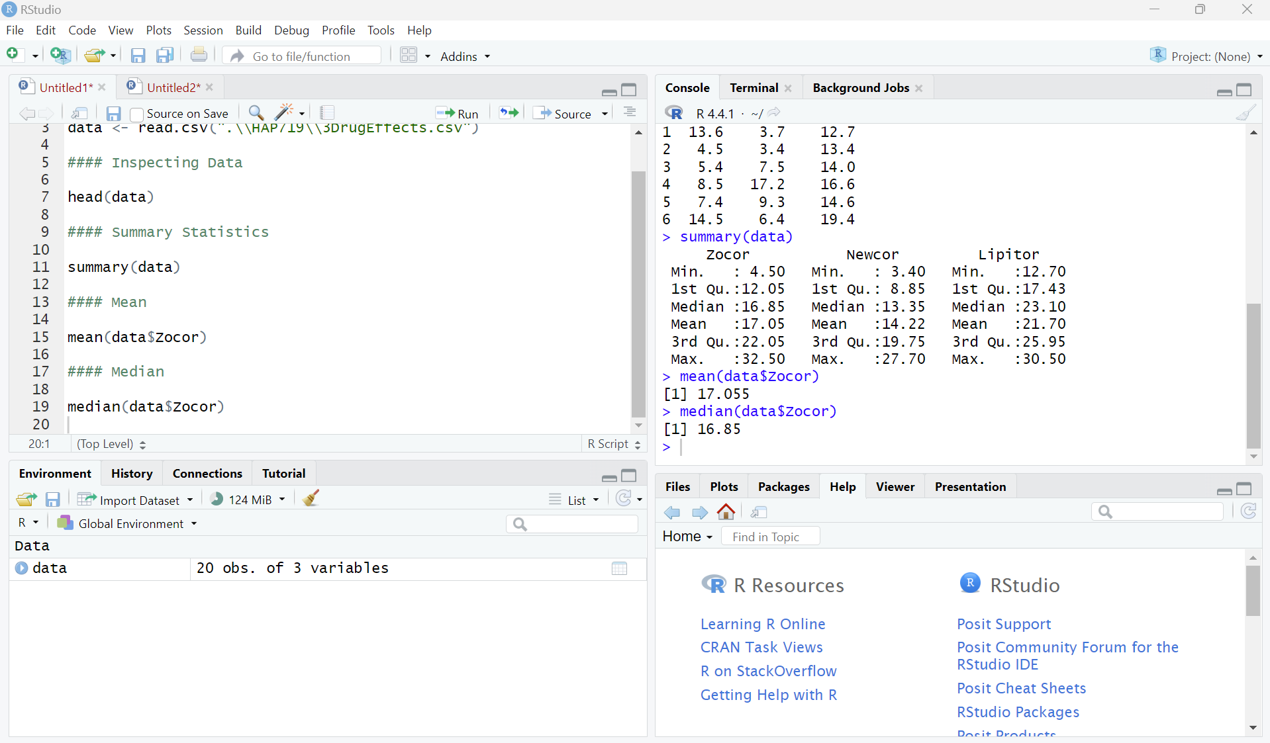
Basic Descriptive Statistics
Purpose
2. Key Functions
Summary Statistics
Mean
Median

Slide 12
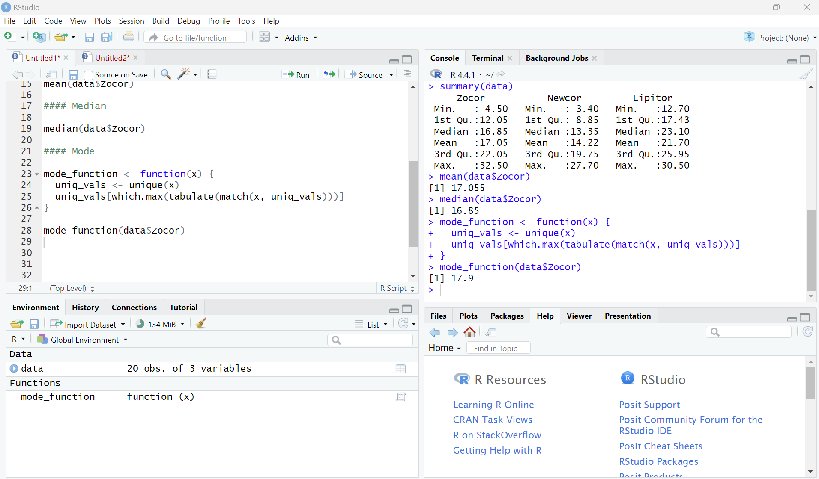
Basic Descriptive Statistics
Purpose
2. Key Functions
Summary Statistics
Mean
Median
Mode

Slide 13
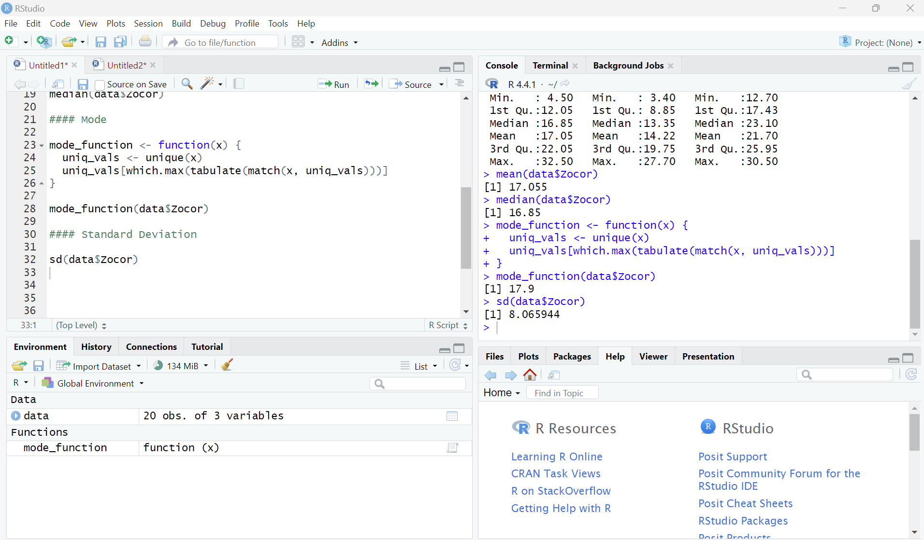
Basic Descriptive Statistics
Purpose
2. Key Functions
Summary Statistics
Mean
Median
Mode
Standard Deviation

Slide 14
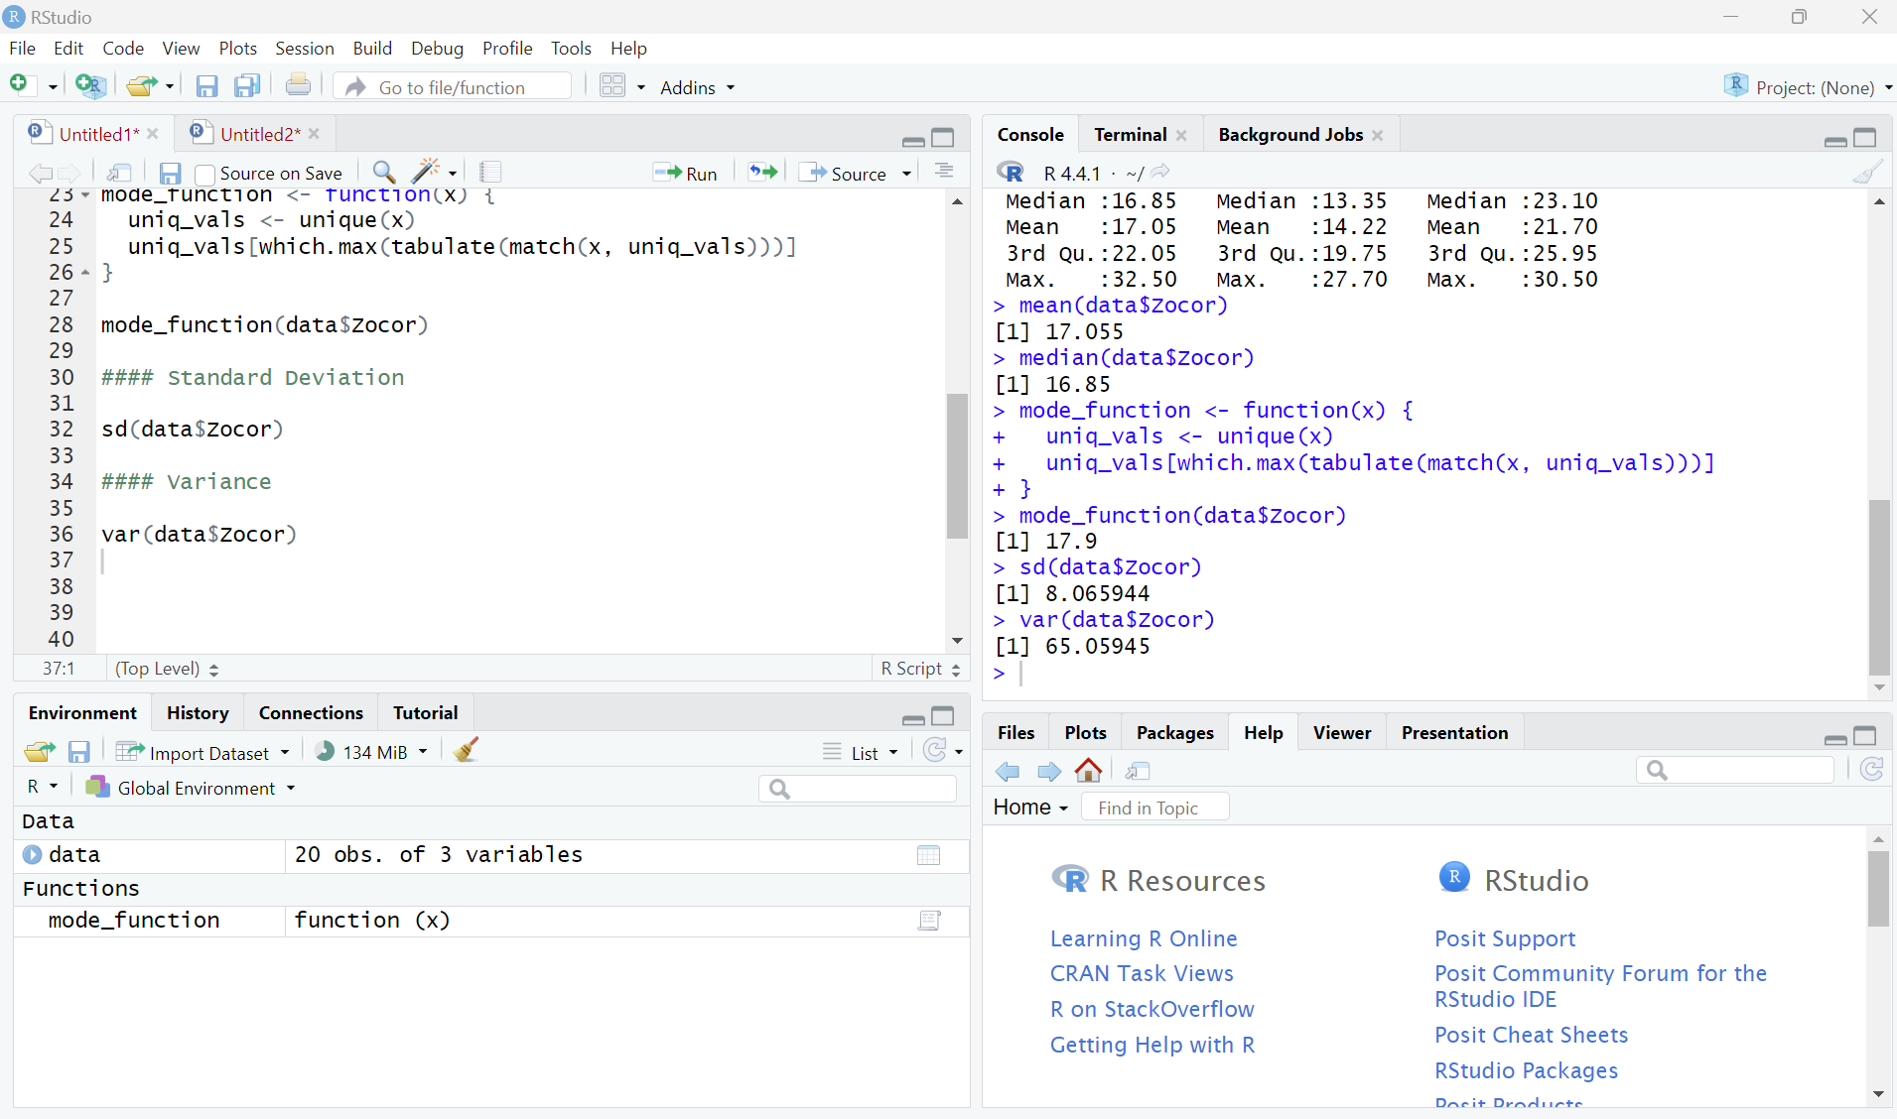
Basic Descriptive Statistics
Purpose
2. Key Functions
Summary Statistics
Mean
Median
Mode
Standard Deviation
Variance

Slide 15
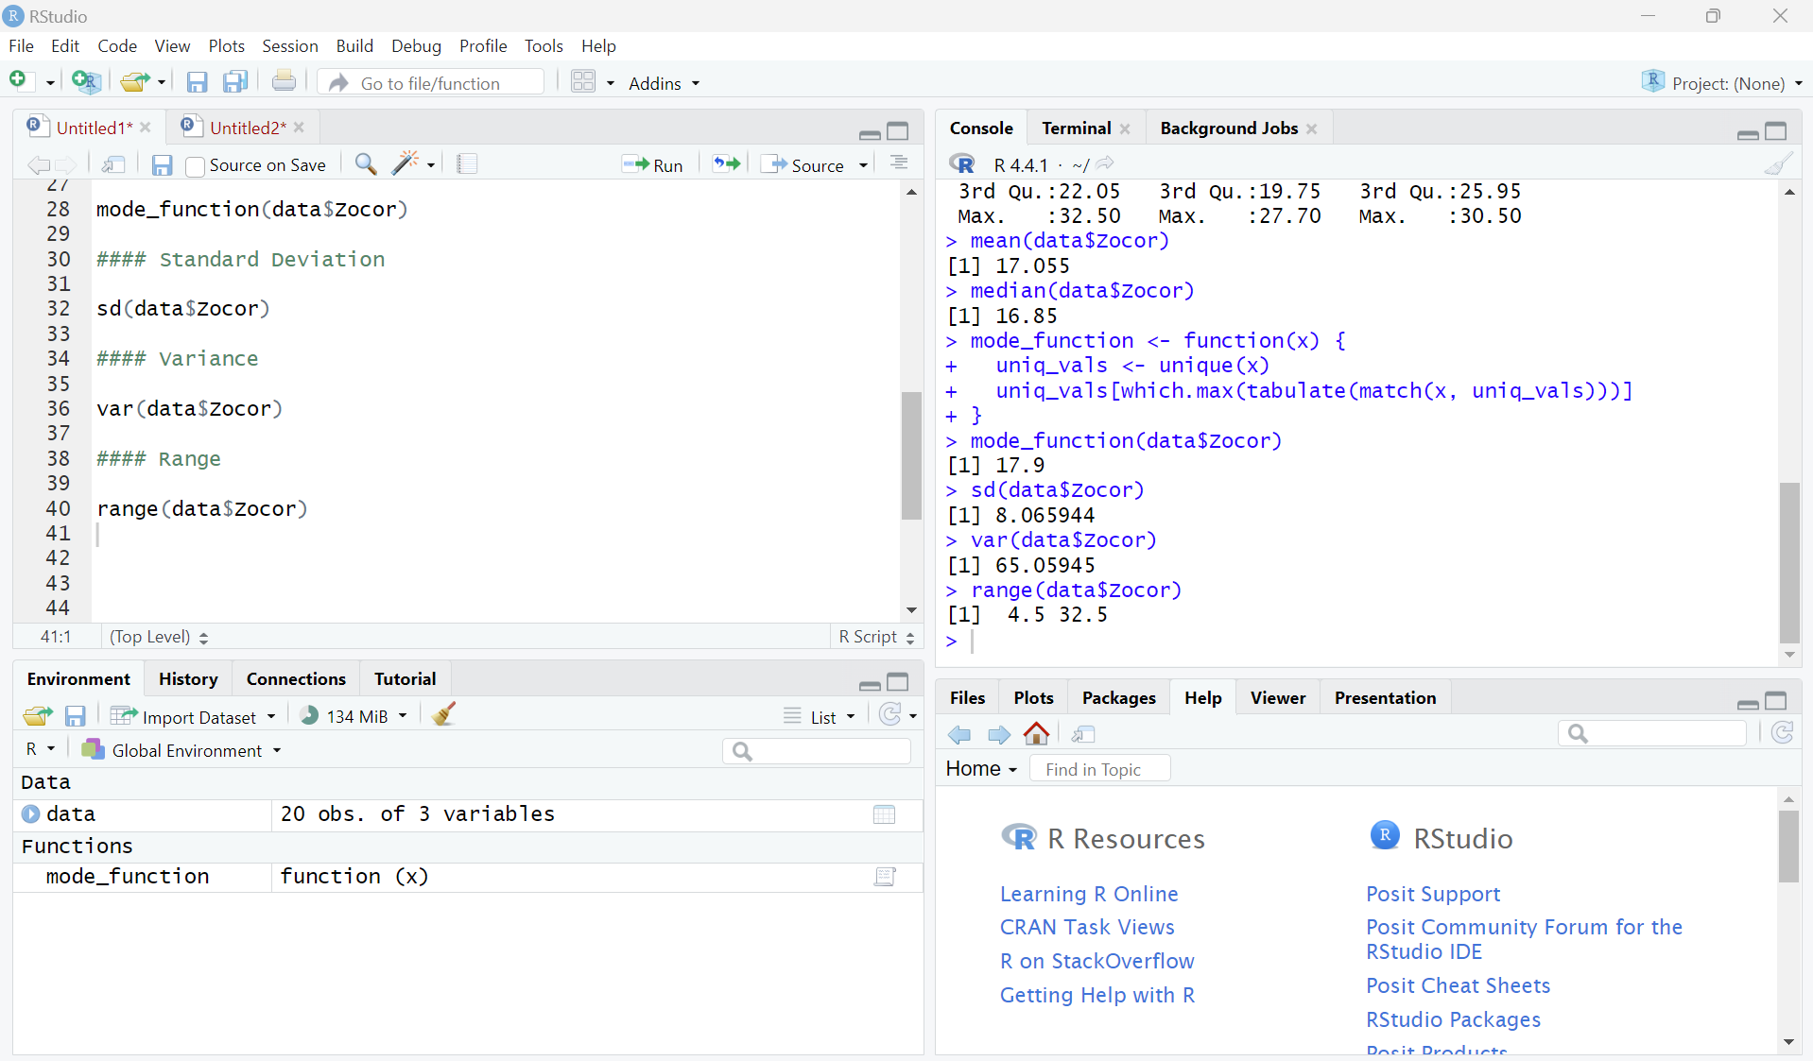
Basic Descriptive Statistics
Purpose
2. Key Functions
Summary Statistics
Mean
Median
Mode
Standard Deviation
Variance
Range

Slide 16
Describing Categorical Data
Purpose

Slide 17
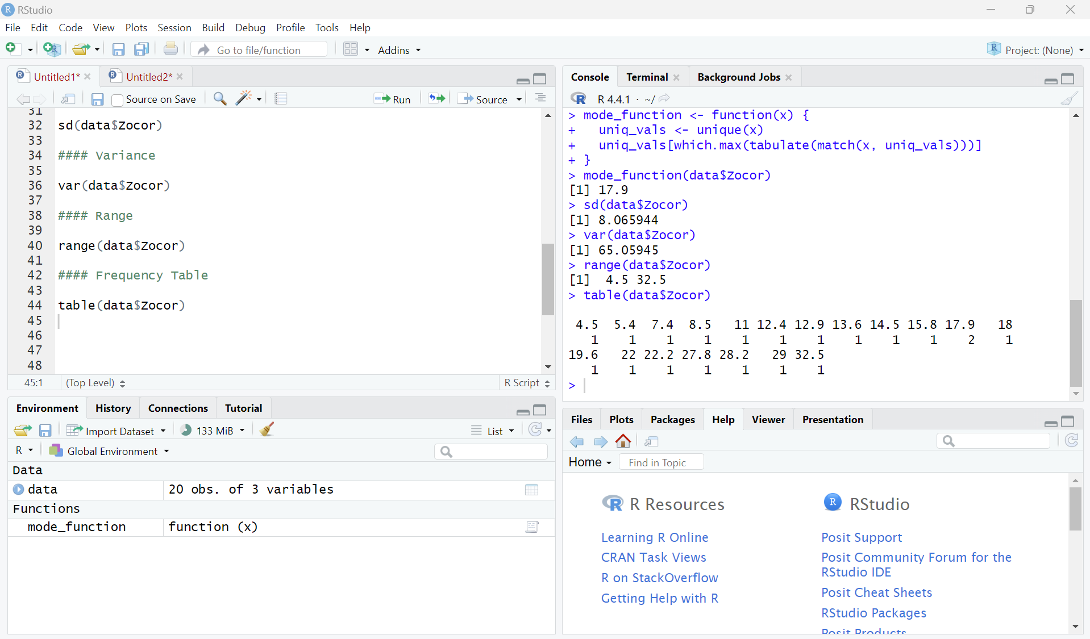
Describing Categorical Data
Purpose
2. Key Functions
Frequency Table

Slide 18
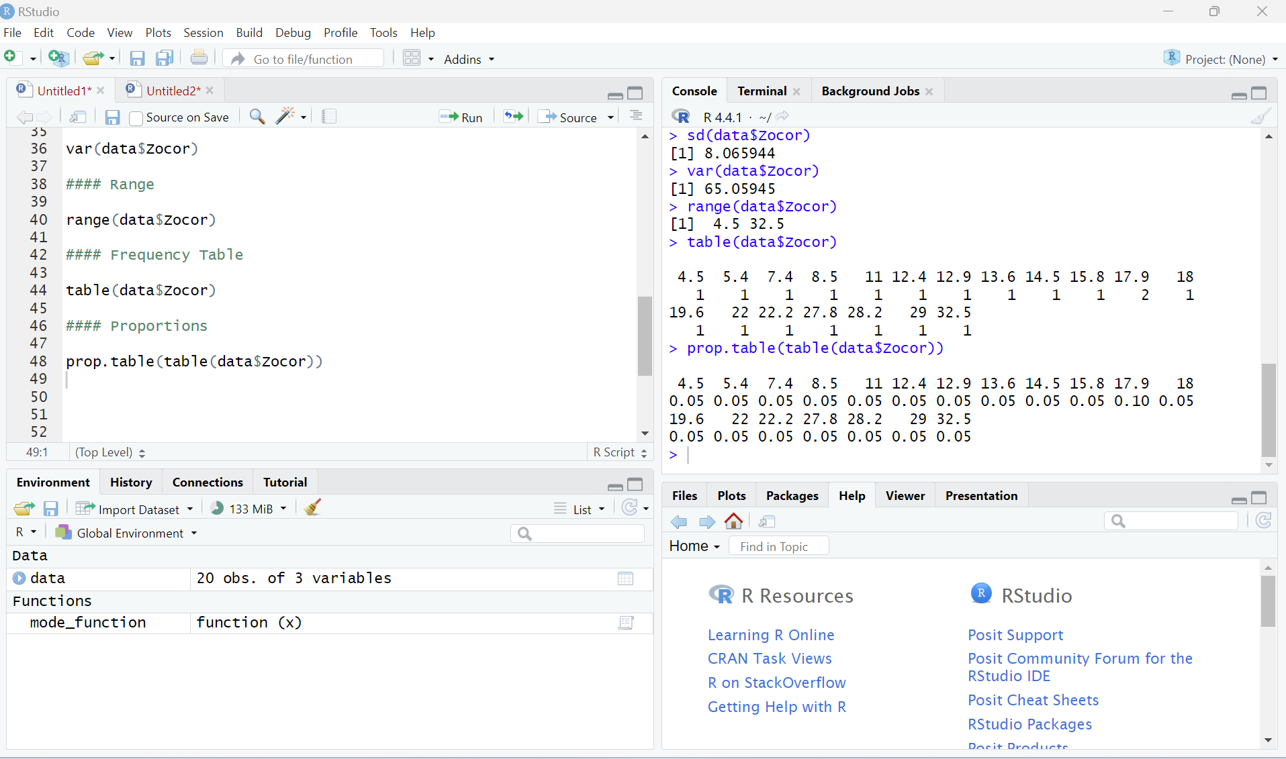
Describing Categorical Data
Purpose
2. Key Functions
Frequency Table
Proportions

Slide 19
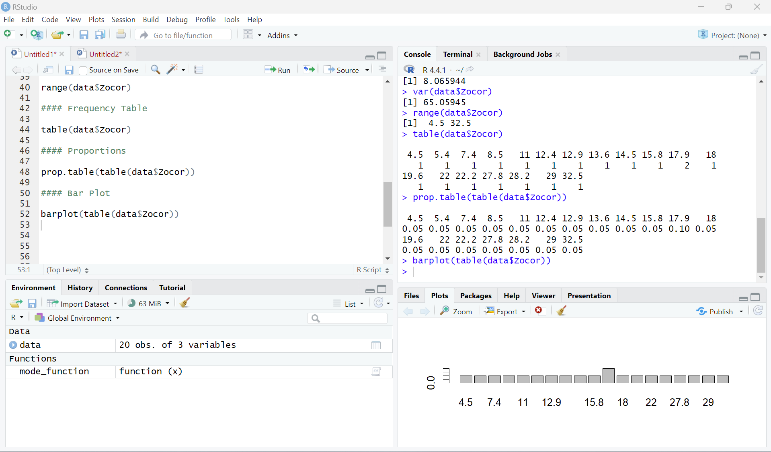
Describing Categorical Data
Purpose
2. Key Functions
Frequency Table
Proportions
3. Visualization
Bar Plot

Slide 20
Exploring Data Distribution
Purpose

Slide 21
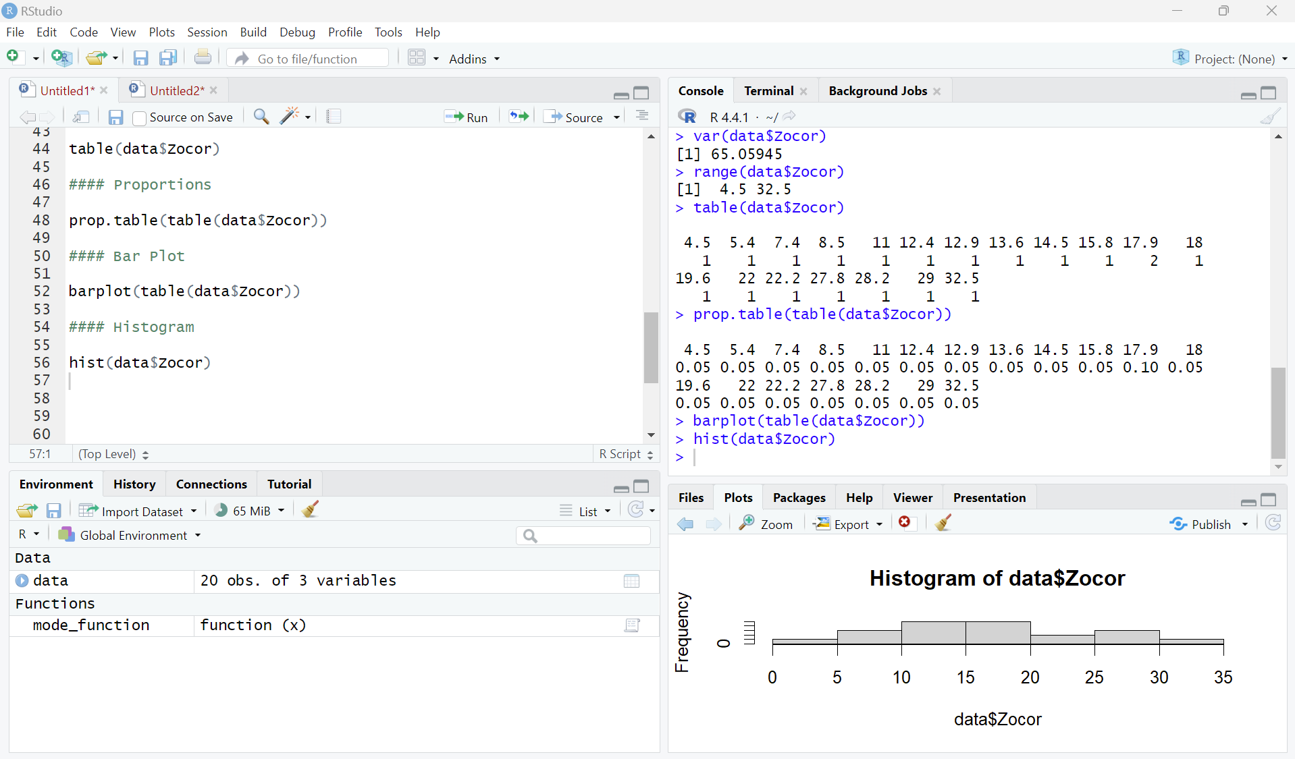
Exploring Data Distribution
Purpose
2. Key Functions
Histogram

Slide 22
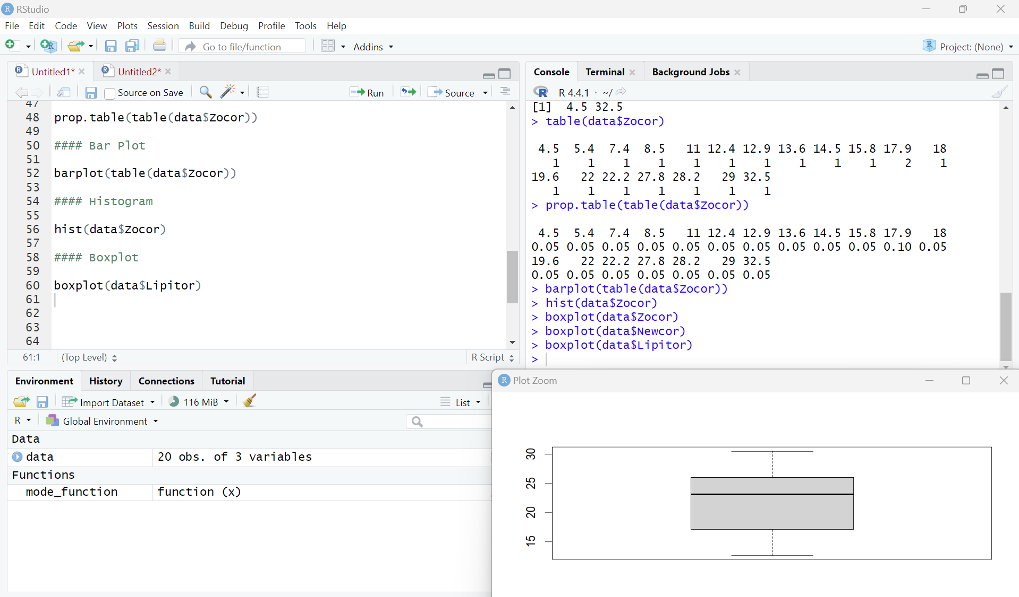
Exploring Data Distribution
Purpose
2. Key Functions
Histogram
Boxplot

Slide 23
Checking Data Structure
Purpose

Slide 24
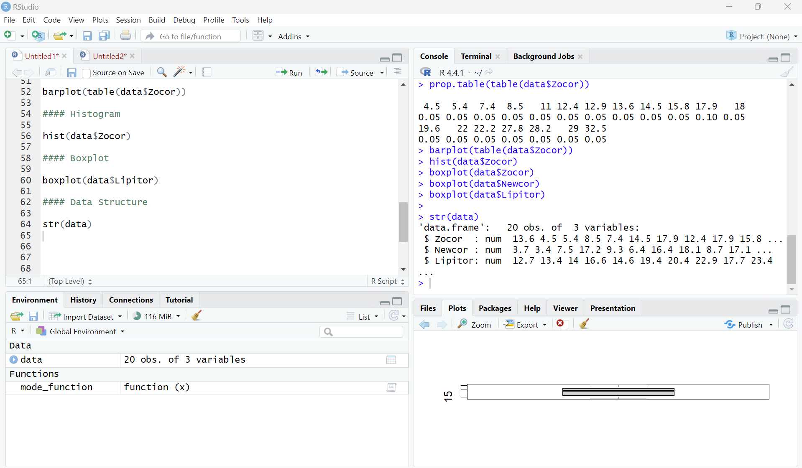
Checking Data Structure
Purpose
2. Key Functions
Data Structure

Slide 25
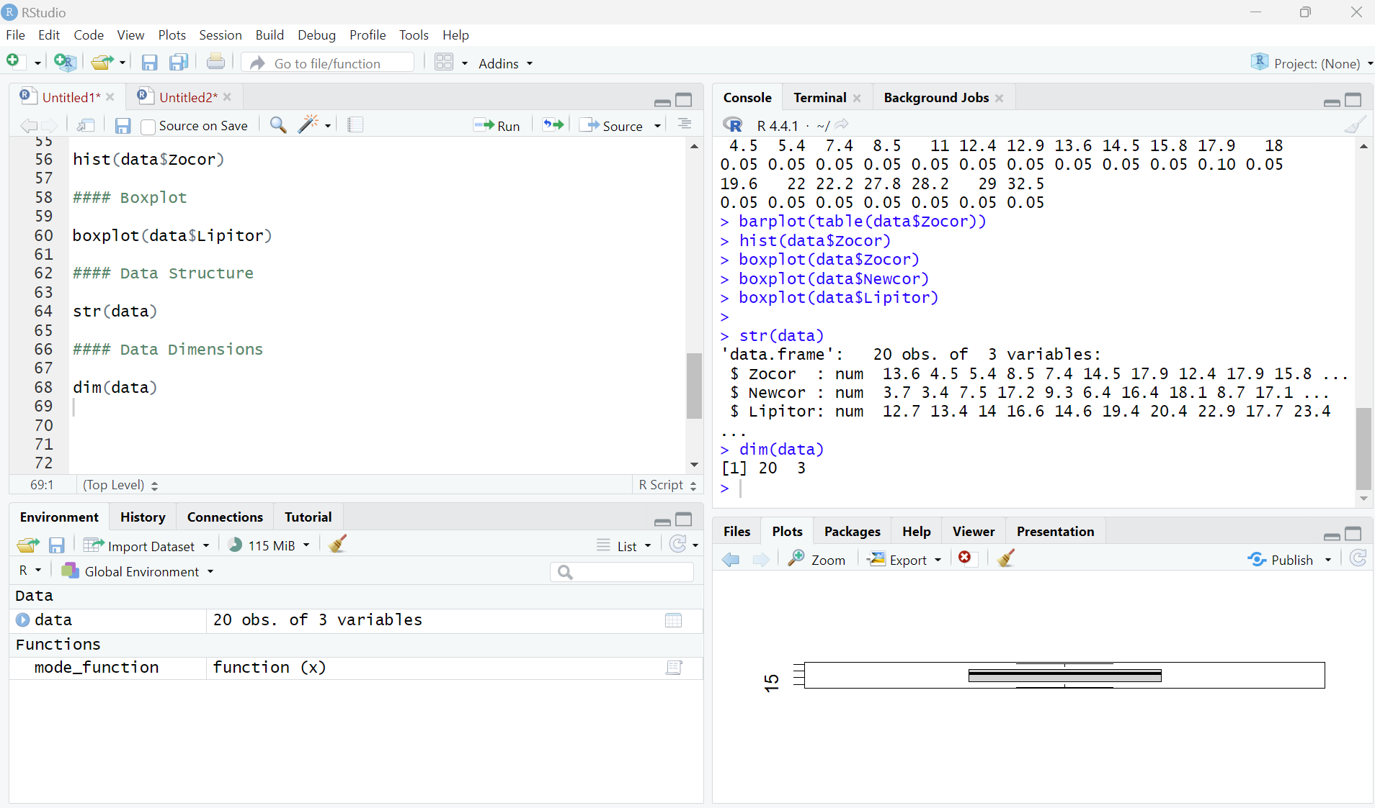
Checking Data Structure
Purpose
2. Key Functions
Data Structure
Data Dimensions

Slide 26
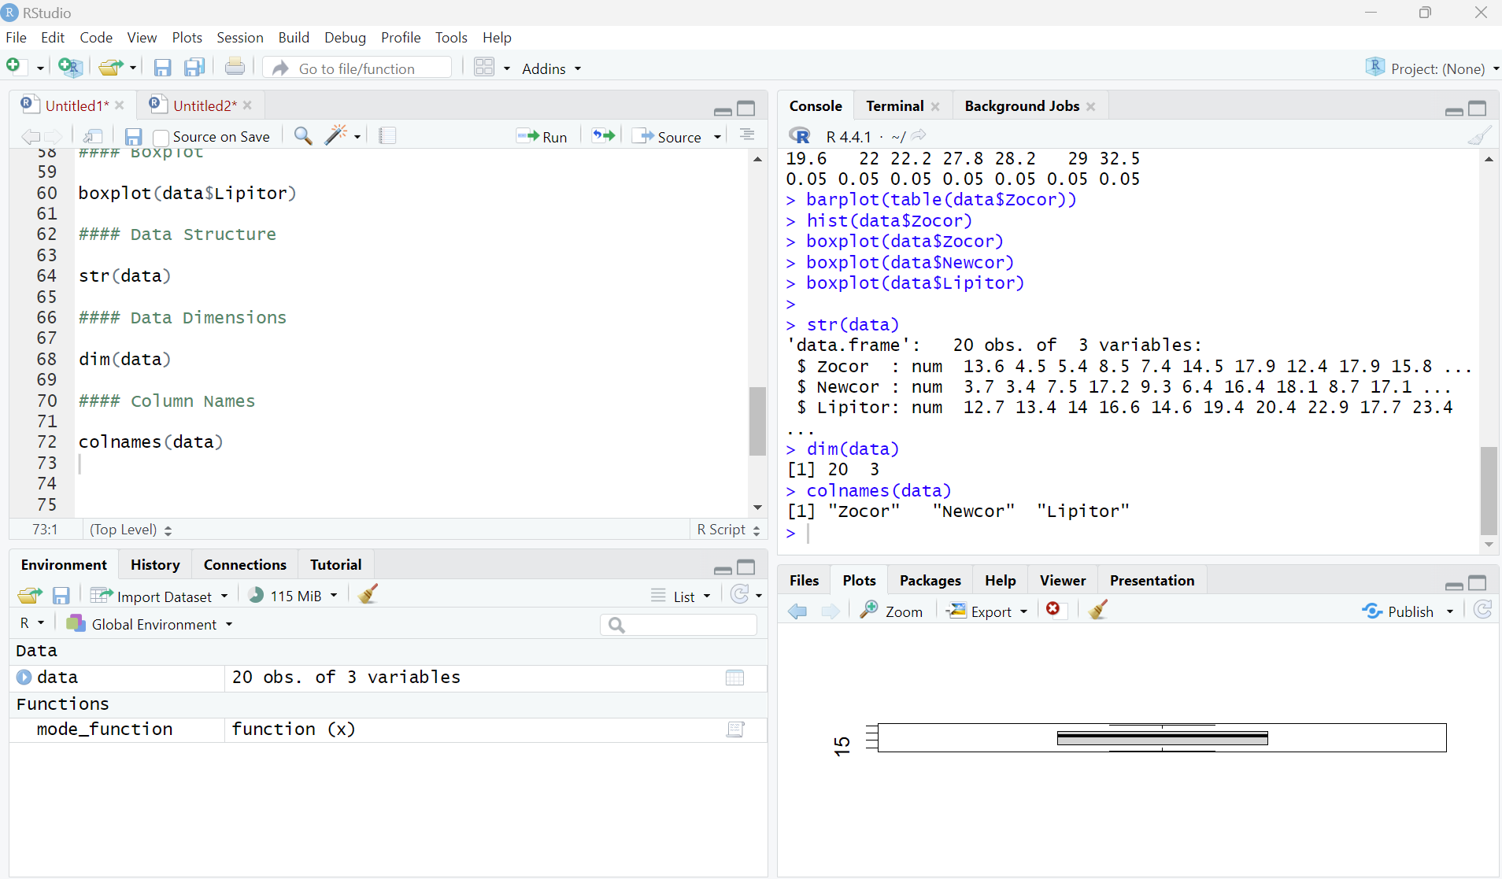
Checking Data Structure
Purpose
2. Key Functions
Data Structure
Data Dimensions
Column Names

Slide 27
Dealing with Missing Data
Purpose

Slide 28
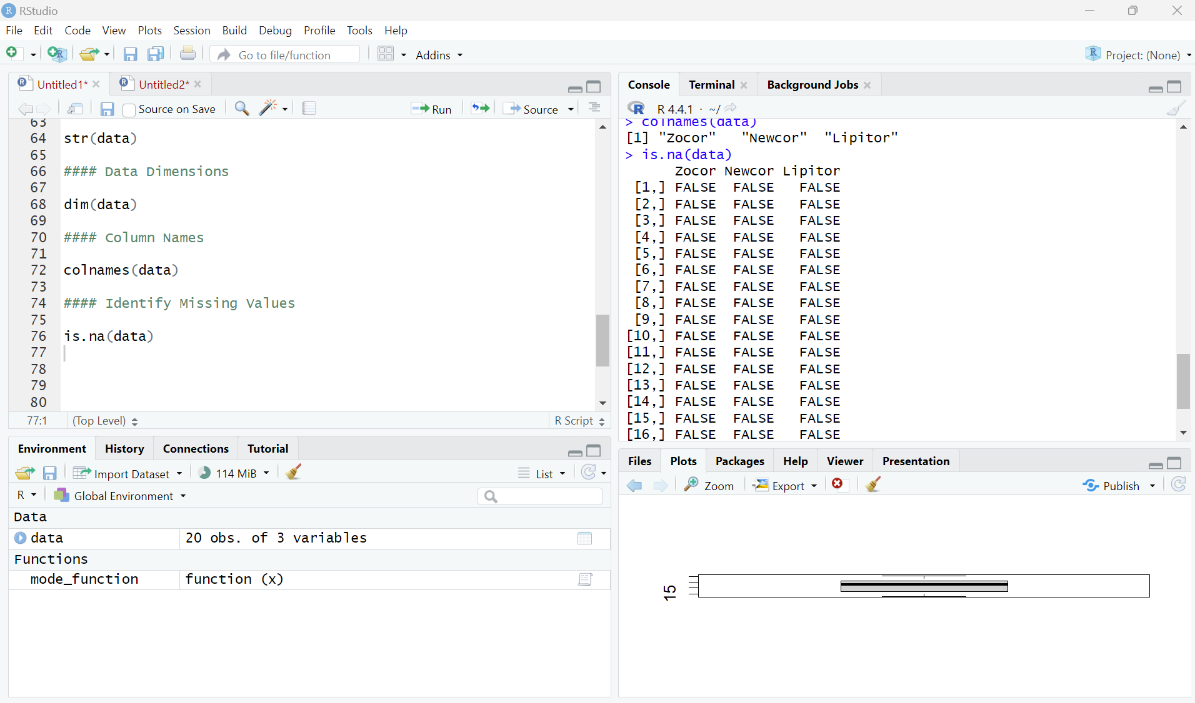
Dealing with Missing Data
Purpose
2. Key Functions
Identify

Slide 29
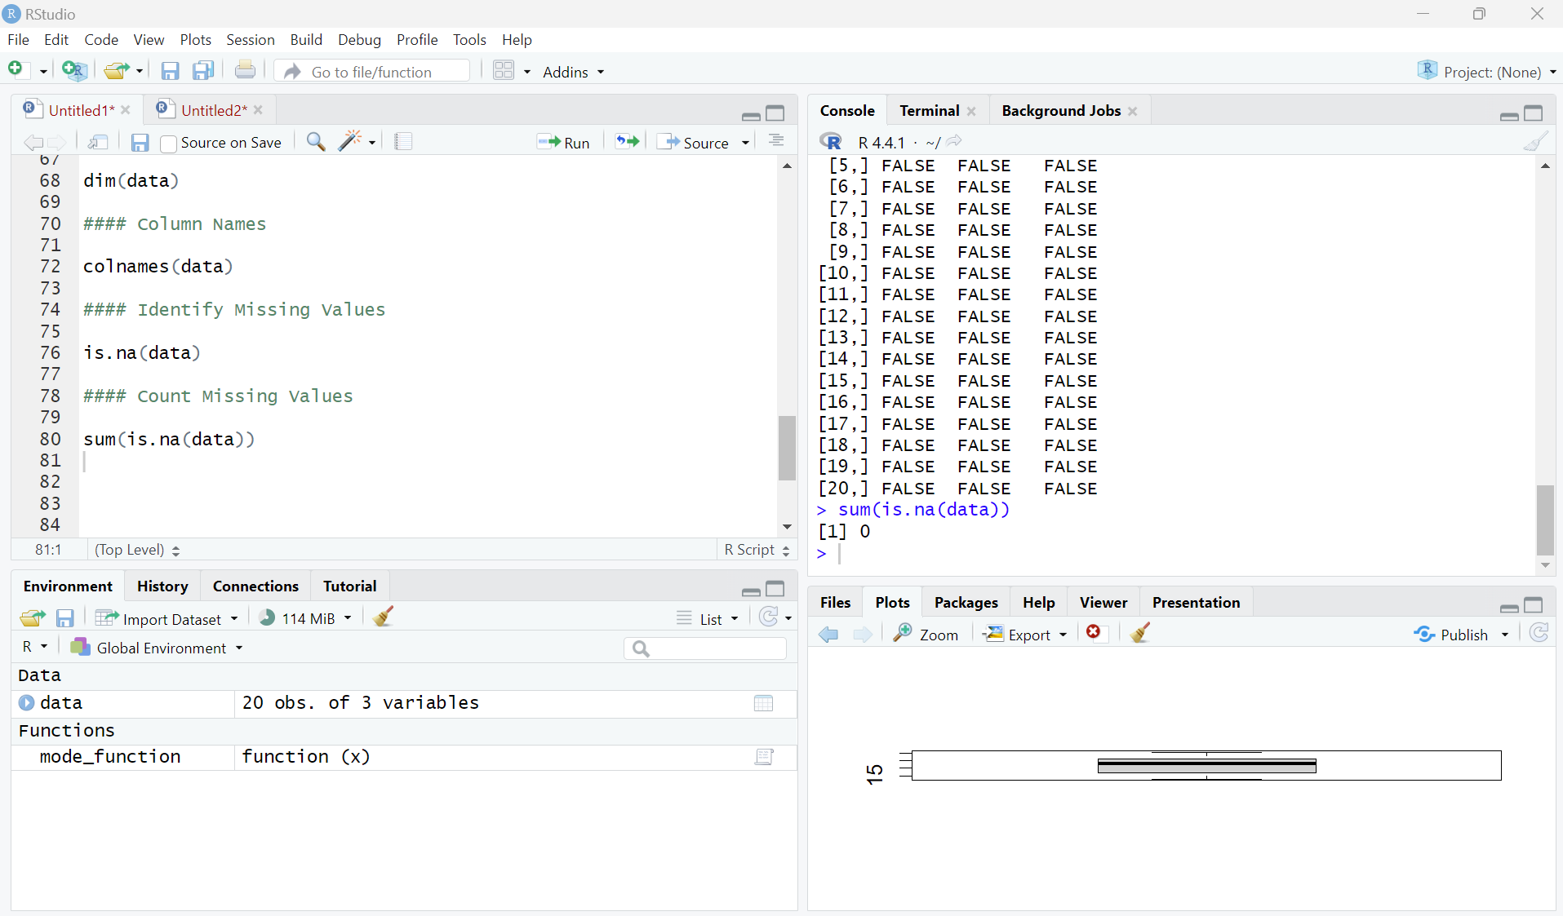
Dealing with Missing Data
Purpose
2. Key Functions
Identify
Count

Slide 30
Dealing with Missing Data
Purpose
2. Key Functions
Identify
Count
Address

Slide 31
Relationships Between Variables
Purpose

Slide 32
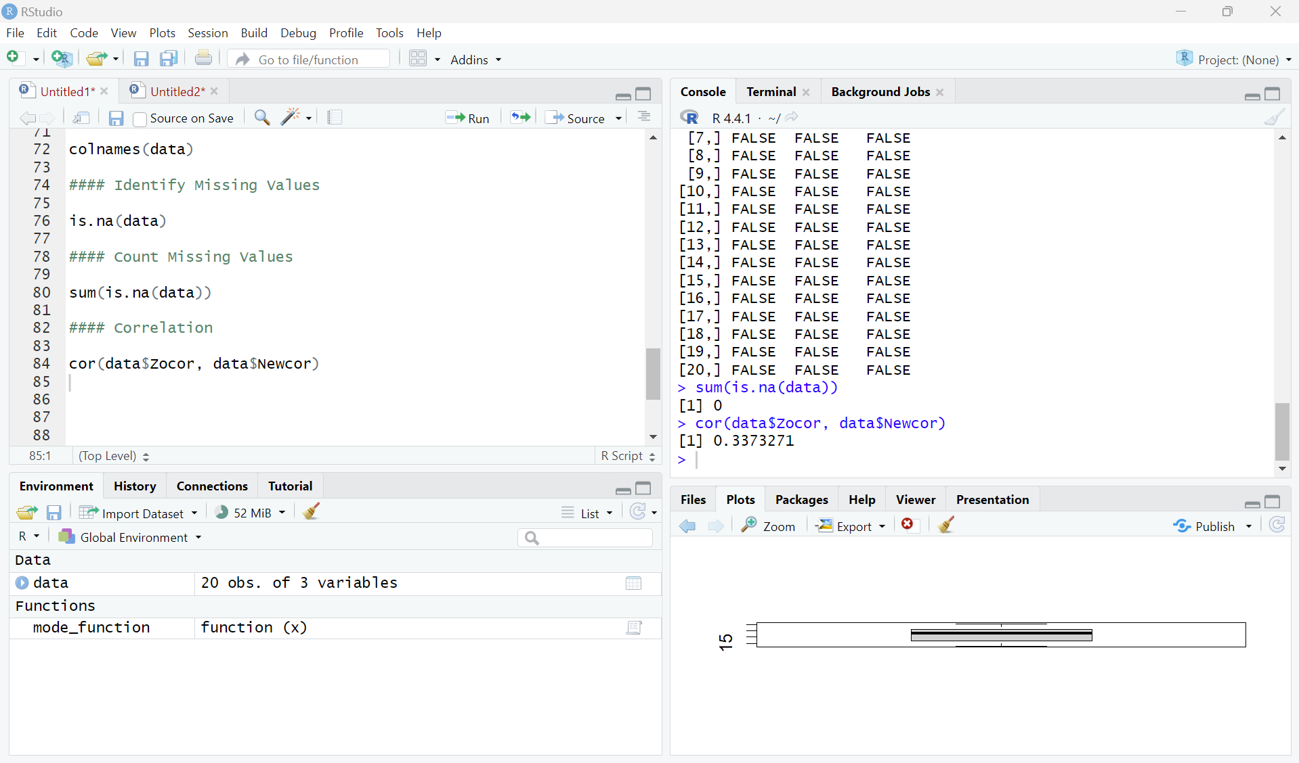
Relationships Between Variables
Purpose
2. Key Functions
Correlation

Slide 33
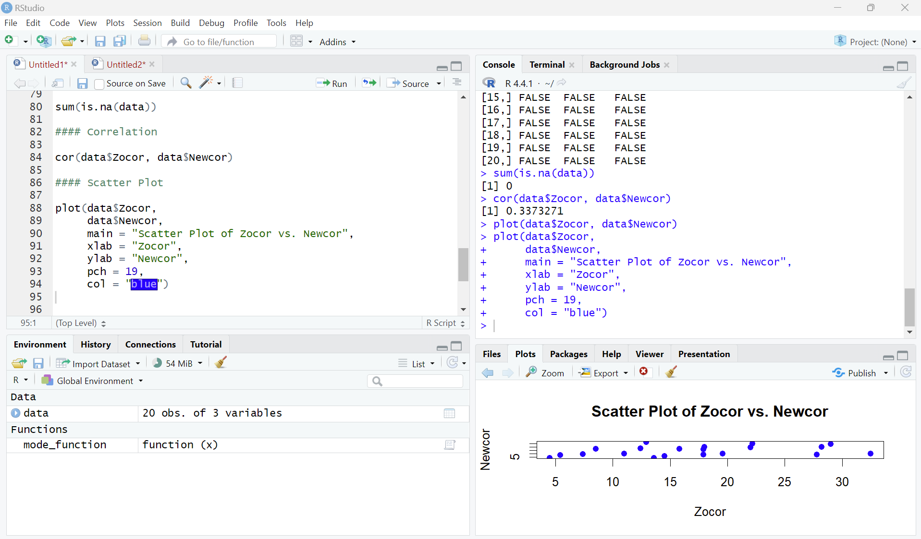
Relationships Between Variables
Purpose
2. Key Functions
Correlation
Scatter Plot

Slide 34
Thank You!

