Slide 1
Introduction to R
HAP 719
By: Sowmya Chakravarthy and Vladimir Cardenas

Slide 2
What is R?
R is a programming language and free software environment used for statistical computing, data analysis, and graphical representation.
R as a powerful tool for data analysis and visualization that can help convey insights effectively.
Its extensive range of libraries, tools, and packages make it an ideal choice for handling and extracting insights from diverse datasets.

Slide 3
Leveraging R for Data Analysis
Data Import and Preparation
Exploratory Data Analysis
Statistical Analysis
Machine Learning and Predictive Modeling
Time Series Analysis
Reporting and Visualization
Notes:
gbvgbhjj

Slide 4
Installing R
Go to: https://cran.r-project.org/

Slide 5
Setting Up R-Studio

Slide 6
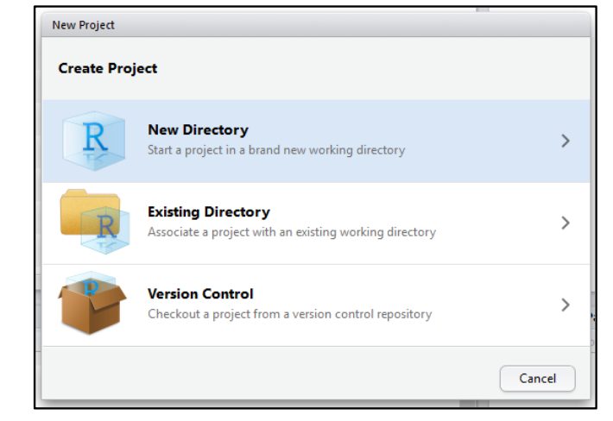
Start a New Project in R

Slide 7
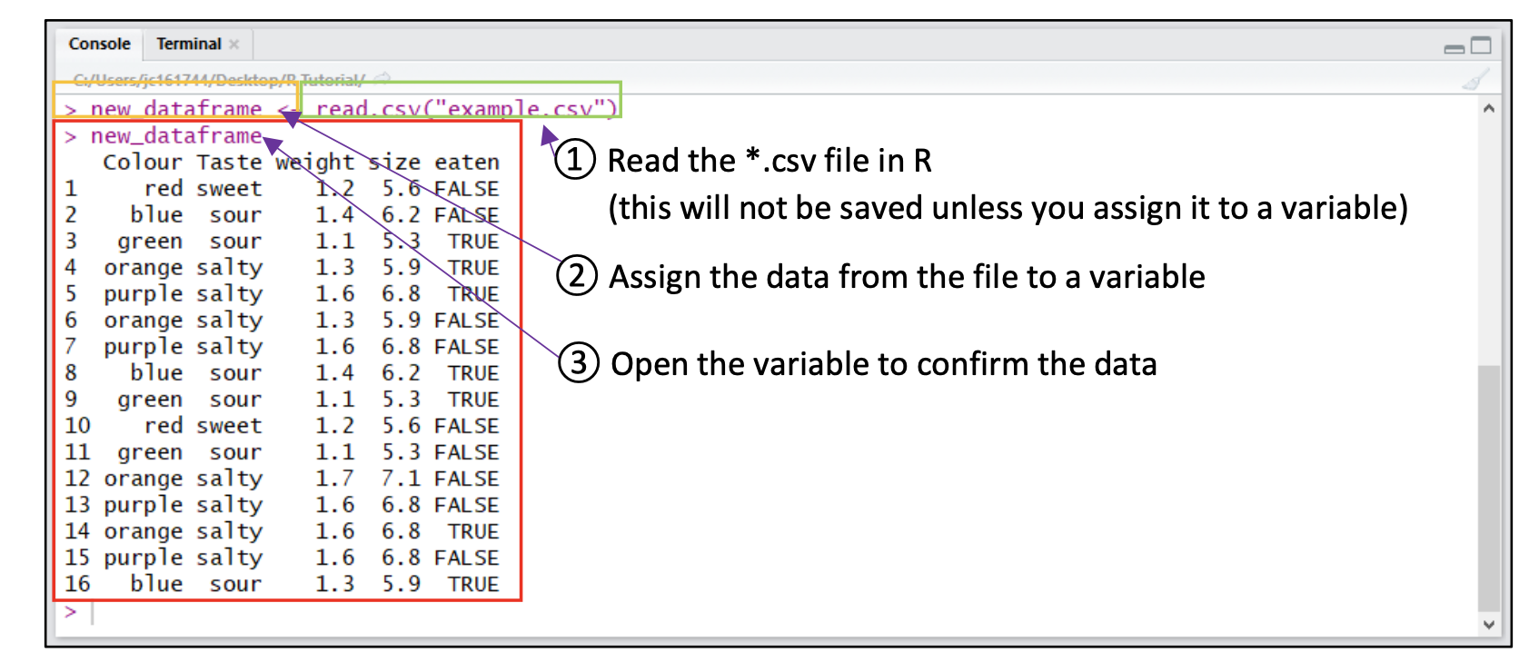
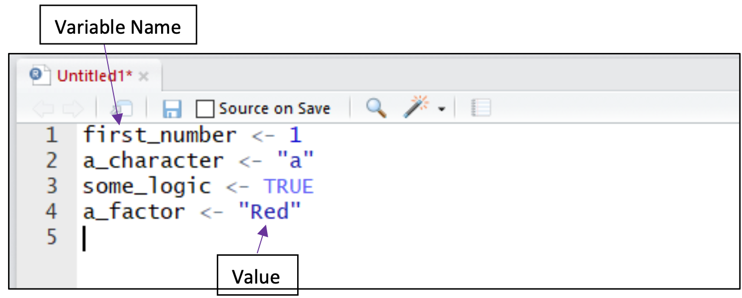
Getting Data into R

Slide 8
Demonstration of R codes for
Computing frequencies
1
Computing descriptives
2
Computing correlations
3
Computing a linear regression
4
Computing a contingency table
5
Displaying a histogram
6

Slide 9
Demonstration ChatGPT and R

Slide 10
Tips (that maybe useful for your homework)
Scatterplots require a lot from your computer for large datasets
Create a random sample (maybe 10% of the population)
You can run your code in the background
Take into account data preparation and transformation before analyzing and plotting data
If you change missing entries to zero then zeroes in your data may not really mean zero (i.e. a missing value may just be a lack of opportunity for measurement)
These may influence your analysis one way or another if not addressed

Slide 11
Next Steps
Learn R independently – it will become easier as you get to it and what it can let you do with data can be pretty cool!
Start with: R for data science (linkedin.com)
Then explore other ways of learning such as more advanced courses, blogs, forums, etc.

Slide 12
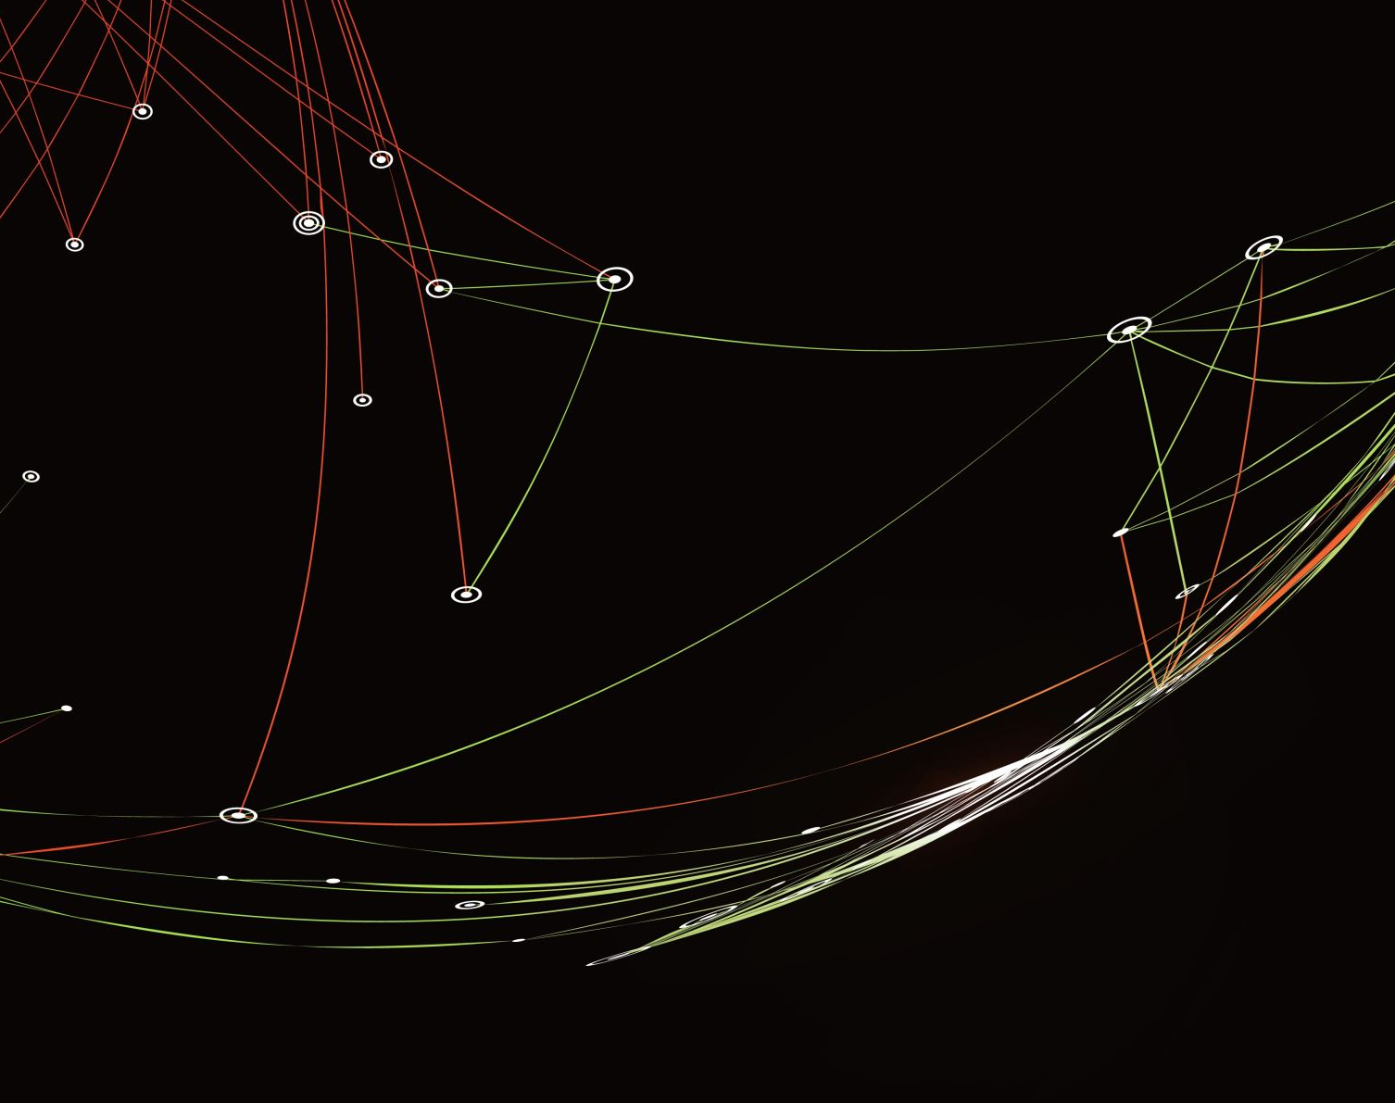
Thank you

