Slide 1
Logistic Regression
Week 2
Question 2

Slide 2
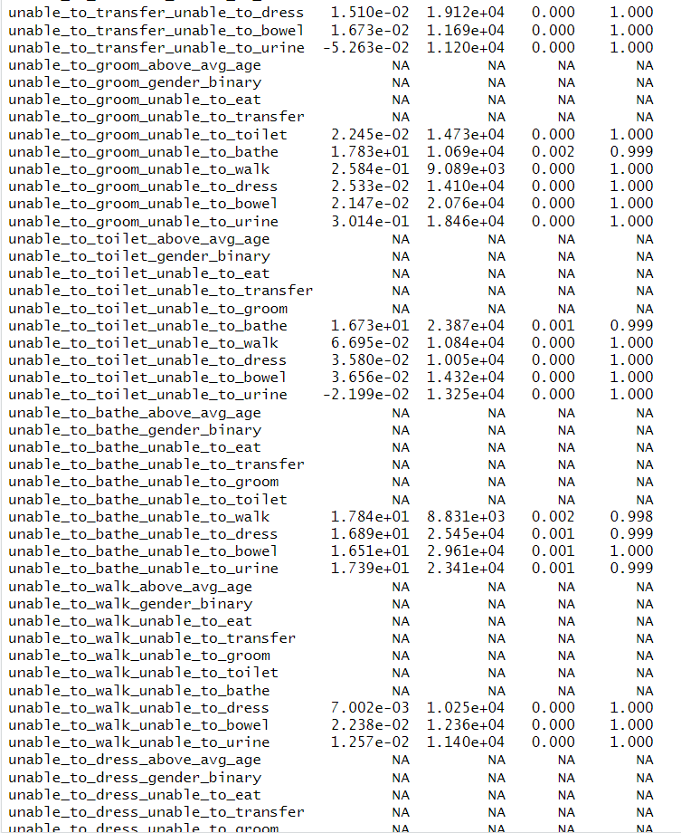
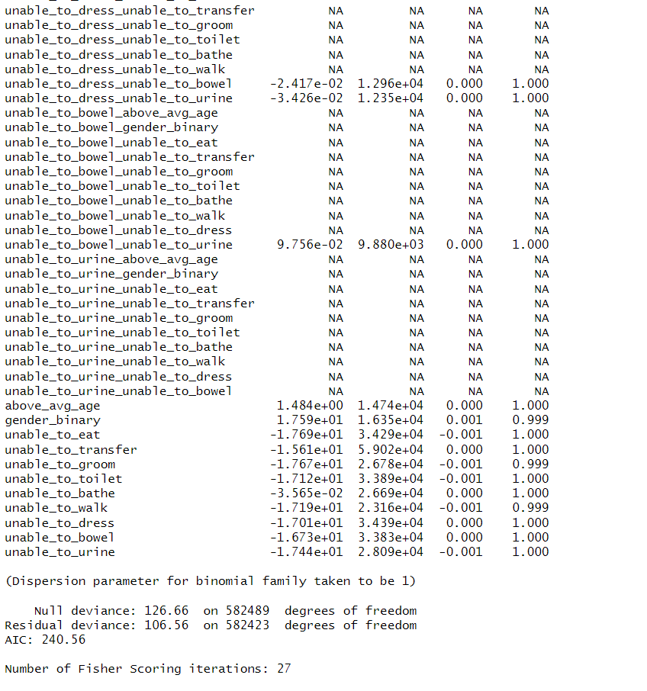
Regress death in 6-months on various current disabilities, age, gender, and pairwise interactions of these variables

