Slide 1
Logistic Regression
Week 3
Question 2

Slide 2
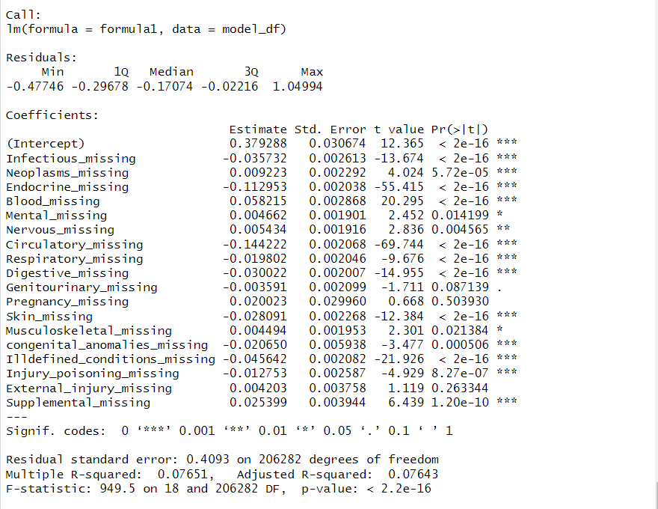
Create a binary variable that is 1 every time a variable is missing and 0 otherwise. Predict diabetes from patterns of missing binary variables Percent of variation explained by the model: 7.65 %

Slide 3
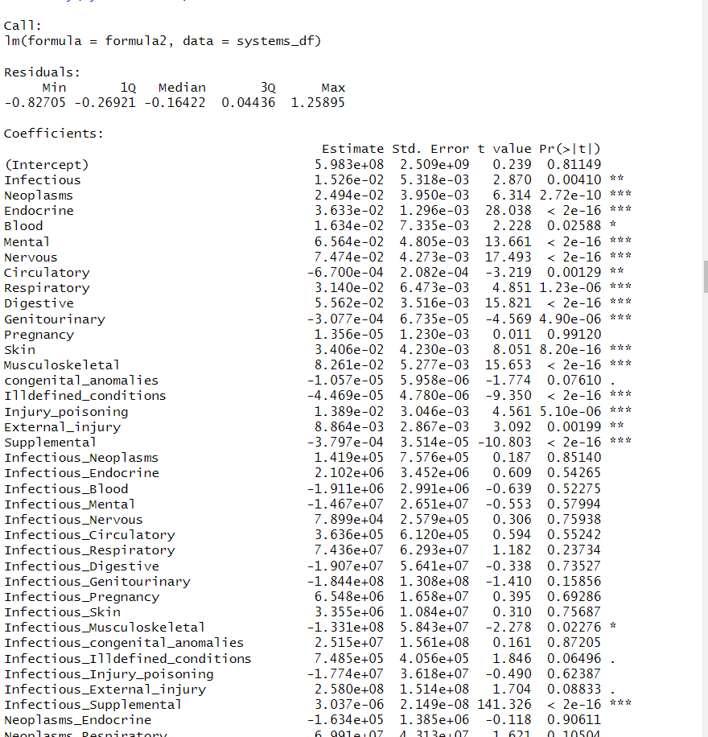
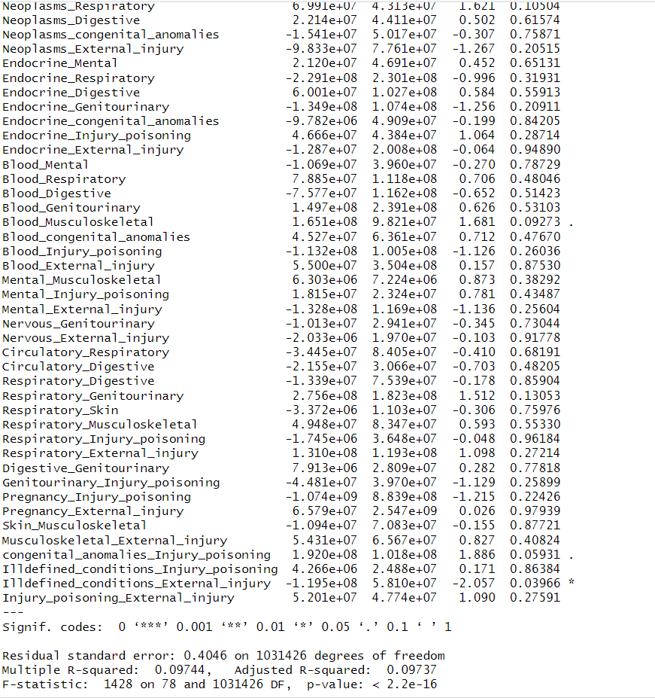
Regress diabetes on body systems and pairs of body systems without missing values and report the percent of variation.

Slide 4
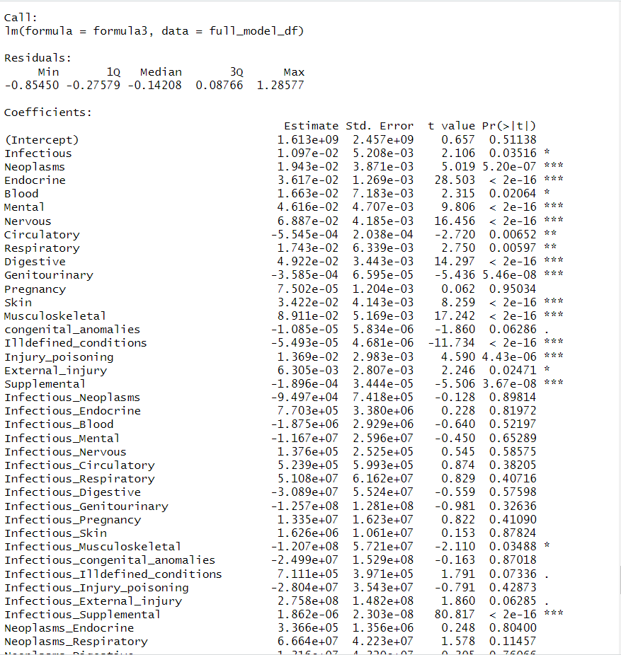
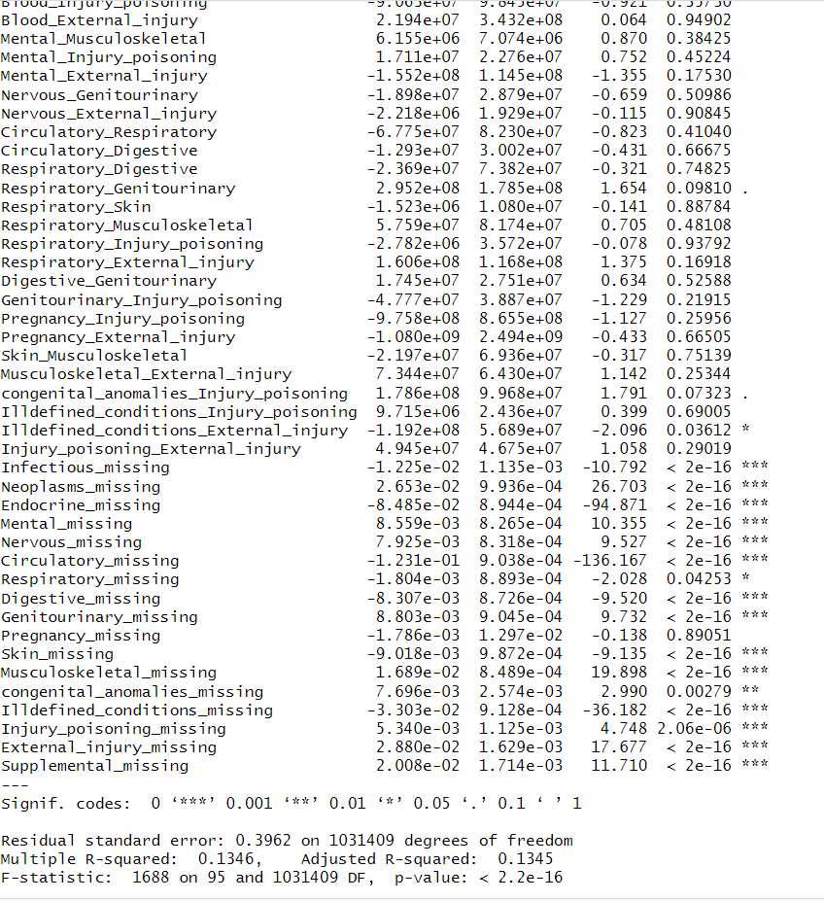
Regress diabetes on body systems, pairs of body systems, and statistically significant patterns of missing values. Report the coefficients and the percent of variation explained Percent of variation explained by the model: 13.46 %

