Slide 1
Logistic Regression

Slide 2
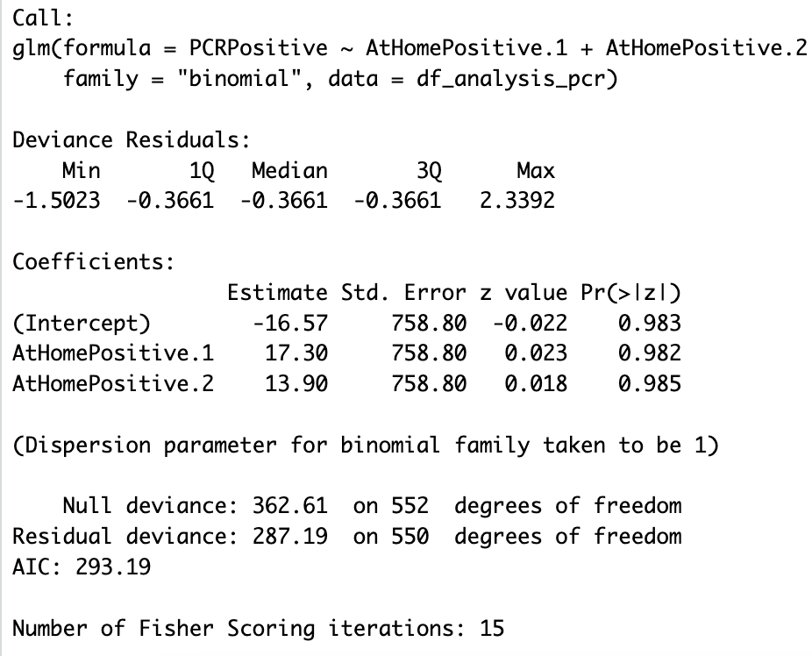
Q1. Build a model that includes only "home test results" as independent variable. Report the percent of variation explained
Here we consider, home test results as the independent variable and PCRpositive as the dependent variable. Pseudo R-squared value: 0.2079854 suggests that approximately 20.8% of the variability in the outcome variable is explained by the model

Slide 3
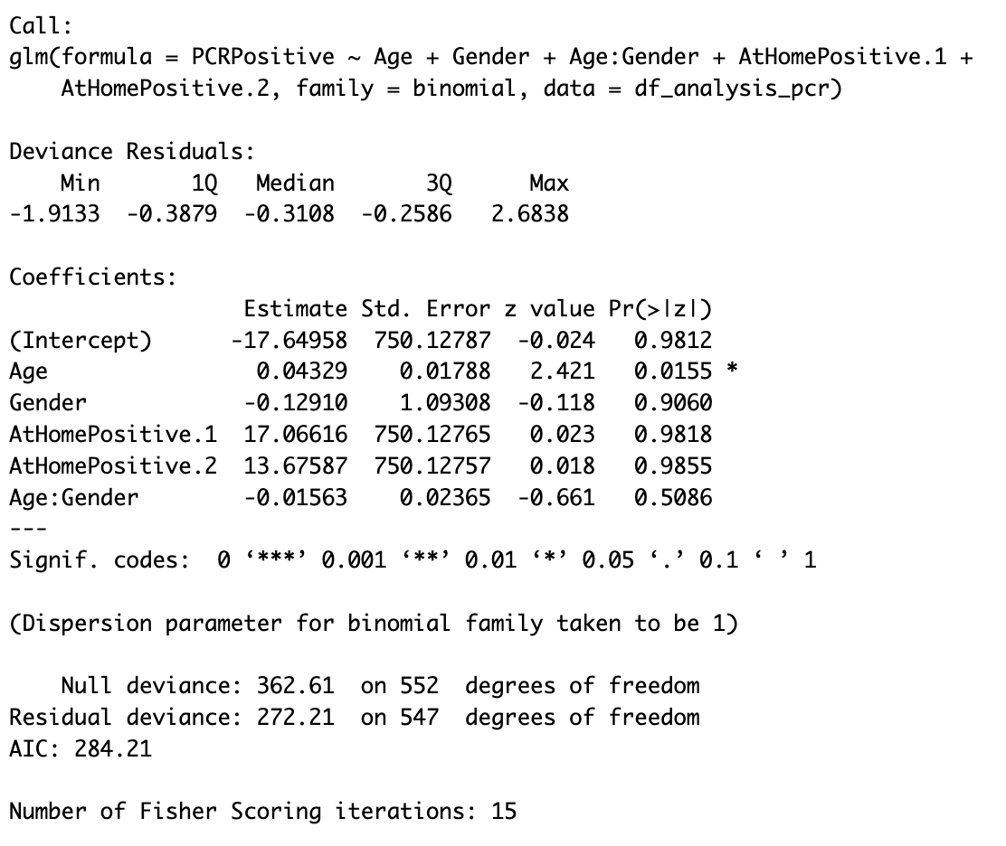
Q2. Build a model that includes age and gender, interaction of age and gender, and home test results as independent variables. Report the percent of variation explained.
Here we are considering age, gender, Interaction between age and gender and home test results as independent and PCRpositive as dependent. "Pseudo R-squared (McFadden's): 0.2493” - This means that about 24.93% of the variability in the log odds of getting a positive test result (as captured by the logistic model) is explained by the independent variables (Age, Gender, their interaction, and the home test results) in your model, compared to a model with no predictors.

Slide 4
Q3. Build a model that includes age and gender, interaction of age and gender, home test results, and symptoms as independent variables. Report the percent of variation explained
Here we are considering age, gender, interaction of age and gender, home test results and all the symptoms as independent variables.
"Pseudo R-squared (McFadden's): 0.5739”. An R^2 of 0.5739 suggests that approximately 57.39% of the variance in the log odds of the outcome is explained by the predictors in the model.
Based on the output: Age (p=0.0248), Difficultybreathing (p=0.0170), LossBalance (p=0.0130),LossTaste (p=0.0109)

Slide 5
Q4. Build a model that includes includes age, gender, interaction of age and gender, symptoms, home test, pairs of symptoms, and triplets of symptoms as independent variables. Report the percent of variation explained
Here I have included age, gender, interaction of age and gender, symptoms, home test results and also included the pairs of symptoms as independent variables
Percent of variance explained: a McFadden's R^2 of 0.7623239 suggests that the predictors in your logistic regression model provide substantial explanatory power relative to a null model.

Slide 6
Q5. What is the most accurate way of diagnosing COVID-19 at home prior to triage to clinics?
The code is trying to explore which symptoms and other factors (like age, gender, and home test results) are significant predictors for a positive COVID-19 PCR test result. This can potentially help in predicting the likelihood of a person being positive for COVID-19 based on these factors.
Q6. Can a clinician learn to make these diagnoses or is the number of adjustments needed beyond human capabilities?
While the models developed are complex, especially with interactions, a clinician does not necessarily need to understand the intricate workings of the model to benefit from its predictions. Instead, clinicians could use the model's outputs (with proper integration into clinical systems) to supplement their decision-making process. However, an over-reliance on the model without considering clinical judgment and context can lead to errors, so a balanced approach is essential.

