Slide 1
Model Selection
HAP 719: Advanced Statistics I
Yili Lin

Slide 2
Understand the Problem & Data
Define the objective
Dependent variable
Independent variables (predictors)
Data types
Measurement units and scales

Slide 3
Preprocessing & Exploratory Data Analysis (EDA)
Handling missing data
Feature engineering
Exploratory visualizations
Create new features
Encoding categorical variables
Scatter plots
Box plots and histograms
Correlation matrices and heatmaps

Slide 4
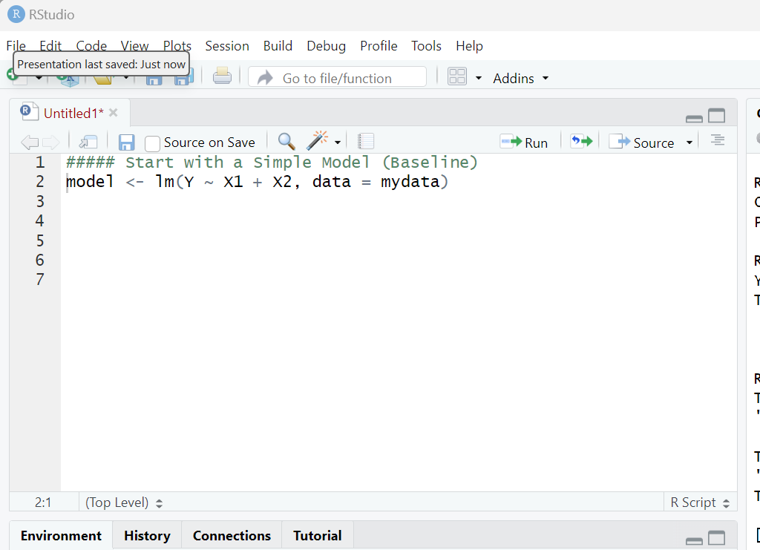
Start with a Simple Model (Baseline)
Fit the simple model
Evaluate the baseline
R-squared
Residuals

Slide 5
Check Assumptions of the Model
ANOVA (Analysis of Variance)
Logistic regression
Ordinary linear regression

Slide 6
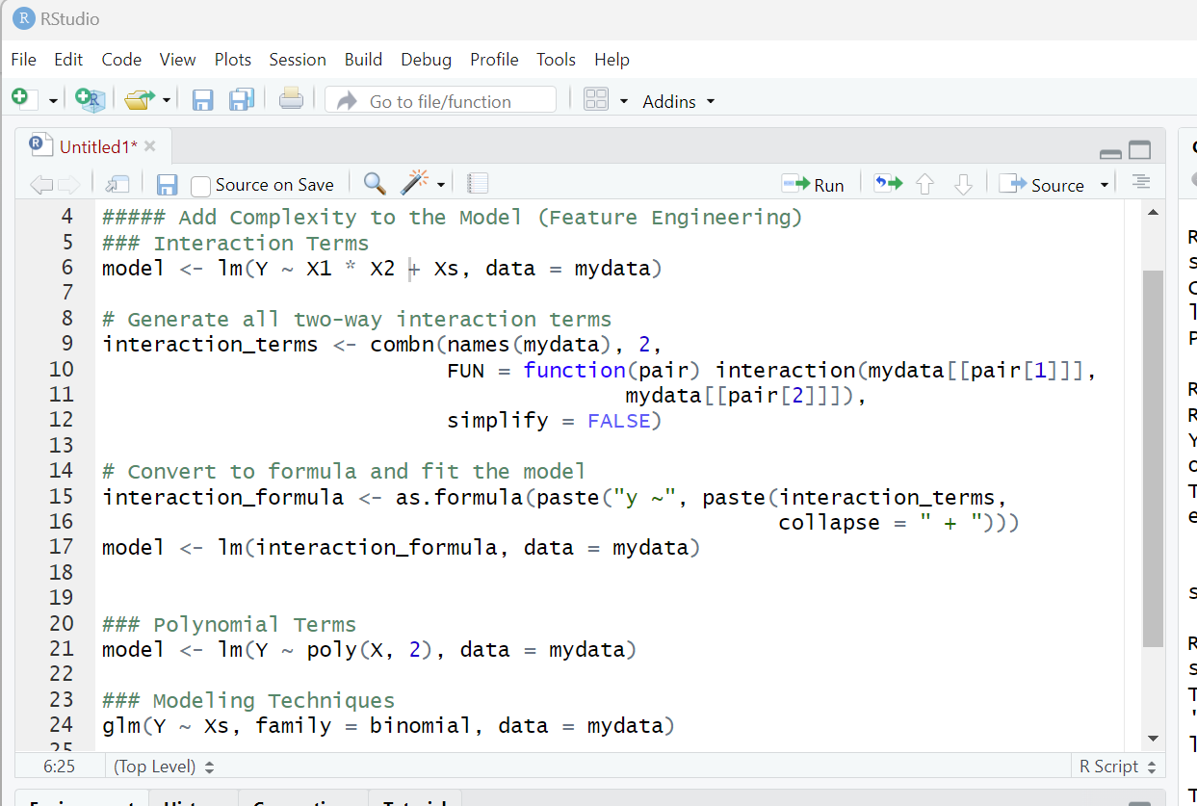
Add Complexity to the Model (Feature Engineering)
Interaction Terms
Polynomial Terms
Transformations
Modeling Techniques

Slide 7
Use Model Selection Techniques
Cross-Validation
Information Criteria (AIC, BIC)
Regularization (Ridge and Lasso)
Stepwise Regression

Slide 8
Assess Model Performance
R-squared
Adjusted R-squared
Root Mean Squared Error (RMSE)
Residual Plots

Slide 9
Check for Overfitting
Compare training and testing error
Cross-validation scores
Simplify the model

Slide 10
Select the Best Model
Prediction accuracy
Simplicity

Slide 11
Interpret & Validate the Model
Interpret coefficients
Check for multicollinearity
Model validation

Slide 12
Thank You!

