Slide 1
Constructing Multiplicative Models Using Corner Cases
HAP 719: Advanced Statistics I
Yili Lin

Slide 2
Creating Temporary Table #Data
Alemi, F. (2020). Big data in Healthcare: Statistical Analysis of the Electronic Health Record. George Mason University.

Slide 3
Looping Through Variables
Alemi, F. (2020). Big data in Healthcare: Statistical Analysis of the Electronic Health Record. George Mason University.

Slide 4
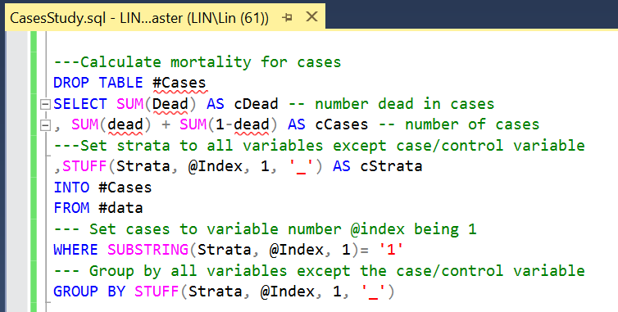
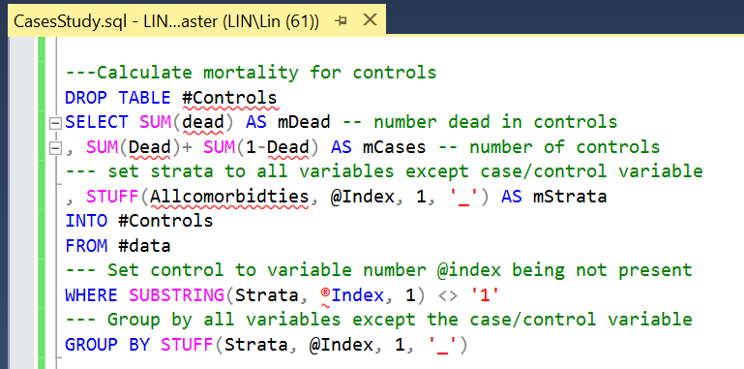
Calculating Mortality for Cases&Controls
Alemi, F. (2020). Big data in Healthcare: Statistical Analysis of the Electronic Health Record. George Mason University.

Slide 5
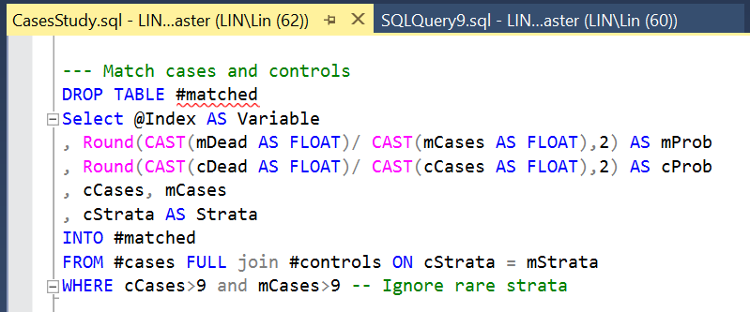
Matching Cases and Controls
Alemi, F. (2020). Big data in Healthcare: Statistical Analysis of the Electronic Health Record. George Mason University.

Slide 6
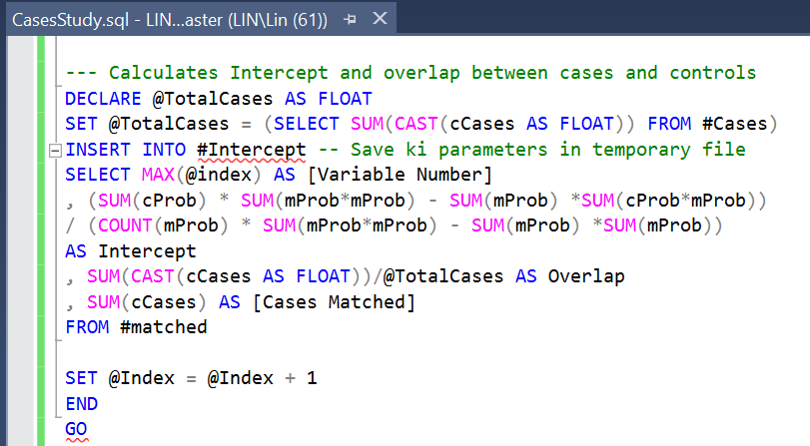
Calculating Intercept and Overlap
Alemi, F. (2020). Big data in Healthcare: Statistical Analysis of the Electronic Health Record. George Mason University.

Slide 7
Estimating Overall k by Trial and Error
Alemi, F. (2020). Big data in Healthcare: Statistical Analysis of the Electronic Health Record. George Mason University.

Slide 8
Thank You!

