Slide 1
Ordinary Regression
Farrokh Alemi, Ph.D.
Notes:
This presentation reviews ordinary regression. This brief presentation was organized by Dr. Alemi.

Slide 2
Purpose of Regression
Notes:
We begin our discussion of regression with clarifying its purpose.

Slide 3
Regress Y on one or more
independent variables X₁ … X_{n}
Notes:
Regression is a general method that relates an outcome variable Y to one or more independent variables X₁ … X_{n} using an equation. Equations are important. They precisely show how variables affect each other. They are the language of science and allow scientists to express their theories.

Slide 4
Parameter Estimation
Notes:
Regression is a procedure for fitting data to an equation. The analyst specifies the equation and the software fits the data to the equation by estimating the parameters of the equation from data. These equation parameters are also referred to as regression coefficients. We use the terms coefficient and parameter interchangeably to break the monotony of a commonly repeated word.

Slide 5
Regression Is
Everywhere
Notes:
Regression can be used to predict future stock market values from current and historical values. Regression can be used to assess the impact of health promotion and components of media campaign on recruitment of new patients. It can be used to predict likelihood of a sale or market penetration given the characteristics of the population in the zip code area. Regression can be used to predict likelihood of project success from its characteristics. Regression can be used to assess financial risk from historical patterns. It can be used to assess the likelihood of bad debt from patient’s characteristics. It can be used to check for fraud by comparing amount charged to amount expected based on patient or provider characteristics. Regression can be used to assess the effectiveness of medical interventions. It can be used to identify the relevant components of care that lead to cost overruns. Regression can be used to summarize the impact of different surgeons on overall cost of bundled care. It can be used to identify relevant risk factors that increase patients’ risk of illness, patients’ risk of compliance with treatment, or likelihood of adverse outcomes. Regression is a versatile tool and is widely used in many different application areas.

Slide 6
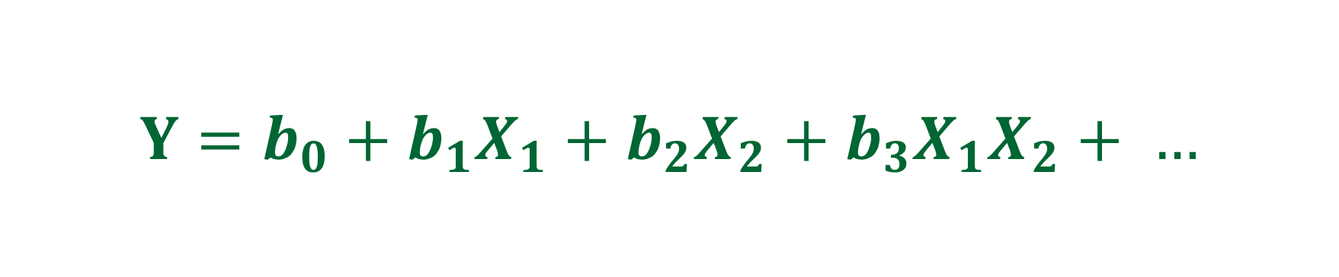
Multiple Regression
$$Y=b_{0}+b_{1}X_{1}+b_{2}X_{2}+b_{3}X_{1}X_{2}+ …$$
Notes:
In multiple regression we have one dependent variable and many dependent variables. The dependent variable Y is described as a function of multiple independent variables. Here the dependent variable, Y, for example cost, is shown as a function of two independent variables, $X_{1},$and $X_{2},$ for example age and gender. There could be also many more independent variables besides the two we have shown here.

Slide 7
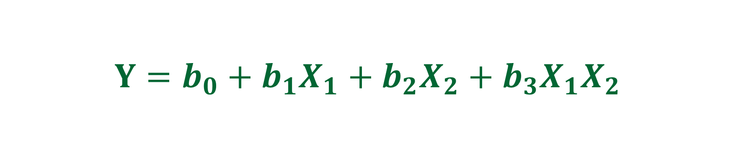
Multiple Regression
$$Y=b_{0}+b_{1}X_{1}+b_{2}X_{2}+b_{3}X_{1}X_{2}$$
Notes:
The equation starts with a constant, $b_{0}$. THis is the intercept of the line when all independent variables are zero.

Slide 8
Multiple Regression
$$Y=b_{0}+b_{1}X_{1}+b_{2}X_{2}+b_{3}X_{1}X_{2}$$
Notes:
$\text{The} \text{main} \text{effect} \text{of} \text{X}\text{1 }\text{and} \text{X}\text{2 }\text{are} \text{captured} \text{by} \text{parameters} b_{1}and b_{2}$.

Slide 9
Multiple Regression
$$Y=b_{0}+b_{1}X_{1}+b_{2}X_{2}+b_{3}X_{1}X_{2}$$
Notes:
The effect of interaction between the two variables, X1$and X_{2 }is captured by the parameter b3.$The interaction term $X_{1}X_{2}$ is the product of the two variables. The interaction of two binary variables is present when both variables are present. If one is missing, it takes the value of zero, then the interaction term is zero too.

Slide 10
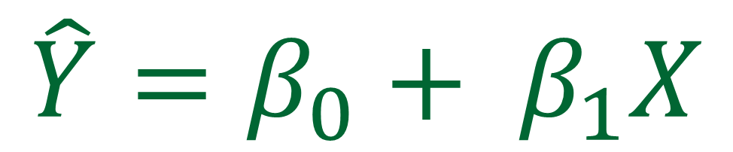
Parameter Estimation
$$\hat{Y}=β_{0}+ β_{1}X$$
Notes:
In regression, the equation of a straight line is used often. Regression parameters for a straight line equation are the intercept and the slope (same terms as what was used to describe a linear equation). The coefficient beta zero is the intercept. The parameter beta 1 is the estimated slope. We use the hat on top of Y to indicate that it represents an estimated variable calculated from independent variables. It is not the observed value of the outcome but an estimate from the formula. We also show the slope and intercept using Greek lettering to emphasize that these are estimated from the sample data.

Slide 11
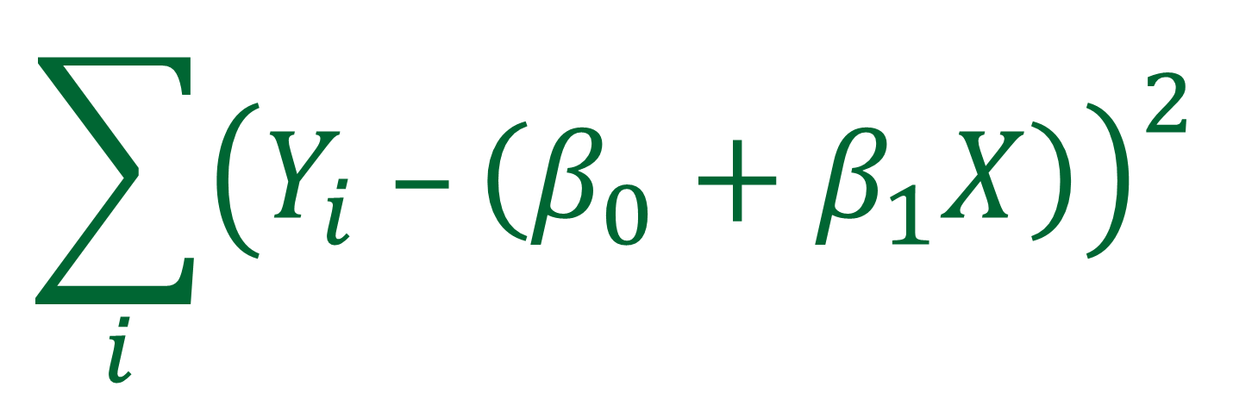
Sum of Squared Residuals
$$\sum_{i}{{\left(Y_{i} –\left(β_{0}+β_{1}X\right)\right)}^{2}}$$
Notes:
To accurately estimate the intercept and slope parameters, regression calculates a residual. Residual is the difference between estimated and observed dependent variable. Regression minimizes the sum of the squared residuals. For a straight line, the intercept,$β_{0}$, and the slope, $β_{1}$, parameters are estimated to minimize the difference between observed Y value and predicted values.

Slide 12
Sum of Squared Residuals
Y | X | Predicted Y | Residual | Squared Residuals
10 | 1 | 10.00 | 0.00 | 0.00
12 | 2 | 10.80 | 1.20 | 1.44
10 | 3 | 11.60 | -1.60 | 2.56
12 | 4 | 12.40 | -0.40 | 0.16
14 | 5 | 13.20 | 0.80 | 0.64
Notes:
In this table, we have used the regression equation to predict a value for Y. The residual is the differences between the observed and predicted values. The square of residuals is given at the column to the right. The sum of these squared residuals tells us how well we have fitted the equation to our data.

Slide 13
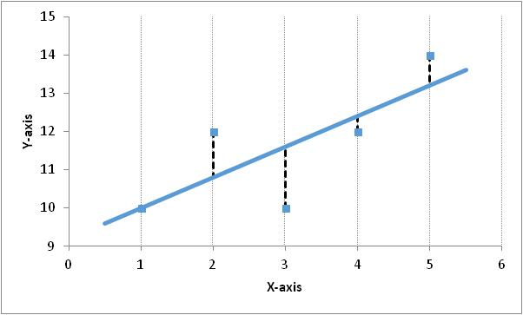
Residuals
Notes:
In this figure, we show the linear relationship between y and X. The predicted values lie on the line. The differences between the observed and predicted values are shown as a dashed line. At x=1, there is no difference. At x=4 there is a small negative difference. The largest difference is at X=3. The positive differences are at X=2 and X=5. Each one of these differences is considered a residual. Regression is fitted to the data so that the sum of the squared residuals is the smallest possible number. The line in this Figure has the sum of squared residuals of 4.8. Different lines are fitted until a line is found with the smallest sum of squared residuals.

Slide 14
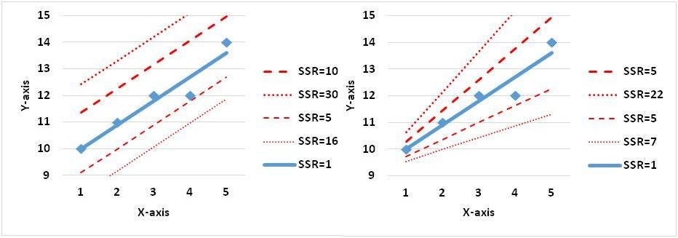
Minimize SSR
Notes:
Different lines will have different sum of squared residuals. The objective of regression analysis is to choose the regression parameters so that the line has the minimum sum of squared residuals. The 5 lines on the left shows the sum of squared residuals associated with lines that have different intercepts but same slope. The one with the lowest sum is the solid blue line and this is in fact the regression line. The same for the right hand side. In the right hand side, five lines are shown with different slopes. Each line has a different sum of squared residuals. Again, the line with the lowest sum is the regression line. Again the solid blue line is the line with the best fitted slope.

Slide 15
Why Minimize SSR?
Notes:
You may reasonably ask why sum the squared residuals should be minimized. This is a heuristic and there is no mathematical reason for it

Slide 16
Why Minimize SSR?
Because it is easy.
Notes:
except that such a sum allows one to easily calculate the parameters of regression. By easy to calculate we mean that it is not necessary to repeatedly try different lines and see which one has the minimum sum of squared regression. A formula for estimating the parameter that would produce the minimum sum of squared calculation has been worked out. No need for minimization, the formula guarantees that the estimated parameters would produce the minimum sum of squared residuals.

Slide 17
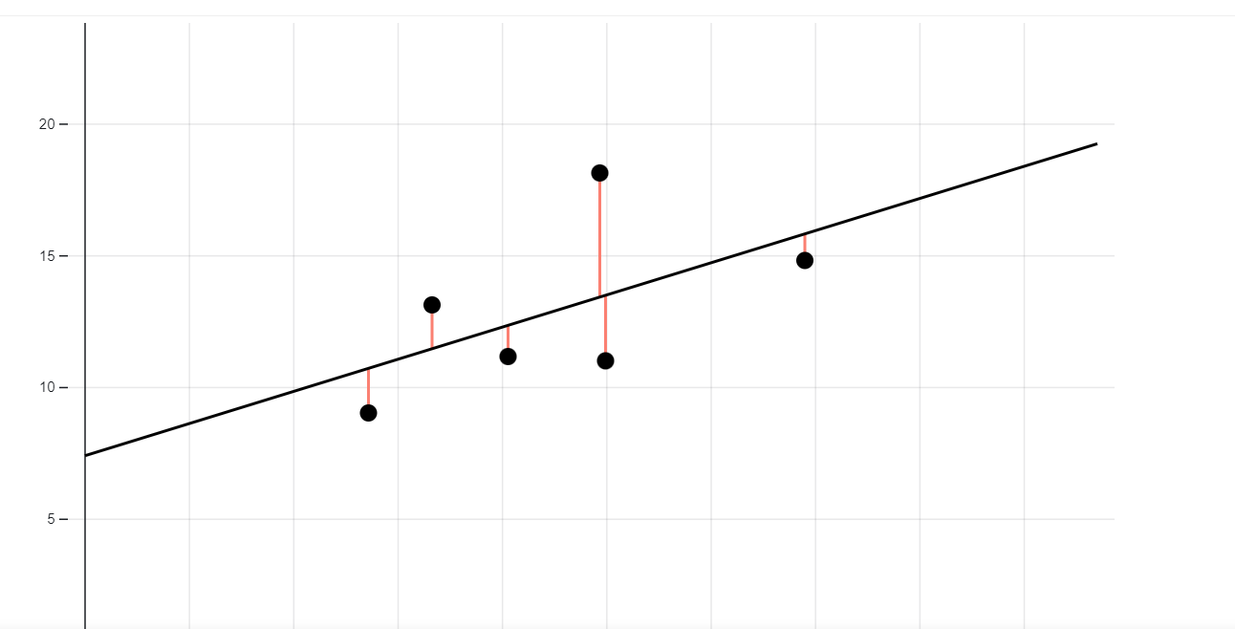
Interactive Visualization

Slide 18
Preparing Variables
for Regression
Notes:
Regression has two sets of variables, dependent and independent. In this section, we discuss how to prepare these variables for analysis.

Slide 19
Preparing Independent
Variables
Notes:
In an ordinary regression, independent variables can be binary, categorical, continuous, or interaction variables.

Slide 20
Dependent Variable:
Continuous Interval Scale
Notes:
In ordinary or standard regression, the dependent variable is a continuous variable. Ordinary regression estimates the mean of the dependent variable as a function of the independent variables.

Slide 21
Independent
Binary Variables
Notes:
Binary or dummy variables are assigned two values: zero or one. They are used often to indicate the occurrence of an event, such as the occurrence of an intervention or an adverse event.

Slide 22
Independent
Categorical Variables
Notes:
Categorical variables have multiple discrete levels. These categorical variables must be turned into binary variables before conducting the regression. For each category, a new binary variable is created. One of these binary variables is dropped as the combined absence of all other variables implies the dropped variable. The dropped category will act as a reference point for comparisons of all other categories

Slide 23
Categorical Variable Race
X₁ White=1, Otherwise = 0
X₂ Black=1, Otherwise = 0
X₃ Asian=1, Otherwise = 0
X₄ Other=1, Otherwise = 0
Notes:
For example, consider patients’ race. It has multiple categories, including White, Black, Asian, and Other. Each category can be turned into a new binary variable. Thus, we can have a binary variable called “White,” its value will be 1 if the patient is White and 0 otherwise. Another binary variable called “Black” will be 1 if the patient is Black and 0 otherwise. Still another variable called “Asian” will be 1 if the patient is Asian or 0 otherwise. Finally, the variable “Other race” will be one if the patient is none of the listed races and 0 otherwise. The single categorical variable called “Race” was broken into the following 4 binary variables assuming values of 1 and 0:
Then, instead of regressing cost on race, one has to regress the dependent variable on several binary independent variables, each standing for one type of race

Slide 24
Categorical Variable Race
Dropped & Reference
X₁ White=1, Otherwise = 0
X₂ Black=1, Otherwise = 0
X₃ Asian=1, Otherwise = 0
X₄ Other=1, Otherwise = 0
Notes:
Since 3 out of the 4 binary variables indicate all possible patient’s race, then one of the binary variables is left out. The category left out is referred to as reference value. Suppose we select White as the reference value. This is the situation where all the other three indicators are 0. The regressing on black, Asian and other categories is sufficient to estimate the impact of race. The intercept $β_{0}$in this equation estimates the impact of White race. The slope for other race parameters indicate the impact of black, Asian or other race categories.

Slide 25
Independent
Continuous Variables
Notes:
Continuous or interval variable can enter regression as they are, without transformation.

Slide 26
Independent
Interaction Variables
Notes:
Interaction variables are the product of two or more variables. In multiple regression, the main effect refers to impact of the variable by itself and the interaction effect refers to the impact of a combined set of variables. Interaction between two or more variables is modeled by the product of the variables.

Slide 27
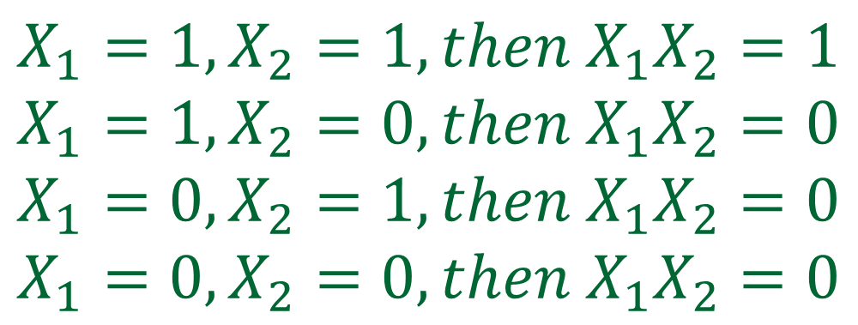
Interaction Variables
$$X_{1}=1, X_{2}=1, then X_{1}X_{2}=1$$
$$X_{1}=1, X_{2}=0, then X_{1}X_{2}=0$$
$$X_{1}=0, X_{2}=1, then X_{1}X_{2}=0$$
$$X_{1}=0, X_{2}=0, then X_{1}X_{2}=0$$
Notes:
For example, consider two binary variables, where when the variable is present it is coded as 1 and 0 otherwise. The product of two binary variables is another binary variable which is 1 when both variables are present and 0 otherwise. With two binary variables four situations are possible and the only time the product is 1 is when both variables are present. If one variable is binary and another continuous, the product of the variable will be 0 when the binary variable or the continuous variable is 0 and otherwise same as the continuous variable. If both variables are continuous then the product of both variables will be continuous and a larger number than the sum of the two variables. Including interaction terms in regression expands our ability to model events.

Slide 28
How to Regress in R
And Excel?
Notes:
Once the data have been prepared, the next step is to run a regression.

Slide 29
Regression:
Using Excel
Notes:
You can do a regression using Excel.

Slide 30
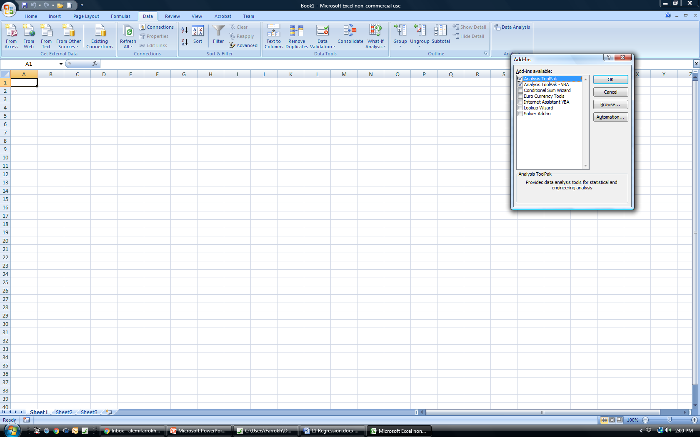
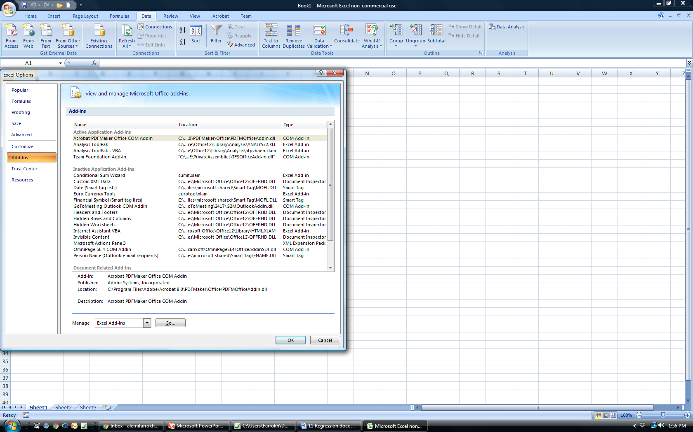
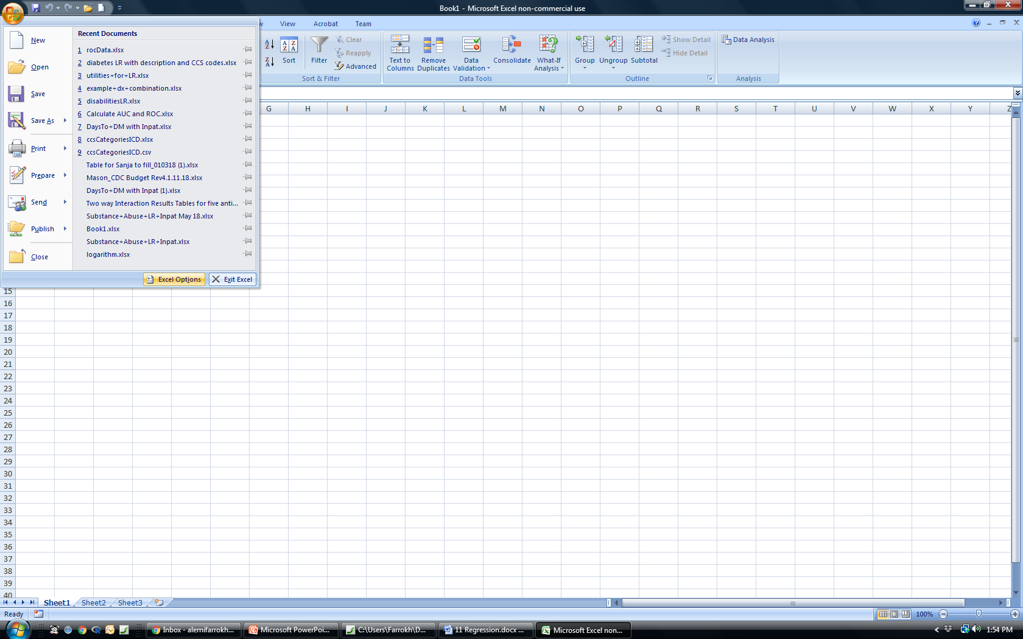
First Add-in Analysis Tool Pack
5
6
1
2
add in the analysis tool pack
4
3
4
3
Notes:
To use Excel to do regression you must first add in the analysis tool pack. This is done by (1) clicking on Excel logo, (2) clicking on “Add Ins,” from the vertical menu list; (3) selecting “Manage Add Ins,” then (4) clicking on “Go.” Once the menu for add in comes in then select both the analysis tool packs.

Slide 31
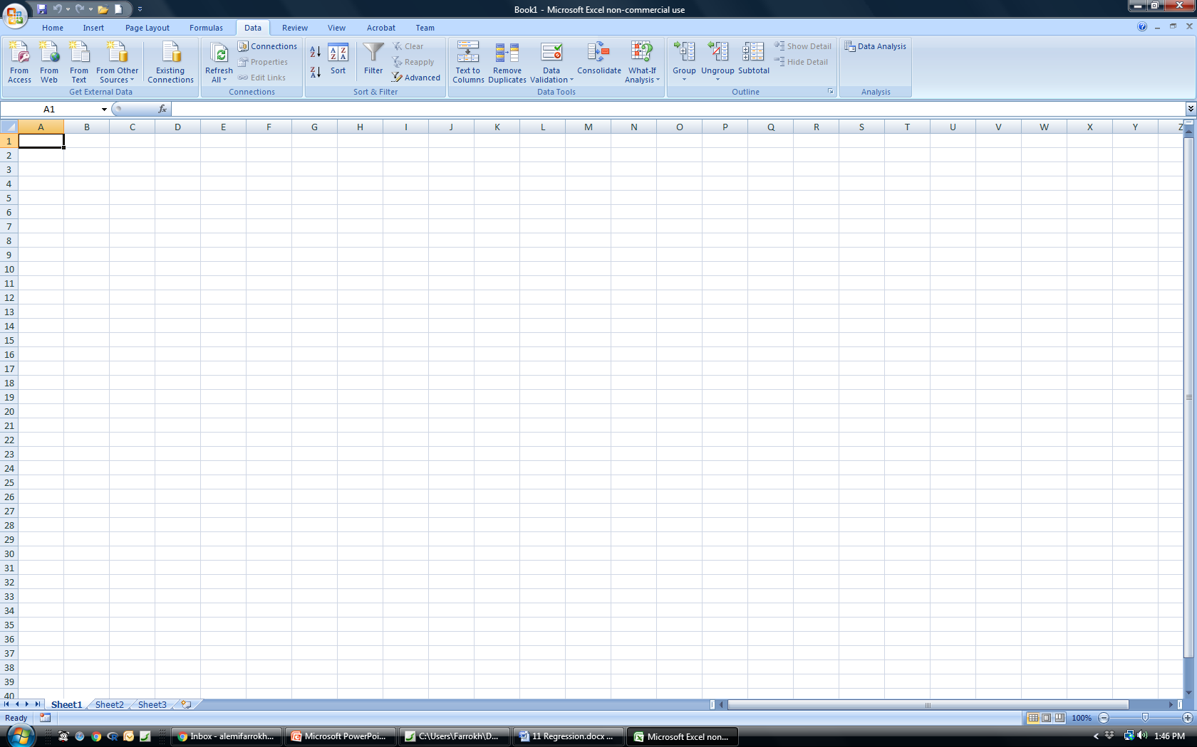
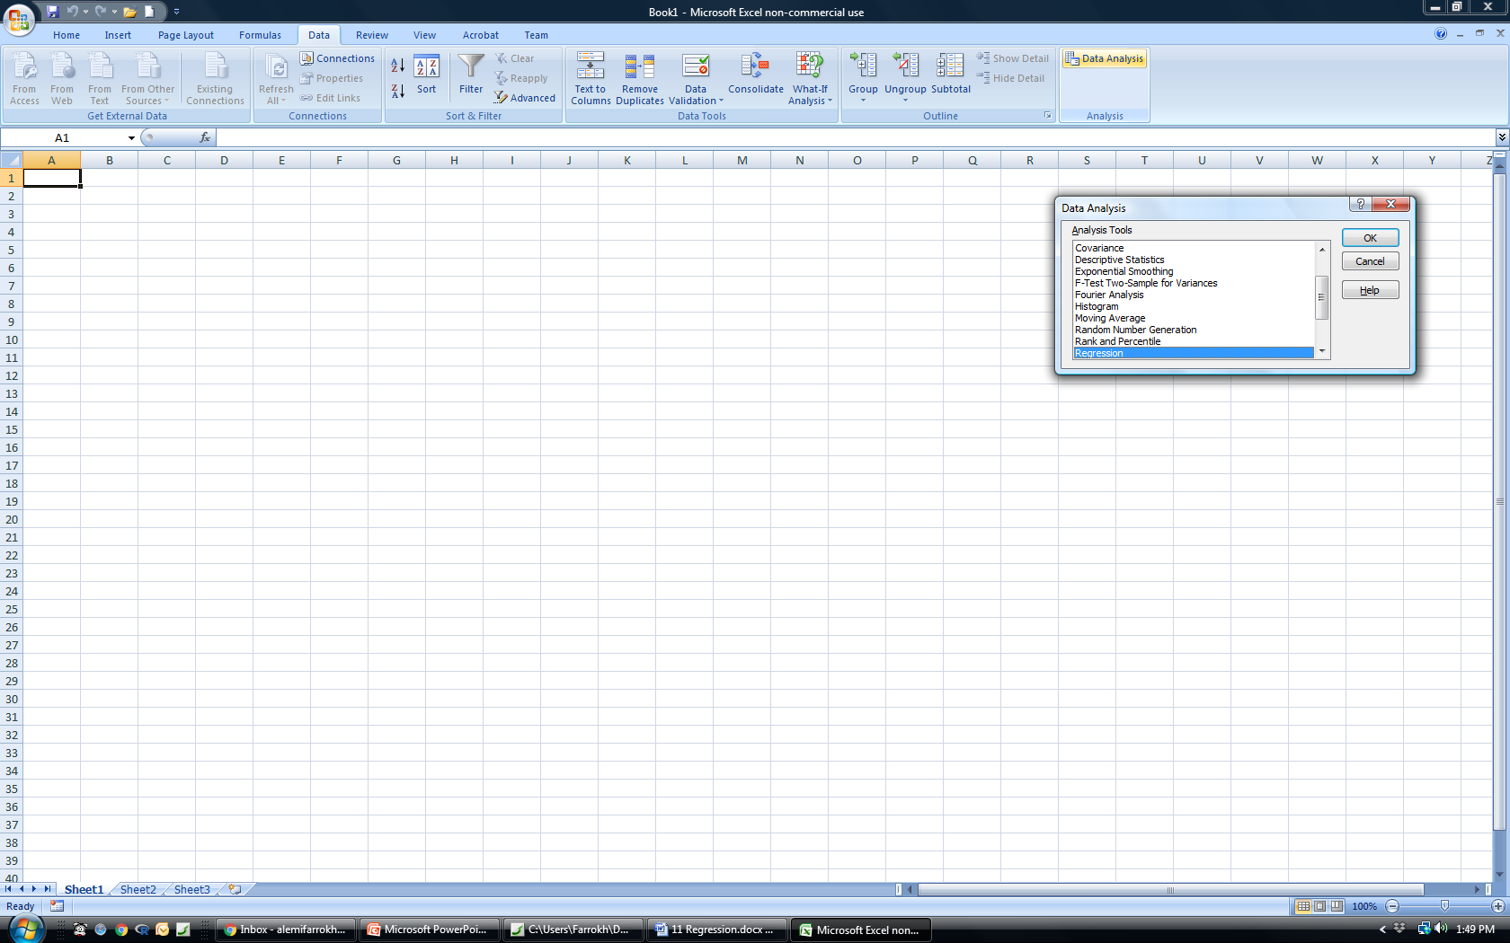
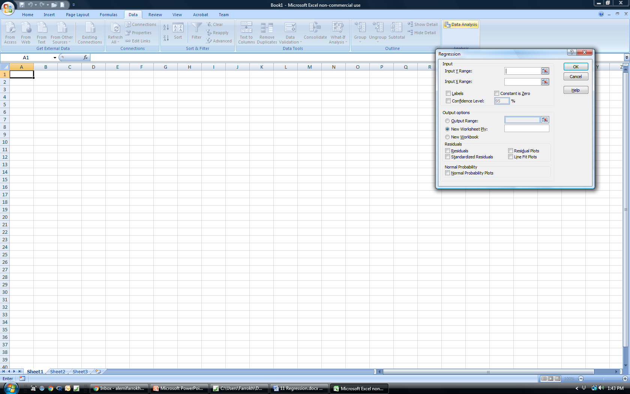
Regression
Menu in Excel
7
8
9
8
Notes:
The first 6 steps had to do with adding in the tool pack. Regression is one of the options in data analysis tool pack. The regression menu requires the specification of the input variables. The dependent or Y range must be specified. The dependent variable must be numerical with no missing value or text. A common error in Excel is that one of the values in the dependent variable is entered as text, making it impossible to run the regression. The range for the independent variables should also be specified. This range must be as long as the dependent variable. Up to a maximum of 250 variables can be included in this range. If the first row contains name of the variable, check the box next to labels. If there are no intercepts allowed in the regression equation, a rare situation, check the box “Constant is Zero.” The output options must be specified and make sure that you do not designate the output to be the same place where you kept the data, as it will wipe out the data. Options on residual plots can also be specified. The normal probability plot tests the assumption of normal distribution of variables.

Slide 32
Regression:
Using R
Notes:
You can do a regression using free software R.

Slide 33
Using R
1. Download R
https://cran.r-project.org/bin/windows/base/old/3.3.1/
Notes:
R is an open source free software which can be installed from this link.

Slide 34


Using R
2. Set Working Directory
Notes:
Before reading data into R, we need to check that we have set our working directory properly. In R, this can be achieved by using the “getwd()” command. It provides what is the working directory for R. In my computer it resulted into the result shown.
What this means, is that R is currently setup to look for files in the “Users/HAP” directory on our machine. Let us assume that our data is stored in the “Users/HAP/Documents” directory, and so to change the R working directory, we need to use the “setwd()” command

Slide 35


Using R
3. Read Data
Notes:
The easiest way to read data into R is use Comma Separated Variable, CSV, Files
Our data file is titled “MFHcleanedup.csv” and to read this into R we need to use the read.csv() command.
What we have done with the above code is to tell R to read the data into an object called “mfh” in our R workspace. We can check the type of the object “mfh” is through using the class() function.
Now we know that we have set up a data frame. A data frame has all the data needed for analysis in a matrix format with headings and related information. We are now set to proceed with analysis.

Slide 36
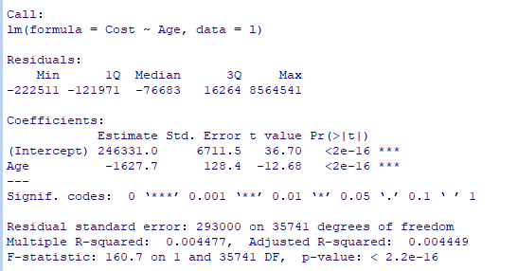
Using R: 4 Regression
Notes:
R code requires us to call a function called lm(). The column listed before the tilde is the response or dependent variable and the column listed after is the independent variable. The first set of output is the distribution of residuals shown in terms of 5 points: minimum, 1st quartile, median, 3rd quartile, and the maximum. One expects to see a normal distribution which is symmetric around median. The coefficients lists the intercept and age parameters. The probability that the t-statistic calculated from the observed coefficient is different from zero is also provided.

Slide 37
Meaning of Regression
Output
Fit Statistics
Fit Statistics
Coefficients
Notes:
There are three components to the regression output. The first has to do with coefficients of the regression equation. The second output has to do with goodness of fit. The last set of output are a series of plots and statistics that can be used to test regression assumptions.

Slide 38
Meaning of
Regression Coefficients
Notes:
Regression output provides the coefficients for the equation we have specified and their statistical significance.

Slide 39
Increase in Y for 1 unit of X
Rise
Run
Notes:
If there are no interaction among the independent variables, the slope $parameter$ estimates the per unit change in dependent variable as a function of 1 unit of increase in independent variable. The slope is the ratio of rise in Y to run in the X variable.

Slide 40
Interaction Variables
Warning:
Changes Meaning
Notes:
A note of warning is necessary about the effect of interactions on interpretation of regression parameters. Interaction terms change the interpretation of the regression parameters. At start of this chapter, we discussed the meaning of regression parameters. We did so with a single predictor or with linear models, where interaction terms are not present. When interaction terms are present, the regression coefficients no longer indicate the rise in outcome for the run in the variable. In fact, the notion of a run in a variable is no longer clear.

Slide 41
Interaction Variables
Not how much Y
changes for 1 unit of X
Notes:
Everything we mentioned about interpretation of the coefficient as slope of the line is not valid, if interaction terms are present. In a way, our effort to explain regression in ways that could help create intuitions about it has put us in a pickle. Our explanations do not work when interaction terms are present. So, what is the meaning of the regression coefficients when interaction terms are present? There is no simple answer to this question. The coefficients are the parameters of the equation and they may not have a meaning other than being a number in the best fitted equation.

Slide 42
Meaning of Probability
of Observing Coefficients
Notes:
Regression output also provides the probability of observing the estimated coefficient. If this probability is small, say smaller than 0.05, then there is a statistically significant relationship between the dependent and the independent variables.

Slide 43
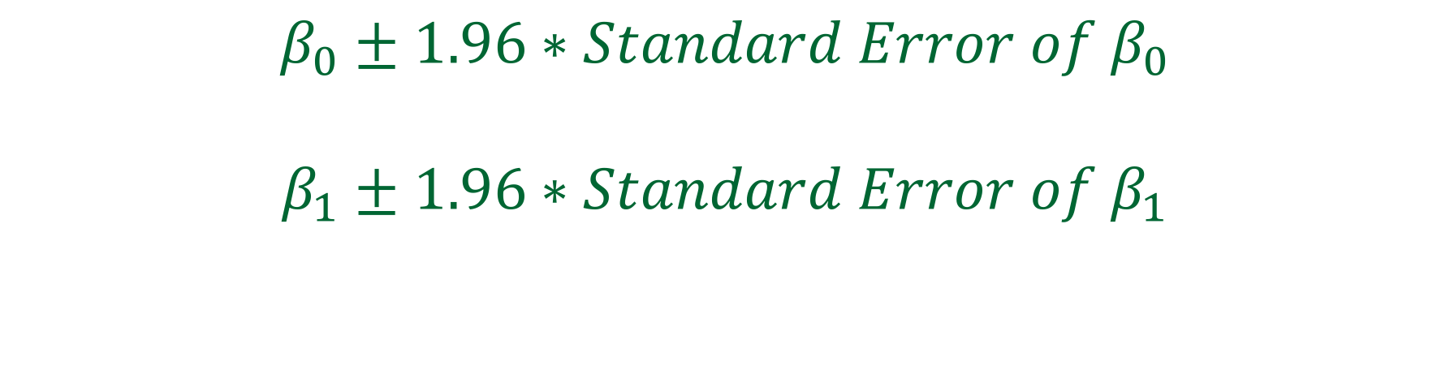
Meaning of the Probabilities
$$β_{0}±1.96∗Standard Error of β_{0}$$
$$β_{1}±1.96∗Standard Error of β_{1}$$
Notes:
The regression parameters are estimated from a sample of data. If multiple samples are taken from the same population the estimates for the parameters will be different for each sample, even though all the samples are taken from the same population. This sampling variability gives rise to standard error associated with each regression. The common way to address the uncertainty with estimates is to develop 95% confidence intervals and p-values. The 95% confidence interval for intercept, $β_{0}$, can be calculated from standard error of the estimates. Similarly 95% confidence interval for regression coefficient of an independent variable can be calculated from standard error of the estimates.

Slide 44
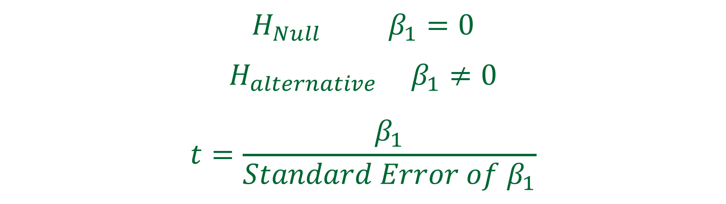
Hypothesis Testing
$${H_{Null} β}_{1}=0$$
$${H_{alternative} β}_{1}≠0$$
$$t=\frac{β_{1}}{Standard Error of β_{1}}$$
Notes:
Regression coefficients and their associated standard error can be used to test hypotheses. The null hypothesis states that real population level mean difference,$β_{1},$is equal to zero whereas the alternate hypothesis would be that this difference is not zero. For the coefficient, assuming null hypothesis to be true, then the standardized t-statistic can be calculated from standard error of the estimate. The t-statistic calculates the number of standard errors the estimated coefficient is away from 0.

Slide 45
Hypothesis Testing
$${H_{Null} β}_{1}=0$$
$${H_{alternative} β}_{1}≠0$$
$$t=\frac{β_{1}}{Standard Error of β_{1}}$$
Warning:
Context Dependent
Notes:
Testing hypotheses using regression coefficients may lead to findings that are different from direct test of hypothesis covered in chapters 4 and 5. The coefficients of regression equation are affected by other variables in the equation. When certain variables are present, a hypothesis may be rejected but when these variables are absent the same hypothesis may be accepted. In short, regression provides a context specific test of hypotheses.

Slide 46
Meaning of Fit Statistics
Notes:
Regression output also provide goodness of fit statistics. These statistics report how well the data fit the regression equation.

Slide 47
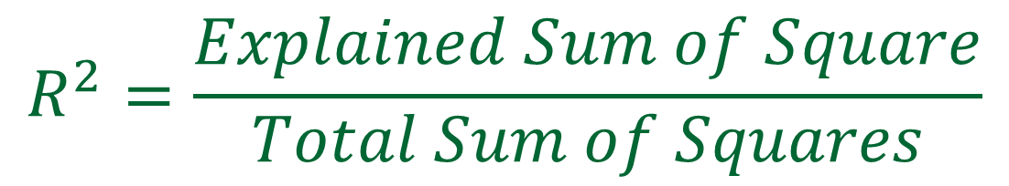
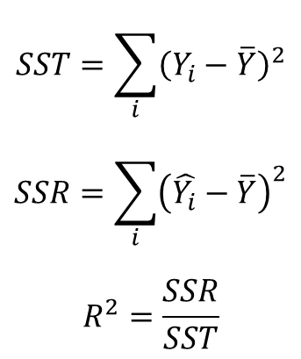
Goodness of Fit, R²
Total SS = Explained SS + Unexplained SSR
$$SST=\sum_{i}{{\left(Y_{i}−\overline{Y}\right)}^{2}}$$
$$SSR=\sum_{i}{{\left(\hat{Y_{i}}−\overline{Y}\right)}^{2}}$$
$$R^{2}=\frac{SSR}{SST}$$
$$R^{2}=\frac{Explained Sum of Square}{Total Sum of Squares}$$
Notes:
The R squared, $R^{2}$, is used to measure the goodness of fit between the equation and the data. It reports the strength of association between the outcome variable denoted by Y and the independent variables. The value of $R^{2}$ can be anywhere from 0 to 1, where 0 highlights no association at all and 1 representing the strongest possible association. An$R^{2 }$of one indicates that the independent variables perfectly predict the dependent variable. Since this only occurs when the prediction task is over specified (more independent variables than cases in the sample), or tautological (predicting something from itself), one never sees an $R^{2}$of 1. The statistic $R^{2}$estimates the percent of variability in the outcome variable explained by independent variables. The total sum of squares is a measure of the variability of observations around the mean of the observations. The unexplained sum of squares is the sum of square of the residuals; where residuals are the difference between observed outcome and predicted outcomes. The difference between total sum of squares and sum of squared residuals is the explained sum of squares. The coefficient of determination is calculated as the ratio of explained to total sum of squares.

Slide 48
Goodness of Fit, R²
Warning:
More Variables Higher R²
Total SS = Explained SS + Unexplained SS
$$R^{2}=\frac{Explained Sum of Square}{Total Sum of Squares}$$
Notes:
One peculiar problem with $R^{2}$is that it increases whenever a new variable is included in the model. In other words, one expects the fit to the data to become increasingly accurate as the number of variables increase. The adjusted-$R^{2}$corrects the $R^{2}$value by the degrees of freedom available. Thus, it allows one to examine if the addition of a new variable increases the adjusted value and thus makes real improvement.

Slide 49
Goodness of Fit, R²
Warning:
Massive Data Lower R²
Total SS = Explained SS + Unexplained SS
$$R^{2}=\frac{Explained Sum of Square}{Total Sum of Squares}$$
Notes:
Keep in mind that the statistic $R^{2}$is sensitive to the size of the data. As the size of data increases, there is more variability in the data; and a smaller percent of variability could be explained by a fixed set of variables. Thus, for very large data, for example millions of patients, 100 independent variables may explain 25% of the total variability. Despite the low number this may be a reasonable model. For a small data, for example 2,000 cases, 100 variables may explain 80% of the variability. An$R^{2}$of 25% maybe low in a small but reasonable in a massive database. In small data there is less variability to explain to begin with.

Slide 50
Models that are
predictive &
parsimonious
Notes:
In developing regression models it is important to keep in mind two competing considerations. The first is that one wants a model that accounts for most of the variation of the dependent variable. In other words, develop a model that maximize the coefficient of determination, the explained proportion of variation in the dependent variable. A larger portion of the variation in outcome can be explained by including more independent variables in the model. The second consideration is that the regression model should be as parsimonious as possible. The simplest model that has the highest coefficient of determination should be chosen. This criterion is maximized by selecting as few independent variable as possible. The analyst must examine several models and then choose the model that has best predictions with fewest independent variables.

Slide 51
Hierarchical Regression:
Add & Re-Test
Notes:
In hierarchical regression modeling two regressions is done. Variables known to have a strong relationship with outcome are put into the first regression. The percent of variation in outcome explained by the regression is noted. Then an additional independent variable or a set of additional variables are added and a second regression is done. If the percent of variation in outcome explained by the second regression is significantly higher than the percent explained by the original regression then the new variable(s) are retained in the regression. Otherwise the variables are discarded. The process is continued until all new independent variables are examined. In this approach the analyst decides on the order with which various sets of variables are entered into the regression.

Slide 52
Forward Selection:
Add & Re-Test
Notes:
When the order is decided by the software, using the variable with highest percent of variation explained first, and then adding additional variable, the process is called forward step-wise selection of variables. In forward selection, once a variable is entered into the regression equation the variable is not taken out if other variables undermine its influence on the outcome.

Slide 53
Backward Selection:
Remove & Re-Test
Notes:
When we start with all independent variables and progressively drop one variable that does not explain variation in the outcome, then the process is called backward stepwise selection of independent variables.

Slide 54
Cross Validation:
Report R² in New Data
Notes:
To avoid over-fitting the data, where the noise in the data is modeled, it is important that the performance of various models -- whether hierarchical, forward, or backward -- should be checked in new data sets, a concept known as cross-validation.

Slide 55
Co-linearity:
Can Change Significance
Notes:
Collinearity refers to strong correlation among some of the independent variables in a regression model. Collinearity affects the variance of regression co-efficient therefore in presence of collinearity the regression coefficients change. A simple view of relationships between two variables assumes that one variable affects another. In regression, this simple view is often proven wrong. The effect of two variables on each other could depend on a yet third variable inside the regression equation.

Slide 56
Co-linearity:
Age
Sex
Cost
Notes:
For example, in predicting cost of care, the effect of aging on cost could depend on gender, a different variable in the equation. If two independent variables (X₁ and X₂) are correlated then the impact of each on the outcome Y depends on the other. Another way of saying this is that if the two variables have strong correlations, then one of these variables can change a significant relationship of the other variable with the outcome to an insignificant relationship. In short, the impact of variables depends on other variables that are also in the regression equation. In this sense, relationships found in regression are context dependent. With one set of variables, the relationship may exist; and with another, it may vanish. The existence of collinearity can be anticipated by calculating the correlation matrix, the correlation between any two pairs of independent variables. It is not always clear what to do with collinearity. One could drop one of the two correlated variables but that may reduce predictive accuracy and may make models that are sensitive to missing values. One can continue with both variables in the model, assuming that the observed coefficients may be affected.

Slide 57
Ordinary Regression assumptions must be verified and output correctly interpreted
Notes:
To use ordinary regression, verify assumptions, transform data, then interpret the results.

