Slide 1
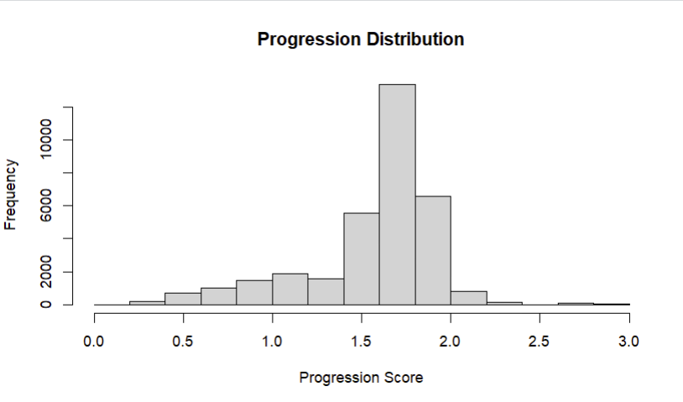
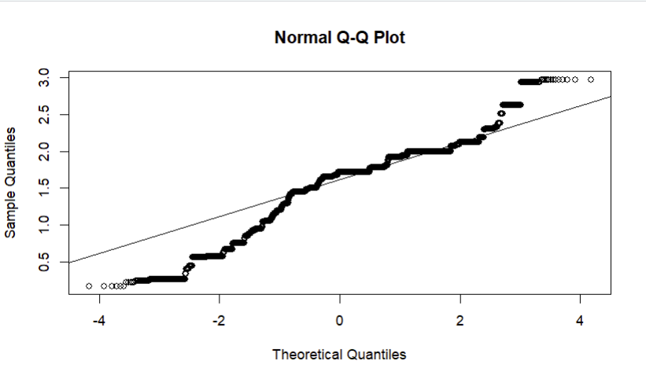
10% sample data Distribution and QQplot

Slide 2
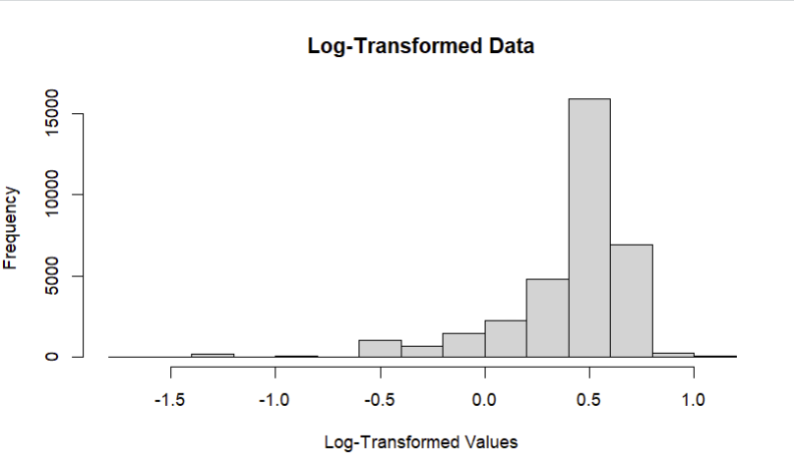
10% sample data Distribution and QQplot after log transformation

Slide 3
10% sample data Distribution and QQplot after squart transformation

Slide 4
10% sample data Distribution and QQplot after quantile transformation

