Slide 1
Ordinary Regression Q2

Slide 2
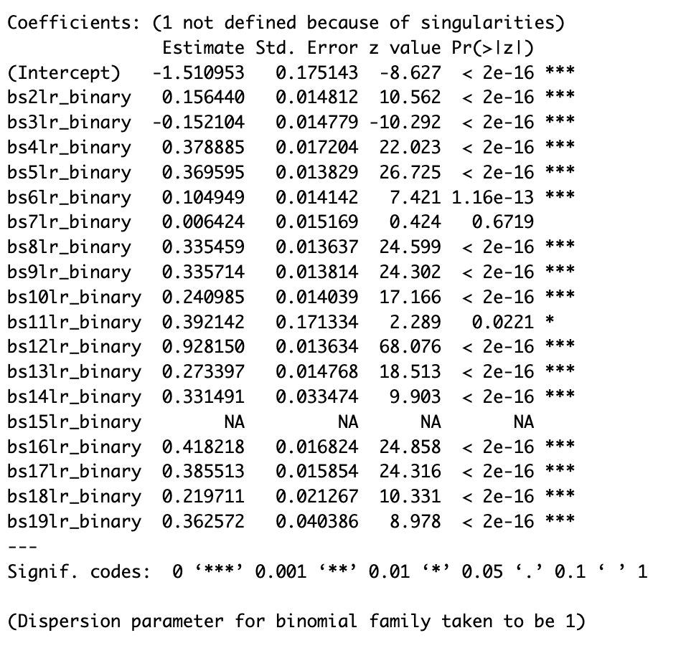
Create a binary variable that is 1 every time a variable is missing and 0 otherwise. Predict Progression in
Infectious and Parasite body system from binary diseases and report if any of the variables is statistically
significant. List variables that are not missing at random.

Slide 3
According to the regression results we can determine that:
bs7lr – Circulatory System is the variable that is missing at Random
bs15lr – Perinatal Period is missing everywhere and should be dropped from analysis.

Slide 4
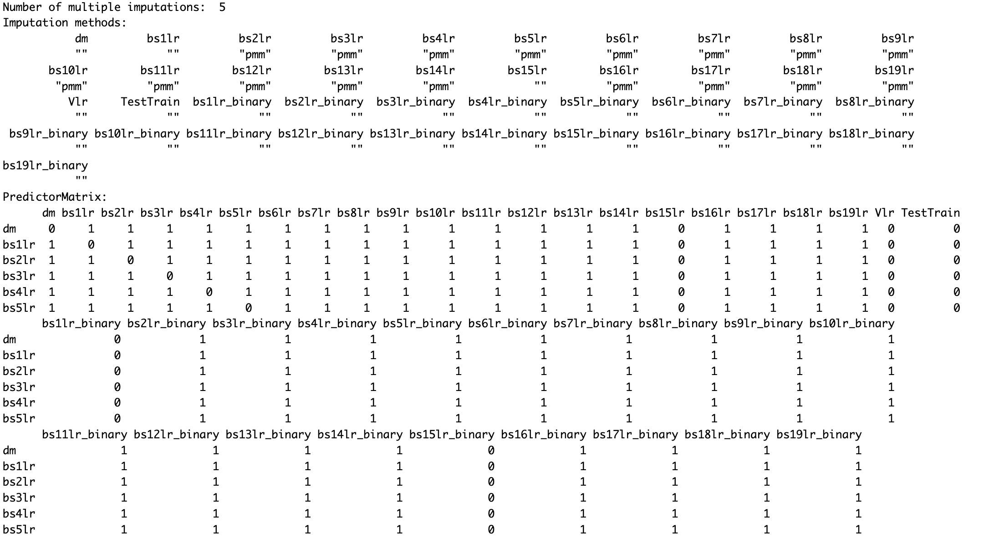
The output of the imputation function:

Slide 5
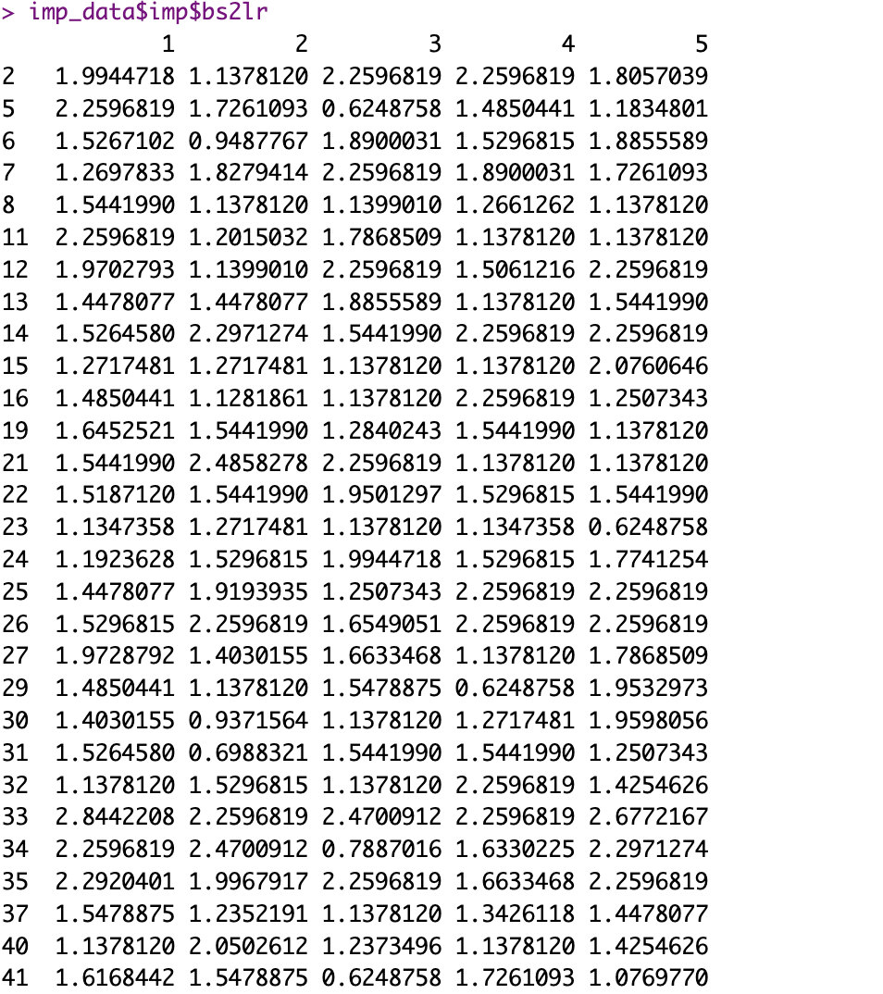
If you want to look at a specific variable's imputed data—for instance, the variable bs2lr

Slide 6
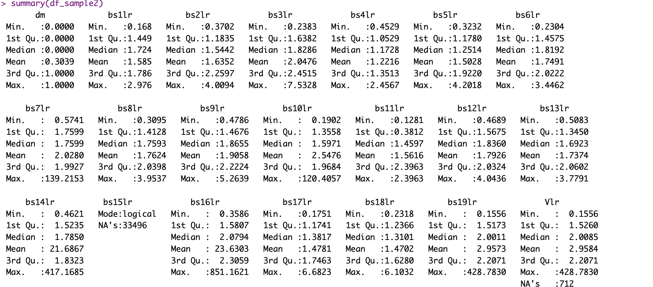
Summary of the Completed data after imputation:

