Slide 1
Performing ANOVA in R
HAP 719
Yili Lin

Slide 2
Introduction to ANOVA
Definition

Slide 3
Introduction to ANOVA
Definition
Purpose

Slide 4
Introduction to ANOVA
Definition
Purpose
Types of ANOVA
One-Way ANOVA

Slide 5
Introduction to ANOVA
Definition
Purpose
Types of ANOVA
One-Way ANOVA
Two-Way ANOVA

Slide 6
Assumptions of ANOVA
Normality

Slide 7
Assumptions of ANOVA
Normality
2. Homogeneity of Variance (Homoscedasticity)

Slide 8
Assumptions of ANOVA
Normality
2. Homogeneity of Variance (Homoscedasticity)
3. Independence of Observations

Slide 9
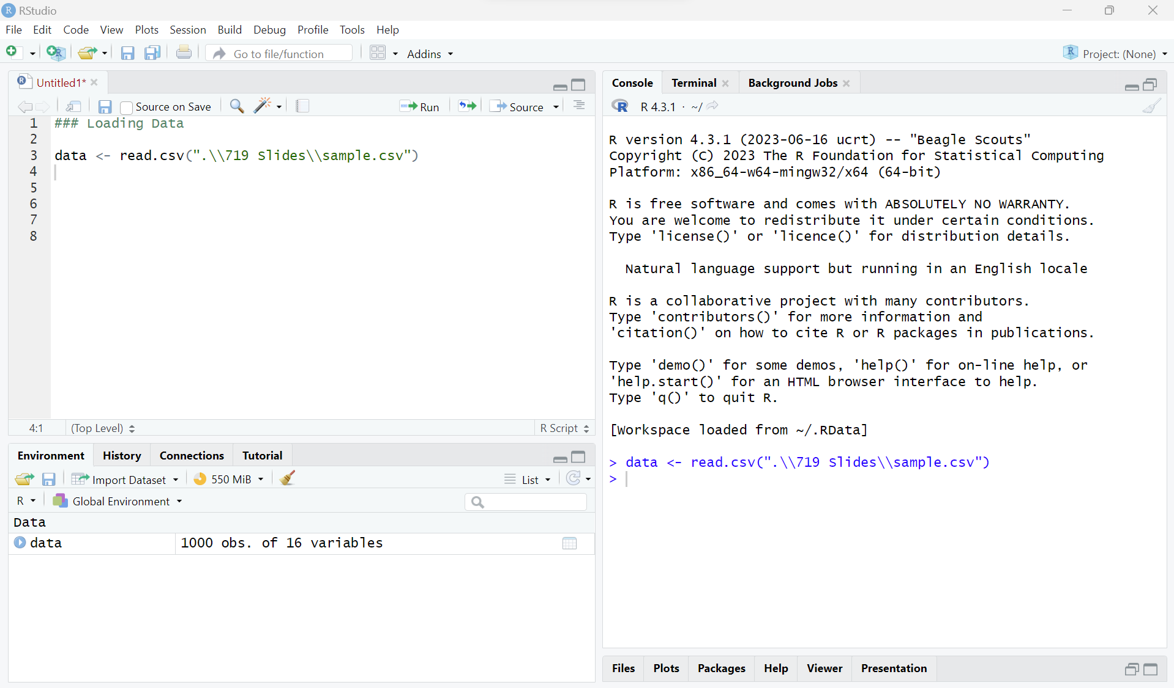
STEP1: Preparing the Data
1.1 Load Data

Slide 10
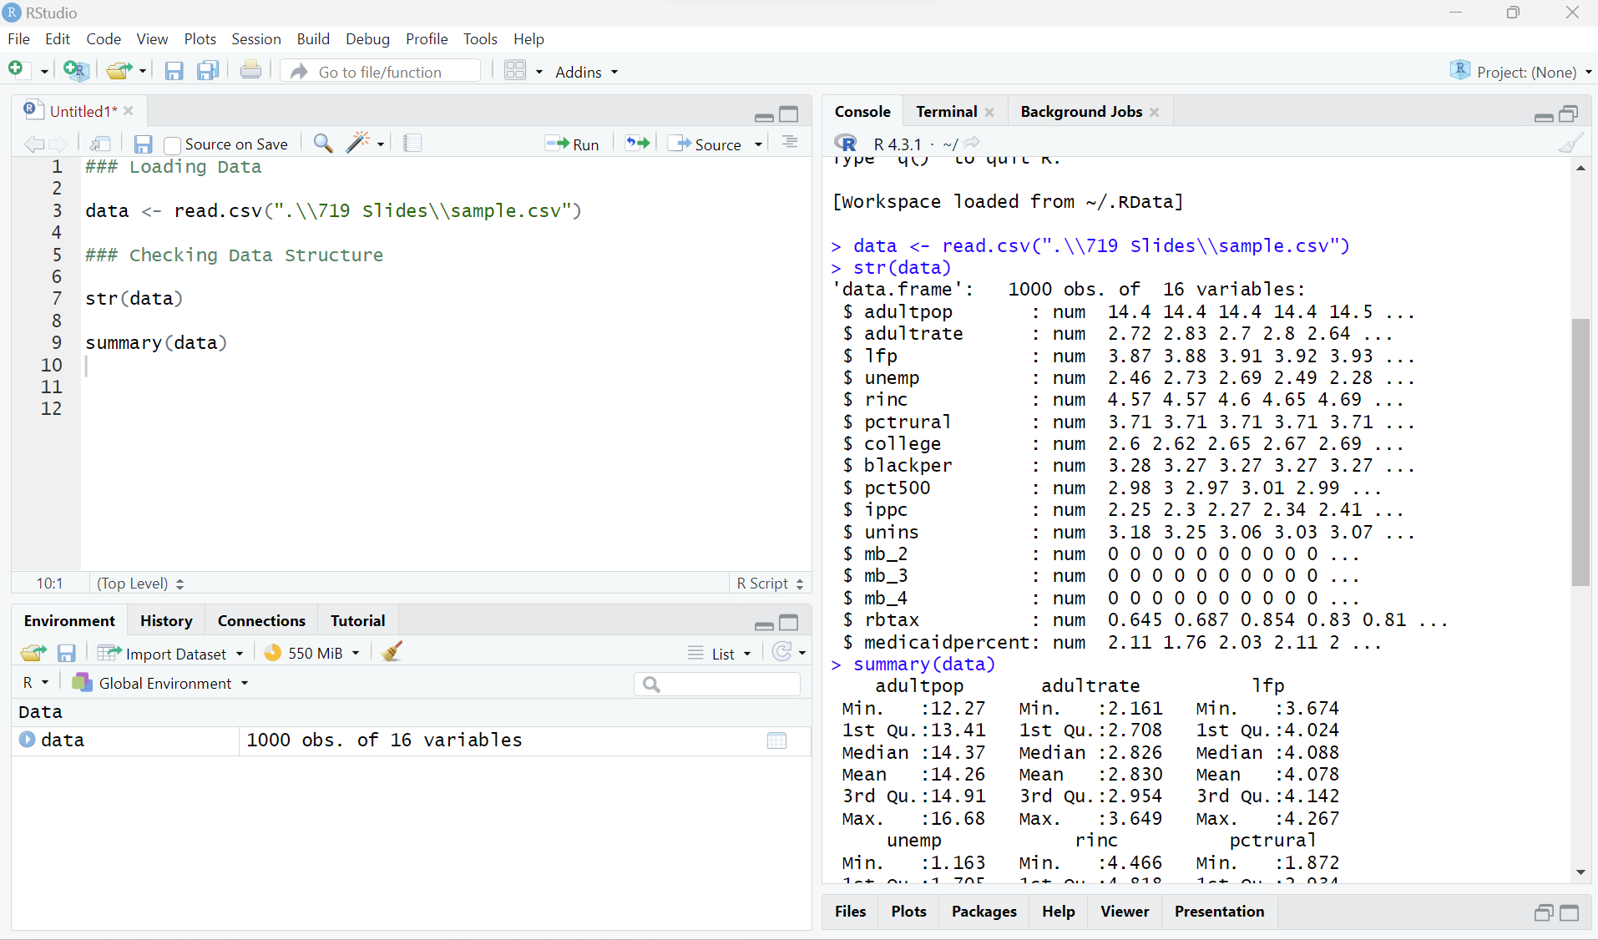
STEP1: Preparing the Data
1.1 Load Data
1.2 Check Data Structure

Slide 11
STEP1: Preparing the Data
1.1 Load Data
1.2 Check Data Structure
1.3 Handle Missing Values
See the session:
Handling Missing Values in R

Slide 12
STEP1: Preparing the Data
1.1 Load Data
1.2 Check Data Structure
1.3 Handle Missing Values
1.4 Check Assumptions
See the session:
Testing Assumptions in R

Slide 13
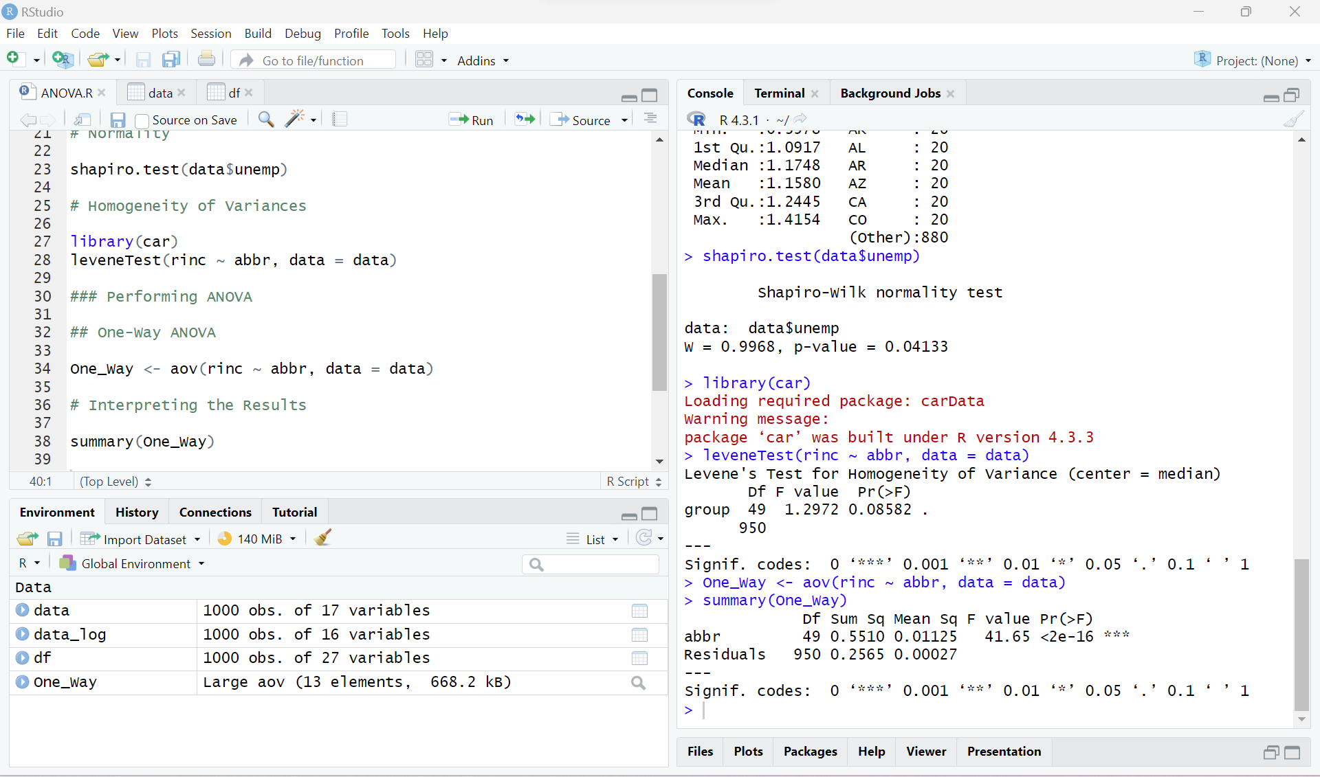
STEP2: Performing ANOVA in R
2.1 One-Way ANOVA

Slide 14
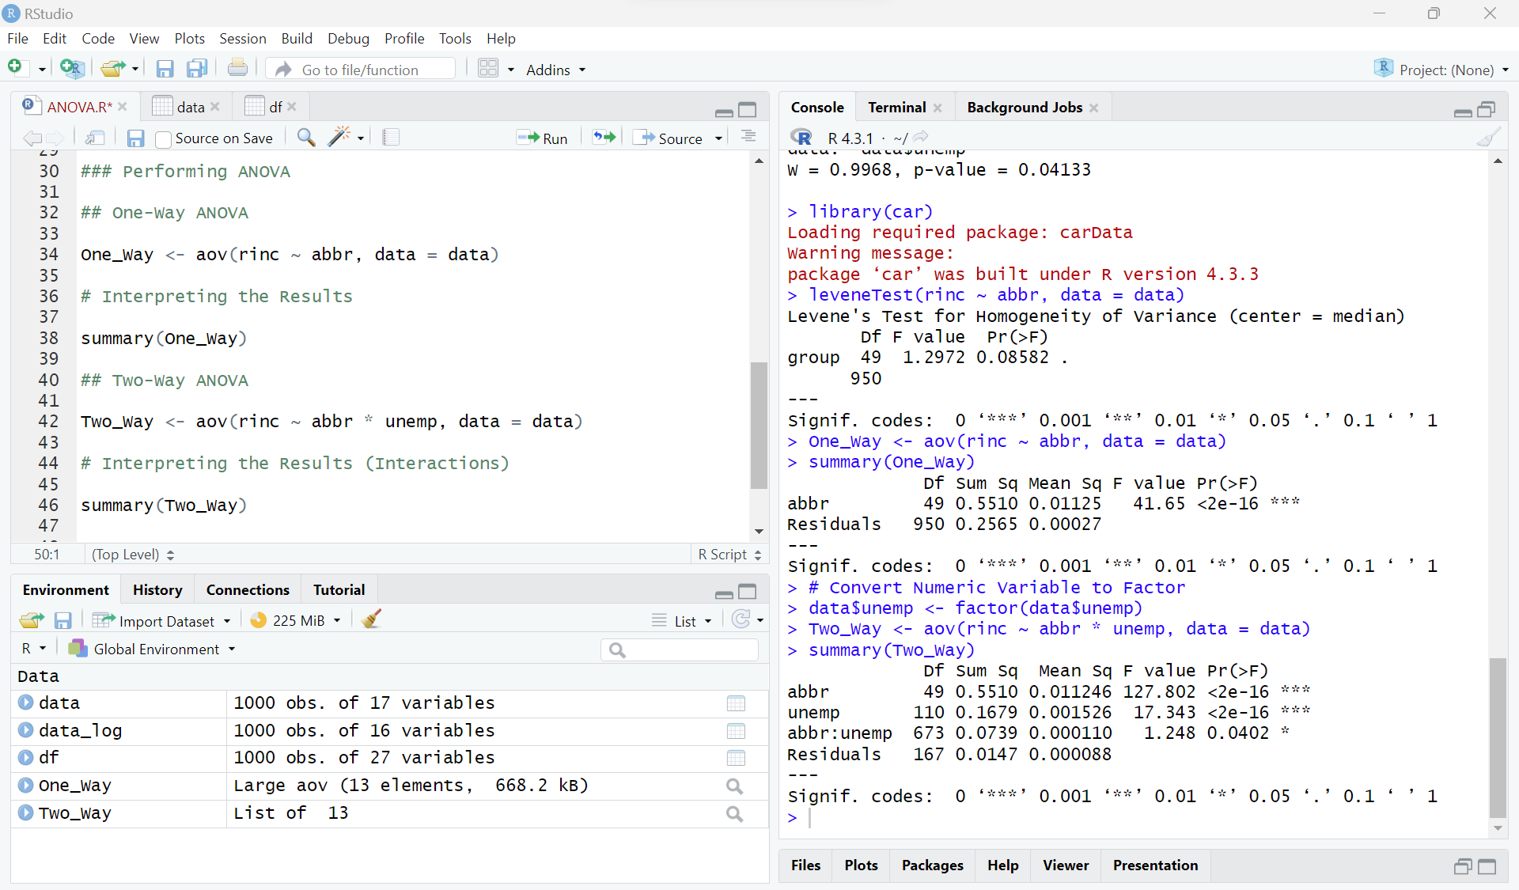
STEP2: Performing ANOVA in R
2.1 One-Way ANOVA
2.2 Two-Way ANOVA

Slide 15
STEP3: Data Interpretation & Validation
3.1 Interpret the Results
See the session: Interpreting ANOVA and Regression Output in R

Slide 16
STEP3: Data Interpretation & Validation
3.1 Interpret the Results
3.2 Check Assumptions (Residuals)
See the session:
Testing Assumptions in R

Slide 17
STEP3: Data Interpretation & Validation
3.1 Interpret the Results
3.2 Check Assumptions (Residuals)
3.3 Consider Further Analysis

Slide 18
STEP3: Data Interpretation & Validation
3.1 Interpret the Results
3.2 Check Assumptions (Residuals)
3.3 Consider Further Analysis
3.4 Review and Validate

Slide 19
STEP4: Communication & Reporting
4.1 Visualize the Results

Slide 20
STEP4: Communication & Reporting
4.1 Visualize the Results
4.2 Report Findings

Slide 21
STEP4: Communication & Reporting
4.1 Visualize the Results
4.2 Report Findings
4.3 Communicate the Results

Slide 22
Thank You!

