Slide 1
Performing Ordinary Regression in R
HAP 719: Advanced Statistics I
Yili Lin

Slide 2
Introduction to Ordinary Regression
Definition
Purpose
Types of Regression
Simple Linear Regression
$$y=β_{0}+β_{1}x+ε$$
$y$ $=$ dependent variable (response)
$β_{0}$ $=$ intercept (constant term)
$β_{1}=$ regression coefficients (slopes for each predictor)
$x_{1}=$ independent variables (predictors)
$ε$ $=$ error term (residuals)

Slide 3
Introduction to Ordinary Regression
Definition
Purpose
Types of Regression
Simple Linear Regression
Multiple Linear Regression
$$y=β_{0}+β_{1}x_{1}+β_{2}x_{2}+ ⋯ +β_{n}x_{n}+ε$$
$y$ $=$ dependent variable (response)
$β_{0}$ $=$ intercept (constant term)
$β_{1}$, $β_{2}$, $⋯$, $β_{n}$ $=$ regression coefficients (slopes for each predictor)
$x_{1}$, $x_{2}$, $⋯$, $x_{2}$ $=$ independent variables (predictors)
$ε$ $=$ error term (residuals)

Slide 4
Assumptions for Ordinary Regression
1. Linearity
2. Homoscedasticity
3. Independence
4. Normality of Residuals
5. No Multicollinearity (For Multiple Regression)

Slide 5
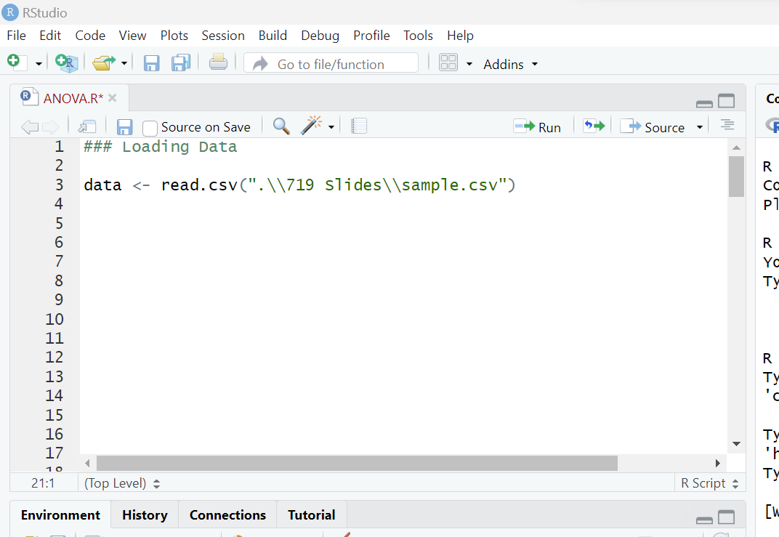
STEP1: Preparing the Data
1.1 Load Data

Slide 6
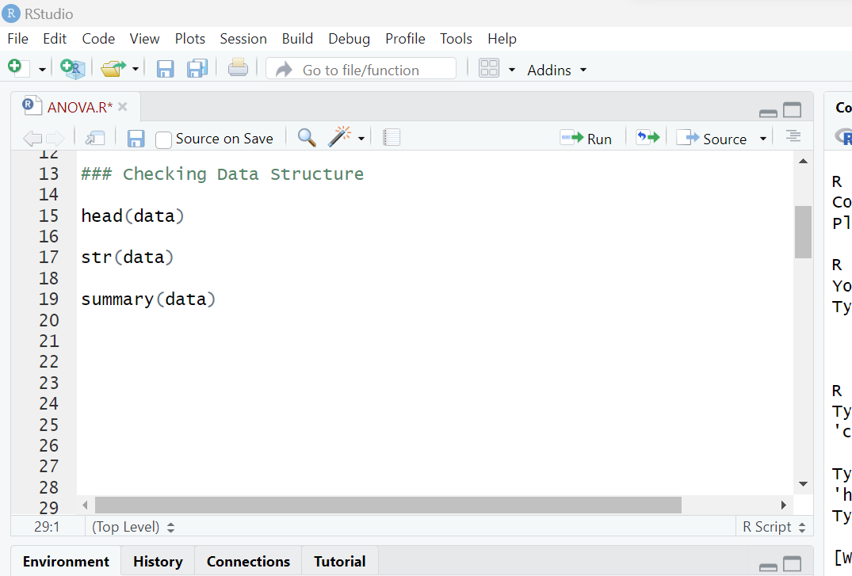
STEP1: Preparing the Data
1.1 Load Data
1.2 Check Data Structure

Slide 7
STEP1: Preparing the Data
1.1 Load Data
1.2 Check Data Structure
1.3 Handle Missing Values
See the session:
Addressing Missing Values in R

Slide 8
STEP1: Preparing the Data
1.1 Load Data
1.2 Check Data Structure
1.3 Handle Missing Values
1.4 Check Assumptions
See the session:
Testing Assumptions for Ordinary Regression in R

Slide 9
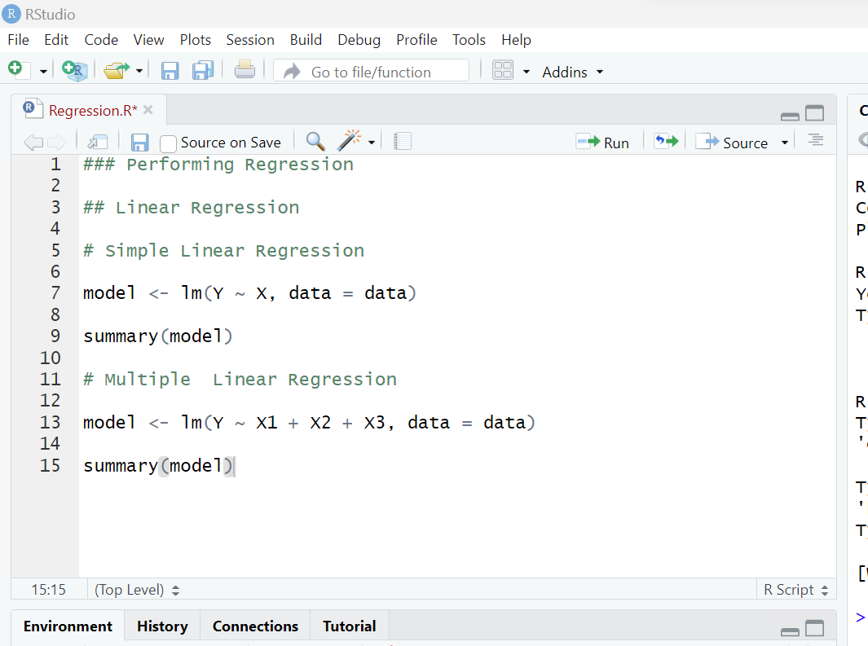
STEP2: Performing Ordinary Regression
2.1 Simple Linear Regression

Slide 10
STEP2: Performing Ordinary Regression
2.1 Simple Linear Regression
2.2 Multiple Linear Regression

Slide 11
STEP3: Data Interpretation & Validation
3.1 Interpret the Results
See the session:
Interpreting Ordinary Regression Output in R

Slide 12
STEP3: Data Interpretation & Validation
3.1 Interpret the Results
3.2 Check Assumptions (Residuals)
See the session:
Testing Assumptions for Ordinary Regression in R

Slide 13
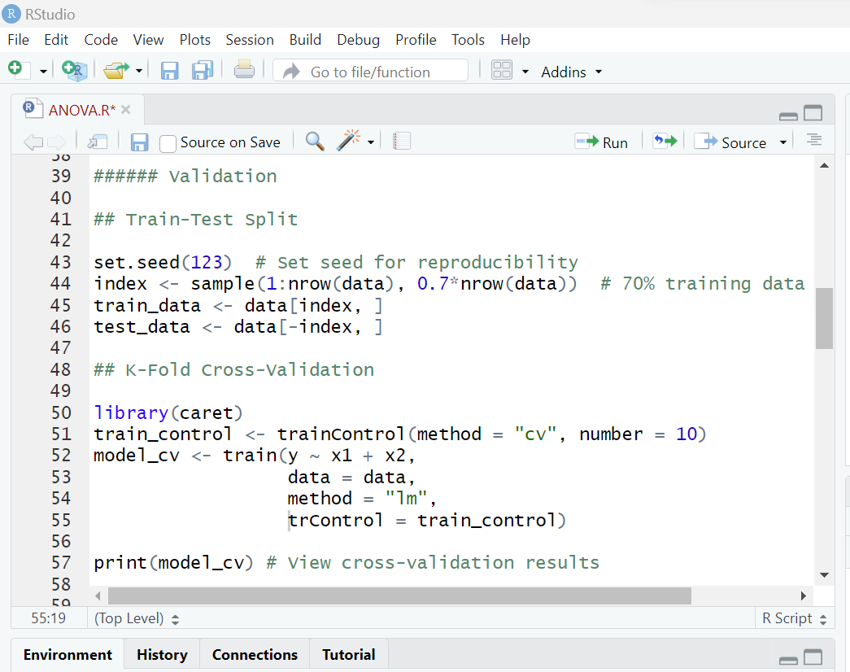
STEP3: Data Interpretation & Validation
3.1 Interpret the Results
3.2 Check Assumptions (Residuals)
3.3 Validation
Train-Test Split

Slide 14
STEP3: Data Interpretation & Validation
3.1 Interpret the Results
3.2 Check Assumptions (Residuals)
3.3 Validation
Train-Test Split
Cross-validation (e.g. K-fold)

Slide 15
STEP3: Data Interpretation & Validation
3.1 Interpret the Results
3.2 Check Assumptions (Residuals)
3.3 Validation
Train-Test Split
Cross-validation (e.g. K-fold)
Validation Metrics (e.g.. MSE, RMSE or R-squared)

Slide 16
STEP4: Communication & Reporting
4.1 State the Objective
4.2 Present Results Clearly
4.3 Interpret the Results
4.4 Acknowledge Limitations
4.5 Provide Recommendations
4.6 Use Visuals Effectively

Slide 17
Thank You!

