Slide 1
Performing Regression Analysis in R
HAP 719: Advanced Statistics I
Yili Lin

Slide 2
Introduction to Regression Analysis
Definition

Slide 3
Introduction to Regression Analysis
Definition
Purpose

Slide 4
Introduction to Regression Analysis
Definition
Purpose
Types of Regression
Linear Regression (Simple&Multiple)
$$y=β_{0}+β_{1}x_{1}+β_{2}x_{2}+ ⋯ +β_{n}x_{n}+ε$$
$y$ $=$ dependent variable (response)
$β_{0}$ $=$ intercept (constant term)
$β_{1}$, $β_{2}$, $⋯$, $β_{n}$ $=$ regression coefficients (slopes for each predictor)
$x_{1}$, $x_{2}$, $⋯$, $x_{2}$ $=$ independent variables (predictors)
$ε$ $=$ error term (residuals)

Slide 5
Introduction to Regression Analysis
Definition
Purpose
Types of Regression
Linear Regression (Simple&Multiple)
Logistic Regression
$\log\left(\frac{P(y=1) }{P(y=0)}\right)=β_{0}+β_{1}x_{1}+β_{2}x_{2}+ ⋯ +β_{n}x_{n}+ε$OR $P\left(y=1\right)=\frac{1}{1+e^{−(β_{0}+β_{1}x_{1}+β_{2}x_{2}+ ⋯ +β_{n}x_{n})}}$
$P(y=1)=$ the probability that the outcome is 1 (success)
$β_{0}$ $=$ intercept (constant term)
$β_{1}$, $β_{2}$, $⋯$, $β_{n}$ $=$ regression coefficients (slopes for each predictor)
$x_{1}$, $x_{2}$, $⋯$, $x_{2}$ $=$ independent variables (predictors)

Slide 6
Assumptions for Regression Analysis
1. Linearity

Slide 7
Assumptions for Regression Analysis
1. Linearity
2. Homoscedasticity

Slide 8
Assumptions for Regression Analysis
1. Linearity
2. Homoscedasticity
3. Independence

Slide 9
Assumptions for Regression Analysis
1. Linearity
2. Homoscedasticity
3. Independence
4. Normality of Residuals

Slide 10
Assumptions for Regression Analysis
1. Linearity
2. Homoscedasticity
3. Independence
4. Normality of Residuals
5. No Multicollinearity

Slide 11
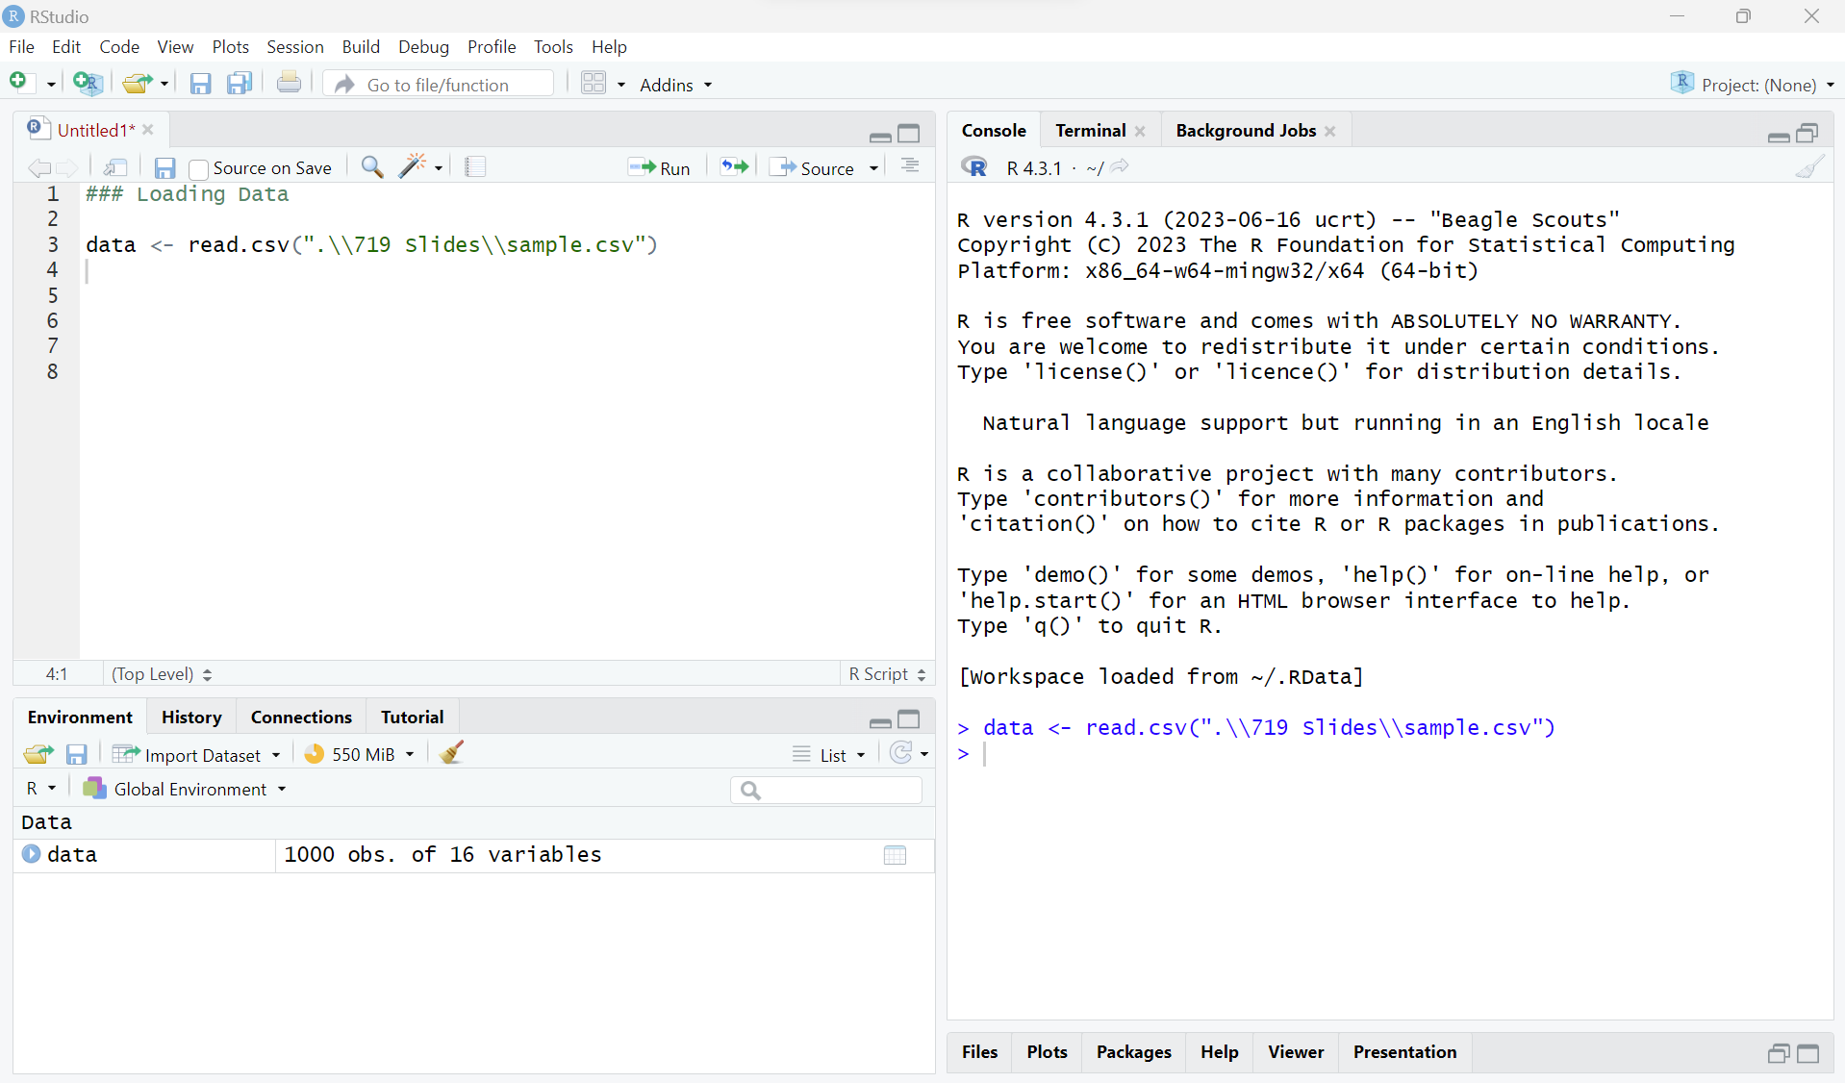
STEP1: Preparing the Data
1.1 Load Data

Slide 12
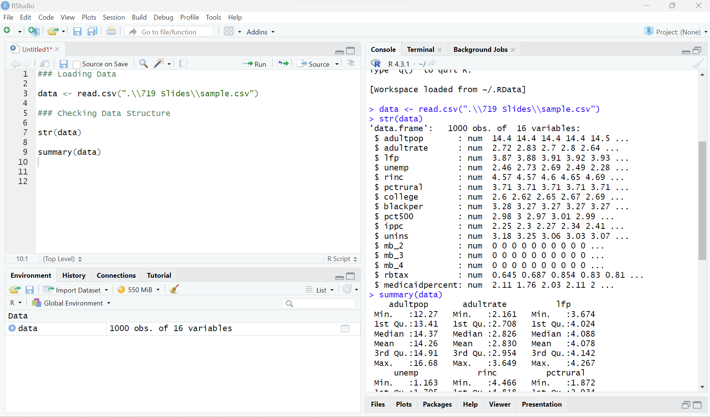
STEP1: Preparing the Data
1.1 Load Data
1.2 Check Data Structure

Slide 13
STEP1: Preparing the Data
1.1 Load Data
1.2 Check Data Structure
1.3 Handle Missing Values
See the session:
Handling Missing Values in R

Slide 14
STEP1: Preparing the Data
1.1 Load Data
1.2 Check Data Structure
1.3 Handle Missing Values
1.4 Check Assumptions
See the session:
Testing Assumptions for Regression in R

Slide 15
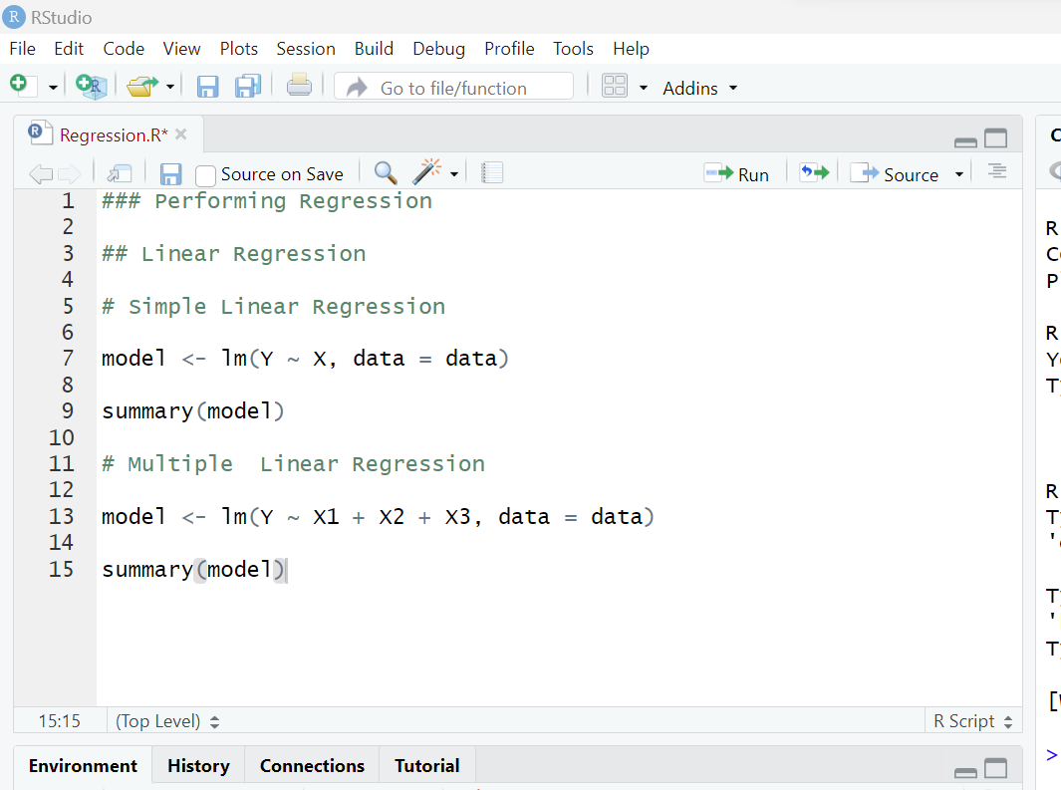
STEP2: Performing Regression in R
2.1 Linear Regression
Simple Linear Regression

Slide 16
STEP2: Performing Regression in R
2.1 Linear Regression
Simple Linear Regression
Multiple Linear Regression

Slide 17
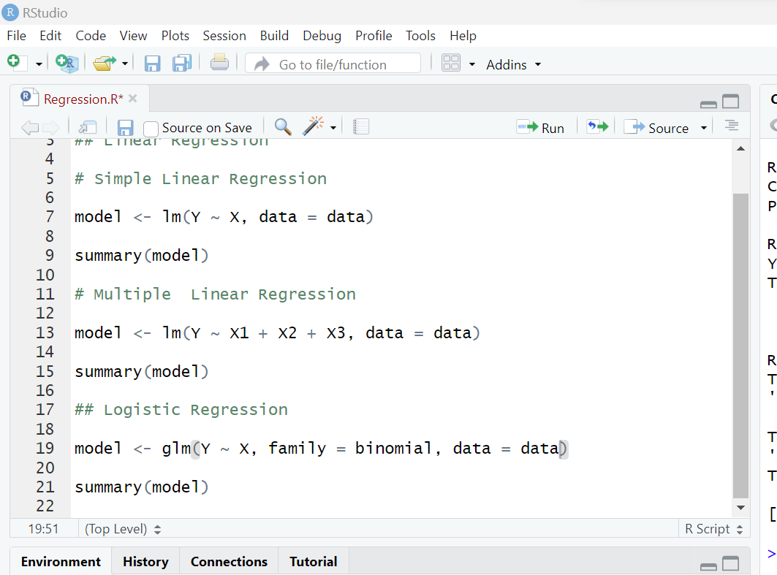
STEP2: Performing ANOVA in R
2.1 Linear Regression
2.2 Logistic Regression

Slide 18
STEP3: Data Interpretation & Validation
3.1 Interpret the Results
See the session: Interpreting Regression Output in R

Slide 19
STEP3: Data Interpretation & Validation
3.1 Interpret the Results
3.2 Check Assumptions (Residuals)
See the session:
Testing Assumptions for Regression in R

Slide 20
STEP3: Data Interpretation & Validation
3.1 Interpret the Results
3.2 Check Assumptions (Residuals)
3.3 Validation
Validation Aspect | Linear Regression | Logistic Regression
Goodness of Fit | R-squared | Pseudo R-squared (McFadden’s R²)

Slide 21
STEP3: Data Interpretation & Validation
3.1 Interpret the Results
3.2 Check Assumptions (Residuals)
3.3 Validation
Validation Aspect | Linear Regression | Logistic Regression
Goodness of Fit | R-squared | Pseudo R-squared (McFadden’s R²)
Cross-Validation | k-fold cross-validation | k-fold cross-validation

Slide 22
STEP3: Data Interpretation & Validation
3.1 Interpret the Results
3.2 Check Assumptions (Residuals)
3.3 Validation
Validation Aspect | Linear Regression | Logistic Regression
Goodness of Fit | R-squared | Pseudo R-squared (McFadden’s R²)
Cross-Validation | k-fold cross-validation | k-fold cross-validation
Prediction Accuracy | Mean Squared Error (MSE) or Root Mean Squared Error (RMSE) | Confusion matrix (Precision, Recall, Accuracy, and F1 Score)

Slide 23
STEP3: Data Interpretation & Validation
3.1 Interpret the Results
3.2 Check Assumptions (Residuals)
3.3 Validation
Validation Aspect | Linear Regression | Logistic Regression
Goodness of Fit | R-squared | Pseudo R-squared (McFadden’s R²)
Cross-Validation | k-fold cross-validation | k-fold cross-validation
Prediction Accuracy | Mean Squared Error (MSE) or Root Mean Squared Error (RMSE) | Confusion matrix (Precision, Recall, Accuracy, and F1 Score)
ROC Curve & AUC | N/A | Unique

Slide 24
STEP3: Data Interpretation & Validation
See the session: Interpreting Regression Output in R
3.1 Interpret the Results
3.2 Check Assumptions (Residuals)
3.3 Validation
Validation Aspect | Linear Regression | Logistic Regression
Goodness of Fit | R-squared | Pseudo R-squared (McFadden’s R²)
Cross-Validation | k-fold cross-validation | k-fold cross-validation
Prediction Accuracy | Mean Squared Error (MSE) or Root Mean Squared Error (RMSE) | Confusion matrix (Precision, Recall, Accuracy, and F1 Score)
ROC Curve & AUC | N/A | Unique

Slide 25
STEP4: Communication & Reporting
4.1 Visualize the Results

Slide 26
STEP4: Communication & Reporting
4.1 Visualize the Results
4.2 Report Findings

Slide 27
STEP4: Communication & Reporting
4.1 Visualize the Results
4.2 Report Findings
4.3 Communicate the Results

Slide 28
Thank You!

