Slide 1
Probability Calculus
Farrokh Alemi Ph.D.
Notes:
This lecture was organized by Farrokh Alemi. It is part of an open online course on managerial statistics.

Slide 2
Probability Calculus
Co-occurring
One of two occurring
One occurring after another
Notes:
In this lecture, we describe how to calculate some common probabilities. In particular we talk about how to calculate the probability of two events co-occurring, or one of two events occurring or one event occurring after another.

Slide 3
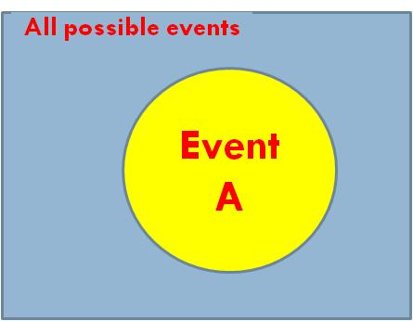
What is probability?
Probability of A =
Notes:
Recall that a Venn diagram could be used to visually calculate the probability of an event. To calculate the probability of an event, we divide the number of occurrences of event A by number of occurrences of all possible events

Slide 4
Joint & Marginal
One
Two or more
Notes:
If a probability is based on a single event, it is a marginal probability. The probability of two or more events is called a joint probability.

Slide 5
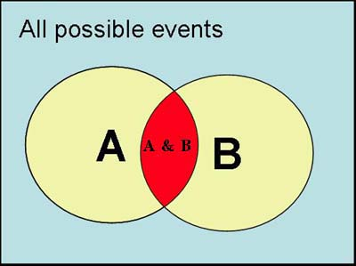
Two Events Occurring
Notes:
This Venn diagram shows the probability of two events occurring. The red area shows the situations where both events co-occur. The yellow area marked with letter A shows the frequency of event A occurring without event B. Similarly the yellow area with letter B in it shows the events in which only event B occurs.

Slide 6
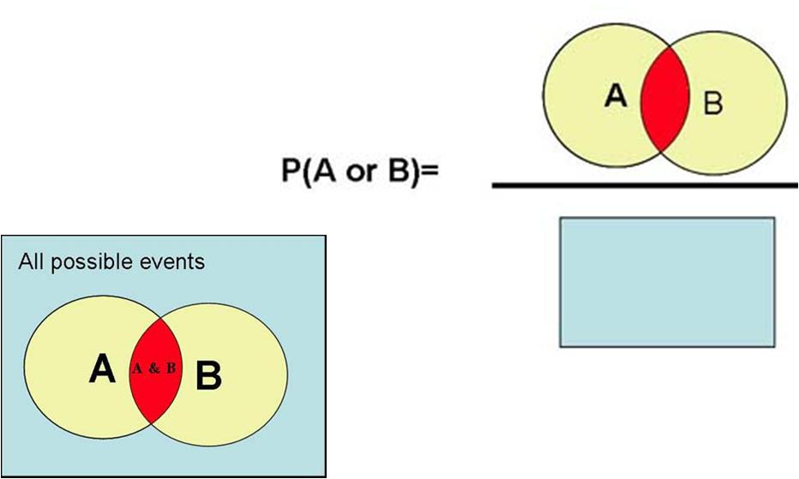
One or Other Event Occurring
Notes:
The probability of either of two events A and B occurring, is calculated by first summing all the possible ways in which event A will occur plus all the ways in which event B will occur, minus all the possible ways in which both event A and B will occur. We have to subtract the intersection of the two events because it is double counted, once in the event A and another time in event B.

Slide 7
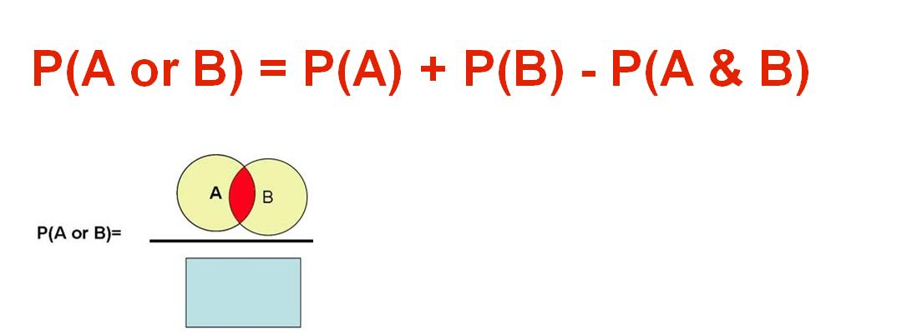
One or Other Event Occurring
Notes:
In mathematical terms we say that Probability of A or B occurring is equal to Probability of A plus probability of B minus the probability of the intersection of A and B occurring

Slide 8
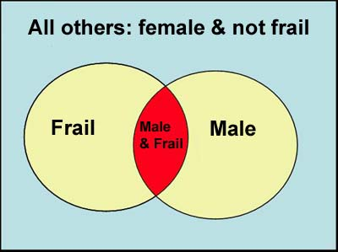
HMO Market Penetration
Notes:
Let us look at an example. We want to understand who will join our accountable care organization. This kind of information is very important in calculating market penetration of our organization and the selection bias we may face if we attract patients who are more likely to use health services.

Slide 9
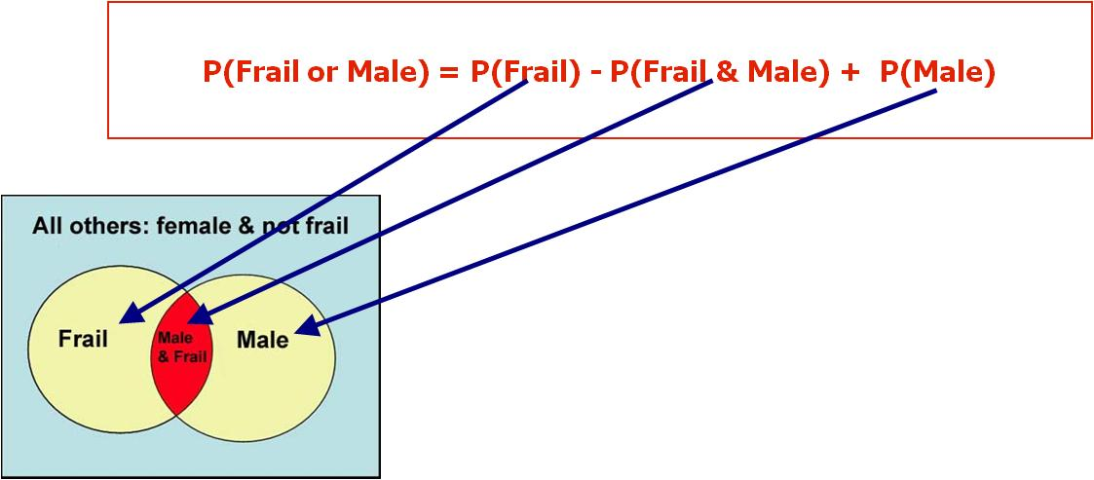
HMO Market Penetration
Notes:
Supposed we want to calculate the probability of a frail or male elderly joining our HMO. This is calculated by the sum of the probability of frail elderly joining the HMO plus the probability of a male person joining minus the probability of a male frail elderly joining.

Slide 10
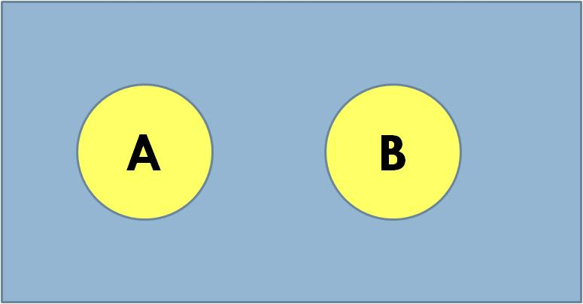
Mutually Exclusive Outcomes
Notes:
Disjoint or mutually exclusive events do not share any elements. Here we see a Venn diagram of two disjoint events.

Slide 11
Mutually Exclusive Outcomes
=0
Notes:
Since there are no shared elements, then the probability of both events occurring is zero and therefore the probability of either event occurring is the sum of the probability of each event.

Slide 12
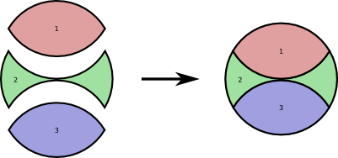
Addition Rule
Notes:
Probability of one of several disjoint events occurring

Slide 13
Addition Rule
P(A, B, …, or Z) = P(A)+P(B)+ … + P(Z)
Notes:
is the sum of the probability of each occurring.

Slide 14
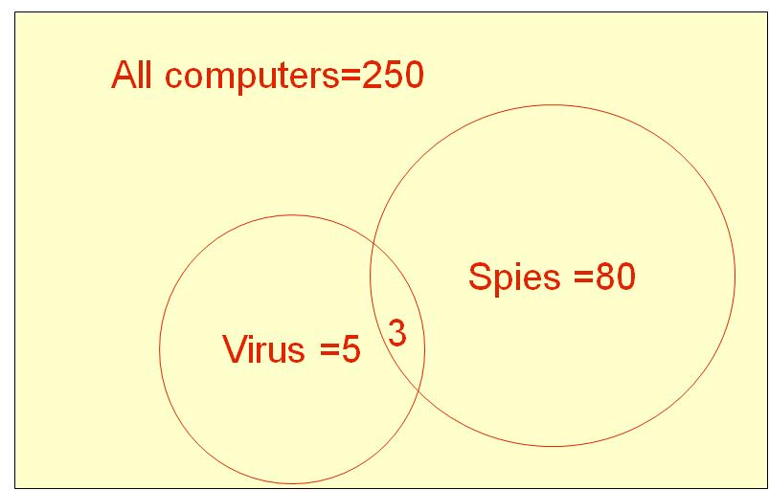
Do One: Computers Infected
Notes:
Given the Venn Diagram indicated, what are the elements of this Venn diagram? What are the events? What is the probability of each event? What is the probability of either event occurring? What is the probability of one or the other event occurring?

Slide 15
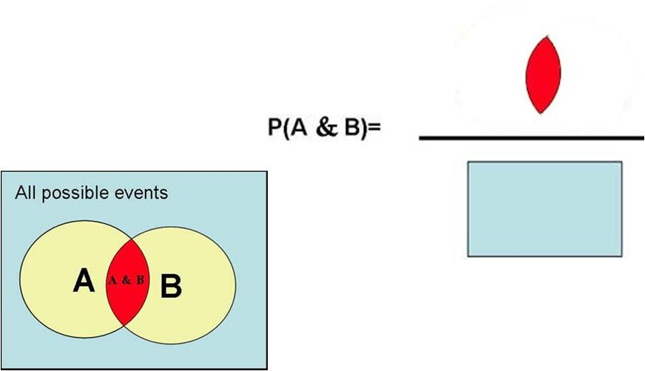
Events Co-Occurring
Notes:
Let us now examine what is the probability of both events co-occurring. The probability of A and B occurring together, corresponds to the overlap between A and B and can be shown graphically as the red area divided by all possible events (the rectangular blue area).

Slide 16
Conditional Probabilities
Notes:
Often we want to calculate the probability of an event given other situations. Probability of B given A is shown as the letter B, followed by a straight line, and followed by symbol letter A. The straight line designates that event A has occurred and we are interested in if event B will occur.

Slide 17
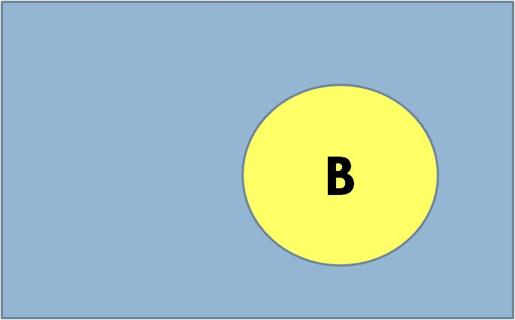
Shrinking Universe of Possibilities
A
Notes:
We can get a good intuition about conditional probability by examining the Venn diagram and shrinking the possible events to only situation where A occurs.

Slide 18
Shrinking Universe of Possibilities
A
Notes:
Then we can use our definition of probabilities to calculate conditional probabilities. Recall that we had defined probability to be number of times an event occurs divided by all possible events. So let us begin by shrinking the universe of possibilities.

Slide 19
Shrinking Universe of Possibilities
A

Slide 20
Shrinking Universe of Possibilities
A

Slide 21
Shrinking Universe of Possibilities
A

Slide 22
Shrinking Universe of Possibilities
A

Slide 23
Shrinking Universe of Possibilities
A

Slide 24
Shrinking Universe of Possibilities
A
Notes:
Now the only event possible is A. All the blue area is gone. The event B alone, without A, is gone. A shrinking universe of possibilities helps you think through calculation of the conditional probability of the event.

Slide 25
Shrinking Universe of Possibilities
Notes:
To calculate the probability of B given that A has occurred, we start with the number of times B occurs in the reduced sample space. Since the universe of possible events are just events where A has occurred, this is the red area where B and A co-occur.

Slide 26
Shrinking Universe of Possibilities
Notes:
We divide the red area by number of all possible events. Since the only thing possible is A, this is given by the yellow circle of A.

Slide 27
Shrinking Universe of Possibilities
Notes:
As before we are calculating the probability of an event as the ratio of occurrence of the event by the possible events but now event A has occurred and the universe has shrunk. This notion of shrinking universe of possibilities is important in giving you intuitions about the meaning of conditional probabilities.

Slide 28
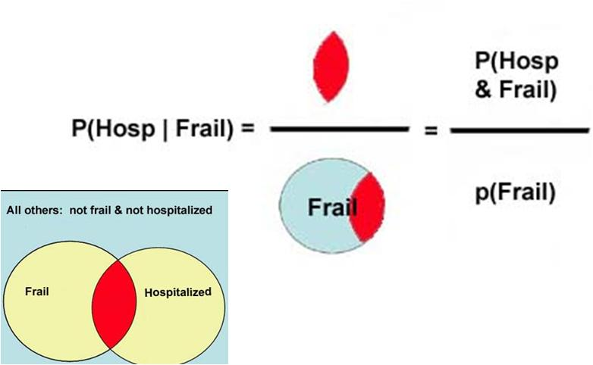
Hospitalization of Frail Patients
Notes:
In this example we see how the conditional probability of hospitalization in a frail patients is calculated from the probability of each event. The probability of hospitalization given that the patient is frail is the ratio of probability of the joint events, shown as red, divided by the probability of being frail. Again this example shows how the universe of possibilities shrinks to only frail elderly and among these we look for percent of patients who have been hospitalized.

Slide 29
Multiplication Rule
Notes:
Now that we have defined conditional probability, we can use it to calculate joint probabilities. The probability of two events occurring together, that is the joint probability of two events, is the product of probability of the event times the conditional probability of the other event.

Slide 30
Example of Multiplication Rule
P(Male & Frail) = P(Frail | Male) * P(Male)
Notes:
The joint probability of being male and frail is the product of probability of being male and the conditional probability of being frail given that you are male.

Slide 31
Independence
P(B|A) = P(B)
Notes:
Two events are independent if knowing one provides no useful information about the other. Remember that conditional probability shows the probability of event B given that A has occurred. If A does not add any information to our estimate of probability of B, then the conditional probability of B is the same as the probability of B.

Slide 32
Example
P(Jim|Joe) = P(Jim)
Notes:
If we think that the diabetes of Joe is not related to Jim, we show this as probability of Jim’s diabetes is the same whether or not we know that Joe is also diabetic.

Slide 33
Example
P(Jim|Joe)
not the same as
P(Jim)
Notes:
This is not always the case. For example, if we know that Jim has an infectious disease then Joe is more likely to be infected. Therefore, knowledge of Joe’s condition tells us about Jim’s condition.

Slide 34
Multiplication Rule Simplified
Notes:
Under assumption of independence, the general multiplication rule is simplified so that probability of both events occurring is the product of the probability of each event.

Slide 35
Example
P(Joe)
P(Joe & Jim) = P(Joe|Jim) × P(Jim)
Notes:
So the probability that both Joe and Jim are diabetic is the product of probability of Joe being diabetic and probability of Jim being diabetic.

Slide 36
Take Home Lesson
Conditional probability is calculated from reduced sample space
Notes:
Conditional probability can be measured by applying the definition of probability to the reduced sample space

Slide 37
Do one
1. Probability of getting a virus if computer has a spy?
2. Probability of getting a spy, if computer has a virus?
3. Probability of computers having both?
4. Probability of infected computer?
Notes:
See if you can answer these simple questions from the Venn diagram given.

