Slide 1
Problem 12 Chapter 5

Slide 2
Step 1: Check Assumptions
Each data set is less than 10% of all births and randomly selected, so the observations can be considered independent.
There are more than 30 observations for each group and the data are not strongly skewed, so the observations can be considered normal

Slide 3
Step 2: Standard Error

Slide 4
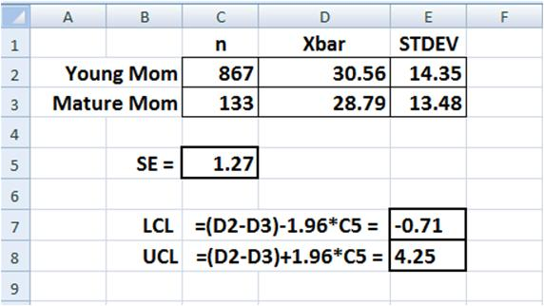
Step 3: Confidence Interval

Slide 5
Step 4: Reject?
We cannot reject as difference of 0 lbs falls within the 95% confidence interval.

