Slide 1
Problem 24 Chapter 2
Farrokh Alemi Ph.D.
Notes:
This is a solution to Problem 2.2 in OpenInto Statistics book. This was organized by Dr. Alemi.

Slide 2
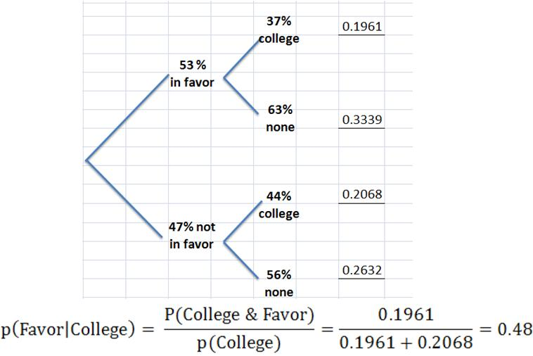
Part A) Favor given College?

