Slide 1
Problem 24, Chapter 1
Farrokh Alemi, Ph.D.

Slide 2
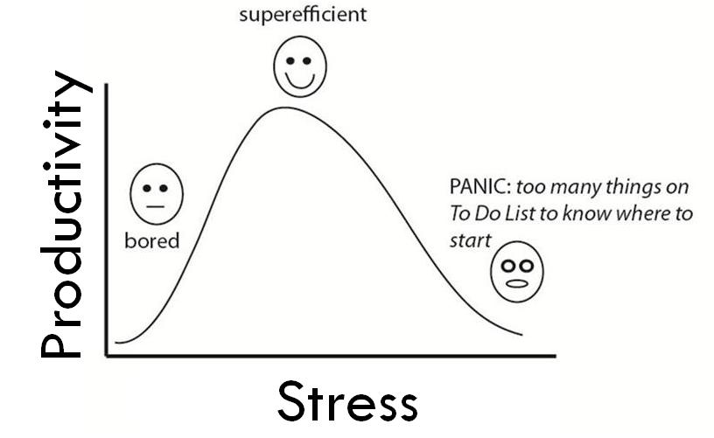
Non-linear Relationship

