Slide 1
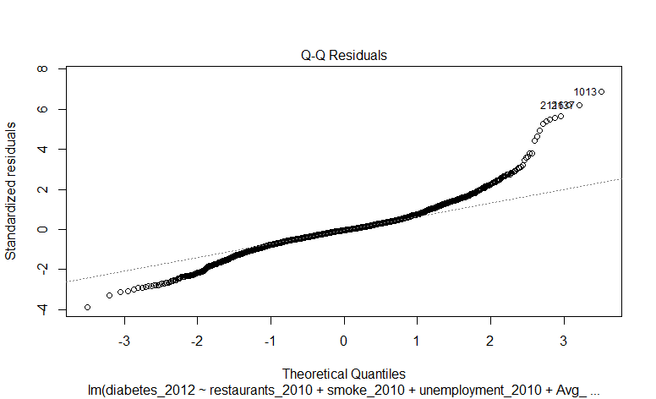
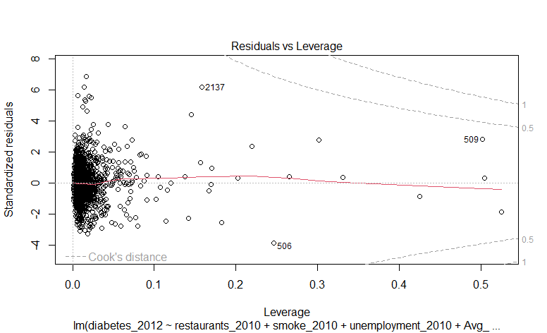
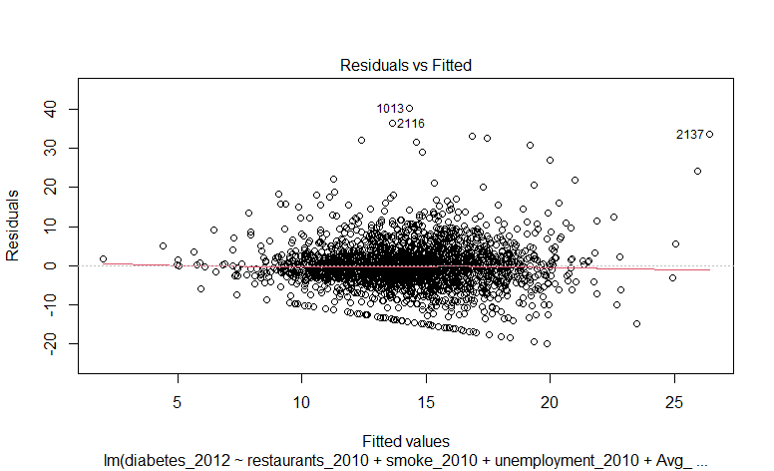
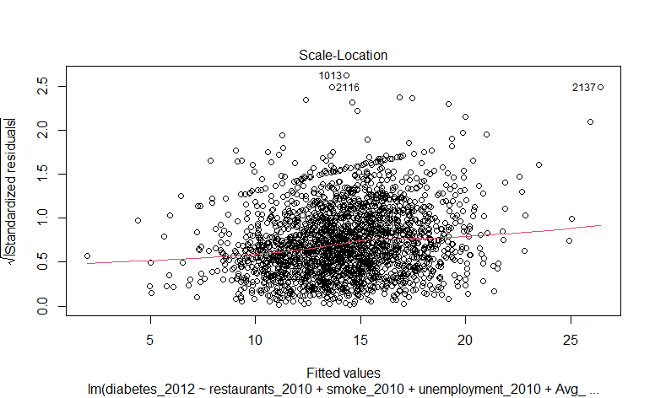
Check for Linearity

Slide 2
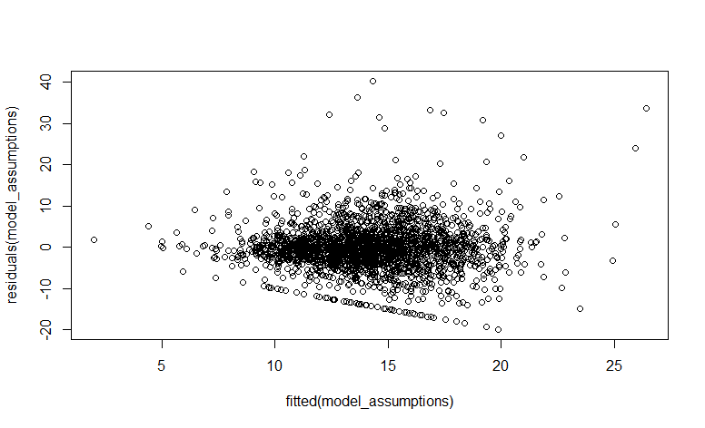
Check for Independence of residuals

Slide 3
Check for Homoscedasticity

Slide 4
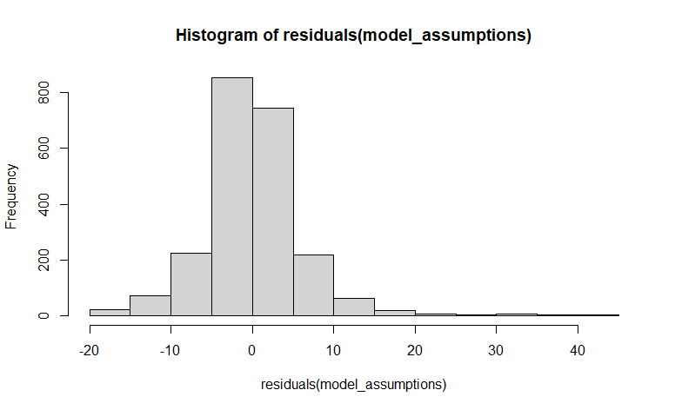
Check for Normality of residuals

Slide 5
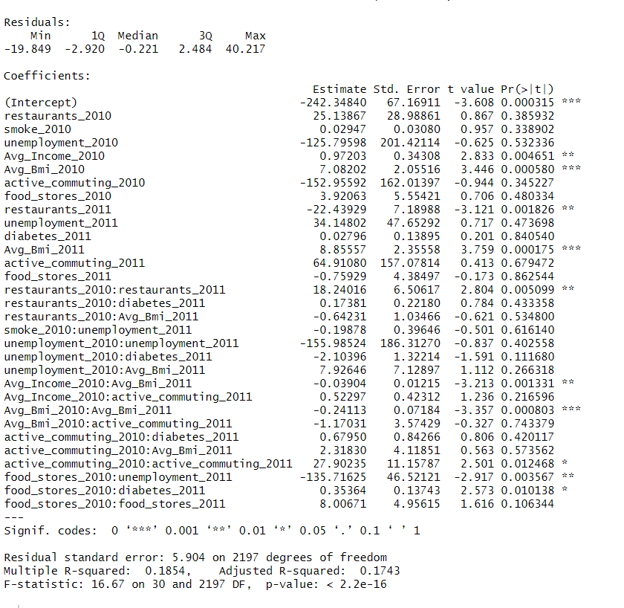
Print out the coefficients of the regression

Slide 6
List variables that take at least 2 years before they have a significant effect on diabetes

Slide 7
List variables that can affect diabetes in 1 year

