Slide 1
Distribution
Question 3 answers

Slide 2
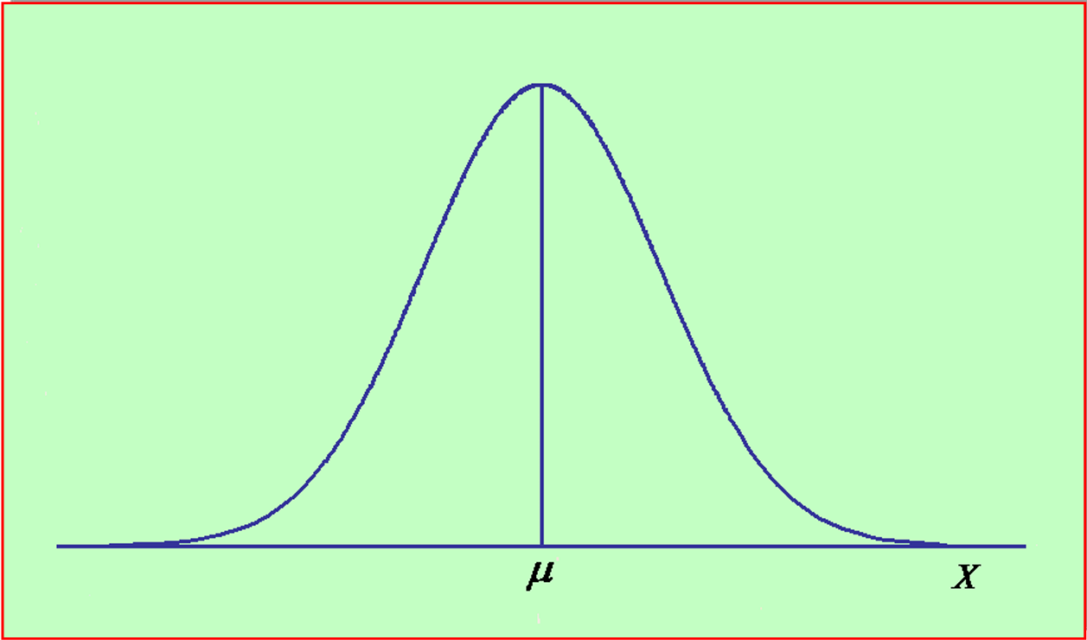
Applying the Z Formula-Example
X is normally distributed with µ=10, and σ=5
For X=12, Z= (X-µ)/ σ=(12-10)/5=0.4
P(X≤12)=P(Z≤0.4)=0.6554=(0.5+0.1554)
0.4

Slide 3
Applying the Z Formula-Example
X is normally distributed with µ=10, and σ=5
For X=22, Z= (X-µ)/ σ=(22-10)/5=2.4
P(X≥22)=P(Z≥2.4)=1-0.9918=0.0082
2.4

Slide 4
Applying the Z Formula-Example
X is normally distributed with µ=10, and σ=5
For X=2, Z= (X-µ)/ σ=(2-10)/5=-1.6
For X=12, Z= (X-µ)/ σ=(12-10)/5=0.4
P(2≤X≤12)=P(-1.6≤X≤0.4)=
(0.5-0.0548)+(0.6554-0.5)=
0.4452+0.1554=0.6006
-1.6
0.4

