Slide 1
Relationship between Two Numerical Variables
By Farrokh Alemi, Ph.D.
Notes:
This lecture is organized by Dr. Alemi and narrated by Yara Alemi. The lecture is based on the OpenIntro Statistics book.

Slide 2
Relationships
Investigators are often interested in relationship between variables
Notes:
Investigators are often interested in relationship between variables

Slide 3
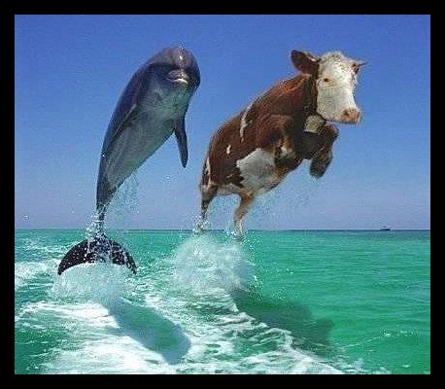
Anecdotal Data
Multiple observations needed
Notes:
To understand the relationship between two variables multiple observations are needed. Relying on one case is often referred to as relying on anecdotal data and could be misleading.

Slide 4
Anecdotal Data
I have smoked all my life and I do not have cancer
Notes:
Here is an example of the fallacy of anecdotal data. In this example, the person claims to beat the odds. We cannot be sure that he will succeed. Cancer may come tomorrow. The relationship between cancer and smoking is established after examining many cases and not just one case.

Slide 5
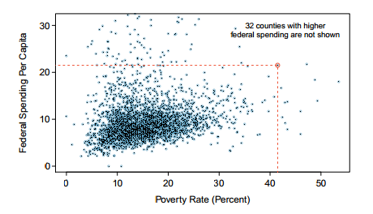
Relationships
Notes:
A scatterplot is often used to show the relationship between two continuous numerical variables. Here we see a scatterplot showing fed spend against poverty. Owsley
County of Kentucky, with a poverty rate of 41.5% and federal spending of $21.50 per capita, is highlighted in the red circle.

Slide 6
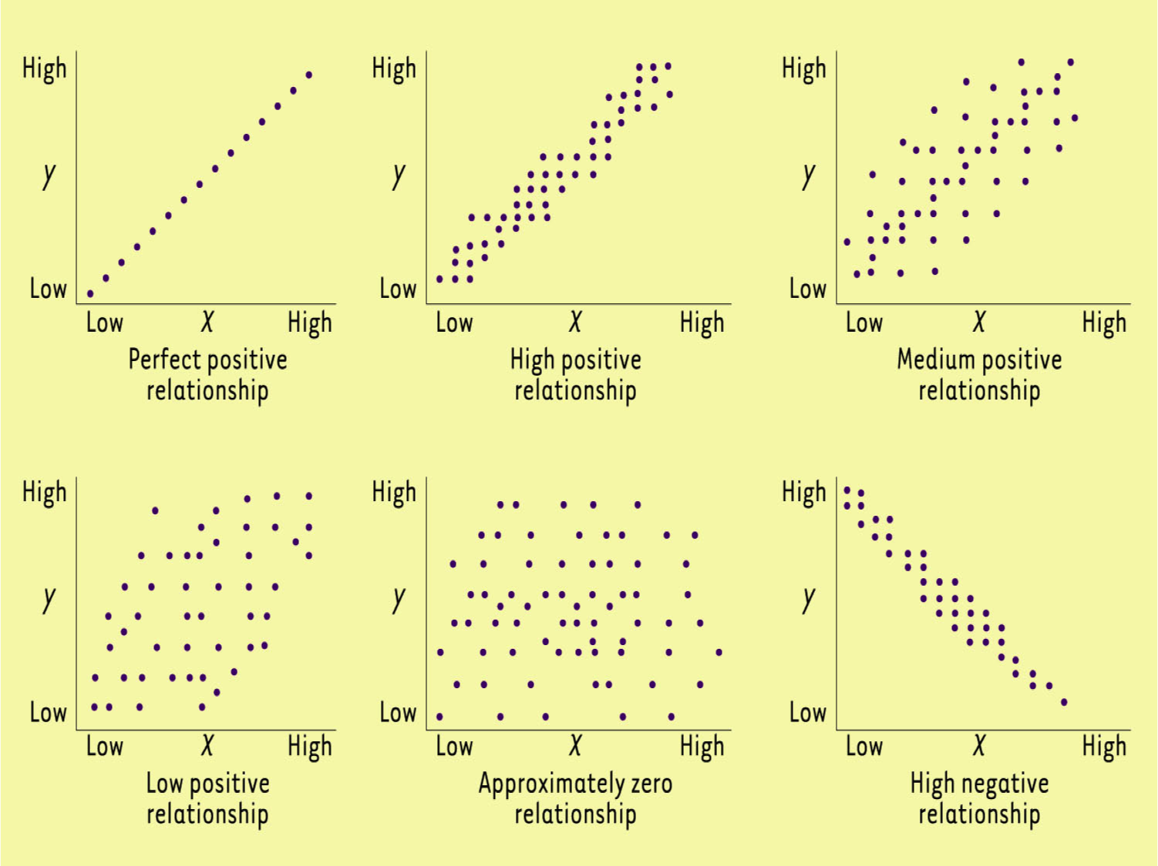
Notes:
Here we see examples of three positive relationship between two variables. Always graph the data, it reveals more than summary statistics.

Slide 7
Notes:
A negative relationship is shown when increases in x variable leads to decreases in the y variable.

Slide 8
Independent X & Y
Notes:
A pair of variables are either related in some way associated or not. A pair of unrelated variables , where there is approximately zero relationship, are referred to as being independent.

Slide 9
Explanatory Variable
Notes:
To identify the explanatory variable in a pair of variables, identify which of the two is suspected of affecting the other and plan an appropriate analysis.

Slide 10
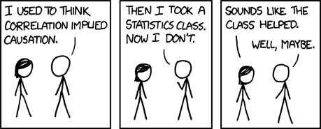
Association Is Not Causation
Notes:
Labeling variables as explanatory and response does not guarantee the relationship between the two is actually causal, even if there is an association identified between the two variables. We use these labels only to keep track of which variable we suspect affects the other.

Slide 11
Causation Requires:
Association
Sequence (causes preceded effects)
Mechanism
Counter factual (no effect when causes are absent)
Notes:
To infer a causation we need three additional pieces of information. We need to know the sequence of the events. A cause must precede an effect.

Slide 12
Causation Requires:
Association
Sequence (causes preceded effects)
Mechanism
Counter factual (no effect when causes are absent)
Notes:
There must be a mechanism that leads from cause to the effect. A mechanism refers to a third variable that occurs as a consequence of the cause and leads to the effect.

Slide 13
Causation Requires:
Association
Sequence (causes preceded effects)
Mechanism
Counter factual (no effect when causes are absent)
Notes:
The counterfactual must hold, that is, when the causes are absent the effect must not be present.

Slide 14
Causation Requires:
Association
Sequence (causes preceded effects)
Mechanism
Counter factual (no effect when causes are absent)
Notes:
Association is not enough. A lot more is needed to establish causation.

Slide 15
Association Is Not Causation
Notes:
In this cartoon, we see report of association between a statistic class and knowledge of cause and effect. We see sequence, the person did not know that “association is not causation” before the class. We can imagine a mechanism. The professor taught it and the student learned it. It is not stated but it is implied. But we do not see counterfactual. There are people who did not take the class but know that association is not causation. Knowledge can be gained without the class. So the effect may be there without the presumed cause. So we cannot conclude that the class caused the new knowledge.

Slide 16
Take Home Message
A Scatterplot can show the association between two variables
Notes:
The take home message for this lecture was that a Scatterplot can show the association between two variables

Slide 17
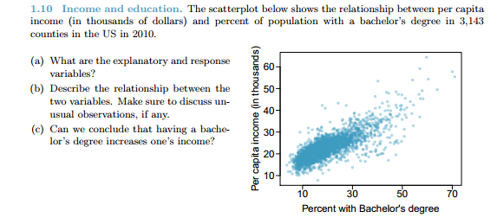
Do one:
Notes:
Let us see if you have understood the relationship between two variables and how to interpret scatterplots.

