Slide 1
Calculate correlation for any pair of variables
Example variable pair: Blood System (bs4lr) and Nervous System (bs6lr)
Correlation: 0.8682

Slide 2
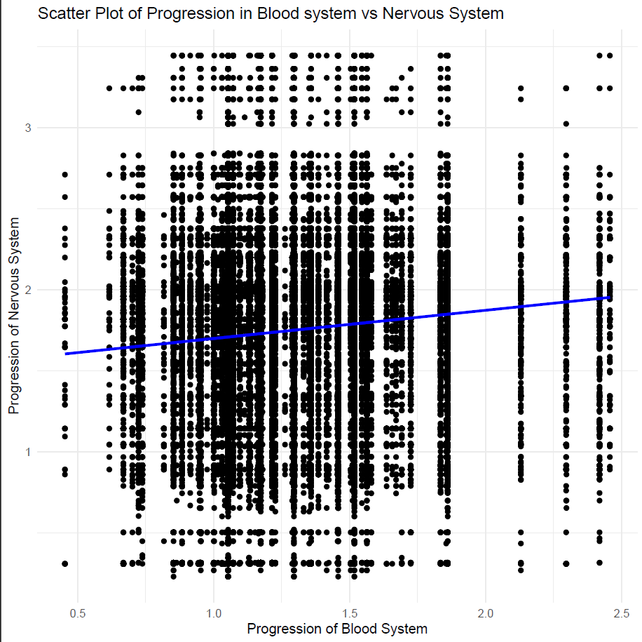
Show the scatterplot of the variables

