Slide 1
Testing Assumptions for ANOVA in R
HAP 719: Advanced Statistics I
Yili Lin

Slide 2
Importance of Testing Assumptions
Assumptions
Validity
Risk of Errors

Slide 3
Testing Before ANOVA
Independence of Observations

Slide 4
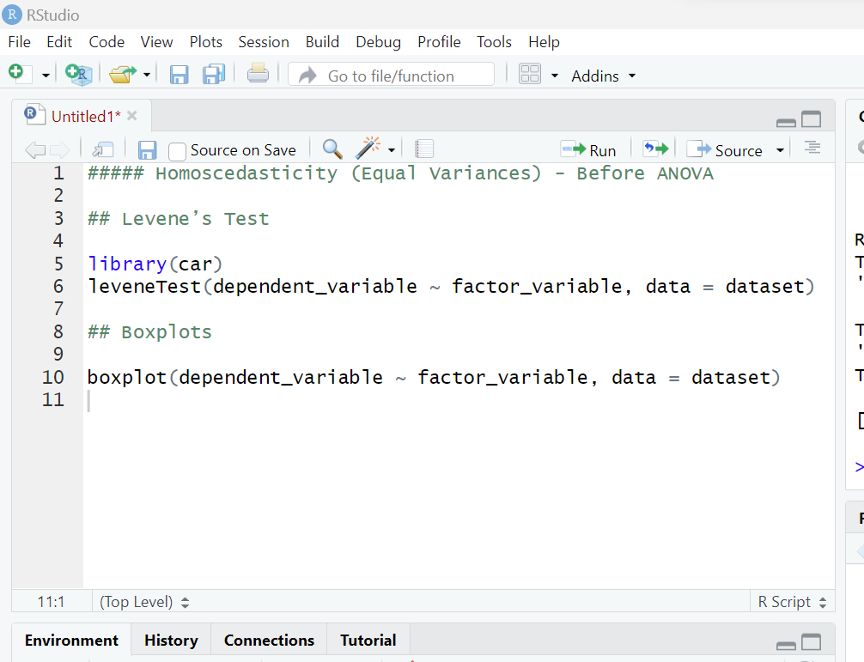
Testing Before ANOVA
Independence of Observations
Homoscedasticity

Slide 5
Testing Before ANOVA
Independence of Observations
Homoscedasticity

Slide 6
Testing Before ANOVA
Independence of Observations
Homoscedasticity
No Significant Outliers

Slide 7
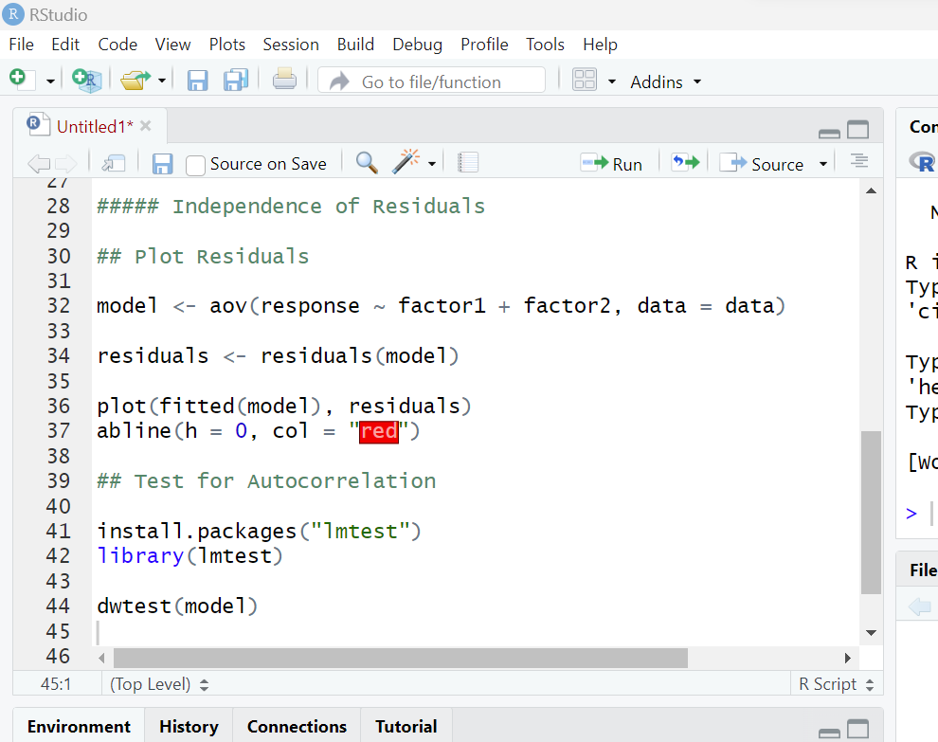
Testing After ANOVA
Independence of Residuals

Slide 8
Testing After ANOVA
Independence of Residuals

Slide 9
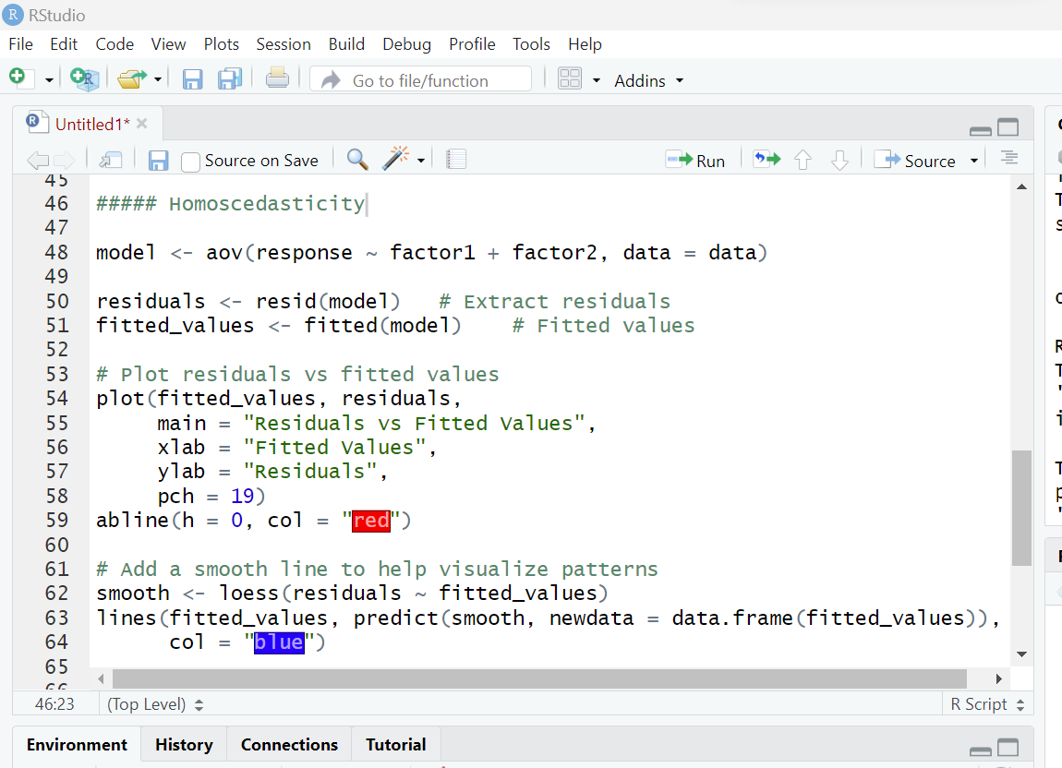
Testing After ANOVA
Independence of Residuals
2. Homoscedasticity

Slide 10
Testing After ANOVA
Independence of Residuals
2. Homoscedasticity

Slide 11
Testing After ANOVA
Independence of Residuals
2. Homoscedasticity

Slide 12
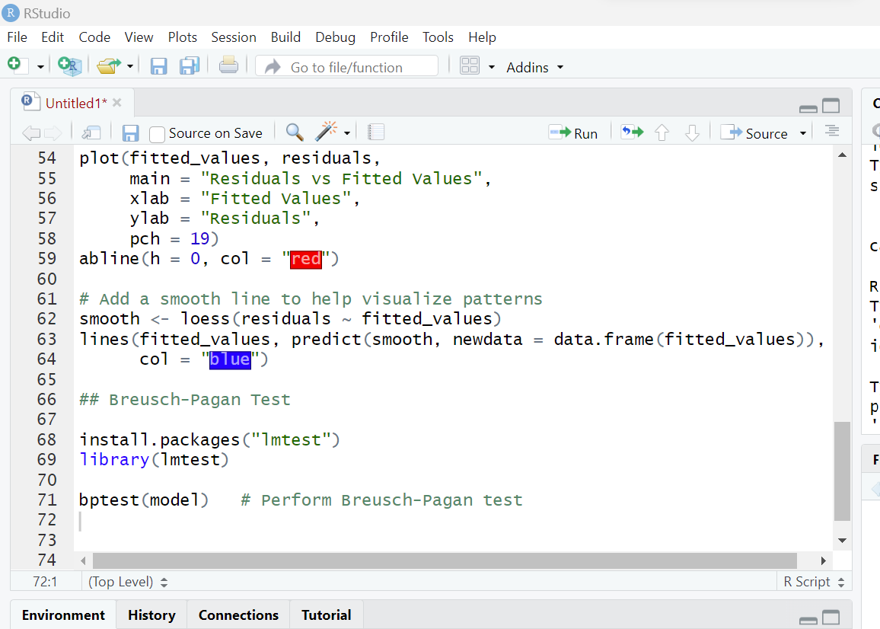
Testing After ANOVA
Independence of Residuals
2. Homoscedasticity

Slide 13
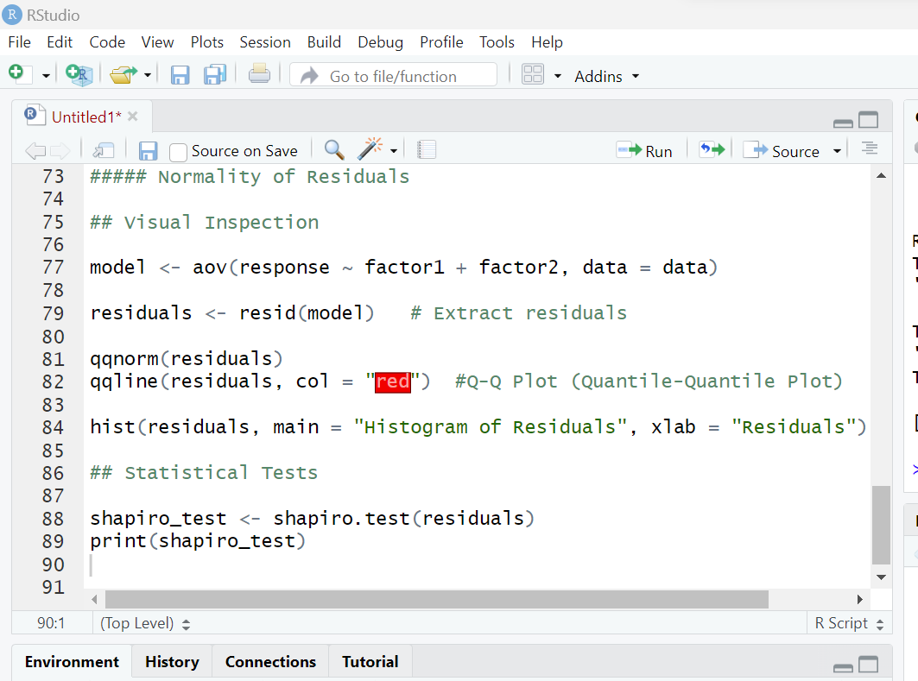
Testing After ANOVA
Independence of Residuals
2. Homoscedasticity
3. Normality of Residuals

Slide 14
Testing After ANOVA
Independence of Residuals
2. Homoscedasticity
3. Normality of Residuals

Slide 15
Testing After ANOVA
Independence of Residuals
2. Homoscedasticity
3. Normality of Residuals

Slide 16
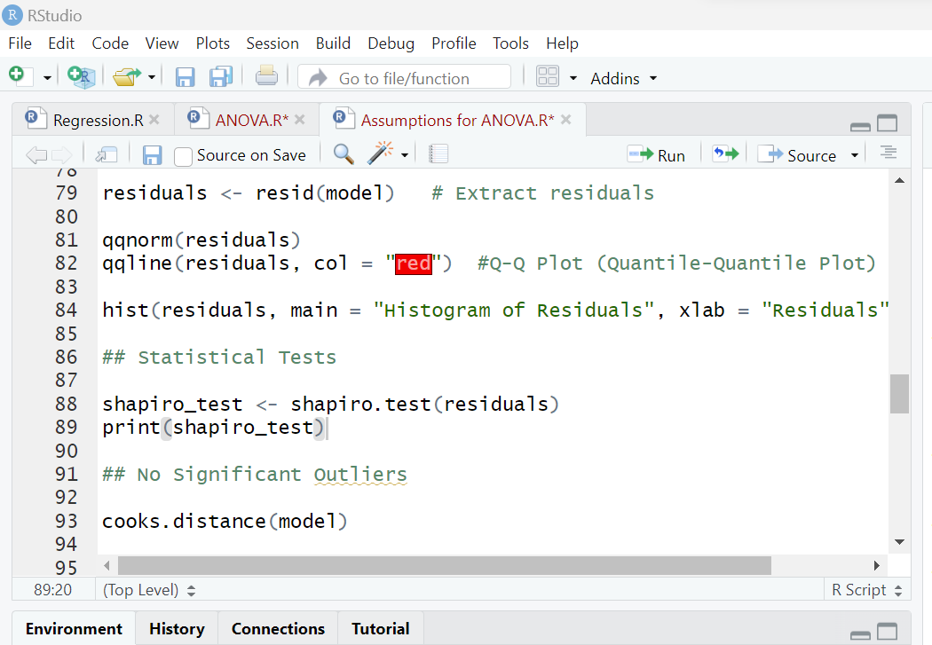
Testing After ANOVA
Independence of Residuals
2. Homoscedasticity
3. Normality of Residuals
4. No Significant Outliers

Slide 17
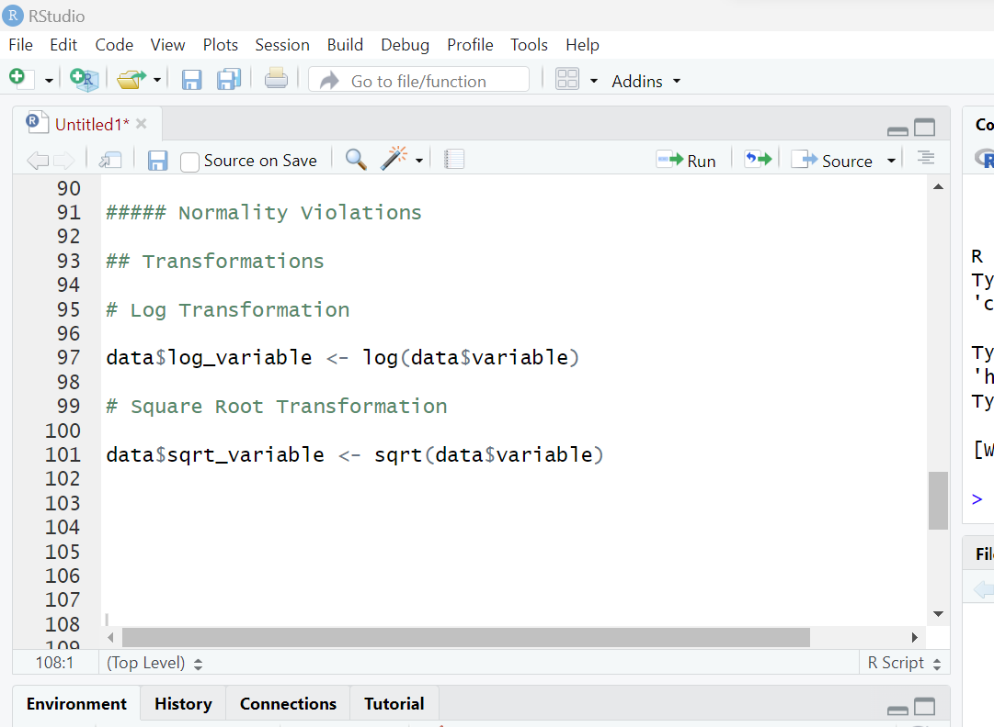
Dealing with Violations of Assumptions
Normality Violations
Transformations
(log, square root)

Slide 18
Dealing with Violations of Assumptions
Normality Violations
Transformations
(log, square root)

Slide 19
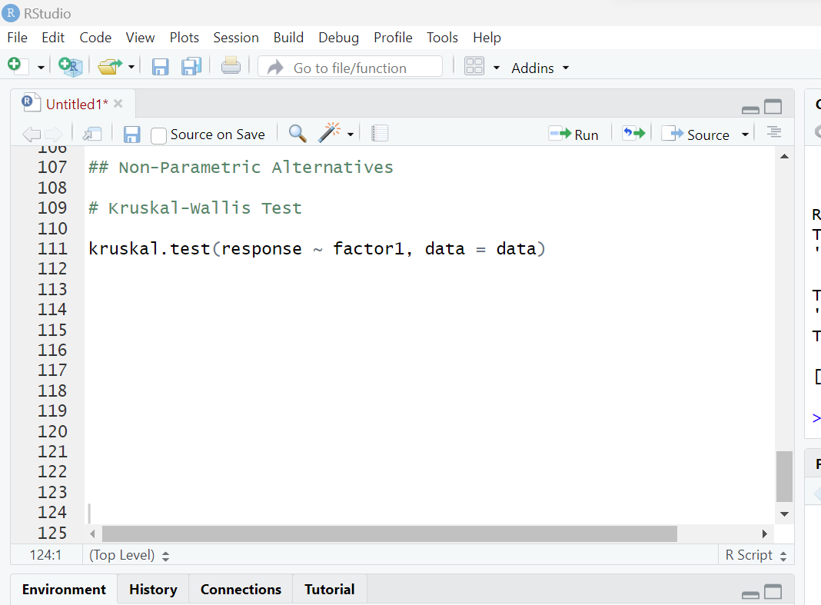
Dealing with Violations of Assumptions
Normality Violations
Transformations
(log, square root)
Non-Parametric Alternatives

Slide 20
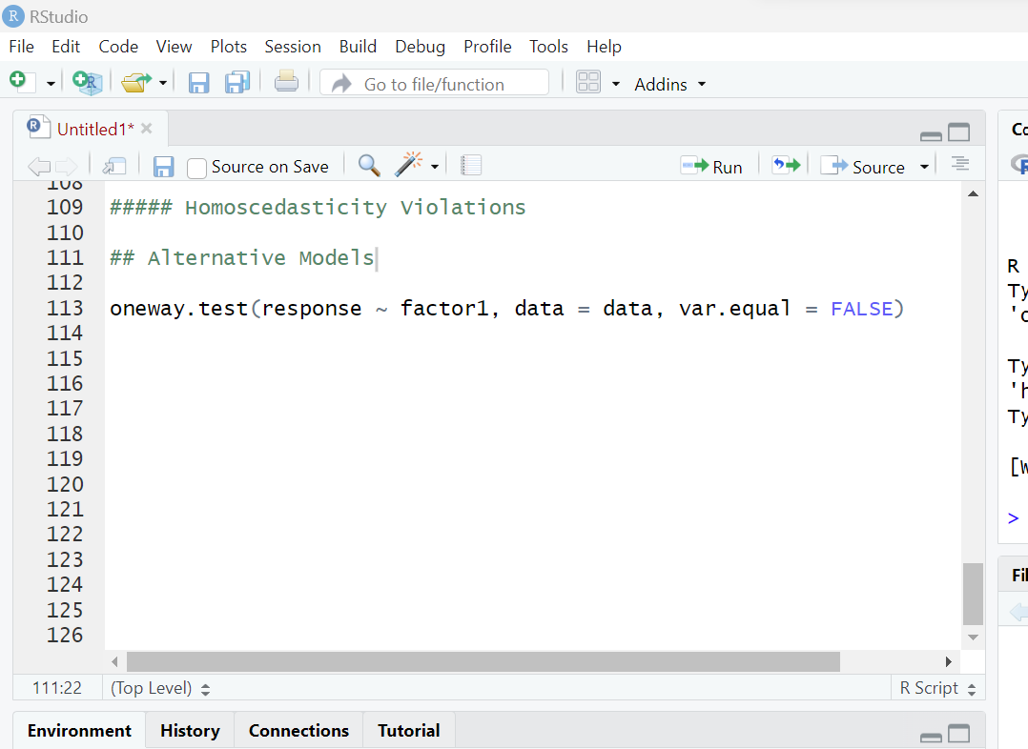
Dealing with Violations of Assumptions
Normality Violations
2. Homoscedasticity Violations
Welch’s ANOVA

Slide 21
Dealing with Violations of Assumptions
Normality Violations
2. Homoscedasticity Violations
3. Independence Violations
Check the Study Design

Slide 22
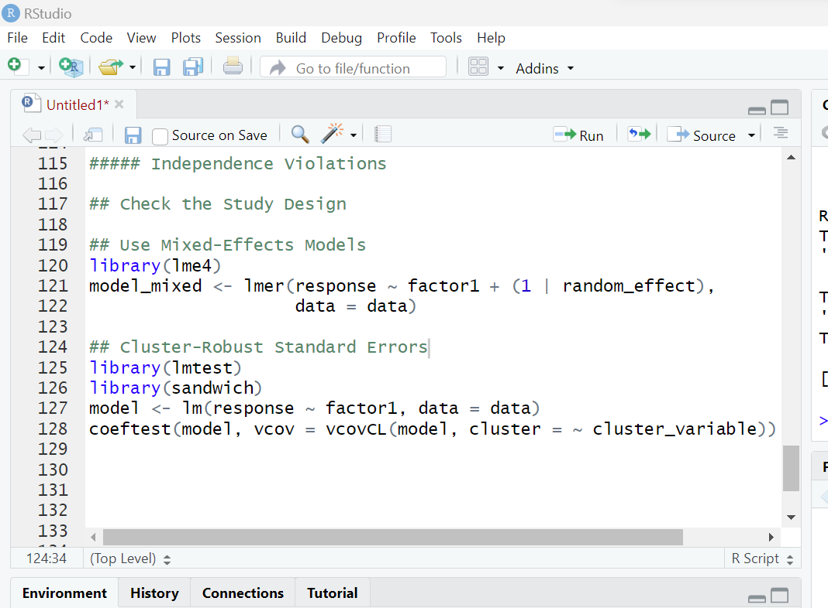
Dealing with Violations of Assumptions
Normality Violations
2. Homoscedasticity Violations
3. Independence Violations
Check the Study Design
Use Mixed-Effects Models

Slide 23
Dealing with Violations of Assumptions
Normality Violations
2. Homoscedasticity Violations
3. Independence Violations
Check the Study Design
Use Mixed-Effects Models
Cluster-Robust Standard Errors

Slide 24
Thank You!

