Slide 1
Testing Assumptions for Ordinary Regression in R
HAP 719: Advanced Statistics I
Yili Lin

Slide 2
Introduction
1. Purpose
2. Key Assumptions
Linearity
Independence
Homoscedasticity
Normality of Residuals
No Multicollinearity

Slide 3
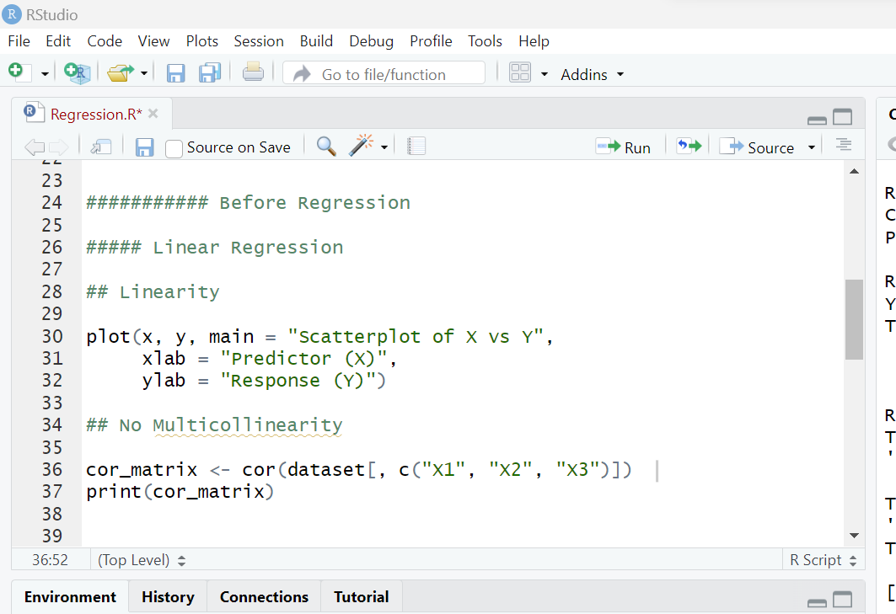
Testing Before Ordinary Regression
Linearity

Slide 4
Testing Before Ordinary Regression
Linearity
Independence of Observations

Slide 5
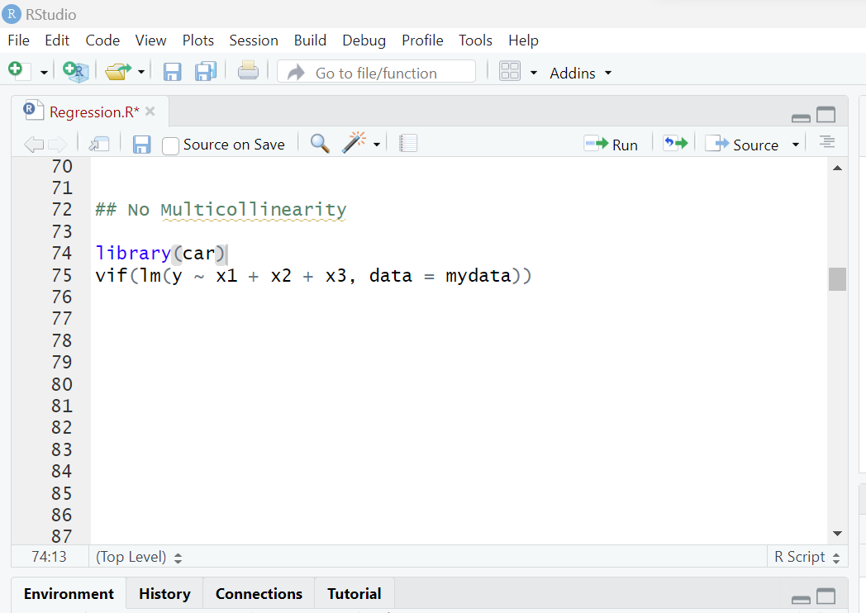
Testing Before Ordinary Regression
Linearity
Independence of Observations
No Multicollinearity

Slide 6
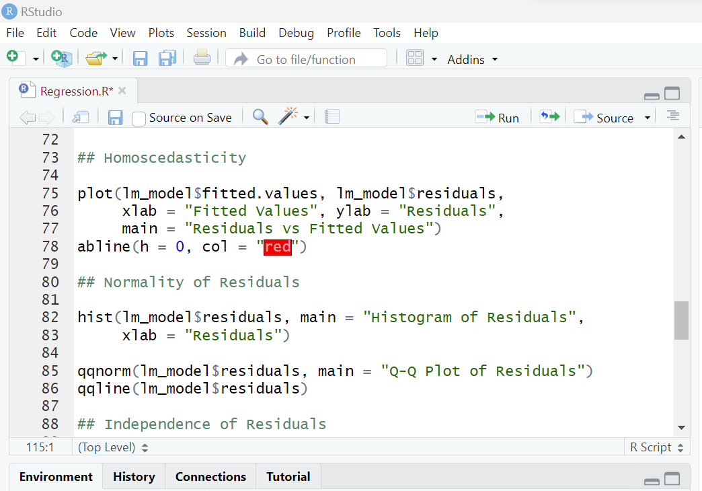
Testing After Ordinary Regression
Homoscedasticity

Slide 7
Testing After Ordinary Regression
Homoscedasticity
Normality of Residuals

Slide 8
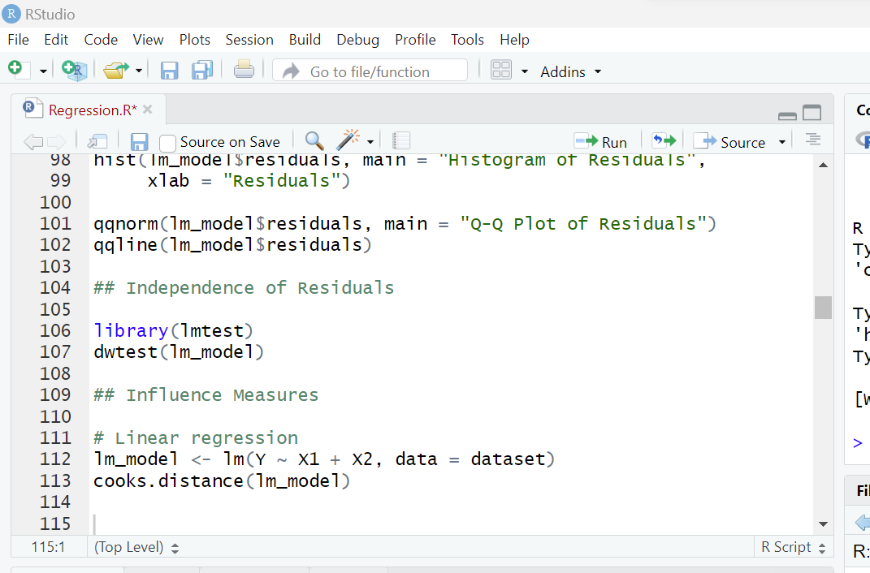
Testing After Ordinary Regression
Homoscedasticity
Normality of Residuals
Independence of Residuals

Slide 9
Testing After Ordinary Regression
Homoscedasticity
Normality of Residuals
Independence of Residuals
Influence Measures

Slide 10
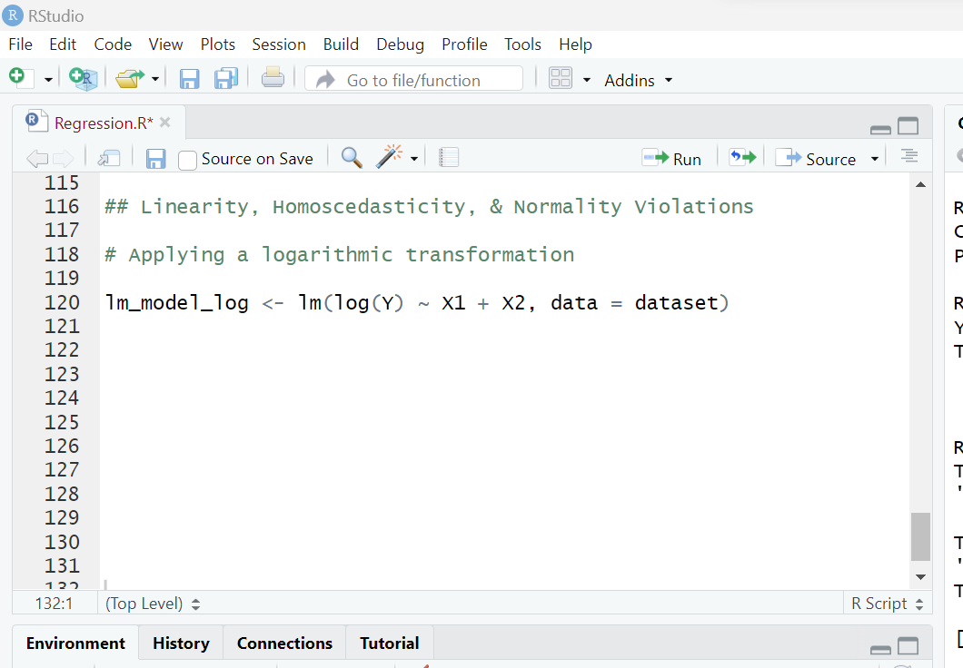
Dealing with Violations of Assumptions
Homoscedasticity
Normality of Residuals
Linearity

Slide 11
Dealing with Violations of Assumptions
Homoscedasticity
Normality of Residuals
Linearity
No Multicollinearity
Remove Variables
Combine Variables
Regularization

Slide 12
Dealing with Violations of Assumptions
Homoscedasticity
Normality of Residuals
Linearity
No Multicollinearity
Outliers and Influential Points
Investigate
Transformations
Robust Methods
Model Checking

Slide 13
Thank You!

