Slide 1
Testing Assumptions for Regression in R
HAP 719: Advanced Statistics I
Yili Lin

Slide 2
Regression Assumptions
Linear Regression
Linearity
Independence
Homoscedasticity
Normality of Residuals
No Multicollinearity

Slide 3
Regression Assumptions
Linear Regression
Logistic Regression
Linearity
Independence
Homoscedasticity
Normality of Residuals
No Multicollinearity
Linearity of the Logit
Independence
No Multicollinearity

Slide 4
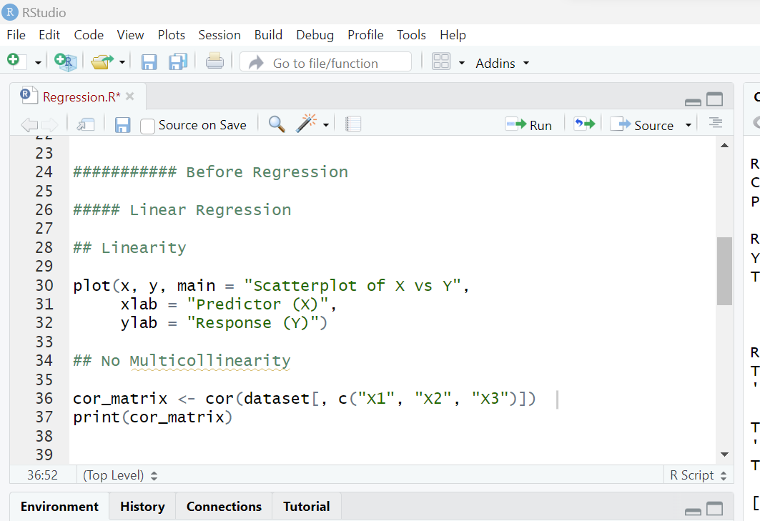
Testing Before Regression
Linear Regression
Linearity

Slide 5
Testing Before Regression
Linear Regression
2. Logistic Regression
Linearity
Independence of Observations
Independence of Observations

Slide 6
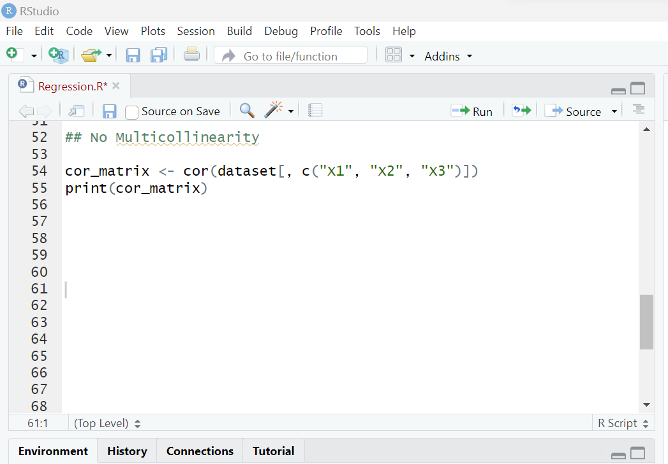
Testing Before Regression
Linear Regression
2. Logistic Regression
Linearity
Independence of Observations
No Multicollinearity
Independence of Observations
No Multicollinearity

Slide 7
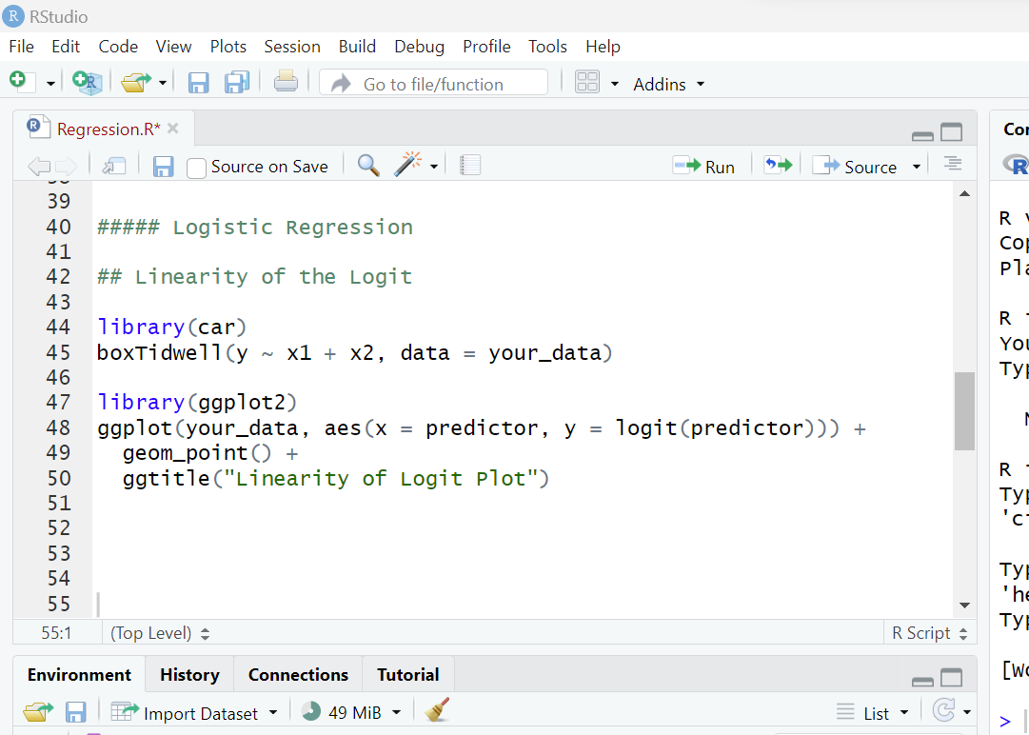
Testing Before Regression
Linear Regression
2. Logistic Regression
Linearity
Independence of Observations
No Multicollinearity
Independence of Observations
No Multicollinearity
Linearity of the Logit

Slide 8
Testing Before Regression
Linear Regression
2. Logistic Regression
Linearity
Independence of Observations
No Multicollinearity
Independence of Observations
No Multicollinearity
Linearity of the Logit

Slide 9
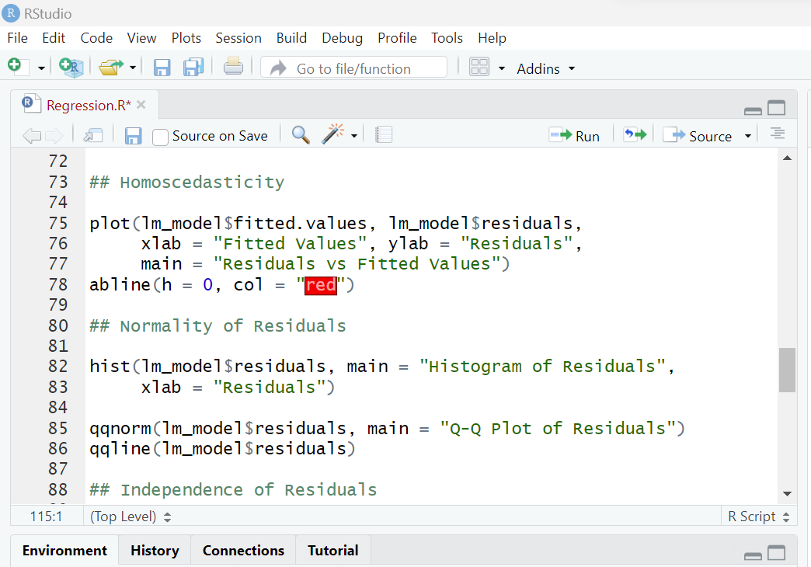
Testing After Regression
Linear Regression
Homoscedasticity

Slide 10
Testing After Regression
Linear Regression
Homoscedasticity
Normality of Residuals

Slide 11
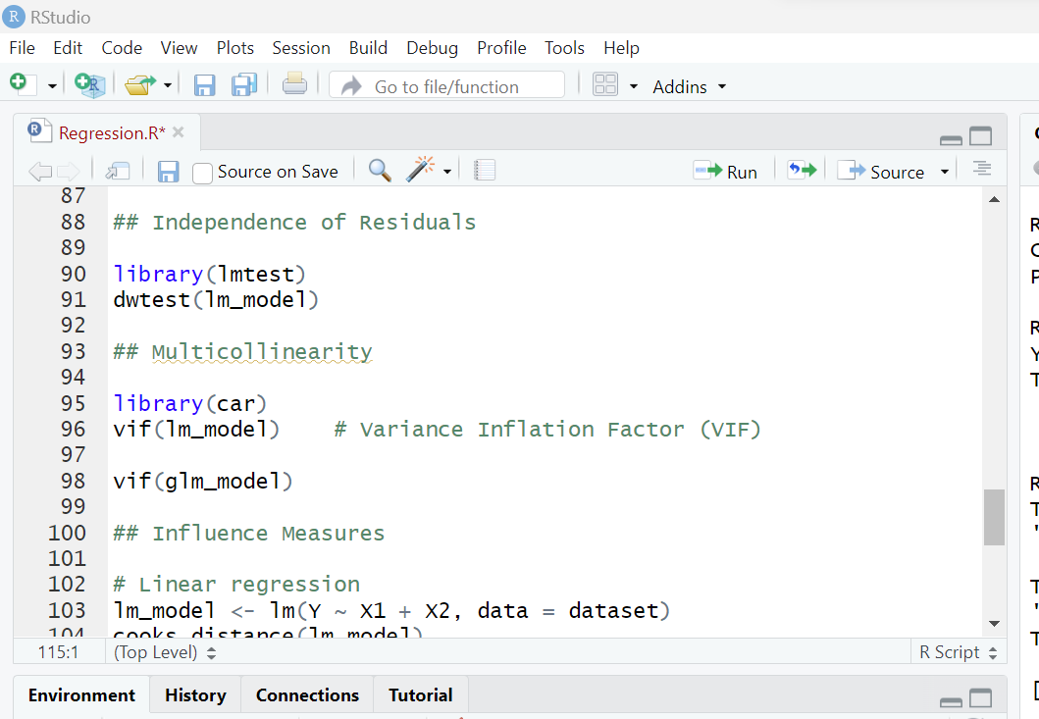
Testing After Regression
Linear Regression
2. Logistic Regression
Homoscedasticity
Normality of Residuals
Independence of Residuals
Independence of Residuals

Slide 12
Testing After Regression
Linear Regression
2. Logistic Regression
Homoscedasticity
Normality of Residuals
Independence of Residuals
No Multicollinearity
Independence of Residuals
No Multicollinearity

Slide 13
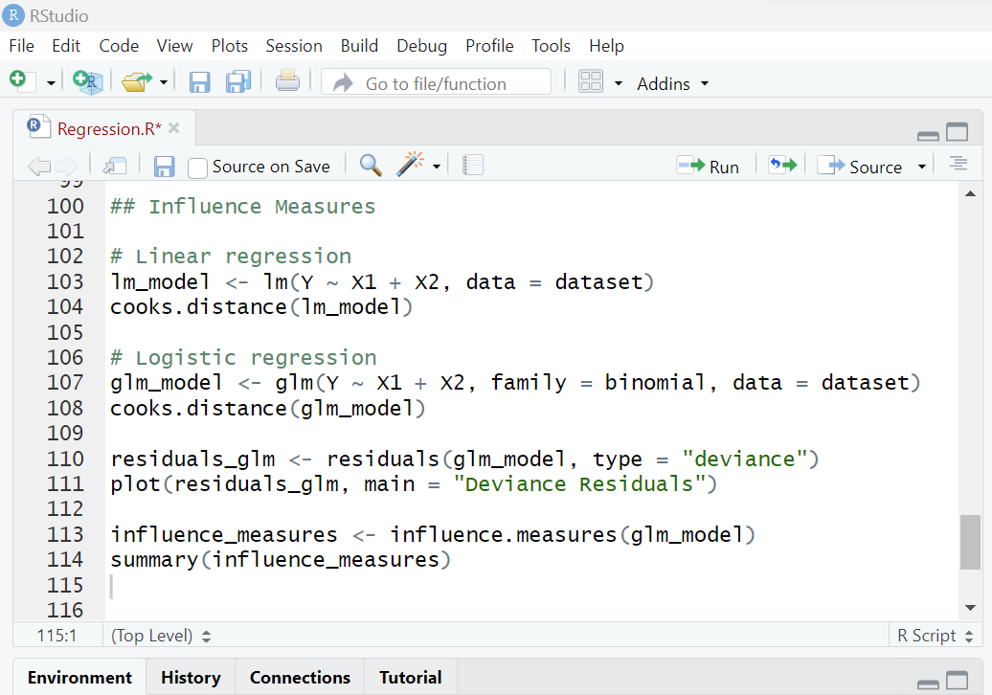
Testing After Regression
Linear Regression
2. Logistic Regression
Homoscedasticity
Normality of Residuals
Independence of Residuals
No Multicollinearity
Influence Measures
Independence of Residuals
No Multicollinearity
Influence Measures

Slide 14
Testing After Regression
Linear Regression
2. Logistic Regression
Homoscedasticity
Normality of Residuals
Independence of Residuals
No Multicollinearity
Influence Measures
Independence of Residuals
No Multicollinearity
Influence Measures

Slide 15
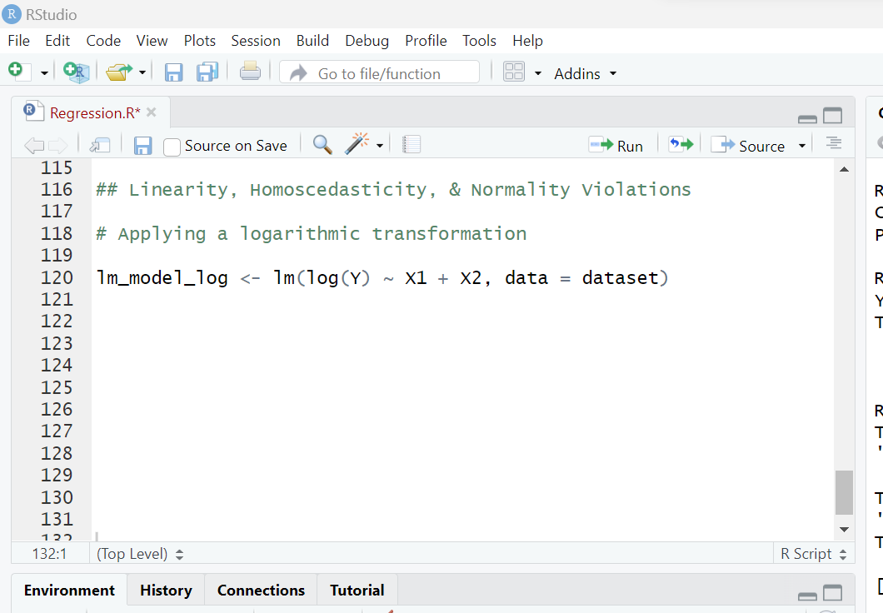
Dealing with Violations of Assumptions
Linear Regression
Linearity
Homoscedasticity
Normality of Residuals

Slide 16
Dealing with Violations of Assumptions
Linear Regression
2. Logistic Regression
Linearity
Homoscedasticity
Normality of Residuals
No Multicollinearity
Remove Variables
No Multicollinearity

Slide 17
Dealing with Violations of Assumptions
Linear Regression
2. Logistic Regression
Linearity
Homoscedasticity
Normality of Residuals
No Multicollinearity
Remove Variables
Combine Variables
No Multicollinearity

Slide 18
Dealing with Violations of Assumptions
Linear Regression
2. Logistic Regression
Linearity
Homoscedasticity
Normality of Residuals
No Multicollinearity
Remove Variables
Combine Variables
Regularization
No Multicollinearity

Slide 19
Dealing with Violations of Assumptions
Linear Regression
2. Logistic Regression
Linearity
Homoscedasticity
Normality of Residuals
No Multicollinearity
Outliers and Influential Points
Investigate
No Multicollinearity
Outliers and Influential Points

Slide 20
Dealing with Violations of Assumptions
Linear Regression
2. Logistic Regression
Linearity
Homoscedasticity
Normality of Residuals
No Multicollinearity
Outliers and Influential Points
Investigate
Transformations
No Multicollinearity
Outliers and Influential Points

Slide 21
Dealing with Violations of Assumptions
Linear Regression
2. Logistic Regression
Linearity
Homoscedasticity
Normality of Residuals
No Multicollinearity
Outliers and Influential Points
Investigate
Transformations
Robust Methods
No Multicollinearity
Outliers and Influential Points

Slide 22
Dealing with Violations of Assumptions
Linear Regression
2. Logistic Regression
Linearity
Homoscedasticity
Normality of Residuals
No Multicollinearity
Outliers and Influential Points
Investigate
Transformations
Robust Methods
Model Checking
No Multicollinearity
Outliers and Influential Points

Slide 23
Thank You!

