Slide 1
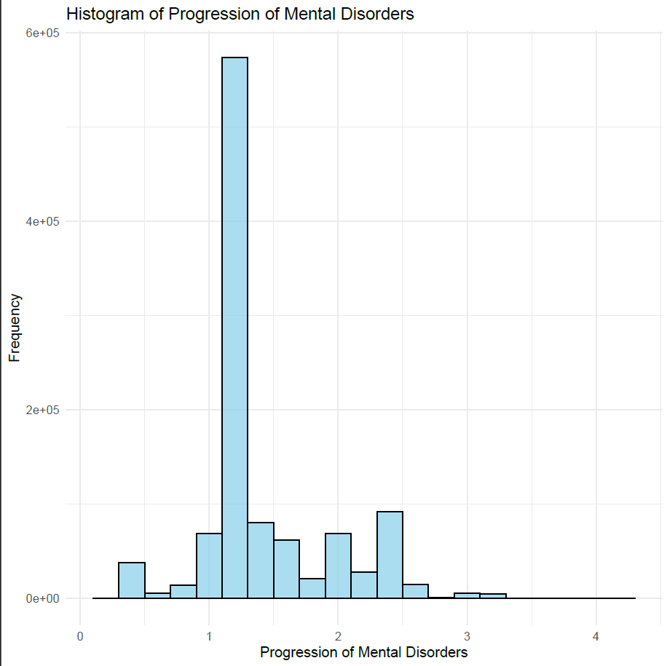
Calculate a histogram of progression in mental disorders.

Slide 2
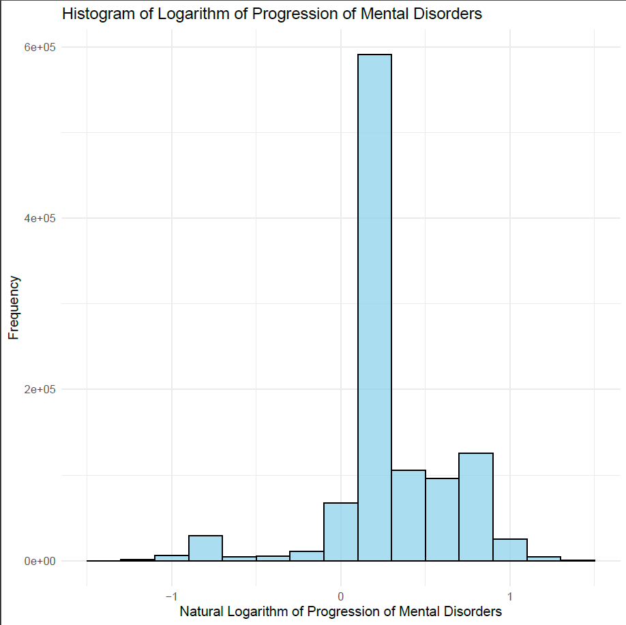
Repeat the histogram and this time use the natural log of progression in mental disorders.

