Slide 1
Analysis of Co-variance (ANCOVA)
HAP719
Yili Lin

Slide 2
Example
21 patients were selected for a formal study on the length of stay:
7 A disease patients, 7 B disease patients, and 7 C disease patients were randomly selected.
7 A | 7 B | 7 C
10 | 8 | 11
9 | 9 | 10
16 | 10 | 10
2 | 7 | 9
7 | 11 | 14
12 | 10 | 18
11 | 10 | 8

Slide 3
Example Con’t
We would like to know if there are differences between/among the 3 groups in length of stay while controlling for the effects of age on length of stay.
How would the 3 groups measure on length of stay if all patients had the same age?
How can we control for initial differences between groups either due to chance or because observations cannot be randomized fully?
7 A | Age_A | 7 B | Age_B | 7 C | Age_C
10 | 27 | 8 | 25 | 11 | 41
9 | 56 | 9 | 27 | 10 | 34
16 | 23 | 10 | 35 | 10 | 37
2 | 22 | 7 | 35 | 9 | 34
7 | 16 | 11 | 44 | 14 | 54
12 | 45 | 10 | 34 | 18 | 67
11 | 34 | 10 | 37 | 8 | 41

Slide 4
Why ANCOVA?
Covariance is the measure of the joint variability between 2 variables.
ANCOVA is an extension of ANOVA in which main effects and interactions are assessed after dependent variable is adjusted for differences associated with one or more covariates that are measured before the dependent variable and are correlated with it.
the focus is one of determining the effects of the independent variable on the dependent variable adjusted for the presence of covariates in the model.

Slide 5
Two Main Purposes
To increase the sensitivity of the test for main effects and interactions by reducing the error term; the error term is adjusted for the relationship between the dependent variable and covariates. Covariates are used to assess the “noise” where noise is the undesirable variance in the dependent variable that is estimated by the level on the covariate.
T adjust the means on the levels of dependent variable itself to what they would be if all subjects scored equally on the covariates. Differences between subjects on covariates are removed so that presumably, the only differences that remain are related to the effects of the grouping independent variables. The covariates enhance prediction of the dependent variable, but there is no implication of causality.

Slide 6
ANOVA Partitioning Sum of Squares
SST
(total/overall) sum of squares
SSC
(main effects/interactions) sum of squares
SSE
Error sum of squares

Slide 7
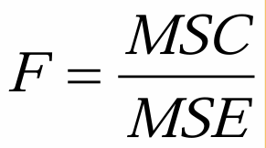
ANCOVA Increasing Power of F
SST
(total/overall) sum of squares
SSE
Error sum of squares
SSC
(main effects/interactions) sum of squares
SSE
(reduced SSE)
Cov

Slide 8
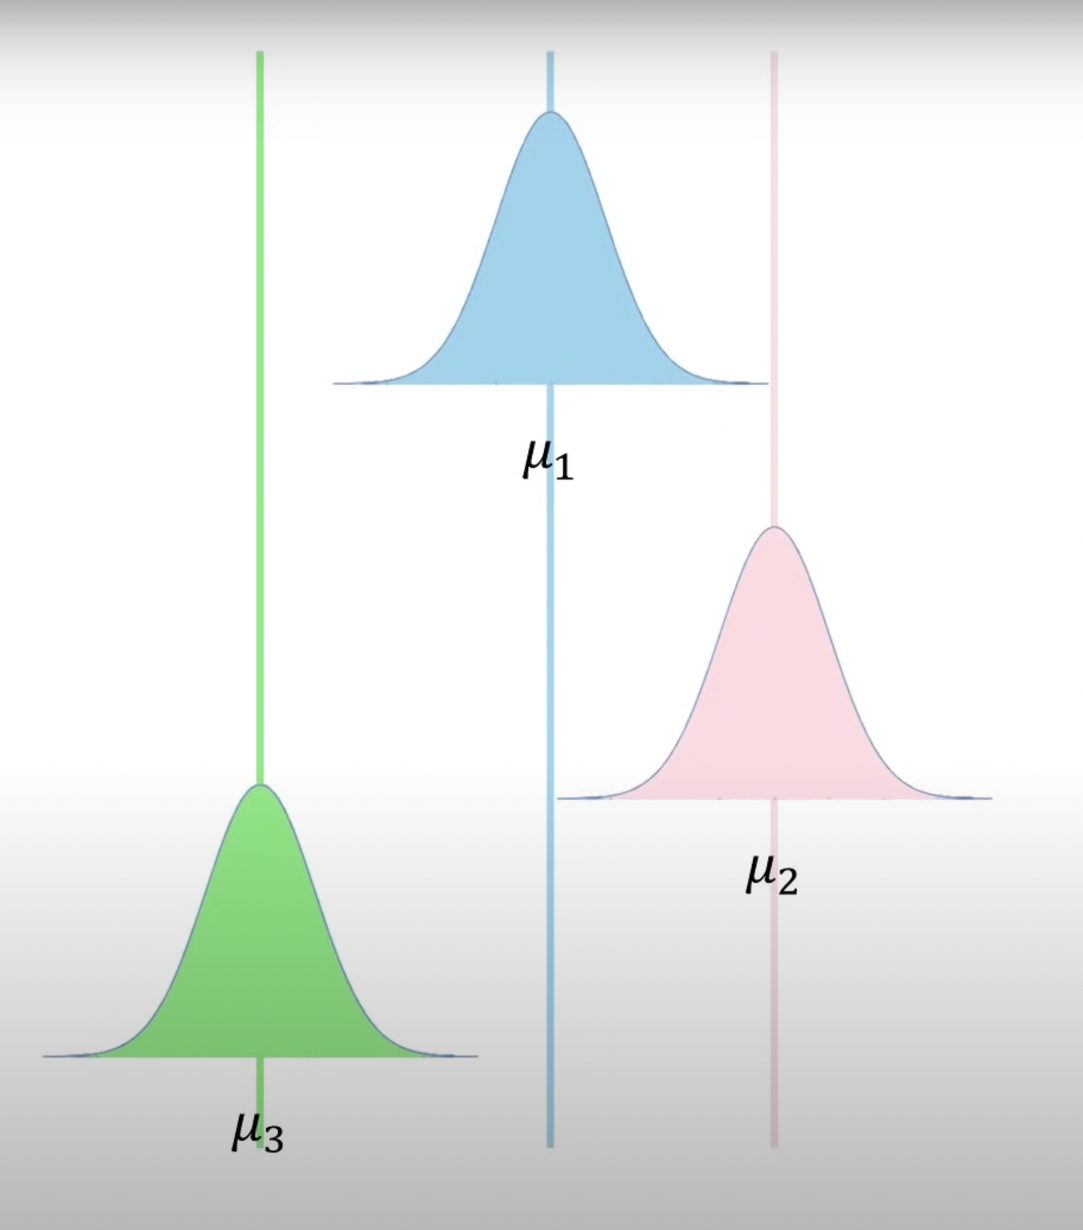
What we are asking is:
Do all three of these means come from a common population?
Or
Is one mean or 2 means so far away from the other one or two that it is likely not from the same population?
Or
Are all three so far apart that they all likely come from unique populations?

Slide 9
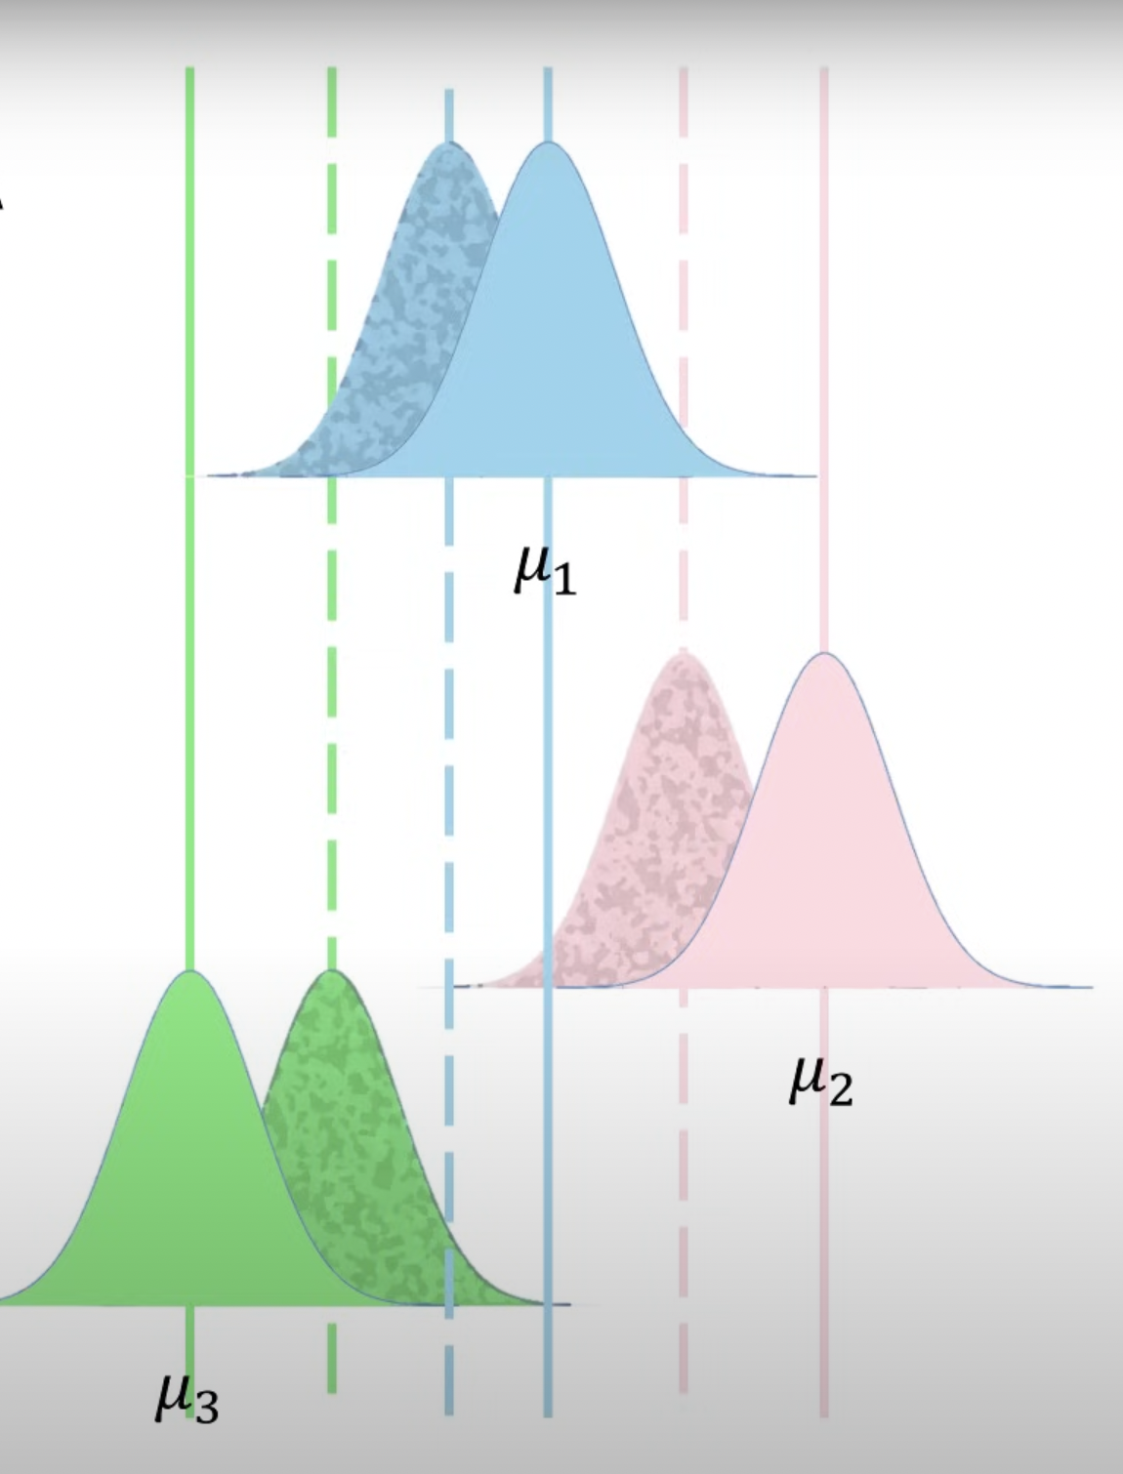
An Exaggerated means adjustment under ANCOVA

